Slide 1

Online Controlled Experiments:
Introduction, Learnings, and Humbling Statistics
ACM Recommender Systems 9/12/2012
Ronny Kohavi
Online Services Division, Microsoft
Notes:
http://sdforum.com/

Slide 2

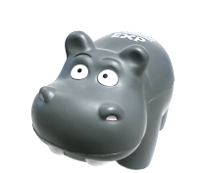
Amazon Shopping Cart Recommendations
Add an item to your shopping cart at a website
  Most sites show the cart
At Amazon, Greg Linden had the idea of showing recommendations based on cart items
Evaluation
  Pro: cross-sell more items (increase average basket size)
  Con: distract people from checking out (reduce conversion)
HiPPO (Highest Paid Person’s Opinion) was: stop the project
Simple experiment was run, wildly successful,
and the rest is history
From Greg Linden’s Blog: http://glinden.blogspot.com/2006/04/early-amazon-shopping-cart.html

Slide 3
Agenda
Controlled Experiments
Examples: you’re the decision maker
Cultural evolution: hubris, insight through measurement, Semmelweis reflex, fundamental understanding
Running Experiments at scale and best practices
Recommendation themes
Two key messages to remember
  It is hard to assess the value of ideas.
  Get the data by experimenting because data trumps intuition
  Make sure the org agrees what you are optimizing

Slide 4

Controlled Experiments in One Slide
Concept is trivial
  Randomly split traffic between
  two (or more) versions
    A (Control)
    B (Treatment)
  Collect metrics of interest
  Analyze
Must run statistical tests to confirm differences are not due to chance
Best scientific way to prove causality, i.e., the changes in metrics are caused by changes introduced in the treatment(s)

Slide 5
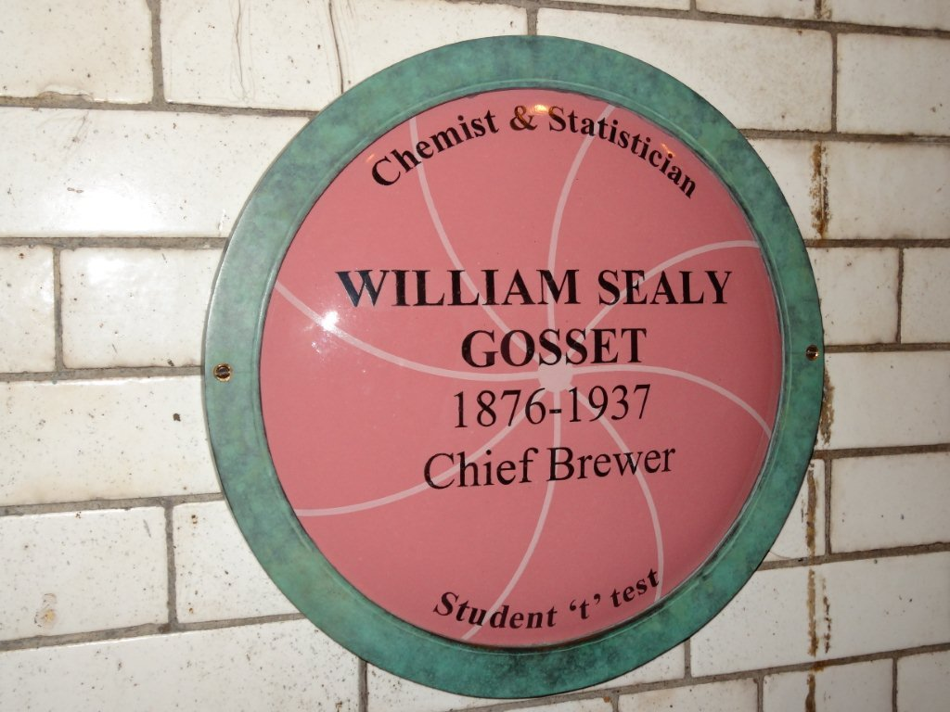
The Dublin Connection
It is an honor to present this talk at Dublin,
10 minutes from where the “t-test” was
introduced by William Gosset in 1908
(picture I took this week)
Gosset worked at Guinness , which prohibited its employees from publishing papers.
He published the papers under the pseudonym "Student“
The student t-test is commonly used in determining statistical significance in controlled experiments
The 2nd floor of the Guinness Storehouse is dedicated to “ads.” Imagine if instead of Student t-test, it was Guinness t-test ☺

Slide 6
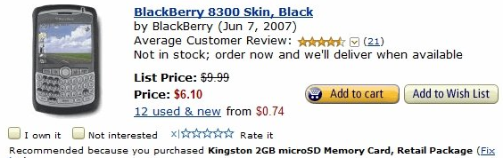
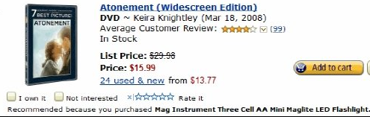
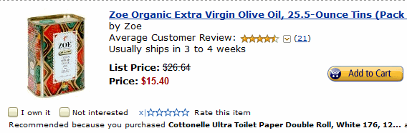
Personalized Correlated Recommendations
Actual personalized recommendations from Amazon.
(I was director of data mining and personalization at Amazon back in 2003, so I can ridicule my work.)
Buy a Blackberry because
you bought a microSD card
Buy Atonement movie DVD because
you bought a Maglite flashlight
(must be a dark movie)
Buy Organic Virgin Olive Oil because
you bought Toilet Paper.
(If there is causality here, it’s probably
in the other direction.)

Slide 7
Advantage of Controlled Experiments
Controlled experiments test for causal relationships, not simply correlations
When the variants run concurrently, only two things could explain a change in metrics:
    The “feature(s)” (A vs. B)
    Random chance
  Everything else happening affects both the variants
  For #2, we conduct statistical tests for significance
The gold standard in science and the only way to prove efficacy of drugs in FDA drug tests
Controlled experiments are not the panacea for everything. Issues discussed in the journal survey paper

Slide 8
Examples
Three experiments that ran at Microsoft
All had enough users for statistical validity
Game: see how many you get right
  Everyone please stand up
  Three choices are:
    A wins (the difference is statistically significant)
    A and B are approximately the same (no stat sig diff)
    B wins

Slide 9
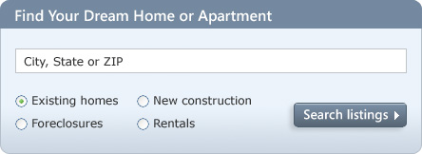
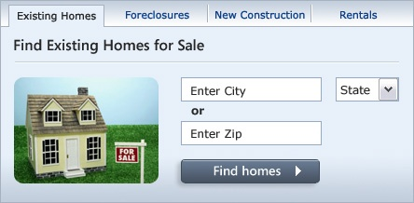
MSN Real Estate
“Find a house” widget variations
Overall Evaluation Criterion(OEC): Revenue to Microsoft generated every time a user clicks search/find button
A
B
Raise your Left hand if you think A Wins
Raise your Right hand if you think B Wins
Don’t raise your hand if you think they’re about the same

Slide 10
MSN Real Estate
Since this is the #1 monetization, it effectively raised revenues significantly
Actual experiment had 6 variants.
If you’re going to experiment, try more variants, especially if they’re easy to implement

Slide 11


MSN Home Page Search Box
OEC: Clickthrough rate for Search box and popular searches
A
B
Differences: A has taller search box (overall size is the same), has magnifying glass icon, “popular searches”
B has big search button
Raise your left hand if you think A Wins
Raise your right hand if you think B Wins
Don’t raise your hand if they are the about the same

Slide 12
Search Box
Insight
  Stop debating, it’s easier to get the data

Slide 13
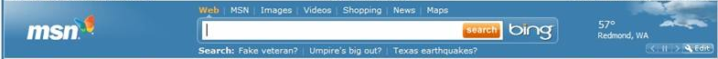

MSN US Home Page: Search Box
A later test showed that changing the magnifying glass to an actionable word (search, go, explore) was highly beneficial.
This:
is better than
In line with Steve Krug’s great book: Don’t Make Me Think

Slide 14
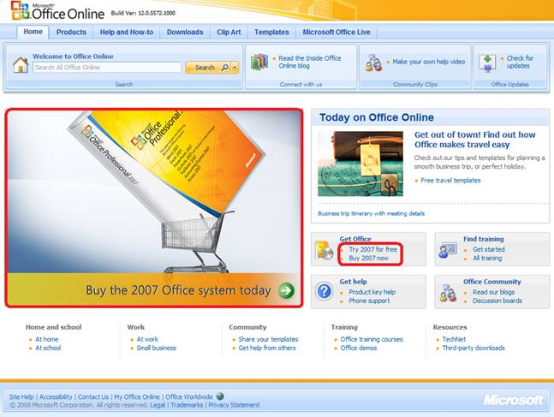
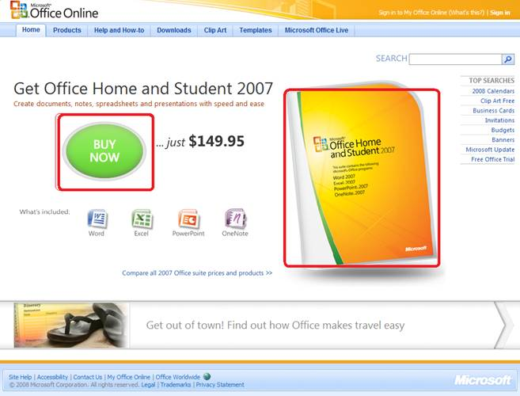
Office Online
OEC: Clicks on revenue generating links (red below)
A
B
Raise your left hand if you think A Wins
Raise your right hand if you think B Wins
Don’t raise your hand if they are the about the same

Slide 15
Office Online
Notes:
There was a “throwdown” (vote for the winning variant) and nobody from MSN Real Estate or Zaaz (the company that did the creative) voted for the winning widget

Slide 16
Twyman’s Law
Any figure that looks interesting or different is usually wrong
If something is “amazing,” find the flaw!
Examples
  If you have a mandatory birth date field and people think it’s unnecessary, you’ll find lots of 11/11/11 or 01/01/01
  If you have an optional drop down, do not default to the first alphabetical entry, or you’ll have lots of: jobs = Astronaut
  Traffic to web sites doubled between 1-2AM November 6, 2011 for many sites, relative to the same hour a week prior. Why?
The previous Office example assumes click maps to revenue.
Seemed reasonable, but when the results look so extreme, find the flaw
Notes:
Sunday, November 4, 2012 – daylight time ends, so at 2AM, the clock moves again to 1AM and there are really two real hours.
Office: One has the price. Sends more qualified buyers

Slide 17
Hard to Assess the Value of Ideas:
Data Trumps Intuition
Features are built because teams believe they are useful.
But most experiments show that features fail to move the metrics they were designed to improve
We joke that our job is to tell clients that their new baby is ugly
In the recently published book Uncontrolled, Jim Manzi writes
    Google ran approximately 12,000 randomized experiments in 2009, with [only] about 10 percent of these leading to business changes.
In an Experimentation and Testing Primer by Avinash Kaushik, authors of Web Analytics: An Hour a Day, he wrote
    80% of the time you/we are wrong about what a customer wants
Notes:
there is no correlation between what people in the organization think will work and what actually does work

Slide 18
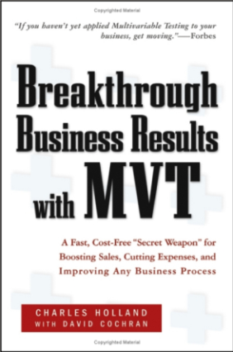
Hard to Assess the Value of Ideas:
Data Trumps Intuition
QualPro tested 150,000 ideas over 22 years
  75 percent of important business decisions and
  business improvement ideas either have no impact on
  performance or actually hurt performance…
Based on experiments at Microsoft (paper)
  1/3 of ideas were positive ideas and statistically significant
  1/3 of ideas were flat: no statistically significant difference
  1/3 of ideas were negative and statistically significant
Our intuition is poor: 60-90% of ideas do not improve the
metric(s) they were designed to improve (domain dependent).
Humbling!
Notes:
there is no correlation between what people in the organization think will work and what actually does work

Slide 19
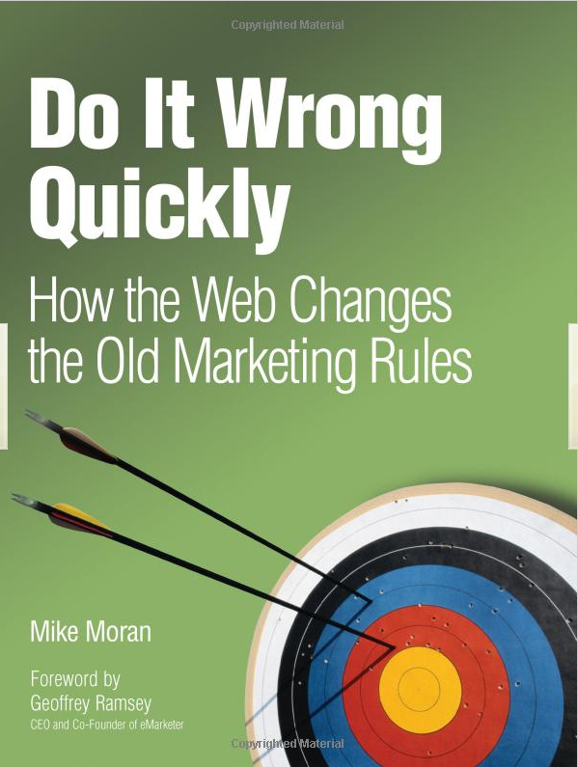
Key Lessons
Avoid the temptation to try and build optimal features through extensive planning without early testing of ideas
Experiment often
  To have a great idea, have a lot of them -- Thomas Edison
  If you have to kiss a lot of frogs to find a prince,
  find more frogs and kiss them faster and faster
  -- Mike Moran, Do it Wrong Quickly
Try radical ideas. You may be surprised
  Doubly true if it’s cheap to implement (e.g., shopping cart recommendations)
  If you're not prepared to be wrong, you'll never come up
  with anything original – Sir Ken Robinson, TED 2006 (#1 TED talk)

Slide 20
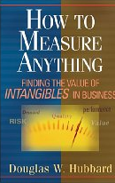
The OEC
If you remember one thing from this talk, remember this point
OEC = Overall Evaluation Criterion
  Agree early on what you are optimizing
  Getting agreement on the OEC in the org is a huge step forward
  Suggestion: optimize for customer lifetime value, not
  immediate short-term revenue
  Criterion could be weighted sum of factors, such as
    Time on site (per time period, say week or month)
    Visit frequency
  Report many other metrics for diagnostics, i.e., to understand the why the OEC changed and raise new hypotheses

Slide 21
OEC for Search
KDD 2012 paper (*)
Search engines (Bing, Google) are evaluated on query share (distinct queries) and revenue as long-term goals
Puzzle
  A ranking bug in an experiment resulted in very poor search results
  Distinct queries went up over 10%, and revenue went up over 30%
  What metrics should be in the OEC for a search engine?
Degraded (algorithmic) search results cause users to search more to complete their task, and ads appear more relevant
(*) KDD 2012 paper with Alex Deng, Brian Frasca, Roger Longbotham, Toby Walker, Ya XU

Slide 22


Puzzle Explained
Analyzing queries per month, we have
$\frac{Queries}{Month} =\frac{Queries}{Session}× \frac{Sessions}{User}×\frac{Users}{Month}$
  where a session begins with a query and ends with 30-minutes of inactivity. (Ideally, we would look at tasks, not sessions).
Key observation: we want users to find answers and complete tasks quickly, so queries/session should be smaller
In a controlled experiment, the variants get (approximately) the same number of users by design, so the last term is about equal
The OEC should therefore include the middle term: sessions/user

Slide 23

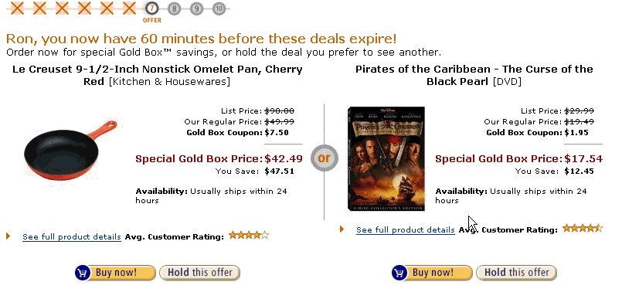
OEC Example: Amazon Goldbox
From eMetrics 2003 talk: Front Line Analytics at Amazon.com (PDF)
Goldbox was a cross-sell and awareness raising tool
We allowed customers to buy items at an additional discount
We got a lot of suggestions on how to improve our goldbox offers to make them more personalized, but…
It’s by design. We discounted items to encourage purchases in new categories!
Different OEC!

Slide 24
Agenda
Controlled Experiments
Examples: you’re the decision maker
Cultural evolution: hubris, insight through measurement, Semmelweis reflex, fundamental understanding
Running Experiments at scale and best practices
Recommendation themes

Slide 25
The Cultural Challenge
It is difficult to get a man to understand something when his salary depends upon his not understanding it.
-- Upton Sinclair
Why people/orgs avoid controlled experiments
  Some believe it threatens their job as decision makers
  At Microsoft, program managers select the next set of features to develop. Proposing several alternatives and admitting you don’t know which is best is hard
  Editors and designers get paid to select a great design
  Failures of ideas may hurt image and professional standing.
  It’s easier to declare success when the feature launches
  We’ve heard: “we know what to do. It’s in our DNA,” and
  “why don’t we just do the right thing?”

Slide 26
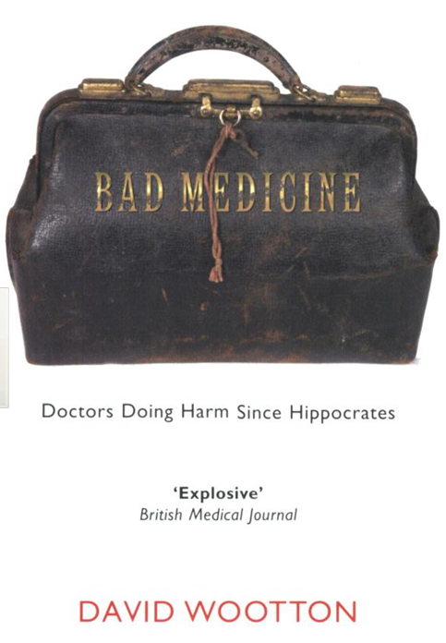
Cultural Stage 1: Hubris
The org goes through stages in its cultural evolution
Stage 1: we know what to do and we’re sure of it
  True story from 1849
  John Snow claimed that Cholera was caused by polluted water
  A landlord dismissed his tenants’ complaints that their water stank
    Even when Cholera was frequent among the tenants
  One day he drank a glass of his tenants’ water to show there was nothing wrong with it
He died three days later
That’s hubris. Even if we’re sure of our ideas, evaluate them
Controlled experiments are a powerful tool to evaluate ideas

Slide 27
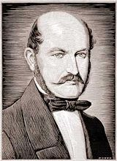
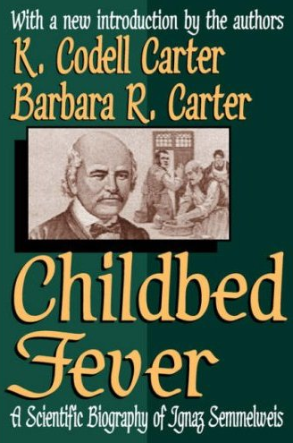
Semmelweis
Cultural Stage 2: Insight through Measurement and Control
Semmelweis worked at Vienna’s General Hospital, an
important teaching/research hospital, in the 1830s-40s
In 19th-century Europe, childbed fever killed more than a million women
Measurement: the mortality rate for women giving birth was
  15% in his ward, staffed by doctors and students
  2% in the ward at the hospital, attended by midwives
Notes:
Collecting stats is the first phase – instrument, measure

Slide 28
Semmelweis
Cultural Stage 2: Insight through Measurement and Control
He tries to control all differences
  Birthing positions, ventilation, diet, even the way laundry was done
He was away for 4 months and death rate fell significantly when he was away. Could it be related to him?
Insight:
  Doctors were performing autopsies each morning on cadavers
  Conjecture: particles (called germs today) were being transmitted to healthy patients on the hands of the physicians
He experiments with cleansing agents
  Chlorine and lime was effective: death rate fell from 18% to 1%
Notes:
Collecting stats is the first phase – instrument, measure

Slide 29
Cultural Stage 3: Semmelweis Reflex
Success? No! Disbelief. Where/what are these particles?
  Semmelweis was dropped from his post at the hospital
  He goes to Hungary and reduced mortality rate in obstetrics to 0.85%
  His student published a paper about the success. The editor wrote
    We believe that this chlorine-washing theory has long outlived its usefulness… It is time we are no longer to be deceived by this theory
In 1865, he suffered a nervous breakdown and was beaten at a mental hospital, where he died
Semmelweis Reflex is a reflex-like rejection of new knowledge because it contradicts entrenched norms, beliefs or paradigms
Only in 1800s? No! A 2005 study: inadequate hand washing is one of the prime contributors to the 2 million health-care-associated infections and 90,000 related deaths annually in the United States

Slide 30
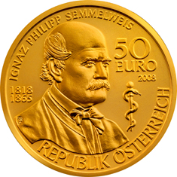
Cultural Stage 4: Fundamental Understanding
In 1879, Louis Pasteur showed the presence of Streptococcus in the blood of women with child fever
2008, 143 years after he died, there is a 50 Euro coin commemorating Semmelweis

Slide 31
Summary: Evolve the Culture
Hubris
Measure and Control
Accept Results avoid Semmelweis Reflex
Fundamental Understanding
In many areas we’re in the 1800s in terms of our understanding, so controlled experiments can help
  First in doing the right thing, even if we don’t understand the fundamentals
  Then developing the underlying fundamental theories

Slide 32
Agenda
Controlled Experiments
Examples: you’re the decision maker
Cultural evolution: hubris, insight through measurement, Semmelweis reflex, fundamental understanding
Running Experiments at scale and best practices
Recommendation themes

Slide 33
Running Controlled Experiments at Scale (1)
UI | Exp 1 | Exp 2 | ExP 3 | Exp 4 | Exp 5
Ads | ExP 1 | ExP 2 | ExP 3 | ExP 4 | Exp 5
Rele vance | …
…
Feature area
Numbers below are approximate to give sense of scale
At Bing, we now run over 50 “useful”
concurrent experiments
  In a visit, you’re in about 10 experiments
  There is no single Bing.
  There are 10M variants (5^10)
Sensitivity: we need to detect small effects
  0.1% change in the revenue/user metric = $1M/year
  Not uncommon to see unintended revenue impact of +/-1% ($10M)
  Sessions/UU, a key component of our OEC, is hard to move, so we’re looking for small effects
  Important experiments run on 10-20% of users

Slide 34
Running Controlled Experiments at Scale (2)
Challenges
  QA. You can’t QA all combinations, of course.
  What are the equivalence classes?
  For UI change, no need to QA combinations of relevance exps
  Alarming on anomalies is critical: notify experiment owners that there’s a big delta on metric M (100 metrics) for browser B
  Interactions:
    Feature areas (rows) get 5 experiment with disjoint users (no worries)
    Optimistic experimentation: assume experiments between feature areas do no interact.
    Run statistical tests for pairwise interactions, and notify owners.
  Carryover effects: reuse of “bucket of users” from one experiment to the next is problematic. Must rehash users (see KDD 2012 paper)

Slide 35
Best Practice: A/A Test
Run A/A tests – simple, but highly effective
  Run an experiment where the Treatment and Control variants are coded identically and validate the following:
    Are users split according to the planned percentages?
    Is the data collected matching the system of record?
    Are the results showing non-significant results 95% of the time?
This is a powerful technique for finding problems
  Generating some numbers is easy
  Getting correct numbers you trust is much harder!

Slide 36
Best Practice: Ramp-up
Ramp-up
  Start an experiment at 0.1%
  Do some simple analyses to make sure no egregious problems can be detected
  Ramp-up to a larger percentage, and repeat until 50%
Big differences are easy to detect because the min sample size is quadratic in the effect we want to detect
  Detecting 10% difference requires a small sample and serious problems can be detected during ramp-up
  Detecting 0.1% requires a population 100^2 = 10,000 times bigger
Abort the experiment if treatment is significantly worse on key metrics

Slide 37
Best Practice: Large User Samples
Novice experimenters run 1% experiments
To detect an effect, you need to expose a certain number of users to the treatment (based on power calculations)
Higher user samples increase sensitivity, which helps confidence (lower p-values for same effect size)
Fastest way to achieve that exposure is to run equal-probability variants (e.g., 50/50% for A/B)
Exception: biggest sites in the world. On the Bing, we run experiments on 10-20% of users instead of 50/50%
Small sites? You want larger effects, so you need less users, but still run 50/50%

Slide 38
Agenda
Controlled Experiments
Examples: you’re the decision maker
Cultural evolution: hubris, insight through measurement, Semmelweis reflex, fundamental understanding
Running Experiments at scale and best practices
Recommendation themes

Slide 39
Which Recommendations?
Finding correlated items is easy.
Deciding what, how, and when to present to the user is hard
-- Francisco Martin’s RecSys 2009 keynote
Amazon is well known for Bought X -> Bought Y
Don’t tweak the algo to compute P(Y|X), apply it differently!
  We tried Viewed X -> Viewed Y
  Then Viewed X -> Bought Y
  Useful, as it warns you if users who are viewing the product you’re viewing end up buying something else!
  Then Searched X -> Bought Y. This was a home run (next slides)

Slide 40
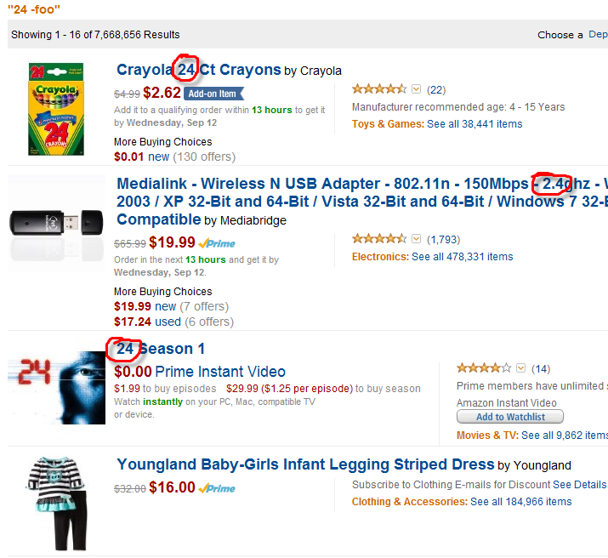
Amazon Behavior-Based Search (BBS) - Motivation
Searches for “24” are underspecified, yet most users want the TV program
Without BBS’s Search X->Bought Y,
you get random stuff:
24 count Crayola
2.4Ghz USB adapter
Dress for 24-months-old girls
The screen shot was generated Sept 2012 by adding “-foo” to the query.
Since nobody searches for that, the BBS algorithm doesn’t kick in

Slide 41
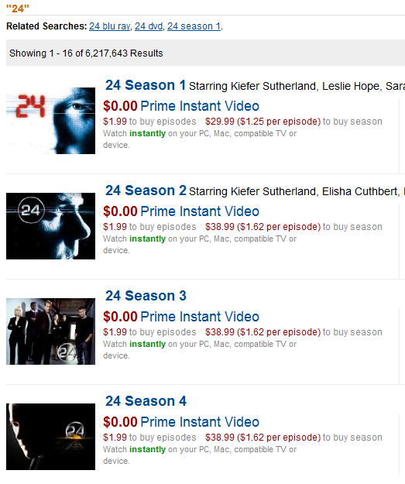
Built Searched X -> Bought Y (Behavior based Search)
Ran controlled experiment with MVP (Minimum Viable Product):
  Very thin UI integration (search team was busy)
  Strong correlations shown at top of page, pushing search results down
  Simple de-duping of results
Result : +3% increase to revenue(*), i.e., 100s of millions of dollars!
More here
(*) Based on UW iEdge Seminar talk by Amazon, 4/2006

Slide 42
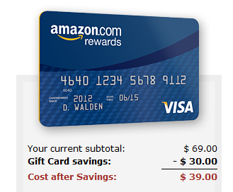
Right Offer at the Right Time
2003 eMetrics: Front Line Analytics at Amazon.com (PDF): Amazon’s home page was auto-optimizing:
offers in slots were evaluated based on real-time experiments
Credit-card offer was winning the top slot, which seemed wrong since it had very low clickthrough-rate
The reason: very profitable (high expected value)
My team moved it from the home page to
the shopping cart (purchase intent) with
simple math UI
Highly successful, both for Amazon and
for users: right offer at the right time
You now see this on other sites (e.g., airlines)

Slide 43
Education is Hard: Interrupting Tasks
In 2003, Amazon was well known as a book seller
Wanted to educate users that it sells other things
Added trivia questions, such as
    How many pots and pans are available on Amazon.com?
    Zero: Amazon only sells only books
    Two
    Over 100
  If you “guessed” correctly (usually the highest number), Amazon added a nickel to your account
Not shown now because of long-term controlled experiment
Most “education” campaigns with pop-ups/eye-grabbing-UI/videos annoy users and are useless when properly evaluated

Slide 44
Explanations Help
This was stated many times at RecSys 2012
Telling users *why* they’re getting a recommendation is useful
Amazon: people who bought X bought Y explains why you’re getting a recommendation for Y
Amazon e-mails: as someone who bought from Author X, …
Netflix: more like X, Watch it Again, …
Allow users to “fix” the reason (e.g., don’t use X for recommendatoins)

Slide 45
Summary
  The less data, the stronger the opinions
Empower the HiPPO with data-driven decisions
  Hippos kill more humans than any other (non-human) mammal (really)
  OEC: make sure the org agrees what you are optimizing (long term lifetime value)
It is hard to assess the value of ideas
  Listen to your customers – Get the data
  Prepare to be humbled: data trumps intuition
Compute the statistics carefully
  Getting a number is easy. Getting a number you should trust is harder
Experiment often
  Triple your experiment rate and you triple your success (and failure) rate.
  Fail fast & often in order to succeed
  Accelerate innovation by lowering the cost of experimenting

Slide 46
Resources and Q&A
http://exp-platform.com has papers, talks including
  Controlled Experiments on the Web: Survey and Practical Guide
  (Data Mining and Knowledge Discovery journal)
  Online experiments at Microsoft
  (Third Workshop on Data Mining Case Studies and Practice Prize)
  Trustworthy Online Controlled Experiments:
  Five Puzzling Outcomes Explained
  (KDD 2012)
This talk at http://www.exp-platform.com/Pages/2012RecSys.aspx

