Slide 1
He Said, She Said: Gender in the ACL Anthology
Adam Vogel and Dan Jurafsky
Stanford University

Slide 2
Gender in Computational Linguistics
Well known gender imbalance in computer science
In 2008, women granted 20.5% of PhDs [CRA, 2008]
Linguistics departments are close to parity
In 2007, women granted 57% of PhDs [LSA, 2008]
What about computational linguistics?

Slide 3
Gender Studies Methodologies
Previous studies utilize:
University enrollment/graduation
Job placement
Professional society membership

Slide 4
Gender Studies Methodologies
Previous studies utilize:
University enrollment/graduation
Job placement
Professional society membership
Corpus based approach using publications:
Overall population
Publication counts
Authorship order
Topic models by gender

Slide 5
ACL Anthology Network
13,000 papers
12,000 authors
Not marked for gender
1965 – 2008
We only use data from 1980 onwards
[Radev et al, 2009]

Slide 6
Determining Gender by Name
Broad background of ACL authors makes automatic assignment difficult
“Jan” in Europe vs. US
“Weiwei” in Chinese
Some names are poorly formatted or missing first names
H. Murakami
ukasz
The LOLITA Group

Slide 7
Determining Gender by Name
Automatic approaches:
Unambiguous first names from US census data
Morphological markings in Czech and Bulgarian
Lists of unambiguous Indian and Basque names
Hand labels:
Help from ACL authors in China, Taiwan, and Singapore
Personal knowledge or website photos
Remaining: 2048 names
Baby name website: www.gpeters.com/names/
Unknown: 761 names

Slide 8
Female: 3359 Male: 8573 Unknown: 761
(26.7%) (67.5%) (6.0%)

Slide 11
Population Conclusions
Female authorship increased from 13% in 1980 to 27% in 2007
Using best fit lines: 19.4% -> 29.1%
50% relative increase!
Male authorship decreased from 79% to 71%

Slide 12
Population Conclusions
Female authorship increased from 13% in 1980 to 27% in 2007
Using best fit lines: 19.4% -> 29.1%
50% relative increase!
Male authorship decreased from 79% to 71%
Next: how prolific are men and women?

Slide 13
For 1st authored papers: Female 27% Male: 71% Unknown: 2%

Slide 17
Publication Count Conclusions
The most prolific authors are male
Men have on average been in the field longer
Men and women have comparable publication output per year

Slide 18
Publication Count Conclusions
The most prolific authors are male
Men have on average been in the field longer
Men and women have comparable publication output per year
Next: what do men and women write about?

Slide 19
Latent Dirichlet Allocation (LDA)

Slide 20
LDA for AAN
Generate 100 topics using LDA
Throw out 27 junk topics, yielding 73 substantive topics
Label topics based on their term distributions
Find topics with biggest difference between men and women:

Slide 21
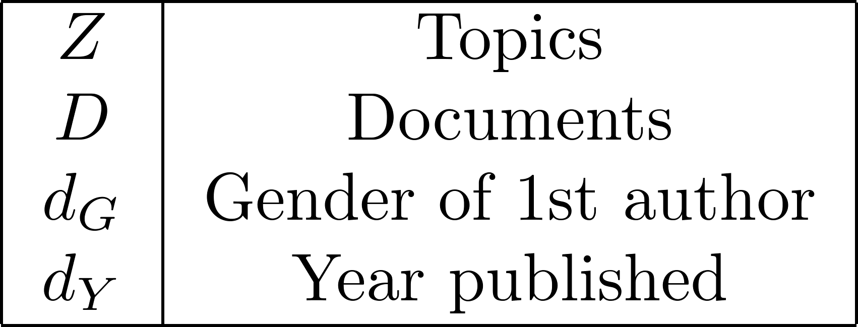
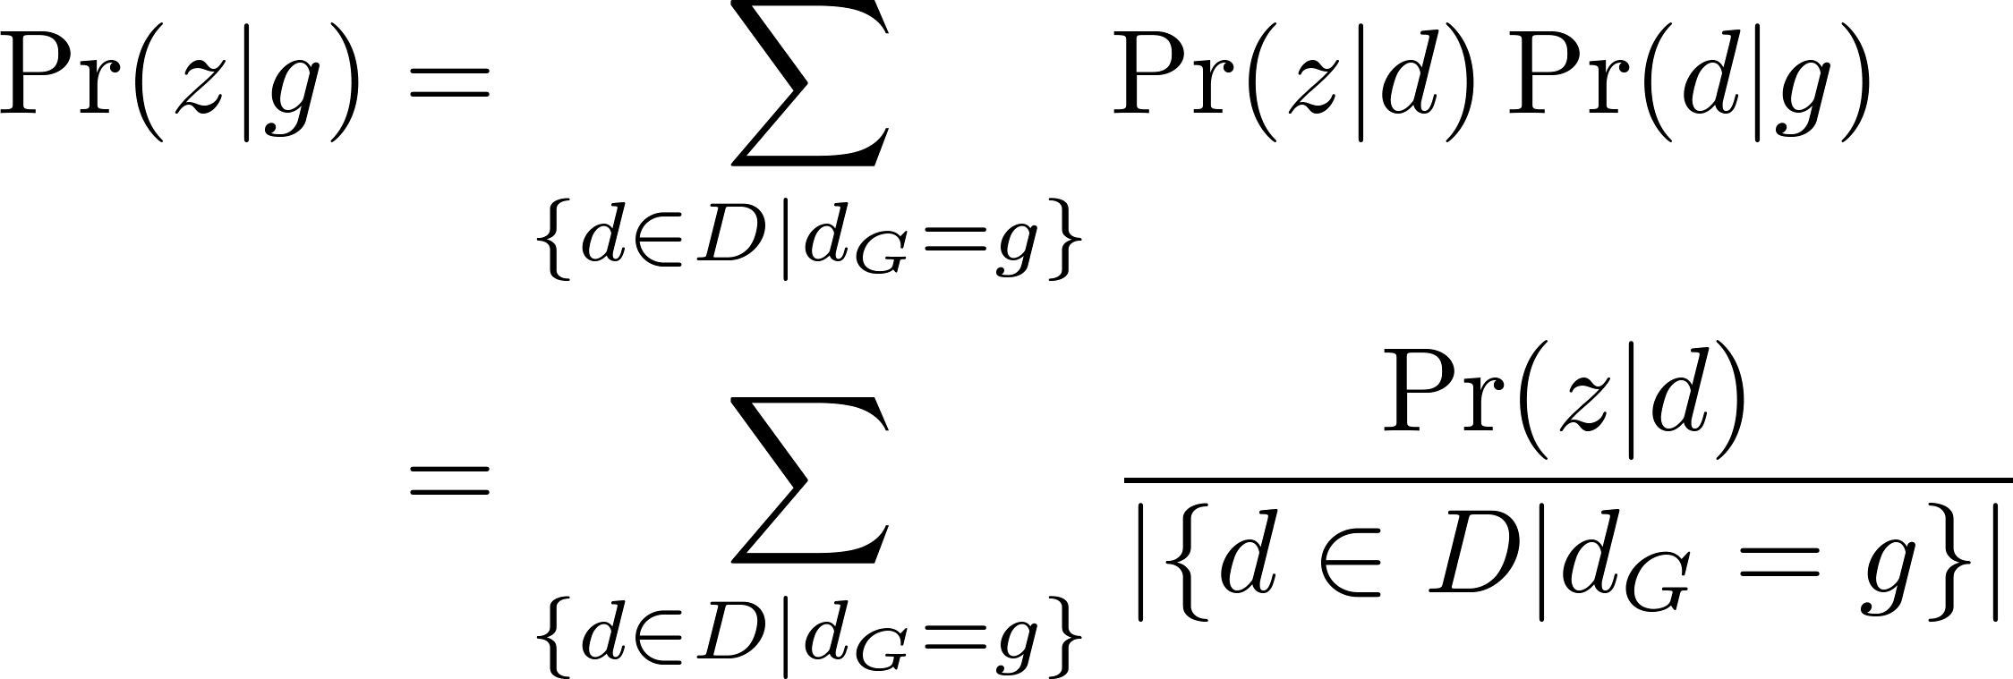
Topic Calculations
Probability of a topic for a gender
Documents with 1st author gender g

Slide 22
Topic Calculations
Probability of a topic for a gender and year
Documents with 1st author gender g written in year y

Slide 23
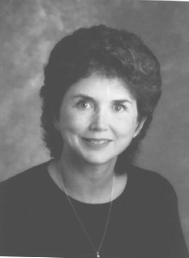
Sandra Carberry
speaker utterance act hearer belief proposition acts beliefs focus evidence

Slide 24
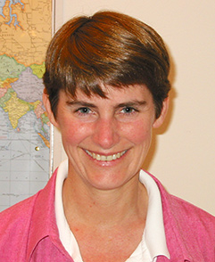
Mari Ostendorf
prosodic pitch boundary accent prosody boundaries cues repairs speaker phrases

Slide 25
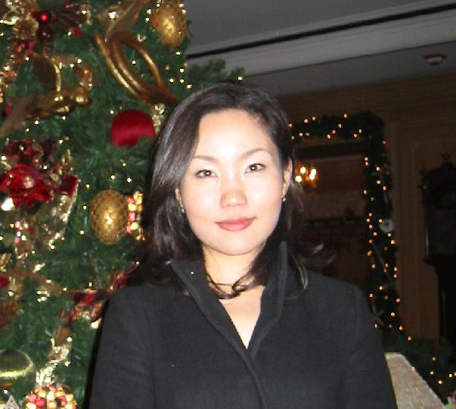
Soo-Min Kim
question answer questions answers answering opinion sentiment negative trec positive

Slide 26
Diane Litman
dialogue utterance utterances spoken dialog dialogues act turn interaction conversation

Slide 27
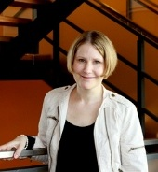
Anna Korhonen
class classes verbs paraphrases classiﬁcation subcategorization paraphrase frames acquisition

Slide 28
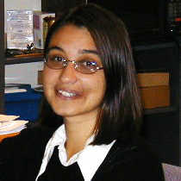
Ani Nenkova
topic summarization summary document news summaries documents topics articles content

Slide 29
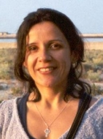
Renata Vieira
resolution pronoun anaphora antecedent pronouns coreference anaphoric deﬁnite reference

Slide 30
Jill Burstein
students student reading course computer tutoring teaching writing essay native

Slide 31
Topic Conclusions
Women published relatively more papers in:
Speech Acts + BDI
Prosody
QA + Sentiment Analysis
Dialog
Acquisition of Verb Subcategorization
Summarization
Anaphora Resolution
Tutoring Systems

Slide 32
Joakim Nivre
dependency dependencies head czech depen dependent treebank structures

Slide 33
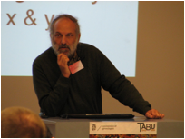
Kenneth Church
search length size space cost algorithms large complexity pruning efﬁcient

Slide 34
Mark Hepple
proof logic deﬁnition let formula theorem every deﬁned categorial axioms

Slide 35
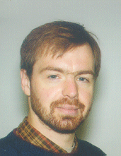
Mark-Jan Nederhof
grammars parse chart context-free edge edges production symbols symbol cfg

Slide 36
Ryan McDonald
label conditional sequence random labels discriminative inference crf ﬁelds

Slide 37
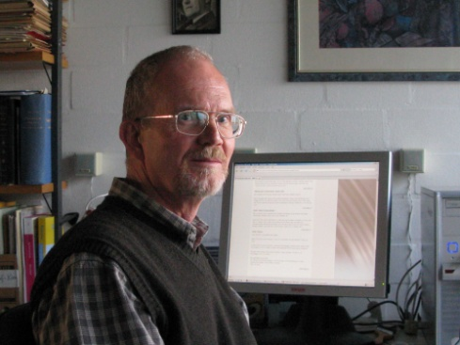
James Kilbury
uniﬁcation constraints structures value hpsg default head grammars values

Slide 38
Mark Johnson
probability probabilities distribution probabilistic estimation estimate entropy

Slide 39
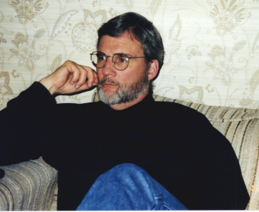
Jerry Hobbs
semantics logical scope interpretation logic meaning representation predicate

Slide 40
Topic Conclusions
Men published relatively more papers in:
Categorial Grammar
Dependency Parsing
Algorithmic Efficiency
Parsing
Discriminative Sequence Models
Unification Based Grammars
Probability Theory
Formal Computation Semantics

Slide 41
Conclusion
Approximately 50% increase in the proportion of female authors since 1980
Men and women have similar publication rates
Gender labels for names available for download: http://nlp.stanford.edu/projects/gender.shtml

Slide 42
Acknowledgements
Thanks to Chu-Ren Huang, Olivia Kwong, Heeyoung Lee, Hwee Tou Ng, and Nigel Ward for helping to label names for gender
Thanks to Chris Manning for helping to assign topic names
Thanks to Steven Bethard and David Hall for creating the topic models

