Slide 1
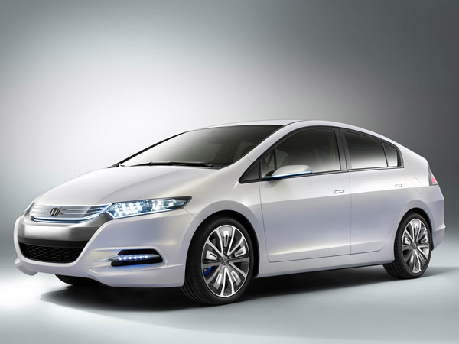
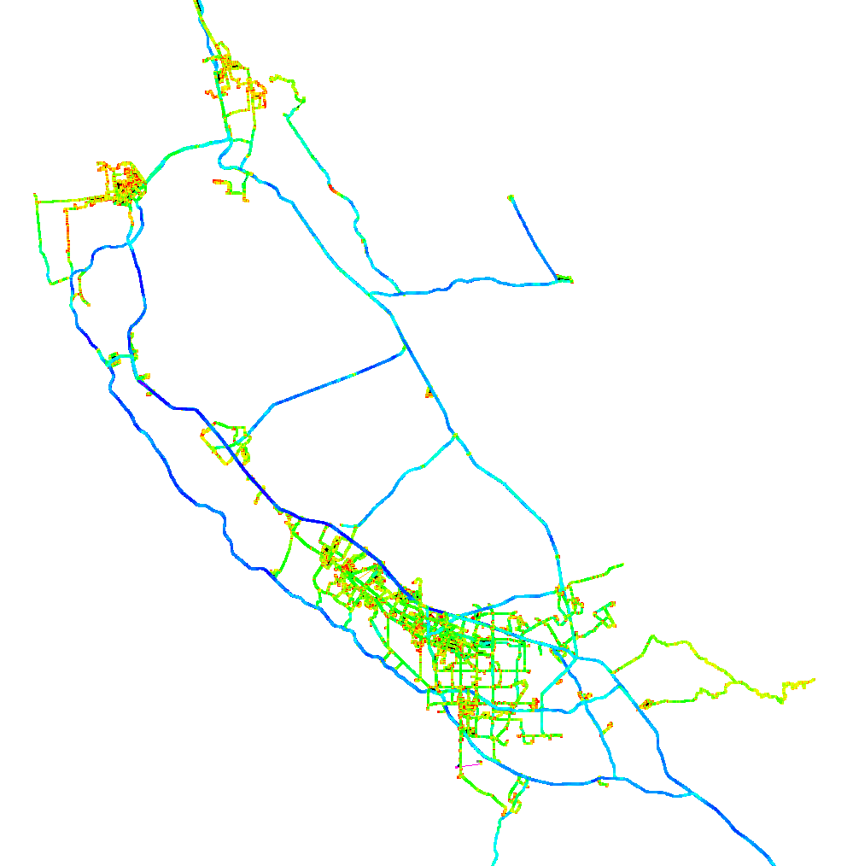
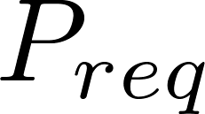
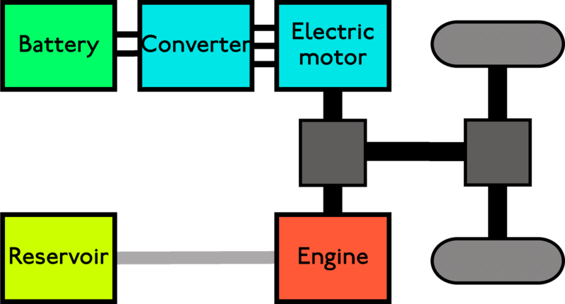
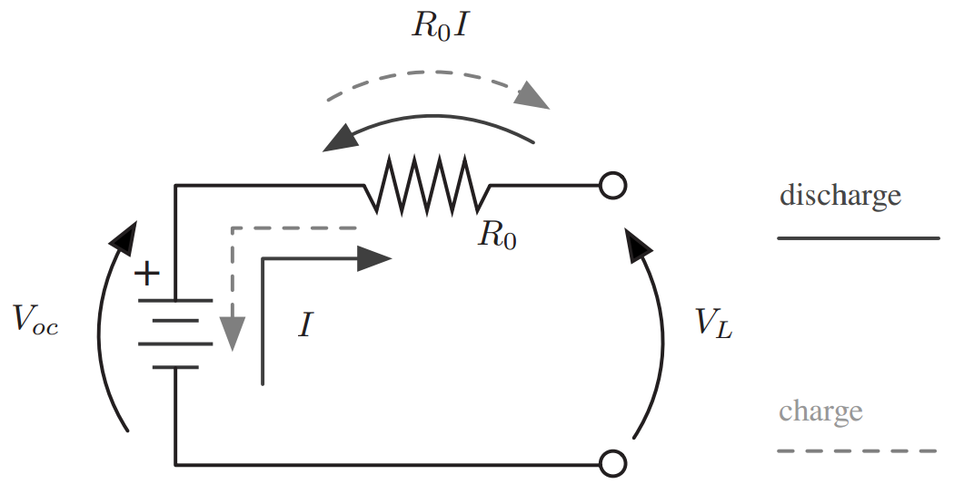
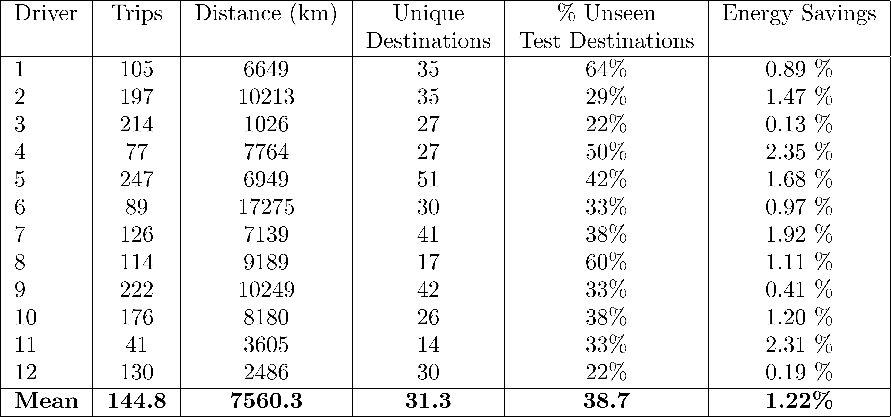
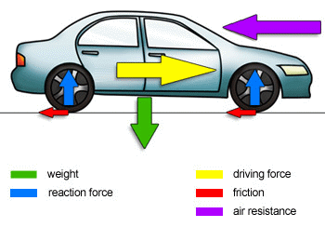
Improving Hybrid Vehicle Fuel Efficiency using Inverse Reinforcement Learning Adam Vogel, Deepak Ramachandran, Rakesh Gupta, Antoine Raux
Key Idea
Use a more energy-efficient combination of engine and battery power in hybrid electric vehicles by predicting likely driving routes based on Inverse Reinforcement Learning.
Dataset
380,000 GPS readings (12 drivers over 4 weeks)
Route Prediction using Inverse Reinforcement Learning
Powertrain Control
Goal: Learn a probabilistic model of future driving routes
Given: Sequence of road segments and turns
Suppose: Driver acts to minimize cost of turns:
Learn: Weights to maximize likelihood of data:
[Ziebart et al. 2008]
Problem: Given required power , choose proportion of engine and battery
Goal: Maximize remaining energy at the end of each trip:
Formalize as Markov Decision Process:
Solve: Forward search w/ horizon T using options
Road segment
Battery Energy
Fuel Energy
Vehicle Simulation
Experiments
Train driver IRL model on 80% of data, test on 20%
Average accuracy for IRL of 65% vs 39% baseline
Vehicle: Battery:
Dynamics: Fuel Usage:
Combine IRL driver model with predictive fuel policy and evaluate energy usage
Baseline energy policy: Charge-Depleting Charge-Sustaining (CDCS)

