Slide 1
Robots and Brains
Andrew Ng, Director, Stanford Artificial Intelligence Lab

Slide 2
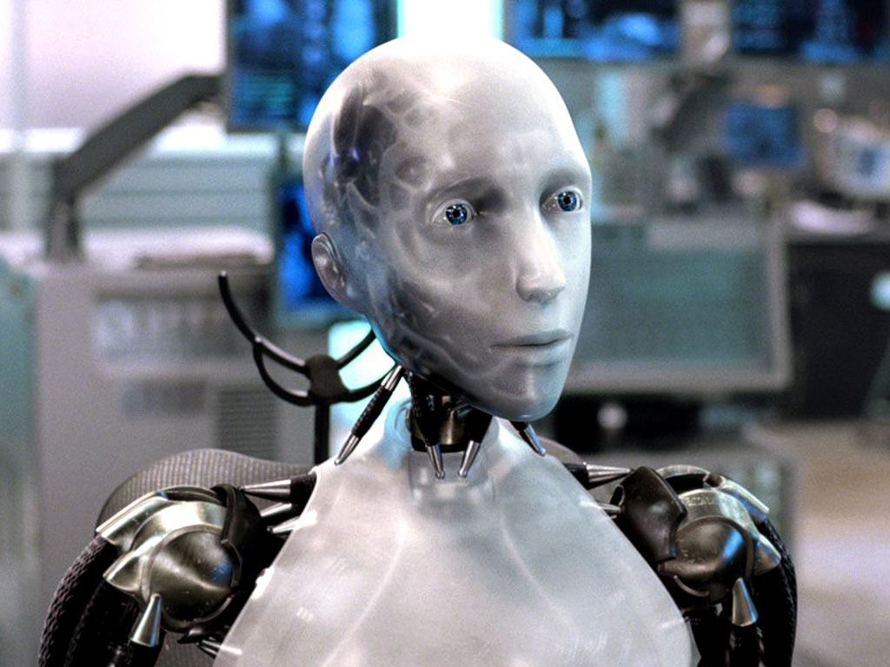
Who wants a robot to clean your house?
[Photo Credit: I, Robot]
Notes:
Science fiction has promised us housecleaning robots for many years. Let me ask… who here wants a robot to clean you house? Raise your hands… great.. Everyone wants a robot! We been thinking of housecleaning robots as being the realm of science fiction, but is this really the case? I’m going to show you a video of this robot, which was built at Stanford.

Slide 3
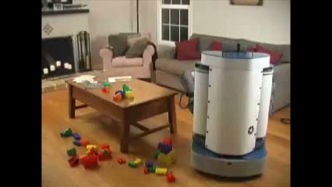
Stanford AI Robot
[Credit: Ken Salisbury]
Notes:
Things aren’t as they seem in this video, and there’s a cheat in it. Let me show you the video first, then talk the cheat. (Show video) What do you think the cheat is?

Slide 4
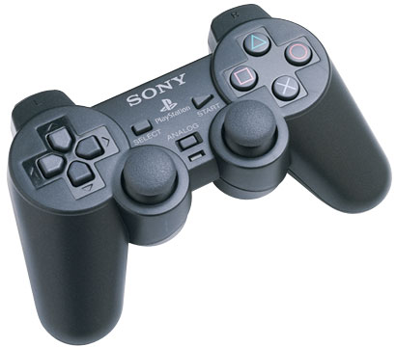
Notes:
This is the cheat. Every tiny little motion of the robot was controlled by a grad student using a joystick. [[I could have a live robot there, and just briefly show a couple of motions of the robots controlled by the joystick.]]

Slide 5
What’s missing?
The software
Control
Perception
Notes:
So, what’s missing? The software. In other words, there’s good news and bad news. The good news is that our robots today are mechanically/physically capable of cleaning our houses, and doing pretty much all the things we want a robot to do. The bad news is that they aren’t smart enough to this by themselves. What does the software need to do? In robotics, we need to solve two problems: Control, perception. Control means once you’ve figured out what you want to robot to do, how to get it to do that. Perception means seeing the world and understanding what’s around us. So, lets start with control. When I started on robotics about 10 years ago, asked around for what was hardest control problem.

Slide 6
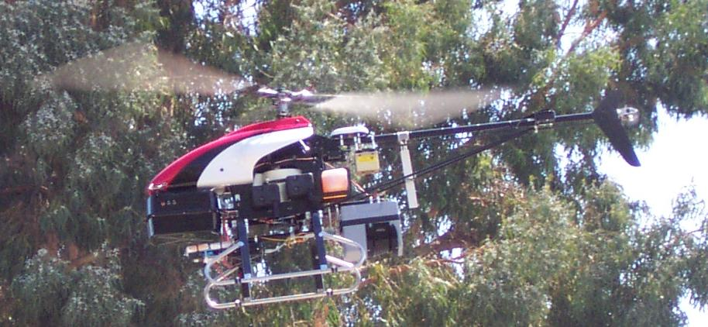
Stanford autonomous helicopter
Notes:
The most common answer I heard back then was autonomous helicopter, so I decided to work on that. Here’s a picture of our autonomous helicopter.

Slide 7
Stanford autonomous helicopter
GPS
Accelerometers
Compass
Computer
Notes:
It’s instrumented with GPS, accelerometers, and a compass, so it always knows where it is. It turns out flying a helicopter is pretty hard. If you ever sit in a helicopter, you’ll see the pilot holding one joystick in each hand, and also stepping on two different foot-pedals, and they’ll using all of these controls and moving both hands and both feel continuously to keep the helicopter in the air. The control problem is: 10 times a second, you’re told the exact position of the helicopter. And 10 times a second, you need to decide how to move the control sticks, in order to keep the helicopter up in the air.

Slide 8
Stanford autonomous helicopter
GPS
Accelerometers
Compass
Notes:
It’s instrumented with GPS, accelerometers, and a compass, so it always knows where it is. It turns out flying a helicopter is pretty hard. If you ever sit in a helicopter, you’ll see the pilot holding one joystick in each hand, and also stepping on two different foot-pedals, and they’ll using all of these controls and moving both hands and both feel continuously to keep the helicopter in the air. The control problem is: 10 times a second, you’re told the exact position of the helicopter. And 10 times a second, you need to decide how to move the control sticks, in order to keep the helicopter up in the air.

Slide 9
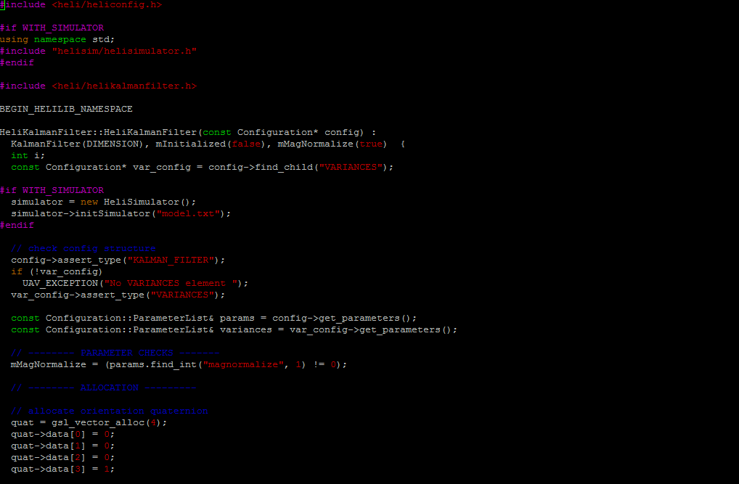
Notes:
So we thought, oh, okay! We just need to write down the a mathematical specification of how helicopters behave, and program that into a computer like this, and then the computer can decide how to move the control sticks.

Slide 10
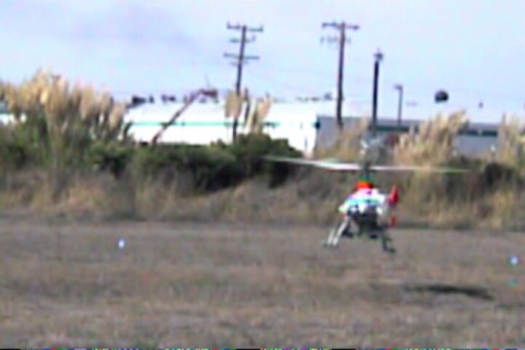
[Courtesy of David Shim]
Notes:
Let me show you a video made by a friend, who took this approach. When I play the video, you’ll hear David Shim’s voice say “enable control”, and that’s when his computer program takes over flying the helicopter.
(Play video.)
That was him shouting “abort, abort.”

Slide 11



Machine learning
Notes:
After looking at this, I realized that helicopters are just too complicated, and we don’t understand their aerodynamics well enough, so no one knows how to write down a mathematical specification for how to fly it. Instead, I realized the best way was to have a computer mimick how human pilots learn to fly—by watching an expert pilot. In other words, rather than relying on our computer has to be able to learn, just like the human brain can. So, we found ourselves an expert human pilot, and asked him to demonstrate flying a helicopter. Our computer watcher him, and used this to learned to fly “just like him.”
Using this idea, we’ve been able to not only have our computer fly our helicopter, but also have it fly different aerobatic stunts. We’ve made a lot of interesting videos of our helicopters flying different stunt maneuvers. Let me show you one of them.

Slide 12
Machine learning
Notes:
After looking at this, I realized that helicopters are just too complicated, and we don’t understand their aerodynamics well enough, so no one knows how to write down a mathematical specification for how to fly it. Instead, I realized the best way was to have a computer learn by itself how to fly a helicopter, similar to how a beginner pilot might—-- mimick how human pilots learn to fly—by being allowed to try things out the helicopter, and seeing what happens, and being able to learn from these experiences of trying to fly. A bit like how you might have learned to ride a bicycle.
[xx In other words, rather than relying on a mathematical specification of the helicopter, of computer has to be able to learn, just like the human brain can.]]
Using this idea, which is what researchers call machine learning, we’ve been able to not only fly our helicopter, but also have the computer fly different aerobatic stunts. We’ve made a lot of interesting videos of our helicopters flying different stunt maneuvers. Let me show you one of them.

Slide 13
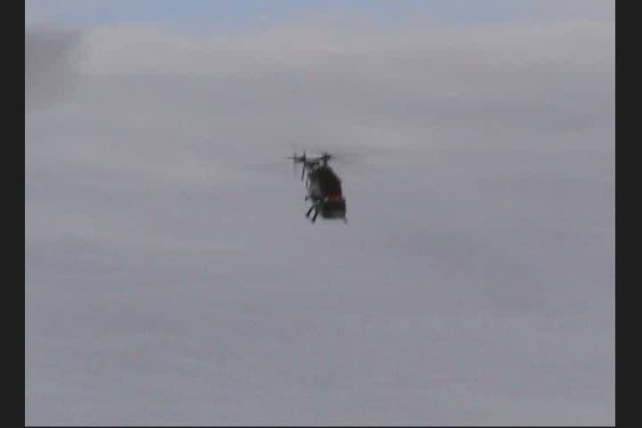
Machine learning to fly helicopter
Notes:
(play video). This was the first helicopter in the world that could fly upside down under computer control, and through being able to learn, our computer can now fly helicopters—including fly stunts—at a skill level comparable to the very best pilots in the world.

Slide 14
What’s missing?
The software
Control
Perception
Notes:
So, that was control. Since we seemed to be doing pretty well on control, I decided to work on perception instead.

Slide 15

“Robot, please find my coffee mug”
Notes:
Lets use an example. Suppose I want my a robot like (this) to find my coffee mug. Because we know how to do control, our robot knows how to drive to the kitchen, to look for the coffee mug. Lets say the robot sees this in my kitchen. Where does it think the coffee mug is?

Slide 16
“Robot, please find my coffee mug”
Mug
Mug
Mug
Mug
Mug
Mug
Mug
Notes:
If you run a computer vision algorithm, this is the sort of result you’ll get. It completely fails to find the coffee mug!

Slide 17
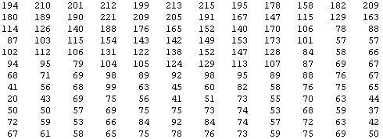
Why is computer vision hard?
But the camera sees this:
Notes:
Why is computer vision hard? You and my visual system is so good that it’s almost hard to understand how a computer program can fail to see what this is. But to understand why this is hard, lets zoom into part of the image. This looks like a coffee mug to you, but what it looks like to the camera… is this. It sees this block of numbers, corresponding to the pixel brightness values, also called the pixel intensity values, in the image. The computer vision problem is to look at all these numbers, and figure out that this is the rim of a coffee mug.
It seems you must need a very complicated mathematical function to decide that that block of numbers represents a coffee mug. And of course, we don’t just want to recognize coffee mugs. We also want to recognize people and faces, we want our robot have depth perception—to tell if things are nearby or far away—and figure out many other things from pictures. And so it seems you have to write a lot of complicated programs to do all these things.

Slide 18
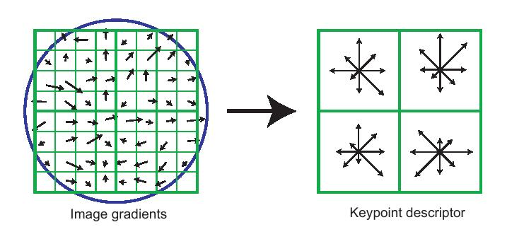
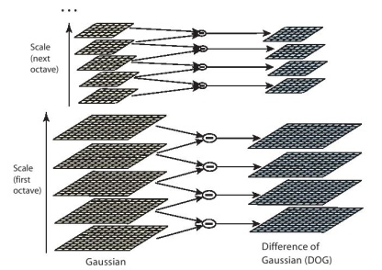
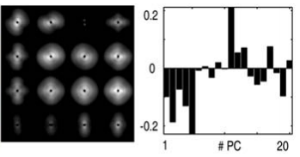
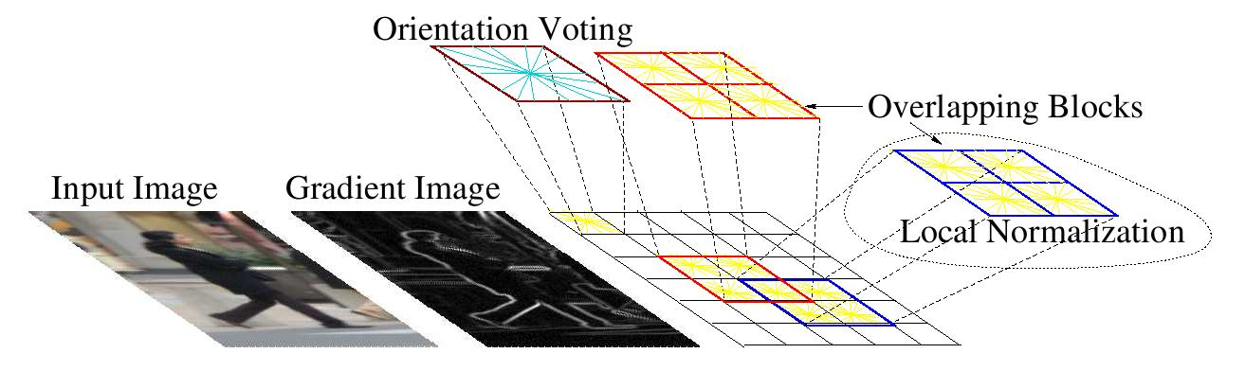
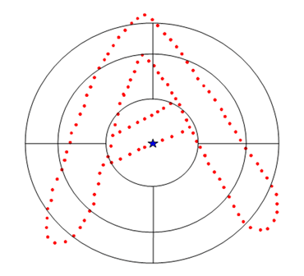
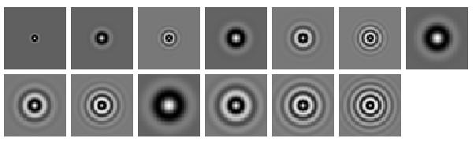
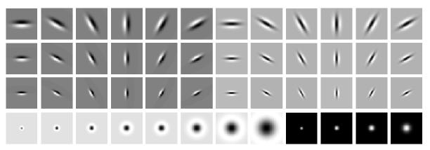
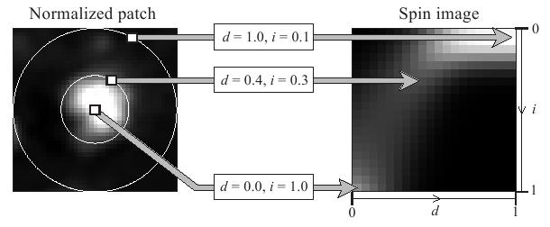
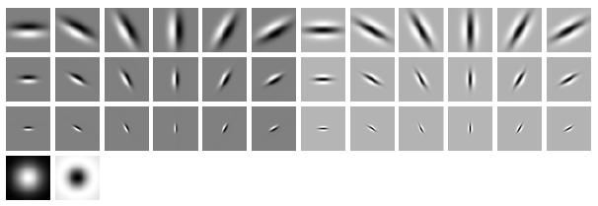
Computer programs (features) for vision
SIFT
GIST
HoG
Shape context
Textons
Spin image
Notes:
And, computer vision researchers have been doing exactly this—writing very complicated programs to try to do vision. These illustrations are from six of the leading computer vision programs (the technical term is “features”), and you know what… they’re really complicated, but unfortunately they don’t seem to work that well.
Now, of course, perception isn’t just about vision. We also have audio. For example, can we get a robot to understand speech; understand our voices?

Slide 19
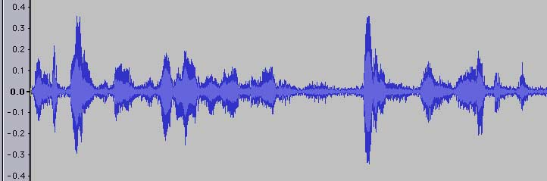
Why is speech recognition hard?
What a microphone records:
“Robot, please find my coffee mug.”
Notes:
There’s starting to be software that can do speech recognition now, but this still turns out to be difficult. Why is this hard? Well, microphone records a sound waveform like this. And the speech recognition problem is to figure out that waveform corresponds to me saying “robot, please find my coffee mug.”
And because it seems you need a very complicated function to go from the waveform to the text…

Slide 20
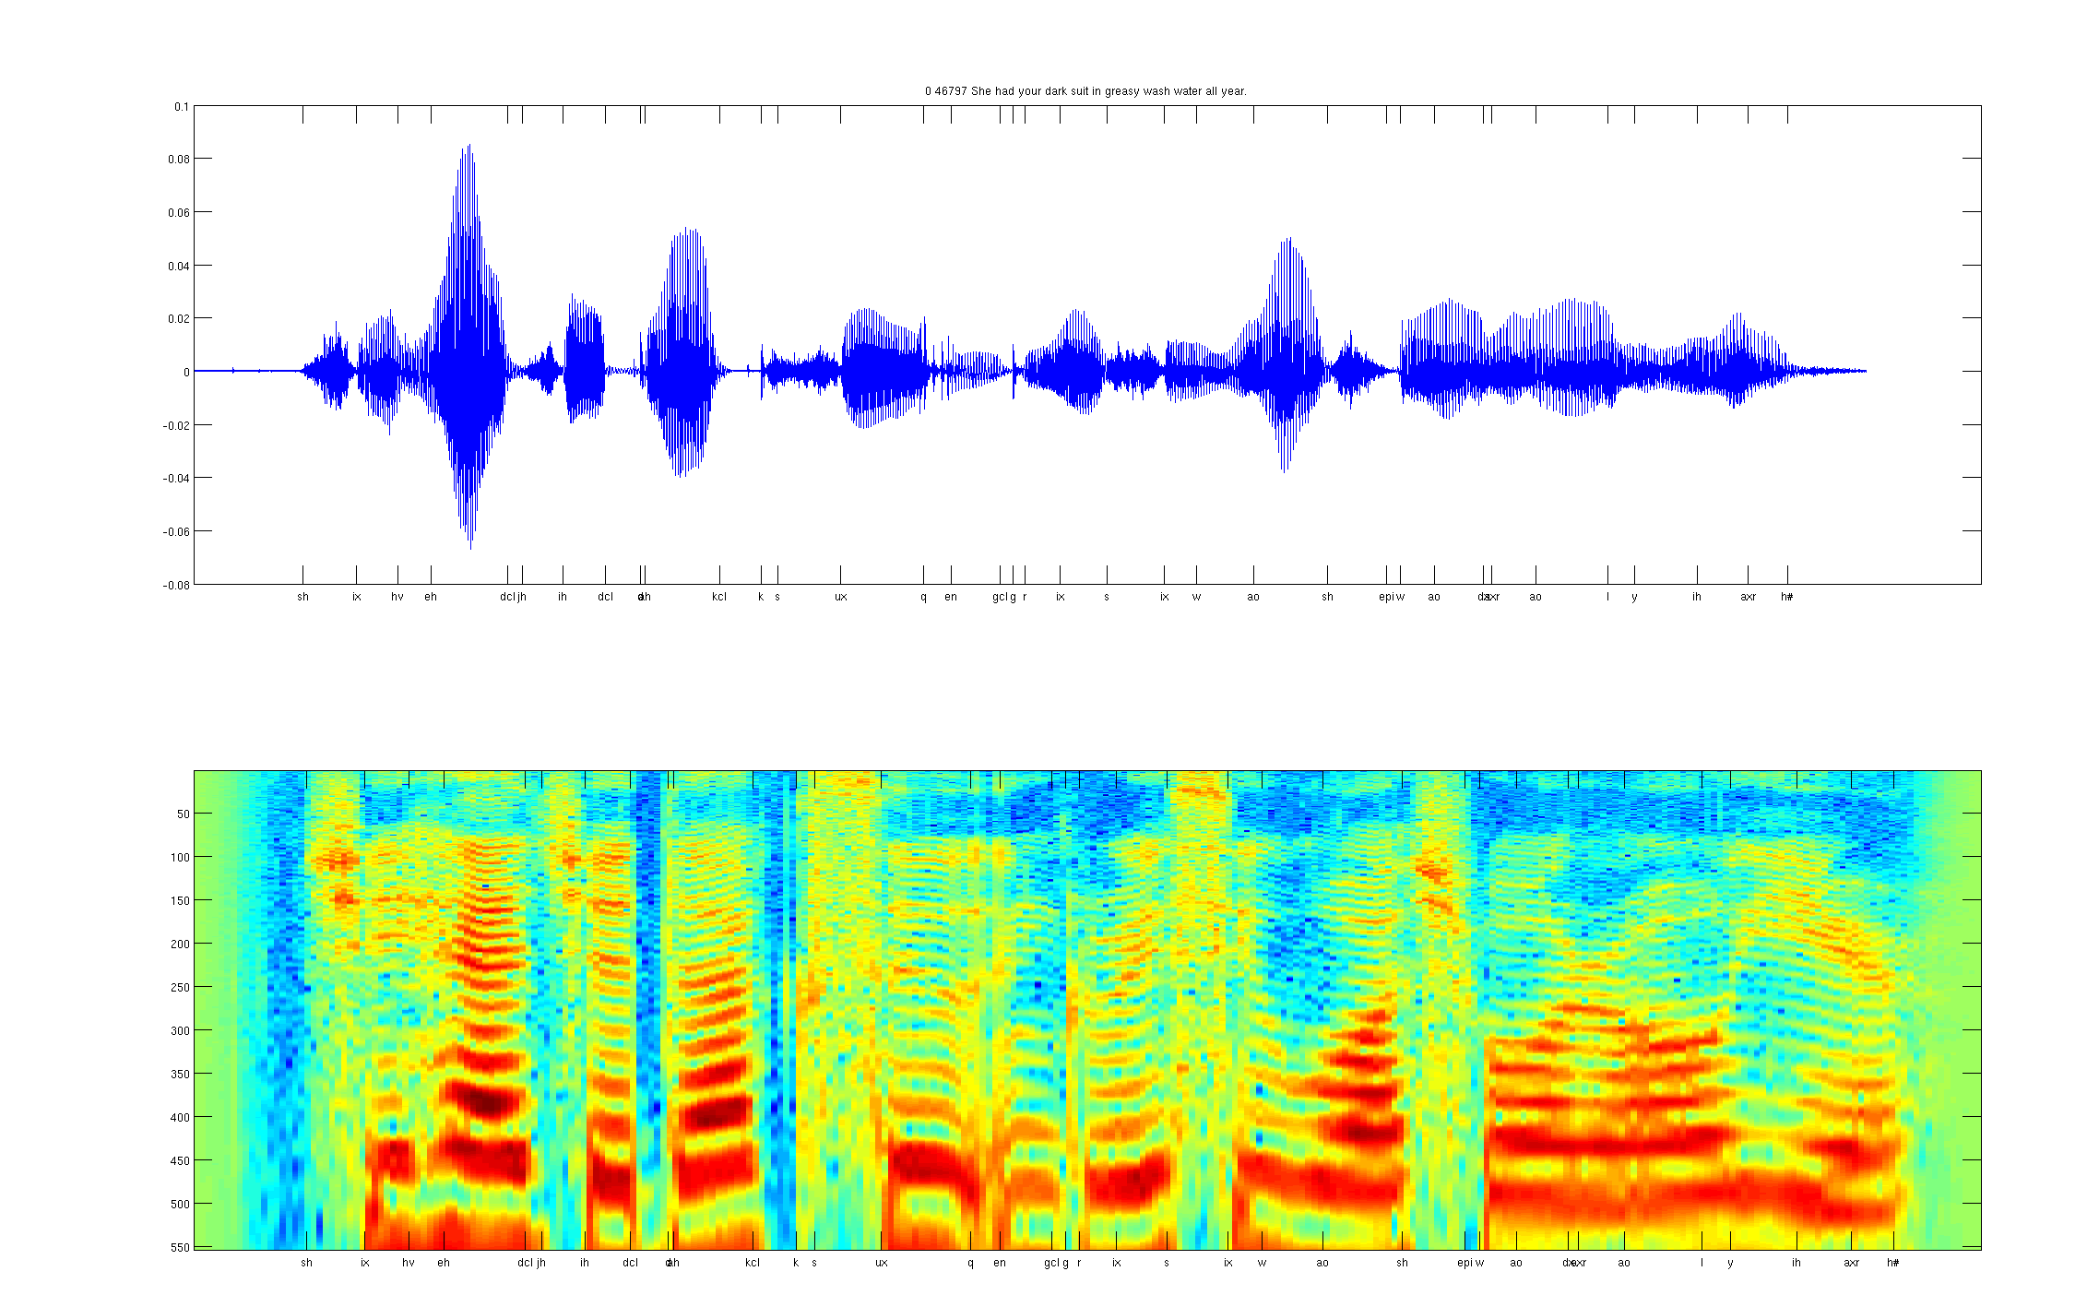
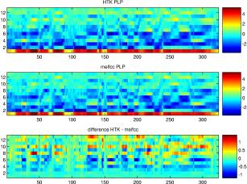
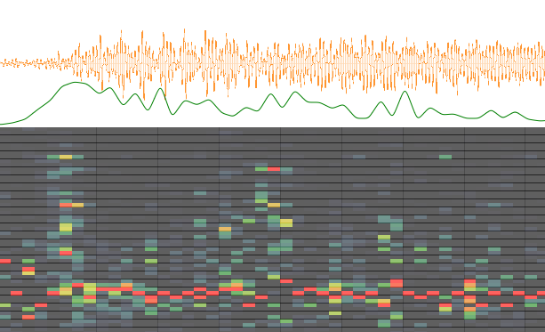
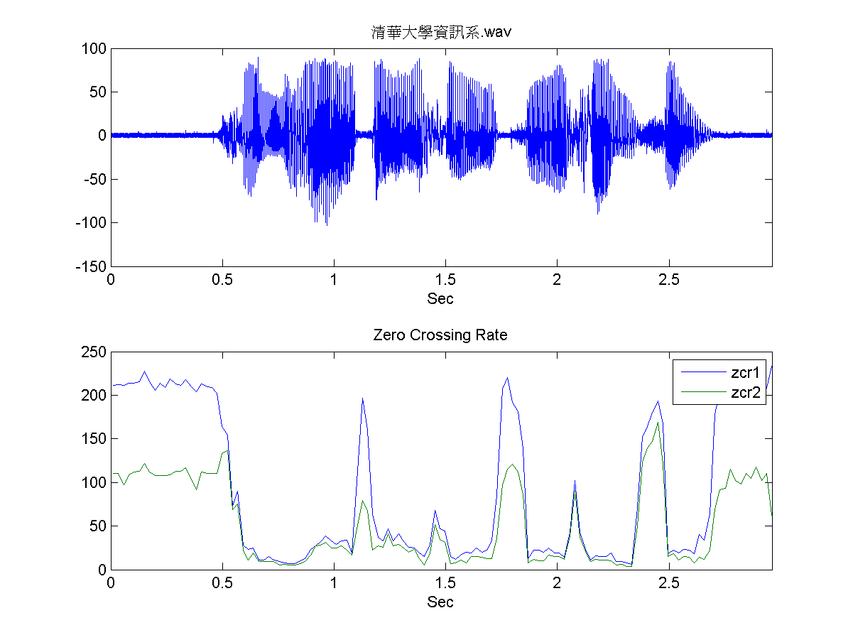
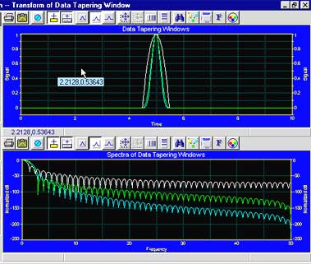
Computer programs (features) for audio
Spectrogram
MFCC
Flux
ZCR
Rolloff
Notes:
… audio researchers have also been writing very complicated computer programs to try to do this, and here are some of the leading approaches.
As I was work on perception myself, it seemed really hard to make progress. We’re writing all these complicated programs for vision, and all these complicated programs for audio, and it was hard to get them to work. I tried writing some even more complicated programs myself, but my programs didn’t really work either, and I frustrated and frankly starting to give up hope of being able to make much progress in this field.
But then I learned about one idea… that completely re-energized my thinking. This idea comes from biology—from neuroscientists.

Slide 21
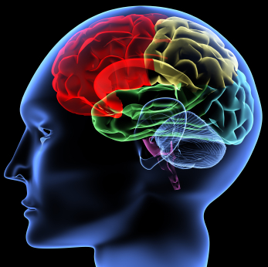
The idea:
Most of perception in the brain may be one simple program.
Notes:
It is that rather than writing a lot of different computer programs for vision, and a lot of different computer programs for audio… if you look at how the brain does perception, it might be doing everything with just one program, and perhaps even a fairly simple one. This would be a program that can learn, but what it means is that rather than having some complicated system in your brain for vision, and some other system for audio, and another system for touch, and so on, it might be possible to design just one simple program—one that learns—to do all of these!

Slide 22

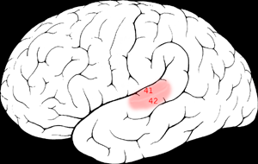

The “one program” hypothesis
Auditory Cortex
Auditory cortex learns to see
[Roe et al., 1992]
Notes:
Here’s why we think this might be true.
That red part of the brain is your auditory cortex. The way you’re understanding my words now is your ears are routing the sound signal to your auditory cortex, and then that’s processing and understanding the sound. Neuroscientists have done the following fascinating experiment. You can cut the wire from the ears to the auditory cortex. And rewire the signal from the eyes—from the optic nerve—so that it ends up going to the auditory cortex. If you do this, then the auditory cortex will learn to see. This is a very reliable result, replicated by multiple research labs on multiple species of animals. That red piece of brain tissue learns to process images, and these animals can do visual discrimination tasks—that is, look at things and make visual judgments—using their auditory cortex.

Slide 23
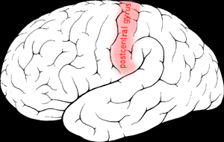

The “one program” hypothesis
Somatosensory Cortex
Somatosensory cortex learns to see
[Metin & Frost, 1989]
Notes:
Here’s another example. That red part of your brain is your somatosensory cortex. It’s what you use to process touch. If you rewire the brain the same way, same thing happens. Your somatosensory cortex learns to see.
There’re a lot of experiments like these showing different parts of the brain being able to understand almost any input sensor. And the fascinating thing is, if the same piece of brain tissue can usually process sight, or sound or touch, then maybe there’s a single program—or algorithm—as well, that can process sight, or sound or touch.

Slide 24
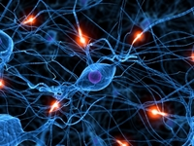
Neurons in the brain
Notes:
How does the brain work? You brain is jam-packed full or neurons that’re connected to and talk to each other.

Slide 25
Neural Network (Sparse Learning)
x₁
x₂
Output
x₃
Layer L₄
x₄
Layer L₃
Layer L₁
Layer L₂
Notes:
In a computer, we can simulate this by building a Neural Network, which is a program that simulates lots of neurons talking to each other. What might we hope for this neural network to do then? Well, lets look more to the biology.

Slide 26
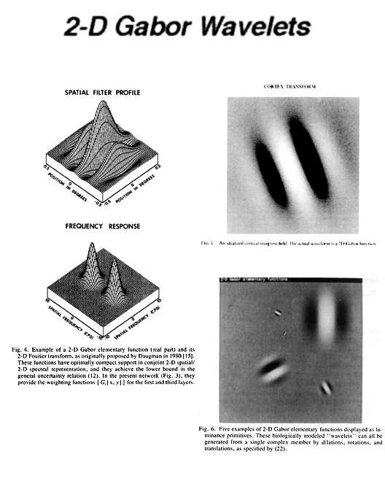
How does the brain process images?
Visual cortex looks for lines/edges.
Neuron #1 of visual cortex
(model)
Neuron #2 of visual cortex
(model)
Notes:
It turns out that the way the brain processes images is it first looks for short lines, or edges. For example, there’s a neuron in your brain now that’s looking for a 45 degree edge like that (left image)—a black band adjacent to a white band. And there’s probably a different neuron looking for an edge like that in the right image—a vertical white band with two black bands on the side. So, the question is, can we get our algorithms to do this too?

Slide 27
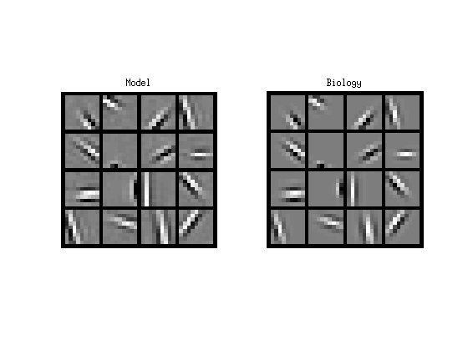
Comparing to Biology
Visual cortex
Learning algorithm
Notes:
Left: edge detectors from visual cortex.
Right: Show that algorithms get same thing. Successfully mimicks visual cortex.

Slide 28
Comparing to Biology
Auditory cortex
Learning algorithm
Notes:
Left: visualization of what auditory cortex is looking for.
Right: Show that algorithms get same thing.
One computer program successfully mimics both the visual and auditory processing systems!

Slide 29
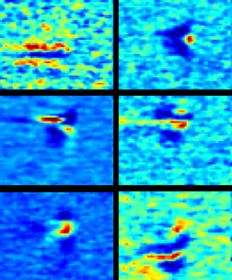
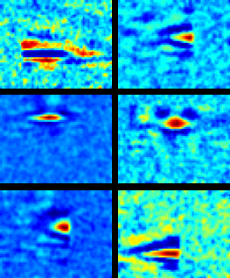
Comparing to Biology
Auditory cortex
Learning algorithm
Notes:
Left: visualization of what auditory cortex is looking for.
Right: Show that algorithms get same thing.
One computer program successfully mimics both the visual and auditory processing systems!

Slide 30


Computer vision results (NORB benchmark)
Classical computer
vision (SVM):
Neural Network:
accuracy
accuracy
Notes:
[[Should be 97.0%?]]
Does this work? We took this approach, and applied it to a bunch of computer vision benchmarks. I’ll share with you just one of the results.
Algorithm does well.

Slide 31
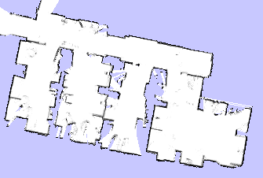
Correctly found mug
Mistake
Notes:
In fact, just for fun, recently, we sent our robot around of office building to take inventory of the coffee mugs in our office .

Slide 32
Correctly found mug
Mistake

Slide 33
Correctly found mug
Mistake

Slide 34





























Correctly found mug
Mistake
Notes:
And there’re the pictures of the mugs found by the robot.

Slide 35
Hope of progress in
Artificial Intelligence
Email: ang@cs.stanford.edu
Notes:
Let me close with a personal story. Since I was a kid, I always wanted to work on AI and build smart robots. And then I went to college, and learned how hard it was, and saw that while AI and machine has given us many great things—it’s helped us build Google, given us spam filters, and tons of great stuff—the bigger dream of building machines that can see and understand the world the way we do just seemed too hard. Only after learning about these ideas that most of brain may be one algorithm, felt like for the first time in my life that we might have a shot at making progress towards this big AI dream, especially in perception. We don’t have real housecleaning robots yet, but I believe that AI algorithms that mimic the brain may be our best way of getting there. I see lots of reasons why I might be wrong or this might not work. But when I look at our lives, I see us spending a lot of time in acts of mental drudgery. Cleaning our houses, filling out paperwork, going shopping for trivial items… and if we can make computers and robots smart enough to free us from many of those tasks, thus leaving us more time to pursue higher endeavors, what could be more exciting than that?
Finally, if you’d like to learn more, or if you’re an engineer or would like to use these ideas or even work on AI yourself, do contact me, and I’d love to share what I know.

Slide 37
Mathematical specification of helicopter
[Courtesy of David Shim]
Notes:
Let me show you a video made by a friend, who took this approach. When I play the video, you’ll hear David Shim’s voice say “enable control”, and that’s when his computer program takes over flying the helicopter.
(Play video.)
That was him shouting “abort, abort.”

Slide 38

Stanford AI Robot
[Credit: Ken Salisbury]
Notes:
Things aren’t as they seem in this video, and there’s a cheat in it. Let me show you the video first, then talk the cheat. (Show video) What do you think the cheat is?

Slide 39
Option 1
BLACK
Notes:
I realized that it was just too hard to sit down and write a program to do this. We don’t understand the aerodynamics of helicopter too well, and helicopters are just too complicated, so we don’t know how to come up with a mathematical specification for how to fly it. Instead, the best way to fly a helicopter is by watching how human pilots learn to fly, and then getting our computers to go through the same learning process. So, we found ourselves an expert human pilot, and asked him to demonstrate flying a helicopter. Just like an amateur pilot. our computer watch him fly it, and learned to fly “just like him.”
Using this idea—called machine learning—we’ve ended up able to do some very fun things with our helicopter.

Slide 40

Machine learning
Option 2
Notes:
I realized that it was just too hard to sit down and write a program to do this. We don’t understand the aerodynamics of helicopter too well, and helicopters are just too complicated, so we don’t know how to come up with a mathematical specification for how to fly it. Instead, the best way to fly a helicopter is by watching how human pilots learn to fly, and then getting our computers to go through the same learning process. So, we found ourselves an expert human pilot, and asked him to demonstrate flying a helicopter. Just like an amateur pilot. our computer watch him fly it, and learned to fly “just like him.”
Using this idea—called machine learning—we’ve ended up able to do some very fun things with our helicopter.
[Some nice graphic here explaining the “have a human
pilot demonstrate flying, have the computer watch the human
and learn from it” would be nice….]

Slide 41
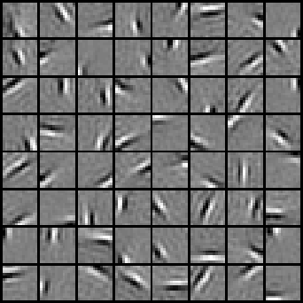



Comparing to Biology
Visual cortex
Learning algorithm
[PICTURE]
Notes:
Left: edge detectors from visual cortex.
Right: Show that algorithms get same thing. Successfully mimicks visual cortex.

Slide 42
Comparing to Biology
Auditory cortex
Learning algorithm
Notes:
Left: visualization of what auditory cortex is looking for.
Right: Show that algorithms get same thing.
One computer program successfully mimics both the visual and auditory processing systems!

Slide 43
Comparing to Biology
Brain
Learning algorithm
Visual
Sound

Slide 44
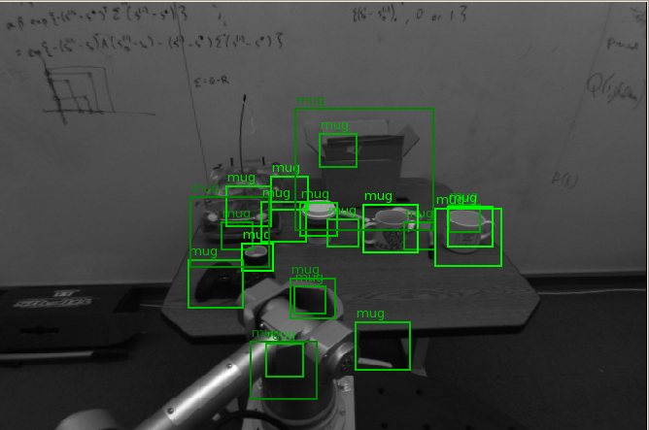
Missed Mugs
True positives
False positives

Slide 45
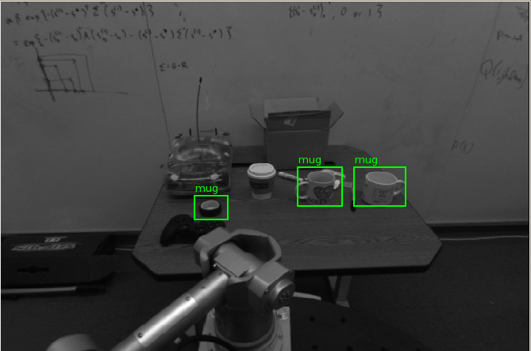
Missed Mugs
True positives
False positives

Slide 46
Results using non-embodied vision
Missed Mugs
True positives
False positives

Slide 47
Missed Mugs
True positives
False positives

Slide 48
Results using non-embodied vision
Missed Mugs
True positives
False positives

Slide 49
Classifications using embodied agent
Missed Mugs
True positives
False positives

Slide 50
Missed Mugs
True positives
False positives
Notes:
In fact, just for fun, recently, we sent our robot around of office building to take inventory of the coffee mugs in our office .

Slide 51
Results using non-embodied vision
Missed Mugs
True positives
False positives

Slide 52
Missed Mugs
True positives
False positives
Notes:
In fact, just for fun, recently, we sent our robot around of office building to take inventory of the coffee mugs in our office .

Slide 53
Missed Mugs
True positives
False positives

Slide 54
Missed Mugs
True positives
False positives

Slide 55
Missed Mugs
True positives
False positives
Notes:
And there’re the pictures of the mugs found by the robot.

