Slide 1
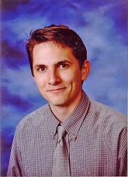
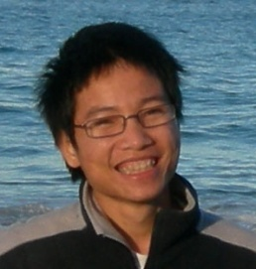

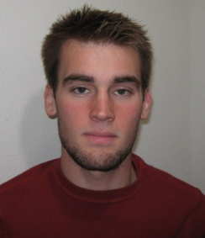


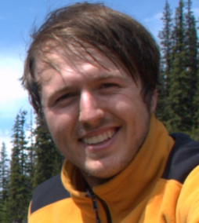

Deep Learning, Self-Taught Learning and Unsupervised Feature Learning
Andrew Ng
Stanford University
Thanks to:
Adam Coates Quoc Le Honglak Lee Andrew Maas Chris Manning Jiquan Ngiam Andrew Saxe Richard Socher

Slide 2



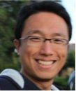
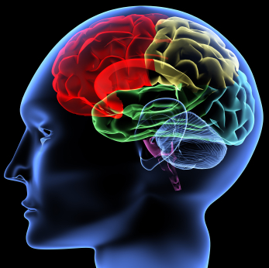
Machine Learning and AI
via Brain simulations
Andrew Ng
Thanks to:
Adam Coates Quoc Le Honglak Lee Andrew Saxe Andrew Maas Chris Manning Jiquan Ngiam Richard Socher Will Zou

Slide 3
Good News
Neural Networks had previously died out at ICML and NIPS.
But they are now making a comeback.

Slide 4
This talk
Deep Learning and Self-Taught Learning: Using neural networks and a particular unsupervised learning formalism, hope to:
- Make learning algorithms much better and easier to use.
- Significantly advance machine learning and AI.
Ideas are not mine; vision shared with many other researchers:
Samy Bengio, Yoshua Bengio, Greg Corrado, Jeff Dean, Tom Dean, Nando de Freitas, Jeff Hawkins, Geoff Hinton, Yann LeCun, Honglak Lee, Tommy Poggio, Marc’Aurelio Ranzato, Kai Yu, ….
I think this is our best shot at significant progress in computer perception (computer vision, audio, …).

Slide 5
This talk
The idea of “deep learning.” Using brain simulations, hope to:
- Make learning algorithms much better and easier to use.
- Make revolutionary advances in machine learning and AI.
Vision is not only mine; shared with many researchers:
E.g., Samy Bengio, Yoshua Bengio, Tom Dean, Nando de Freitas, Jeff Hawkins, Geoff Hinton, Yann LeCun, Honglak Lee, Tommy Poggio, Dawn Song, Josh Tenenbaum, Kai Yu, Jason Weston, ….
I believe this is our best shot at progress towards real AI.

Slide 6
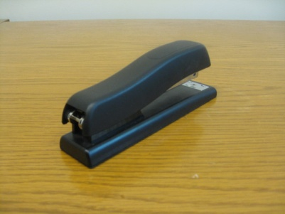
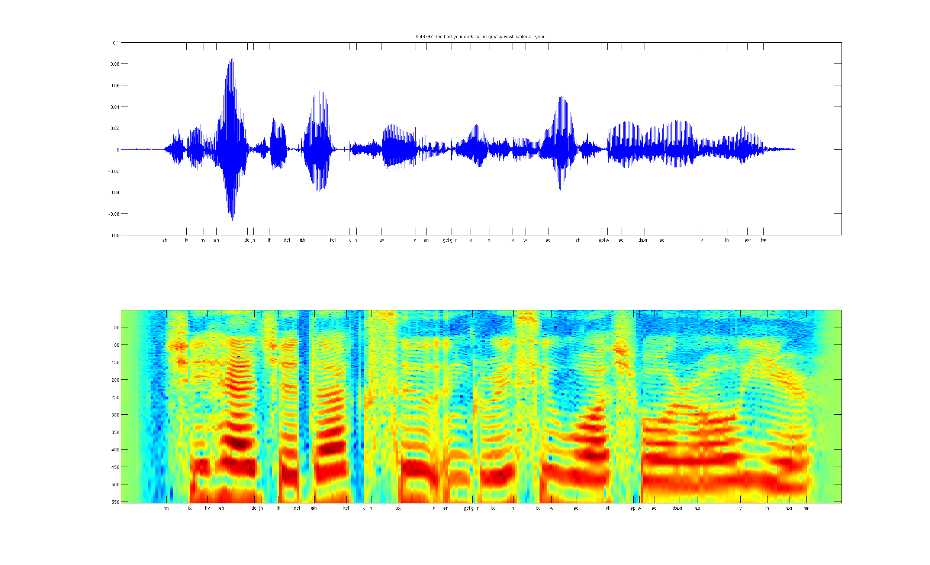
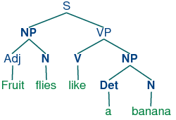
Develop ideas using…
Computer vision
Audio
Text

Slide 7
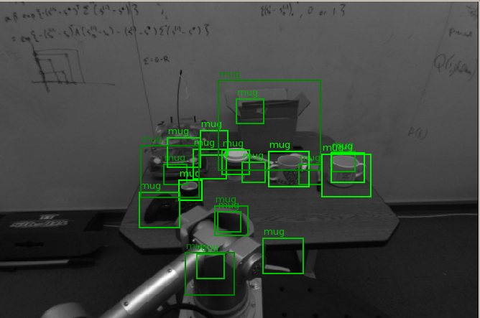
Computer vision is hard!
Notes:
Good faith effort to implement state-of-the-art.
Cluttered scenes.

Slide 8

Machine learning and feature representations
pixel 1
Learning
algorithm
pixel 2
Input
Motorbikes
Input space
“Non”-Motorbikes
pixel 2
pixel 1

Slide 9
Machine learning and feature representations
Learning
algorithm
Input
Motorbikes
Input space
“Non”-Motorbikes
pixel 2
pixel 1

Slide 10
Machine learning and feature representations
handle
Feature representation
Learning
algorithm
wheel
Input
Motorbikes
Input space
Feature space
“Non”-Motorbikes
“handle”
pixel 2
pixel 1
“wheel”

Slide 11
Object classification
handlebars
Feature representation
Learning
algorithm
wheel
Input
Feature space
Motorbikes
“Non”-Motorbikes
“handlebars”
“wheel”

Slide 12
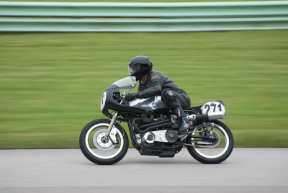


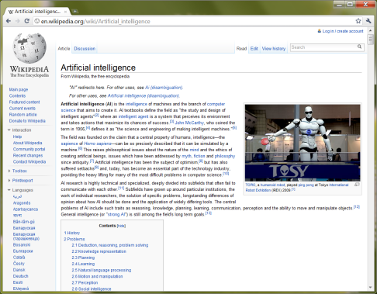
What do we want computers to do with our data?
Label: “Motorcycle”
Suggest tags
Image search
…
Images/video
Audio
Text
Speech recognition
Music classification
Speaker identification
…
Web search
Anti-spam
Machine translation
…

Slide 13
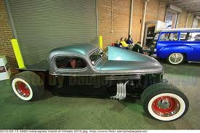
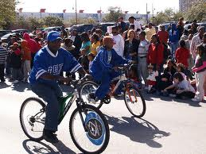
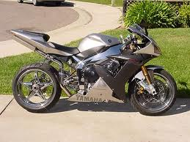
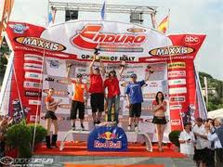
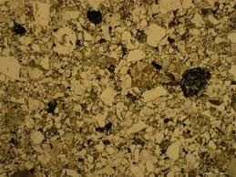
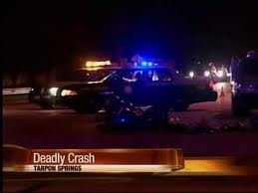
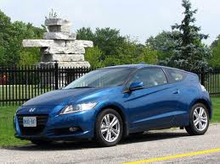
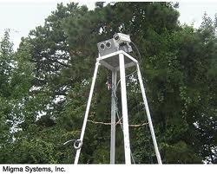
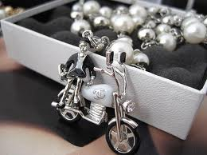
Computer vision is hard!
Motorcycle
Motorcycle
Motorcycle
Motorcycle
Motorcycle
Motorcycle
Motorcycle
Motorcycle
Motorcycle
Notes:
Good faith effort to implement state-of-the-art.
Cluttered scenes.

Slide 14
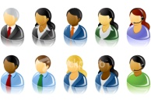
What do we want computers to do with our data?
Label: “Motorcycle”
Suggest tags
Image search
…
Images/video
Audio
Text
Speech recognition
Speaker identification
Music classification
…
Web search
Anti-spam
Machine translation
…
Machine learning performs well on many of these problems, but is a lot of work. What is it about machine learning that makes it so hard to use?

Slide 15
Machine learning for image classification
“Motorcycle”
This talk: Develop ideas using images and audio. Ideas apply to other problems (e.g., text) too.

Slide 16


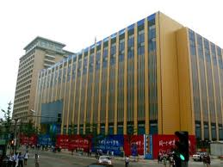
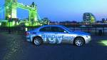
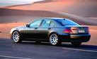
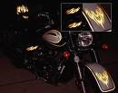

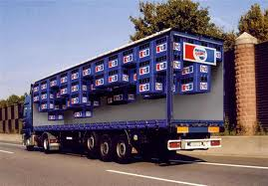
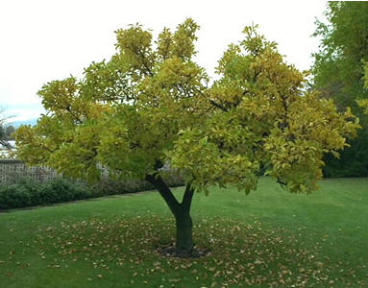


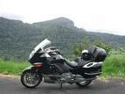

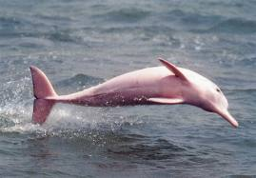
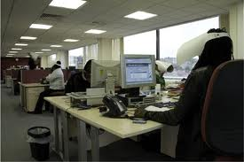


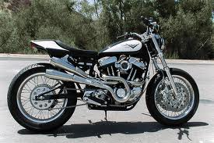
Machine learning for image classification
Motorcycles
Not a motorcycle
Testing:
What is this?

Slide 17
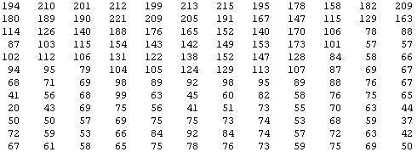
Why is this hard?
You see this:
But the camera sees this:

Slide 18

Machine learning and feature representations
pixel 1
Learning
algorithm
pixel 2
Input
Motorbikes
Raw image
“Non”-Motorbikes
pixel 2
pixel 1

Slide 19
Machine learning and feature representations
pixel 1
Learning
algorithm
pixel 2
Input
Motorbikes
Raw image
“Non”-Motorbikes
pixel 2
pixel 1

Slide 20
Machine learning and feature representations
pixel 1
Learning
algorithm
pixel 2
Input
Motorbikes
Raw image
“Non”-Motorbikes
pixel 2
pixel 1

Slide 21
What we want
handlebars
Feature representation
Learning
algorithm
wheel
Input
E.g., Does it have Handlebars? Wheels?
Motorbikes
Raw image
“Non”-Motorbikes
Features
pixel 2
Wheels
pixel 1
Handlebars

Slide 22
The idea of feature representations
Learning
algorithm
Input
Motorbikes
“Non”-Motorbikes
Raw image
pixel 2
pixel 1

Slide 23
Object classification
handlebars
Feature representation
Learning
algorithm
wheel
Input
Feature space
Motorbikes
“Non”-Motorbikes
“handlebars”
“wheel”

Slide 24

















Computing features in computer vision
But… we don’t have a handlebars detector. So, researchers try to hand-design features to capture various statistical properties of the image.
0.1
0.7
0.4
0.6
0.1
0.7
0.4
0.6
0.1
0.4
0.5
0.5
…
0.1
0.4
0.5
0.5
0.1
0.6
0.5
0.7
0.2
0.3
0.4
0.4
Final
feature
vector
Find edges
at four
orientations
Sum up edge
strength in
each quadrant

Slide 25
Feature representations
Feature Representation
Learning
algorithm
Input
Notes:
Where do we get these low-level representations from?

Slide 26
Feature representations
Notes:
Where do we get these low-level representations from?

Slide 27
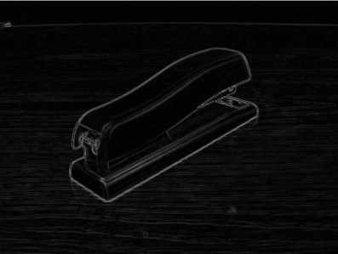



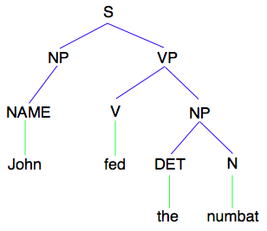
How is computer perception done?
Images/video
Image
Vision features
Detection
Audio
Image
Low-level features
Grasp point
Audio
Audio features
Speaker ID
Text classification, Machine translation, Information retrieval, ....
Text
Text
Text features

Slide 28
How is computer perception done?
Images/video
“Motorcycle”
Image
Vision features
Recognition
Audio
Image
Low-level features
Grasp point
Audio
Audio features
Speaker ID
Information retrieval,
Machine translation,
Text classification,
etc.
Text
Text
Text features

Slide 29
Feature representations
Feature Representation
Learning
algorithm
Input
Notes:
Where do we get these low-level representations from?

Slide 30
Feature representations
Learning
algorithm
Input
Notes:
Where do we get these low-level representations from?

Slide 31
Feature representations
Feature Representation
Learning
algorithm
Input
E.g., SIFT, HoG, etc.
Notes:
Where do we get these low-level representations from?

Slide 32
Feature representations
Input
Feature Representation
Learning
algorithm
Notes:
Where do we get these low-level representations from?

Slide 33
How is computer perception done?
Object detection
Image
Vision features
Detection
Audio classification
Image
Low-level features
Grasp point
Audio
Audio features
Speaker ID
Text classification, Machine translation, Information retrieval, etc.
NLP
Text
Text features

Slide 34
Feature representations
Input
Feature Representation
Learning
algorithm
Notes:
Where do we get these low-level representations from?

Slide 35
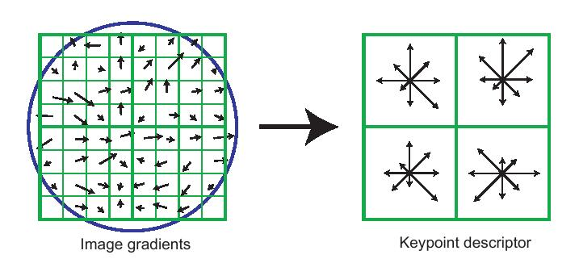
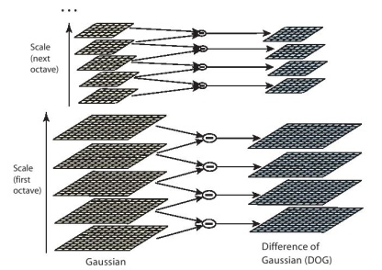
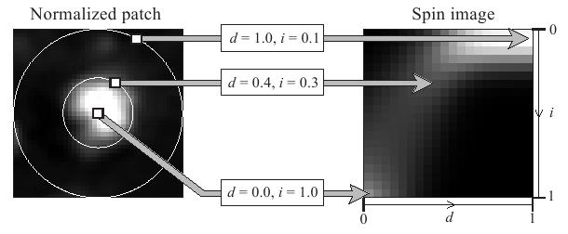
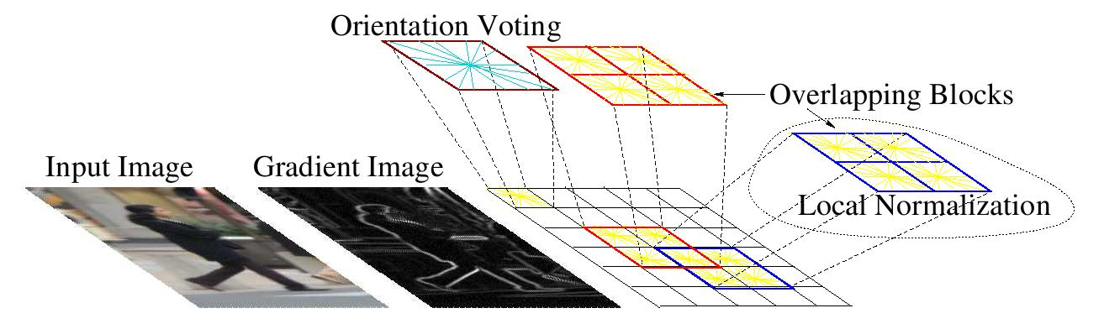
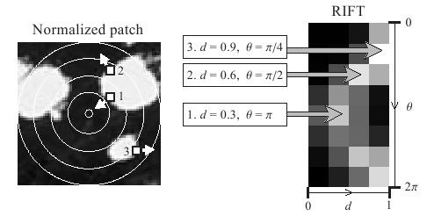
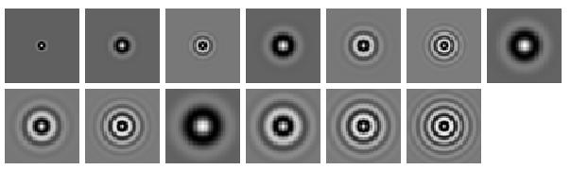
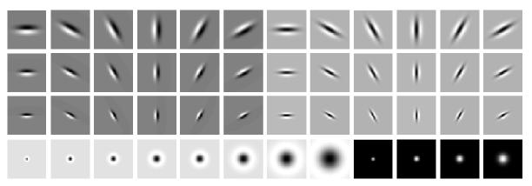
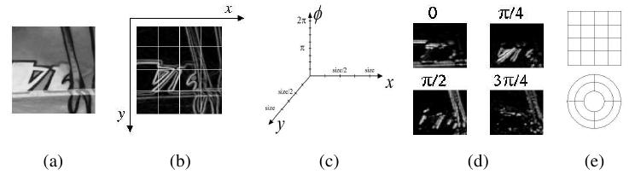
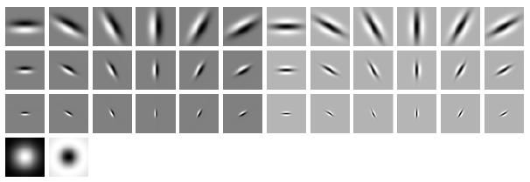
Computer vision features
SIFT
Spin image
HoG
RIFT
Textons
GLOH

Slide 36
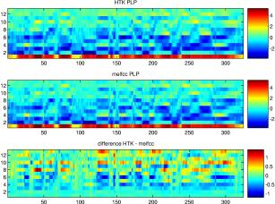
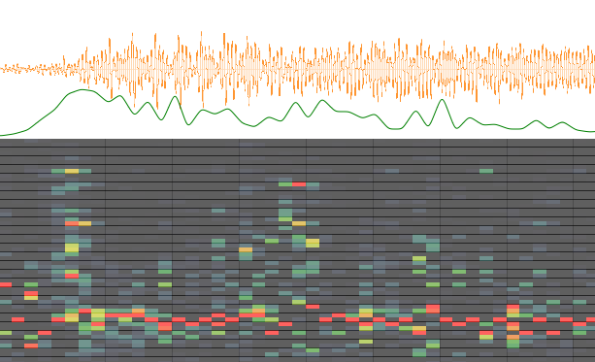
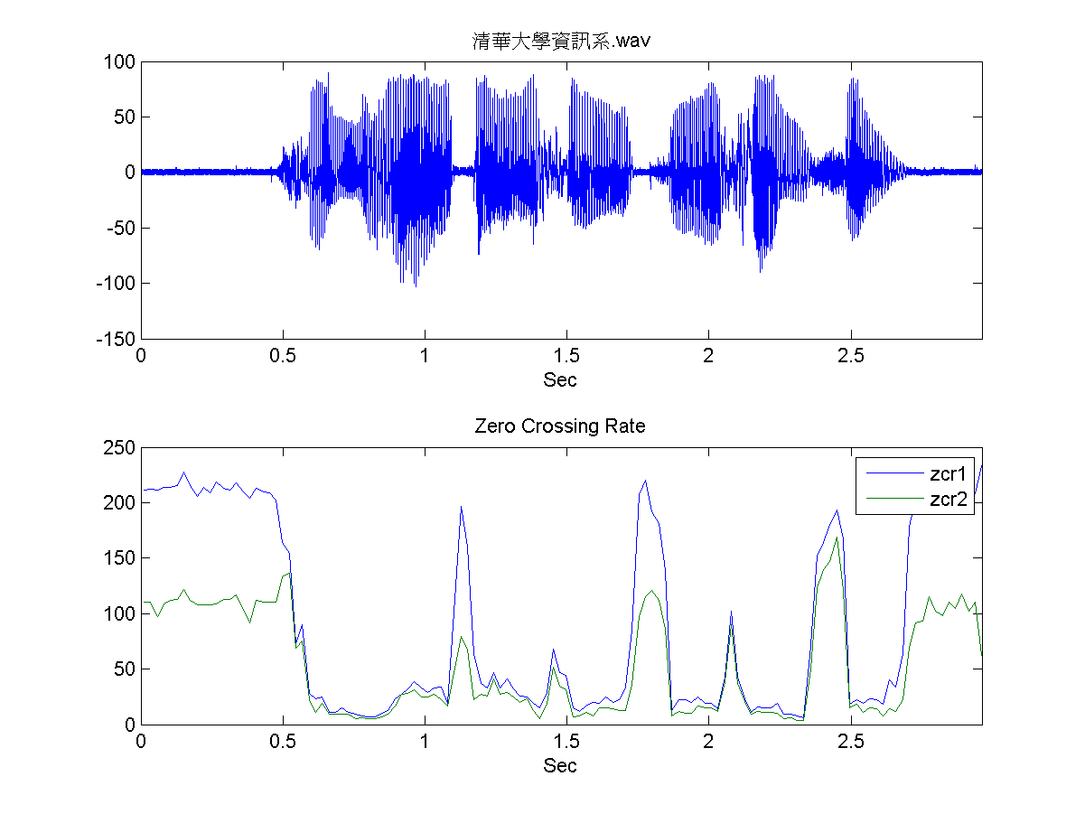
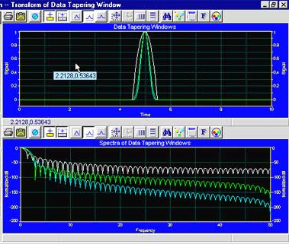
Audio features
Spectrogram
MFCC
Flux
ZCR
Rolloff

Slide 37
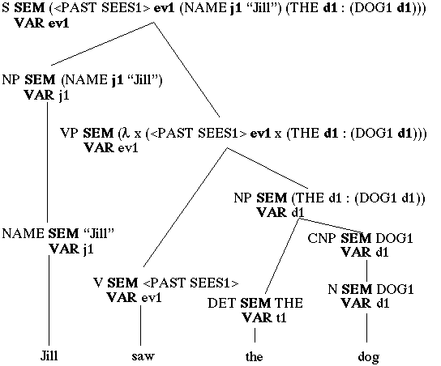
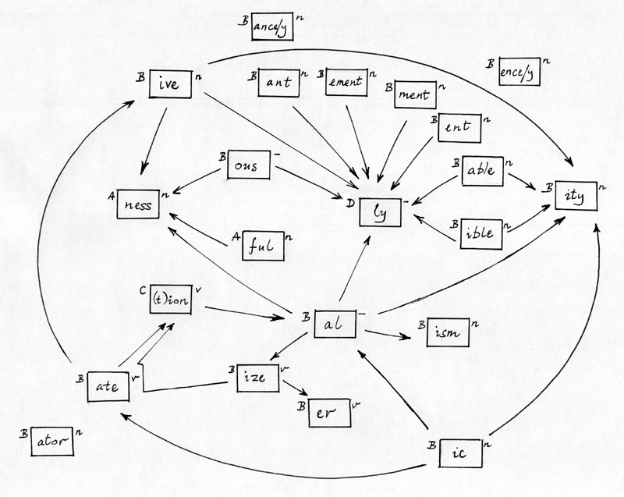




NLP features
NER/SRL
Stemming
Parser features
Anaphora
POS tagging
WordNet features

Slide 38
NLP features
Named entity recognition
Stemming
Parser features
Coming up with features is difficult, time-consuming, requires expert knowledge.
When working applications of learning, we spend a lot of time tuning the features.
Anaphora
Part of speech
Ontologies (WordNet)

Slide 39
Feature representations
Input
Feature Representation
Learning
algorithm
Notes:
Where do we get these low-level representations from?

Slide 40
The hypothesis
Much of perception in the brain can be explained with a single learning algorithm.

Slide 41



The “one learning algorithm” hypothesis
Auditory Cortex
Auditory cortex learns to see
[Roe et al., 1992]

Slide 42


The “one learning algorithm” hypothesis
Somatosensory Cortex
Somatosensory cortex learns to see
[Metin & Frost, 1989]

Slide 43






Sensor representations in the brain
Seeing with your tongue
Human echolocation (sonar)
Haptic belt: Direction sense
Implanting a 3rd eye
[BrainPort; Welsh & Blasch, 1997; Nagel et al., 2005; Constantine-Paton & Law, 2009]

Slide 44

Sensor representations in the brain
Array of electrodes
allows you to see with your tongue.
Human echolocation (sonar)
[BrainPort; Welsh & Blasch, 1997]

Slide 45


Sensor representation in the brain
Auditory cortex learns to see.
(Same rewiring process also works for touch/ somatosensory cortex.)
Auditory
Cortex
Seeing with your tongue
Human echolocation (sonar)
[Roe et al., 1992; BrainPort; Welsh & Blasch, 1997]

Slide 46

Other sensory remapping examples
Haptic compass belt. North facing motor vibrates. Gives you a “direction” sense.
Implanting a 3rd eye.
[Nagel et al., 2005; Constantine-Paton & Law, 2009]
Dunlop et al., 2006

Slide 47
On two approaches to computer perception
The adult visual (or audio) system is incredibly complicated.
We can try to directly implement what the adult visual (or audio) system is doing. (E.g., implement features that capture different visual properties: 2d and 3d shapes, context, relations between object parts, …).
Or, if there is a more general computational principal/algorithm that underlies most of perception, can we instead try to discover and implement that?

Slide 48



On two approaches to computer perception
The adult visual system computes an incredibly complicated function of the input.
We can try to directly implement this incredibly complicated function.
But if there is a more general computational principal/algorithm that underlies most of intelligence (perception), can we instead try to discover and implement that?
[Technical comment: A trained learning algorithm (e.g., neural network, boosting, decision tree, SVM,…) is very complex. But the learning algorithm itself is usually very simple. The complexity of the trained algorithm comes from the data, not the algorithm.]

Slide 49






Learning input representations
Find a better way to represent images than pixels.

Slide 50

Learning input representations
Find a better way to represent audio.

Slide 51

Feature learning problem
Given a 14x14 image patch x, can represent it using 196 real numbers.
Problem: Can we find a learn a better feature vector to represent this?
255
98
93
87
89
91
48
…

Slide 52


















Self-taught learning (Unsupervised Feature Learning)
…
Unlabeled images
Testing:
What is this?
Motorcycles
Not motorcycles
[This uses unlabeled data. One can learn the features from labeled data too.]

Slide 53
Self-taught learning (Feature learning problem)
Motorcycles
Labeled Motorcycles
Labeled Cars
Not motorcycles
Testing:
What is this?
[Lee, Raina and Ng, 2006; Raina, Lee, Battle, Packer & Ng, 2007]

Slide 54
Self-taught learning (Feature learning problem)
Motorcycles
Not motorcycles
Testing:
What is this?
…
Unlabeled images
[Lee, Raina and Ng, 2006; Raina, Lee, Battle, Packer & Ng, 2007]
[This uses unlabeled data. One can learn the features from labeled data too.]

Slide 55
Supervised Learning
Labeled Cars
Labeled Motorcycles
Testing:
What is this?
[Lee, Raina and Ng, 2006; Raina, Lee, Battle, Packer & Ng, 2007]

Slide 56
Unsupervised Feature Learning (Self-taught learning)
Labeled Cars
Labeled Motorcycles
Testing:
What is this?
Unlabeled images
[Lee, Raina and Ng, 2006; Raina, Lee, Battle, Packer & Ng, 2007]

Slide 57
Traditional machine learning
Labeled Cars
Labeled Motorcycles
Testing:
What is this?

Slide 58
Unsupervised feature learning (Self-taught learning)
Unlabeled images
Testing:
What is this?
Labeled Car(s)
Labeled Motorcycle(s)
[Lee, Raina and Ng, 2006; Raina, Lee, Battle, Packer & Ng, 2007]

Slide 59

First stage of visual processing: V1
V1 is the first stage of visual processing in the brain.
Neurons in V1 typically modeled as edge detectors:
Neuron #1 of visual cortex
(model)
Neuron #2 of visual cortex
(model)
Notes:
http://www.ldeo.columbia.edu/4d4/wavelets/dm.html

Slide 60

Learning sensor representations
Sparse coding (Olshausen & Field,1996)
Model developed to explain visual perception in the brain.
Input: Images x⁽¹⁾, x⁽²⁾, …, x^{(m)} (each in R^{n x n})
Learn: Dictionary of bases φ₁, φ₂, …, φ_{k} (also R^{n x n}), so that each input x can be approximately decomposed as:
x ∑ a_{j} φ_{j}
s.t. a_{j}’s are mostly zero (“sparse”)
^{k}
^{j=1}
[NIPS 2006, 2007]

Slide 61



First stage of visual processing: V1
V1 is the first stage of visual processing in the brain.
Hubel & Wiesel (1962)’s simple cell model:
Green: Responds to white dot.
Red: Responds to black dot.
Schematic of simple cell
Actual simple cell
Alternative treatment: Model as “Gabor functions.”
Also used in image compression and denoising.
[Images from DeAngelis, Ohzawa & Freeman, 1995]
Notes:
http://www.ldeo.columbia.edu/4d4/wavelets/dm.html

Slide 62
Learning sensor representations
Sparse coding (Olshausen & Field,1996)
Input: Images x⁽¹⁾, x⁽²⁾, …, x^{(m)} (each in R^{n x n})
Learn: Dictionary of bases φ₁, φ₂, …, φ_{k} (also R^{n x n}), so that each input x can be approximately decomposed as:
x ∑ a_{j} φ_{j}
s.t. a_{j}’s are mostly zero (“sparse”)
Use to represent 14x14 image patch succinctly, as [a₇=0.8, a₃₆=0.3, a₄₁ = 0.5]. I.e., this indicates which “basic edges” make up the image.
^{k}
^{j=1}
[NIPS 2006, 2007]

Slide 63
Feature Learning via Sparse Coding
Sparse coding (Olshausen & Field,1996). Originally developed to explain early visual processing in the brain (edge detection).
Input: Images x⁽¹⁾, x⁽²⁾, …, x^{(m)} (each in R^{n x n})
Learn: Dictionary of bases φ₁, φ₂, …, φ_{k} (also R^{n x n}), so that each input x can be approximately decomposed as:
x ∑ a_{j} φ_{j}
s.t. a_{j}’s are mostly zero (“sparse”)
^{k}
^{j=1}
[NIPS 2006, 2007]

Slide 64







Sparse coding illustration
Natural Images
Learned bases (φ_{1 , …,} φ₆₄): “Edges”
Test example
≈ 0.8 * + 0.3 * + 0.5 *
x ≈ 0.8 * φ₃₆ + 0.3 * φ₄₂ + 0.5 * φ₆₃
[a₁, …, a₆₄] = [0, 0, …, 0, 0.8, 0, …, 0, 0.3, 0, …, 0, 0.5, 0]
(feature representation)
More succinct, higher-level, representation.

Slide 65








More examples
Represent as: [a₁₅=0.6, a₂₈=0.8, a₃₇ = 0.4].
Represent as: [a₅=1.3, a₁₈=0.9, a₂₉ = 0.3].
0.6 * + 0.8 * + 0.4 *
φ₁₅ φ₂₈ φ₃₇
1.3 * + 0.9 * + 0.3 *
φ₅ φ₁₈ φ₂₉
Method “invents” edge detection.
Automatically learns to represent an image in terms of the edges that appear in it. Gives a more succinct, higher-level representation than the raw pixels.
Quantitatively similar to primary visual cortex (area V1) in brain.

Slide 66
Sparse coding applied to audio
Image shows 20 basis functions learned from unlabeled audio.
[Evan Smith & Mike Lewicki, 2006]

Slide 67
Sparse coding applied to audio
Image shows 20 basis functions learned from unlabeled audio.
[Evan Smith & Mike Lewicki, 2006]

Slide 68



Sparse coding applied to touch data
Collect touch data using a glove, following distribution of grasps used by animals in the wild.
Grasps used by animals
[Macfarlane & Graziano, 2009]
Example learned representations
Biological data
Learning Algorithm
[Andrew Saxe]

Slide 69
What about text?
Sparse coding works great on “natural signals” like images and audio.
But text is different!
≈ 0.8 * + 0.3 * + 0.5 *
φ₃₆ φ₄₂ φ₆₃
Image ≈ 0.8 * “Edge 36” + 0.3 * “Edge 42” + 0.5 * “Edge 63”

Slide 70
Sparse coding on bag-of-word vectors (illustration)
a
aardvark
aardwolf
able
account
acid
across
…
baby
back
…
cradle
…
…
…
zylophone
1
0
0
0
1
0
0
0
1
0
0
1
0
0
0
1
x
Document

Slide 71
Sparse coding on bag-of-word vectors (illustration)
a
aardvark
aardwolf
able
account
acid
across
…
baby
back
…
cradle
…
…
…
zylophone
1
0
0
0
1
0
0
0
1
0
0
1
0
0
0
1
.1
.2
0
0
.1
.1
0
0
1.2
0
0
1
0
.1
0
.1
1.8
0
.1
0
0
.1
0
.2
0
0
.2
.1
0
.1
.1
0
.1
0
0
0.8
0
0
.1
.2
.1
.2
0
.3
0
0
0
1.2
0.8 * + 0.3 * + 0.5 *
Basis functions correspond to topics. But who needs another topic model? (Already have LSA, LDA, etc….)
φ₃₆ φ₄₂ φ₆₃
x
Document ≈ 0.8 * “Topic 36” + 0.3 * “Topic 42” + 0.5 * “Topic 63”

Slide 72
Sparse coding on text
Top five words in example “topics”:
Topic 1: Share, exchange, stock securities, commission.
Topic 2: Subscribe, online, service, server, database.
Topic 3: Actor, actress, film, comedian, star.
But… who needs another topic model? LSA (Landauer, et al., 1998), Distributional clustering (Brown et al 1992; Pereira et al., 1993) LDA (Blei et al., 2003), ….

Slide 73

Learning feature hierarchies
Higher layer
(Combinations of edges;
cf. V2)
a₁
a₂
a₃
“Sparse coding”
(edges; cf. V1)
x₁
x₂
x₃
x₄
Input image (pixels)
[Technical details: Sparse autoencoder or sparse version of Hinton’s DBN.]
[Lee, Ranganath & Ng, 2007]

Slide 74
Learning feature hierarchies
Higher layer
(Model V3?)
Higher layer
(Model V2?)
a₁
a₂
a₃
Model V1
x₁
x₂
x₃
x₄
Input image
[Technical details: Sparse autoencoder or sparse version of Hinton’s DBN.]
[Lee, Ranganath & Ng, 2007]

Slide 75


Hierarchical Sparse coding (Sparse DBN): Trained on face images
object models
object parts
(combination
of edges)
edges
Note: Sparsity important for these results.
pixels
[Honglak Lee]

Slide 76
Hierarchical Sparse coding (Sparse DBN)
Features learned from different object classes.
Faces
Cars
Elephants
Chairs
[Honglak Lee]

Slide 77
Training on multiple objects
Features learned by training on 4 classes (cars, faces, motorbikes, airplanes).
Third layer bases learned from 4 object categories.
Object specific features
Features shared across object classes
Second layer bases learned from 4 object categories.
Edges
[Honglak Lee]

Slide 78

Training on multiple objects
Trained on 4 classes (cars, faces, motorbikes, airplanes).
Second layer: Shared-features and object-specific features.
Third layer: More specific features.
Third layer bases learned from 4 object categories.
Plot of H(class|neuron active)
Second layer bases learned from 4 object categories.

Slide 79

Hierarchical probabilistic inference
Generating posterior samples from faces by “filling in” experiments
(cf. Lee and Mumford, 2003). Combine bottom-up and top-down inference.
Input images
Samples from
feedforward
Inference (control)
Samples from
Full posterior
inference
Notes:
Aglioti et al., 1994; Halligan et al., 1993; Weinstein, 1969; Ramachandran, 1998; Halligan et al., 1993; Sadato et al., 1996; Halligan et al., 1999

Slide 80
Machine learning applications

Slide 81
Traditional machine learning
Cars
Motorcycles
Testing:
What is this?

Slide 82
Unsupervised feature learning (Self-taught learning)
Unlabeled data
Testing:
What is this?
Car
Motorcycle
[Lee, Raina and Ng, 2007; Raina, Lee, Battle, Packer & Ng, 2008]

Slide 83


Unsupervised feature learning (Self taught learning)
Natural scenes
Testing:
What is this?
Segway
[NIPS 2006, ICML 2007]

Slide 84



Unsupervised feature learning (Self-taught learning)
Unlabeled data
Image
Learned bases φ_{i}
Learned representation [a₁, ... , a₆₄]
Off-the-shelf classifier (SVM)
In NLP:
Distributional representations and vector space model ideas. (Brown et al., 1992; Pereira, Tishby & Lee, 1993; Salton et al., 1975; Pantel & Lin, 2002; Rapp, 2003; Turney et al., 2003).
Latent Semantic Analysis (Deerwester et al.,1990)
Structural Learning (Ando & Zhang, 2005)
….

Slide 85

Video Activity recognition (Hollywood 2 benchmark)
Method | Accuracy
Hessian + ESURF [Williems et al 2008] | 38%
Harris3D + HOG/HOF [Laptev et al 2003, 2004] | 45%
Cuboids + HOG/HOF [Dollar et al 2005, Laptev 2004] | 46%
Hessian + HOG/HOF [Laptev 2004, Williems et al 2008] | 46%
Dense + HOG / HOF [Laptev 2004] | 47%
Cuboids + HOG3D [Klaser 2008, Dollar et al 2005] | 46%
Unsupervised feature learning (our method) | 52%
Unsupervised feature learning significantly improves on the previous state-of-the-art.
[Le, Zhou & Ng, 2011]

Slide 86



Self-taught learning: Example applications
Handwritten character classification
Speaker identification
Digits
Alphabets
Spectrogram | 38.5%
MFCCs | 43.8%
Sparse coding | 48.7%
Raw | 54.8%
PCA | 54.8%
Sparse coding | 58.5%
8.7% error reduction
8.2% error reduction
Music genre classification
Text classification
Newswire
Webpages
Spectrogram | 48.4%
MFCCs | 54.0%
Music-specific model | 49.3%
Sparse coding | 56.6%
# examples | 4 | 10 | 20
Raw words | 70.4% | 75.7% | 81.6%
LDA | 66.8% | 75.3% | 82.4%
Exp. Fam. Sparse coding | 75.0% | 81.4% | 85.1%
5.7% error reduction
15-23% error reduction
[Lee, Battle, Raina, & Ng, 2006; Raina, Battle, Lee, Packer & Ng, 2007, Grosse, Raina, Kwong & Ng, 2007]

Slide 87

CDBN for audio
Max pooling unit
Detection units
Spectrogram
[ICML 2009, NIPS 2009]

Slide 88

Sparse coding on audio (speech)
Spectrogram
≈ 0.9 * + 0.7 * + 0.2 *
x φ₃₆ φ₄₂ φ₆₃

Slide 89
Probabilistic max pooling
Convolutional DBN:
Convolutional Neural net:
max {x₁, x₂, x₃, x₄}
max {x₁, x₂, x₃, x₄}
X₁
X₂
X₃
X₄
Where x_{i} are {0,1}, and mutually exclusive. Thus, 5 possible cases:
X₁
X₂
X₃
X₄
Where x_{i} are real numbers.
Collapse 2^{n} configurations into n+1 configurations. Permits bottom up and top down inference.

Slide 90
Dictionary of bases φ_{i} learned for speech
Many bases seem to correspond to phonemes.
[Honglak Lee]
Notes:
Visual bases: Look at them and see if make sense/correspond to Gabors. Try to perform similar analysis on audio bases.

Slide 91








Many bases seem to be detecting phonemes
“oy”
“el”
“s”
Phoneme
First layer bases
[Lee, Pham and Ng, 2009]
Notes:
We select the bases that have the highest average activation for each phoneme.
Visual inspection shows bases capture patterns relevant to the phoneme.

Slide 92






Comparison of bases to gender (“ae” phoneme)
Phonemes
First layer bases
Second layer bases
Female
Male
[Lee, Pham and Ng, 2009]
Notes:
Female speech is characterized by clear horizontal banding patterns whereas male speech is characterized by intensity spread across lower frequencies.
Both first and second CRBM layers found these patterns even though they were trained in an unsupervised manner.

Slide 93
Sparse DBN for audio
Spectrogram
[Lee, Pham and Ng, 2009]
Notes:
Time-invariant features

Slide 94
Hierarchical Sparse coding (sparse DBN) for audio
Spectrogram
[Honglak Lee]
Notes:
Time-invariant features

Slide 95
Hierarchical Sparse coding (sparse DBN) for audio
Spectrogram
[Honglak Lee]

Slide 96

Convolutional DBN for audio
Max pooling
Second CDBN
layer
Detection units
Max pooling
One CDBN
layer
Detection units
[ICML 2009, NIPS 2009]

Slide 97
Hierarchical Sparse coding (sparse DBN) for audio
[Honglak Lee]

Slide 98
Application to speech recognition tasks
Speaker identification
Phone classification
Gender classification
Music classification
Use same set of learned features for all three tasks.
Notes:
Basic idea: compute CDBN activations and use them as features for supervised learning algorithms. We used the same CDBN for all three tasks.

Slide 99

Phone Classification (TIMIT benchmark)
Test set accuracy:
Feature Learning
Clarkson and Moreno (1999): 77.6%
Gunawardana et al. (2005): 78.3%
Sung et al. (2007): 78.5%
Petrov et al. (2007): 78.6%
Sha and Saul (2006): 78.9%
Yu et al. (2009): 79.2%
Unsupervised feature learning significantly improves on the previous state-of-the-art.

Slide 100
Phoneme Classification (TIMIT benchmark)
Method | Accuracy
Clarkson and Moreno (1999) | 77.6%
Gunawardana et al. (2005) | 78.3%
Sung et al. (2007) | 78.5%
Petrov et al. (2007) | 78.6%
Sha and Saul (2006) | 78.9%
Yu et al. (2006) | 79.2%
Unsupervised feature learning (our method) | 80.3%
Clarkson and Moreno (1999): 77.6%
Gunawardana et al. (2005): 78.3%
Sung et al. (2007): 78.5%
Petrov et al. (2007): 78.6%
Sha and Saul (2006): 78.9%
Yu et al. (2009): 79.2%
Unsupervised feature learning significantly improves on the previous state-of-the-art.

Slide 101



Audio problems
Gender classification:
Music genre classification:
Music artist classification:
Outperforms MFCC baselines. Having a deeper network generally does better.

Slide 102

Speaker Identification
Test set accuracy:
[16] D. A. Reynolds. Speech Commun,1995.
The CDBN features outperform the MFCC features, especially when the number of training examples is small.

Slide 103
State-of-the-art Unsupervised feature learning

Slide 104
Audio
TIMIT Phone classification | Accuracy
Prior art (Clarkson et al.,1999) | 79.6%
Stanford Feature learning | 80.3%
TIMIT Speaker identification | Accuracy
Prior art (Reynolds, 1995) | 99.7%
Stanford Feature learning | 100.0%
Images
CIFAR Object classification | Accuracy
Prior art (Ciresan et al., 2011) | 80.5%
Stanford Feature learning | 82.0%
NORB Object classification | Accuracy
Prior art (Scherer et al., 2010) | 94.4%
Stanford Feature learning | 95.0%
Galaxy
Video
Hollywood2 Classification | Accuracy
Prior art (Laptev et al., 2004) | 48%
Stanford Feature learning | 53%
YouTube | Accuracy
Prior art (Liu et al., 2009) | 71.2%
Stanford Feature learning | 75.8%
KTH | Accuracy
Prior art (Wang et al., 2010) | 92.1%
Stanford Feature learning | 93.9%
UCF | Accuracy
Prior art (Wang et al., 2010) | 85.6%
Stanford Feature learning | 86.5%
Multimodal (audio/video)
AVLetters Lip reading | Accuracy
Prior art (Zhao et al., 2009) | 58.9%
Stanford Feature learning | 65.8%
Other unsupervised feature learning records:
Pedestrian detection (Yann LeCun)
Different audio tasks (Geoff Hinton, Honglak Lee)
PASCAL VOC object classification (Kai Yu)
Notes:
Other SOTA performance records held by Kai Yu, Geoff Hinton.

Slide 105
Image Segmentation
MSRC segmentation | Accuracy
Prior art (Gould et al., 2008) | 76.5%
Stanford Feature learning | 76.7%
Stanford multi-class segmentation | Accuracy
Prior art (Tighe & Lazebnik, 2010) | 77.5%
Stanford Feature learning | 78.1%
Text/NLP
Paraphrase detection | Accuracy
Prior art (Das & Smith, 2009) | 76.1%
Stanford Feature learning | 76.4%
Sentiment (MR/MPQA data) | Accuracy
Prior art (Nakagawa et al., 2010) | 77.3%
Stanford Feature learning | 77.7%
Notes:
Other SOTA performance records held by Kai Yu, Geoff Hinton.

Slide 106
Audio
TIMIT Phone classification | Accuracy
Prior art (Clarkson et al.,1999) | 79.6%
Stanford Feature learning | 80.3%
TIMIT Speaker identification | Accuracy
Prior art (Reynolds, 1995) | 99.7%
Stanford Feature learning | 100.0%
Images
CIFAR Object classification | Accuracy
Prior art (Ciresan et al., 2011) | 80.5%
Stanford Feature learning | 82.0%
NORB Object classification | Accuracy
Prior art (Scherer et al., 2010) | 94.4%
Stanford Feature learning | 95.0%
Galaxy
Video
Hollywood2 Classification | Accuracy
Prior art (Laptev et al., 2004) | 48%
Stanford Feature learning | 53%
YouTube | Accuracy
Prior art (Liu et al., 2009) | 71.2%
Stanford Feature learning | 75.8%
KTH | Accuracy
Prior art (Wang et al., 2010) | 92.1%
Stanford Feature learning | 93.9%
UCF | Accuracy
Prior art (Wang et al., 2010) | 85.6%
Stanford Feature learning | 86.5%
Multimodal (audio/video)
AVLetters Lip reading | Accuracy
Prior art (Zhao et al., 2009) | 58.9%
Stanford Feature learning | 65.8%
Notes:
Other SOTA performance records held by Kai Yu, Geoff Hinton.

Slide 107
Image Segmentation
MSRC segmentation | Accuracy
Prior art (Gould et al., 2008) | 76.5%
Stanford Feature learning | 76.7%
Stanford multi-class segmentation | Accuracy
Prior art (Tighe & Lazebnik, 2010) | 77.5%
Stanford Feature learning | 78.1%
Text/NLP
Paraphrase detection | Accuracy
Prior art (Das & Smith, 2009) | 76.1%
Stanford Feature learning | 76.4%
Sentiment (MR/MPQA data) | Accuracy
Prior art (Nakagawa et al., 2010) | 77.3%
Stanford Feature learning | 77.7%
Other unsupervised feature learning records:
Pedestrian detection (Yann LeCun)
Different audio tasks (Geoff Hinton)
ImageNet challenge; PASCAL VOC 09 object classification (Kai Yu)
Notes:
Other SOTA performance records held by Kai Yu, Geoff Hinton.

Slide 108


Kai Yu’s PASCAL VOC (Object recognition) result (2009)
Class
Feature
Learning
Best of
Other Teams
Difference
Sparse coding to learn features.
Unsupervised feature learning beat all the other approaches by a significant margin.
[Courtesy of Kai Yu]

Slide 109
Technical challenge: Scaling up

Slide 110

Supervised Learning
Choices of learning algorithm:
  Memory based
  Winnow
  Perceptron
  Naïve Bayes
  SVM
  ….
What matters the most?
Accuracy
Training set size (millions)
[Banko & Brill, 2001]
“It’s not who has the best algorithm that wins. It’s who has the most data.”

Slide 111

Scaling and classification accuracy (CIFAR-10)
Large numbers of features is critical. The specific learning algorithm is important, but ones that can scale to many features also have a big advantage.
[Adam Coates]

Slide 112

Approaches to scaling up
Efficient sparse coding algorithms. (Lee et al., NIPS 2006)
GPUs for deep learning. (Raina et al., ICML 2008)
Tiled Convolutional Networks (Le et al., NIPS 2010)
  The scaling advantage of convolutional networks, but without hard-coding translation invariance.
Simple, fast feature decoders (Coates et al., 2011)
[Raina, Madhavan and Ng, 2008]

Slide 113
Approaches to scaling up
Efficient sparse coding algorithms. (Lee et al., NIPS 2006)
Parallel implementations via Map-Reduce (Chu et al., NIPS 2006)
GPUs for deep learning. (Raina et al., ICML 2008)
Tiled Convolutional Networks (Le et al., NIPS 2010)
Efficient optimization algorithms (Le et al., ICML 2011)
Simple, fast feature decoders (Coates et al., AISTATS 2011)
[Raina, Madhavan and Ng, 2008]

Slide 114
Attempts to scale up
Significant effort spent on algorithmic tricks to get algorithms to run faster.
Efficient sparse coding. [LeCun, Ng, Yu]
Efficient posterior inference [Bengio, Hinton]
Convolutional Networks. [Bengio, de Freitas, LeCun, Lee, Ng]
Tiled Networks. [Hinton, Ng]
Randomized/fast parameter search. [DiCarlo, Ng]
Massive data synthesis. [LeCun, Schmidhuber]
Massive embedding models [Bengio, Collobert, Hinton, Weston]
Fast decoder algorithms. [LeCun, Lee, Ng, Yu]
GPU, FPGA and ASIC implementations. [Dean, LeCun, Ng, Olukotun]
[Raina, Madhavan and Ng, 2008]

Slide 115
Scaling up using GPU hardware
Use GPU (Graphics Processor Unit) hardware.
You already have this in your desktop, and it runs 10-100x faster than your CPU.
[Raina, Madhavan and Ng, 2008]

Slide 116
Audio
TIMIT Phone classification | Accuracy
Prior art (Clarkson et al.,1999) | 79.6%
Stanford Feature learning | 80.3%
TIMIT Speaker identification | Accuracy
Prior art (Reynolds, 1995) | 99.7%
Stanford Feature learning | 100.0%
Images
CIFAR Object classification | Accuracy
Prior art (Ciresan et al., 2011) | 80.5%
Stanford Feature learning | 82.0%
NORB Object classification | Accuracy
Prior art (Scherer et al., 2010) | 94.4%
Stanford Feature learning | 95.0%
Galaxy
Video
Hollywood2 Classification | Accuracy
Prior art (Laptev et al., 2004) | 48%
Stanford Feature learning | 53%
YouTube | Accuracy
Prior art (Liu et al., 2009) | 71.2%
Stanford Feature learning | 75.8%
KTH | Accuracy
Prior art (Wang et al., 2010) | 92.1%
Stanford Feature learning | 93.9%
UCF | Accuracy
Prior art (Wang et al., 2010) | 85.6%
Stanford Feature learning | 86.5%
Multimodal (audio/video)
AVLetters Lip reading | Accuracy
Prior art (Zhao et al., 2009) | 58.9%
Stanford Feature learning | 65.8%
Other unsupervised feature learning records:
Pedestrian detection (Yann LeCun)
Different audio tasks (Geoff Hinton, Honglak Lee)
PASCAL VOC object classification (Kai Yu)
Notes:
Other SOTA performance records held by Kai Yu, Geoff Hinton.

Slide 117
Learning Recursive Representations

Slide 118
Feature representations of words
Imagine taking each word, and embedding it in an n-dimensional space.
[Distributional representations, or Bengio et al., 2003, Collobert & Weston, 2008.]
2-d embedding example below, but in practice use ~100-d embeddings.
5
4
3
2
1
On
8
5
0
0
0
0
1
0
0
0
0
1
0
0
0
0
0
0
2
4
Monday
x₂
Tuesday
2.1
3.3
Britain
9
2
France
9.5
1.5
Monday Britain
0 1 2 3 4 5 6 7 8 9 10
x₁
On Monday, Britain ….
Representation:
8
5
2
4
9
2
E.g., LSA (Landauer & Dumais, 1997); Distributional clustering (Brown et al., 1992; Pereira et al., 1993);

Slide 119
“Generic” hierarchy on text doesn’t make sense
Node has to represent sentence fragment “cat sat on.” Doesn’t make sense.
9
1
5
3
7
1
8
5
9
1
4
3
The cat sat
The cat on the mat.
Feature representation for words

Slide 120
What we want (illustration)
S
This node’s job is to represent
“on the mat.”
VP
PP
NP
NP
9
1
5
3
7
1
8
5
9
1
4
3
The cat sat
The cat on the mat.

Slide 121
What we want (illustration)
5
4
S
This node’s job is to represent
“on the mat.”
7
3
VP
8
3
PP
5
2
NP
3
3
NP
9
1
5
3
7
1
8
5
9
1
4
3
The cat sat
The cat on the mat.

Slide 122
What we want (illustration)
5
4
3
2
1
The day after my birthday
x₂
Monday
Tuesday
The country of my birth
Britain
France
0 1 2 3 4 5 6 7 8 9 10
x₁
3
5
9
3
8
3
9
2
5
2
3
3
2
8
3
2
g
9
2
3
2
g
9
9
3
2
8
5
2
4
9
2
8
5
9
2
2
2
The day after my birthday, …
The country of my birth…

Slide 123
Learning recursive representations
5
4
S
This node’s job is to represent
“on the mat.”
7
3
VP
8
3
PP
5
2
NP
3
3
NP
9
1
5
3
7
1
8
5
9
1
4
3
The cat sat
The cat on the mat.

Slide 124
Learning recursive representations
This node’s job is to represent
“on the mat.”
8
3
3
3
8
5
9
1
4
3
The cat on the mat.

Slide 125
Learning recursive representations
This node’s job is to represent
“on the mat.”
8
3
3
3
8
5
9
1
4
3
The cat on the mat.

Slide 126
Learning recursive representations
Basic computational unit: Neural Network that inputs two candidate children’s representations, and outputs:
Whether we should merge the two nodes.
The semantic representation if the two nodes are merged.
This node’s job is to represent
“on the mat.”
8
3
8
3
“Yes”
3
3
Neural
Network
8
5
9
1
4
3
The cat on the mat.
8
5
3
3

Slide 127
Learning recursive representations
This node’s job is to represent
“on the mat.”
Basic computational unit: Recursive Neural Network that inputs two children nodes’ feature representations, and outputs the representation of the parent node.
8
3
8
3
3
3
Neural
Network
8
5
9
1
4
3
The cat on the mat.
8
5
3
3

Slide 128
Parsing a sentence
5
2
0
1
0
1
0
0
3
3
Yes
No
No
No
Yes
Neural
Network
Neural
Network
Neural
Network
Neural
Network
Neural
Network
9
1
5
3
7
1
8
5
9
1
4
3
The cat sat
The cat on the mat.

Slide 129
Parsing a sentence
0
1
0
1
8
3
No
No
Yes
Neural
Network
Neural
Network
Neural
Network
5
2
3
3
9
1
5
3
7
1
8
5
9
1
4
3
The cat sat
The cat on the mat.

Slide 130
Parsing a sentence
0
1
8
3
No
Yes
Neural
Network
Neural
Network
5
2
3
3
9
1
5
3
8
5
9
1
4
3
The cat on the mat.
[Socher, Manning & Ng]

Slide 131
Parsing a sentence
5
4
7
3
8
3
5
2
3
3
9
1
5
3
7
1
8
5
9
1
4
3
The cat sat
The cat on the mat.

Slide 132
Finding Similar Sentences
Each sentence has a feature vector representation.
Pick a sentence (“center sentence”) and list nearest neighbor sentences.
Often either semantically or syntactically similar. (Digits all mapped to 2.)
Similarities | Center Sentence | Nearest Neighbor Sentences (most similar feature vector)
Bad News | Both took further hits yesterday | We 're in for a lot of turbulence ... BSN currently has 2.2 million common shares outstanding This is panic buying We have a couple or three tough weeks coming
Something said | I had calls all night long from the States, he said | Our intent is to promote the best alternative, he says We have sufficient cash flow to handle that, he said Currently, average pay for machinists is 22.22 an hour, Boeing said Profit from trading for its own account dropped, the securities firm said
Gains and good news | Fujisawa gained 22 to 2,222 | Mochida advanced 22 to 2,222 Commerzbank gained 2 to 222.2 Paris loved her at first sight Profits improved across Hess's businesses
Unknown words which are cities | Columbia , S.C | Greenville , Miss UNK , Md UNK , Miss UNK , Calif

Slide 133
Finding Similar Sentences
Similarities | Center Sentence | Nearest Neighbor Sentences in Embedding Space
Bad News | Both took further hits yesterday | We 're in for a lot of turbulence ... BSN currently has 2.2 million common shares outstanding This is panic buying We have a couple or three tough weeks coming
Something said | I had calls all night long from the States, he said | Our intent is to promote the best alternative, he says We have sufficient cash flow to handle that, he said Currently, average pay for machinists is 22.22 an hour, Boeing said Profit from trading for its own account dropped, the securities firm said
Gains and good news | Fujisawa gained 22 to 2,222 | Mochida advanced 22 to 2,222 Commerzbank gained 2 to 222.2 Paris loved her at first sight Profits improved across Hess's businesses
Unknown words which are cities | Columbia , S.C | Greenville , Miss UNK , Md UNK , Miss UNK , Calif

Slide 134
Finding Similar Sentences
Similarities | Center Sentence | Nearest Neighbor Sentences (most similar feature vector)
Declining to comment = not disclosing | Hess declined to comment | PaineWebber declined to comment Phoenix declined to comment Campeau declined to comment Coastal wouldn't disclose the terms
Large changes in sales or revenue | Sales grew almost 2 % to 222.2 million from 222.2 million | Sales surged 22 % to 222.22 billion yen from 222.22 billion Revenue fell 2 % to 2.22 billion from 2.22 billion Sales rose more than 2 % to 22.2 million from 22.2 million Volume was 222.2 million shares , more than triple recent levels
Negation of different types | There's nothing unusual about business groups pushing for more government spending | We don't think at this point anything needs to be said It therefore makes no sense for each market to adopt different circuit breakers You can't say the same with black and white I don't think anyone left the place UNK UNK
People in bad situations | We were lucky | It was chaotic We were wrong People had died They still are

Slide 135
Experiments
No linguistic features. Train only using the structure and words of WSJ training trees, and word embeddings from (Collobert & Weston, 2008).
Parser evaluation dataset: Wall Street Journal (standard splits for training and development testing).
Method | Unlabeled F1
Greedy Recursive Neural Network (RNN) | 76.55
Greedy, context-sensitive RNN | 83.36
Greedy, context-sensitive RNN + category classifier | 87.05
Left Corner PCFG, (Manning and Carpenter, '97) | 90.64
CKY, context-sensitive, RNN + category classifier (our work) | 92.06
Current Stanford Parser, (Klein and Manning, '03) | 93.98

Slide 136
Application: Paraphrase Detection
Task: Decide whether or not two sentences are paraphrases of each other. (MSR Paraphrase Corpus)
Method | F1
Baseline | 79.9
Rus et al., (2008) | 80.5
Mihalcea et al., (2006) | 81.3
Islam et al. (2007) | 81.3
Qiu et al. (2006) | 81.6
Fernando & Stevenson (2008) (WordNet based features) | 82.4
Das et al. (2009) | 82.7
Wan et al (2006) (many features: POS, parsing, BLEU, etc.) | 83.0
Stanford Feature Learning | 83.4
Method | F1
Baseline | 57.8
Tf-idf + cosine similarity (from Mihalcea, 2006) | 75.3
Kozareva and Montoyo (2006) (lexical and semantic features) | 79.6
RNN-based Model (our work) | 79.7
Mihalcea et al. (2006) (word similarity measures: WordNet, dictionaries, etc.) | 81.3
Fernando & Stevenson (2008) (WordNet based features) | 82.4
Wan et al (2006) (many features: POS, parsing, BLEU, etc.) | 83.0

Slide 137

Parsing sentences and parsing images
A small crowd quietly enters the historic church.
Each node in the hierarchy has a “feature vector” representation.

Slide 138

Multi-class segmentation: Stanford background dataset
Method | Accuracy
Pixel CRF (Gould et al., 2009) | 74.3%
Classifier on superpixel features | 75.9%
Region-based energy (Gould et al., 2009) | 76.4%
Local labelling (Tighe & Lazebnik, 2010) | 76.9%
Superpixel MRF (Tighe & Lazebnik, 2010) | 77.5%
Simultaneous MRD (Tighe & Lazebnik, 2010) | 77.5%
Feature learning (our method) | 78.1%
Clarkson and Moreno (1999): 77.6%
Gunawardana et al. (2005): 78.3%
Sung et al. (2007): 78.5%
Petrov et al. (2007): 78.6%
Sha and Saul (2006): 78.9%
Yu et al. (2009): 79.2%

Slide 139
Algorithm learns a “representation” for each node of hierarchy
A small crowd quietly enters the historic church.

Slide 140

Nearest neighbor examples for image patches
Each node (e.g., set of merged superpixels) in the hierarchy has a feature vector.
Select a node (“center patch”) and list nearest neighbor nodes.
I.e., what image patches/superpixels get mapped to similar features?
Selected patch
Nearest Neighbors

Slide 141




Multi-class segmentation (Stanford background dataset)
Method | Accuracy
Pixel CRF (Gould et al., ICCV 2009) | 74.3
Classifier on superpixel features | 75.9
Region-based energy (Gould et al., ICCV 2009) | 76.4
Local labelling (Tighe & Lazebnik, ECCV 2010) | 76.9
Superpixel MRF (Tighe & Lazebnik, ECCV 2010) | 77.5
Simultaneous MRF (Tighe & Lazebnik, ECCV 2010) | 77.5
Stanford Feature learning (our method) | 78.1
Clarkson and Moreno (1999): 77.6%
Gunawardana et al. (2005): 78.3%
Sung et al. (2007): 78.5%
Petrov et al. (2007): 78.6%
Sha and Saul (2006): 78.9%
Yu et al. (2009): 79.2%

Slide 142








Multi-class Segmentation MSRC dataset: 21 Classes
Methods | Accuracy
TextonBoost (Shotton et al., ECCV 2006) | 72.2
Framework over mean-shift patches (Yang et al., CVPR 2007) | 75.1
Pixel CRF (Gould et al., ICCV 2009) | 75.3
Region-based energy (Gould et al., IJCV 2008) | 76.5
Stanford Feature learning (out method) | 76.7
Notes:
Unpublished !!!!!!!!!!!!!!!!!!!!

Slide 143
Weaknesses & Criticisms

Slide 144
Weaknesses & Criticisms
You’re learning everything. It’s better to encode prior knowledge about structure of images (or audio, or text).
A: Wasn’t there a similar machine learning vs. linguists debate in NLP ~20 years ago….
Unsupervised feature learning cannot currently do X, where X is:
  Go beyond Gabor (1 layer) features.
  Work on temporal data (video).
  Learn hierarchical representations (compositional semantics).
  Get state-of-the-art in activity recognition.
  Get state-of-the-art on image classification.
  Get state-of-the-art on object detection.
  Learn variable-size representations.
  A: Many of these were true, but not anymore (were not fundamental weaknesses). There’s still work to be done though!
We don’t understand the learned features.
A: True. Though many vision/audio/etc. features also suffer from this (e.g, concatenations/combinations of different features).
Notes:
Q1: Encode translation, rotational invariance.
Q2: Kai Yu’s result.

Slide 145
Conclusion

Slide 146












Unsupervised Feature Learning Summary
Deep Learning and Self-Taught learning: Lets learn rather than manually design our features.
Discover the fundamental computational principles that underlie perception?
Sparse coding and deep versions very successful on vision and audio tasks. Other variants for learning recursive representations.
To get this to work for yourself, see online tutorial:
http://deeplearning.stanford.edu/wiki
Thanks to:
Car
Motorcycle
Unlabeled images
Adam Coates Quoc Le Honglak Lee Andrew Saxe Andrew Maas Chris Manning Jiquan Ngiam Richard Socher Will Zou

Slide 147
Kai Yu’s PASCAL VOC (Object recognition) result (2009)
Class
Feature
Learning
Best of
Other Teams
Difference
Sparse coding to learn features.
Unsupervised feature learning beat all the other approaches by a significant margin.
[Slide courtesy of Kai Yu]

Slide 148
Music Classification results
Music Genre Classification
Music Artist Classification
The CDBN features give better performance than the MFCC features.

Slide 149
END END END
Notes:
NS goal: Understanding the brain
CS/engineering goal:

Slide 150
What about text?

Slide 151
Sparse coding on bag-of-word vectors (illustration)
a
aardvark
aardwolf
able
account
acid
across
…
baby
back
…
cradle
…
…
…
zylophone
1
0
0
0
1
0
0
0
1
0
0
1
0
0
0
1
0
0
0
0
0
0
0
0
1
0
0
1
0
0
0
0
1
0
0
0
0
0
0
0
0
0
0
0
0
0
0
0
0
0
0
1
0
0
0
0
0
0
0
0
0
0
0
1
0.8 * + 0.3 * + 0.5 *
But we already have lots of topic models.
E.g., LSA (Landauer, et al., 1998), Distributional clustering (Brown et al 1992; Pereira et al., 1993), LDA (Blei, Ng & Jordan, 2003), ….
φ₃₆ φ₄₂ φ₆₃
x
Document ≈ 0.8 * “Topic 36” + 0.3 * “Topic 42” + 0.5 * “Topic 63”

Slide 152
Sparse coding on bag-of-word vectors (illustration)
a
aardvark
aardwolf
able
account
acid
across
…
baby
back
…
cradle
…
…
…
zylophone
1
0
0
0
1
0
0
0
1
0
0
1
0
0
0
1
.1
.2
0
0
.1
.1
0
0
1.2
0
0
1
0
.1
0
.1
1.8
0
.1
0
0
.1
0
.2
0
0
.2
.1
0
.1
.1
0
.1
0
0
0.8
0
0
.1
.2
.1
.2
0
.3
0
0
0
1.2
0.8 * + 0.3 * + 0.5 *
But we already have lots of topic models.
E.g., LSA (Landauer, et al., 1998), Distributional clustering (Brown et al 1992; Pereira et al., 1993), LDA (Blei, Ng & Jordan, 2003), ….
φ₃₆ φ₄₂ φ₆₃
x
Document ≈ 0.8 * “Topic 36” + 0.3 * “Topic 42” + 0.5 * “Topic 63”

Slide 153
Sparse coding on text
Top five words in example “topics”:
Topic 1: Share, exchange, stock securities, commission.
Topic 2: Subscribe, online, service, server, database.
Topic 3: Actor, actress, film, comedian, star.
There’re already lots of topic models: LSA (Landauer, et al., 1998), Distributional clustering (Brown et al 1992; Pereira et al., 1993) LDA (Blei, Ng & Jordan, 2003), ….

Slide 154

Text classification results
20 Newsgroups
Webpages (business) classification
Error
Error
Sparse coding
Sparse coding
#examples
#examples
Red: feature learning (sparse coding). Cyan: LDA. Green: PCA. Black: Raw words.
Another success: Ranganath, Jurafsky and McFarland (EMNLP 2009).
[Lee, Raina, Teichman & Ng, IJCAI 2009]
Notes:
LDA not tuned tremendously. Probably other LDA-like algorithms if tuned could beat sparse coding. But nice sanity-check that this sort of algorithm promising.

Slide 155
But text is different….

Slide 156
Some ways that text is different
It’s symbolic! → Very sparse representations
Recursive structure
Rest of this talk: Ideas (some preliminary) for adapting feature learning ideas to text.

Slide 157
Text is different #1: Sparse vectors
Image representation:
Text representation:
One-hot vectors
to represent sequence of words
Sparse bag-of-word vector
0
0
0
0
1
0
0
0
0
1
0
0
0
0
0
0
0
0
0
1
0
0
0
0
0
1
0
1
1
0
0
0
Dense 196-dimensional vector
or
255
98
93
87
89
91
48
…
The cat sat ….

Slide 158
Feature learning problem
Given a 14x14 image patch x, can represent it using 196 real numbers.
Problem: Can we find a learn a better representation for this?
255
98
93
87
89
91
48
…

Slide 159
Idea #1: Dense representations
Imagine taking each word, and embedding it in an n-dimensional space. (cf. distributional representations).
2-d embedding example below, but in practice use ~100-d embeddings.
5
4
3
2
1
On
8
5
0
0
0
0
1
0
0
0
0
1
0
0
0
0
0
0
2
4
Monday
x₂
Tuesday
2.1
3.3
Britain
9
2
France
9.5
1.5
Monday Britain
0 1 2 3 4 5 6 7 8 9 10
x₁
On Monday, Britain ….
Representation:
8
5
2
4
9
2
E.g., LSA (Landauer & Dumais, 1997); Distributional clustering (Brown et al., 1992; Pereira et al., 1993);

Slide 160
Algorithms for finding word vector representations
Examples of algorithms:
Many distributional representation and vector space model ideas (Brown et al., 1992; Pereira et al., 1993; Salton et al., 1975; Pantel & Lin, 2002; Rapp, 2003; Turney et al., 2003).
LSA (Landauer & Dumais, 1997).
Latent Dirichlet Allocation (LDA; Blei et al., 2003)
…
E.g., Represent a word via the statistics of what it co-occurs with.
Recent development: “Neural Language models.” (Bengio et al., 2003. Collobert & Weston, 2008).
Learn a separate parameter vector for each word, that summarizes its co-occurrence with other words.
Formally, learn an embedding f(w) of each word w so that you can estimate a language model as:

Slide 161

Visualization of learned embedding
[Image courtesy of Joseph Turian, Lev Ratinov and Yoshua Bengio.]

Slide 162

Comparing learned representations
Notes:
We train our model on 24,000 reviews from the IMBD archive and use cosine similarity to find the words deemed most similar to a given query word (bold)
Our model (top) captures semantic similarity whereas the representations trained via a neural language model (bottom) capture similar parts of speech or short-range context
TODO the words here are somewhat random. I need to hand select better examples. The new model should do a much better job on these
CAVEAT the LM representations were induced with newspaper articles, not reviews

Slide 163
Closest words in “semantic” space (IMDB data)
Select a word (left column), and show nearest words in 100-d embedding space.
Center word | Nearest neighbor words in embedding space
Comedy | Laughs Comedic Hilarious Funny
Romantic | Chemistry Love Smitten Engaged
Amazing | Brilliant Incredible Greatest Ever
Awful | Worst Worse Bad Boring
[Andrew Maas]
Notes:
comedy
laughs
comedies
comedic
hilarious
funny
romantic
romance
chemistry
love
smitten
engaged
amazing
brilliant
incredible
greatest
ever
everything
awful
worst
worse
bad
boring
lame
thrills
thrilling
thriller
suspense
chills
thrillers

Slide 164
Closest words in “semantic” space
Select a word (shown in bold), and show nearest words in 100-d embedding space.
amazing, incredible, absolutely, fantastic, the, delicious, simply, awesome, spectacular, fabulous, food, and, totally, terrific, was
wonderful, lovely, evening, a, meal, setting, fabulous, terrific, perfect, superb, outstanding, wow, ambiance, delicious, absolutely
bad, never, many, disappointment, disappointed, otherwise, before, found, could, maybe, having, here, though, had, over
terrible, ok, horrible, okay, rather, average, mediocre, poor, overpriced, decent, bland, nearly, maybe, less, seemed
[Andrew Maas]
Notes:
comedy
laughs
comedies
comedic
hilarious
funny
romantic
romance
chemistry
love
smitten
engaged
amazing
brilliant
incredible
greatest
ever
everything
awful
worst
worse
bad
boring
lame
thrills
thrilling
thriller
suspense
chills
thrillers

Slide 165
Sentiment classification
Features | # Features | Accuracy
Bag of Words | 20,000 | 87.45
Neural language model (Mnih & Hinton ’09) | 100 | 71.25
LDA p(word|topic) vectors (Blei et al ‘03) | 100 | 71.20
LSA word vectors (Landauer et al ‘07) | 100 | 77.85
Our method word vectors | 100 | 87.05
Our method + BoW | 20,100 | 89.35
Contextual valence shifters (Kennedy & Inkpen ‘06) | 43,607 | 86.20
Appraisal taxonomy (Whitelaw et al ‘05) | 49,911 | 90.20
Delta TF-IDF weighting (Martineau & Finin ‘09) | ? | 88.10
Pang and Lee; 2004. Sentiment polarity v. 2.0
Notes:
We evaluate our method using the movie review dataset of Pang and Lee 2004. It has 1k positive and 1k negative reviews, and we report numbers on 10-fold CV as specified in the dataset
Our model uses 24,000 Imdb reviews from Pang and Lee’s raw html files to induce word vectors
To use word vectors in classification, we take the mean word vector of all words present in a review. We see that the word vectors of topic models (LSA and LDA) perform poorly, as does the syntactically focused word vectors of the neural language model of Mnih and Hinton.
When we concatenate our word vectors with the BoW representation we obtain a classifier competitive with the best reported results in the literature
TODO need more information on the previously published models?
TODO our results should improve with further learning on the new unsupervised dataset

Slide 166
Sentiment classification (Movie reviews)
Sentiment polarity v. 2.0 dataset (Pang & Lee, 2004)
Features | # Features | Accuracy
Bag of Words | 20,000 | 87.45
Neural language model (Mnih & Hinton ’09) | 100 | 71.25
LDA p(word|topic) vectors (Blei et al ‘03) | 100 | 71.20
LSA word vectors (Landauer et al ‘07) | 100 | 77.85
Our method word vectors | 100 | 87.05
Learned features (Our method) | 20,100 | 89.35
Contextual valence shifters (Kennedy & Inkpen ‘06) | 43,607 | 86.20
Appraisal taxonomy (Whitelaw et al ‘05) | 49,911 | 90.20
Delta TF-IDF weighting (Martineau & Finin ‘09) | ? | 88.10
Features | Accuracy
LDA word vectors (Blei et al ‘03) | 71.20
LSA word vectors (Landauer et al ‘07) | 77.85
Contextual valence shifters (Kennedy & Inkpen ‘06) | 86.20
Delta TF-IDF weighting (Martineau & Finin ‘09) | 88.10
Learned embedding (Mass and Ng; our method) | 89.35
Appraisal taxonomy (Whitelaw et al ‘05) | 90.20
89.35
[Andrew Maas]

Slide 167
Sentiment classification (Movie reviews)
Sentiment polarity v. 2.0 dataset (Pang & Lee, 2004)
Features | # Features | Accuracy
Bag of Words | 20,000 | 87.45
Neural language model (Mnih & Hinton ’09) | 100 | 71.25
LDA p(word|topic) vectors (Blei et al ‘03) | 100 | 71.20
LSA word vectors (Landauer et al ‘07) | 100 | 77.85
Our method word vectors | 100 | 87.05
Learned features (Our method) | 20,100 | 89.35
Contextual valence shifters (Kennedy & Inkpen ‘06) | 43,607 | 86.20
Appraisal taxonomy (Whitelaw et al ‘05) | 49,911 | 90.20
Delta TF-IDF weighting (Martineau & Finin ‘09) | ? | 88.10
Features | Accuracy
NLM model (Mnih & Hinton ’09) | 71.25
LDA word vectors (Blei et al ‘03) | 71.20
LSA word vectors (Landauer et al ‘07) | 77.85
Contextual valence shifters (Kennedy & Inkpen ‘06) | 86.20
Delta TF-IDF weighting (Martineau & Finin ‘09) | 88.10
Learned embedding (Mass and Ng; our method) | 89.35
Appraisal taxonomy (Whitelaw et al ‘05) | 90.20
89.35
[Andrew Maas]
Notes:
XXXX

Slide 168
Classification results
20 newsgroups (10 examples per class):
Algorithm | Error
Raw features (BOW) | 24.3
PCA (exponential family) | 26.3
LDA (Blei, Ng, Jordan, 2003) | 24.7
Our method | 18.6
OpenTable sentiment classification (1000 examples, predict 1-5 star rating)
Algorithm | Abs. Error
Raw features (BOW) | 0.92
Our method | 0.68

Slide 169
Closest words in 100-d embedding space
Select a word (show in blue), and show nearest four words in 100-d embedding space.
chemistry
flat
uninteresting
lovers
romantic
dull
steal
lifeless
comedy
romance
computer
realistic
excellent
totally
effects
highly
special
twister
ending
enjoyable
[Andrew Maas]

Slide 170
Text representations
0
0
0
0
0
0
0
1
0
0
0
1
0
0
0
0
0
0
0
0
0
0
0
0
1
0
0
0
0
0
0
0
1
0
0
0
0
0
0
0
0
0
0
1
0
0
0
0
0
1
0
0
0
0
One-hot
representation
The cat sat on the mat.
“Semantic”
embedding
9
1
5
3
7
3
8
5
9
1
4
3
The cat sat on the mat.

Slide 171

Text is different #2: Variable length input, recursive structure
Audio/Images
Text
Recursive structure,
Input-specific hierarchy.
“Generic” hierarchies.

Slide 172
Text is different #2: Variable recursive structure
Images/audio
Text
Recursive structure.
“Generic” hierarchies.

Slide 173
“Generic” hierarchy on text doesn’t make sense
Node has to represent sentence fragment “cat sat on.” Doesn’t make sense.
9
1
5
3
7
1
8
5
9
1
4
3
The cat sat
The cat on the mat.

Slide 174
What we want (illustration)
S
This node’s job is to represent
“on the mat.”
VP
PP
NP
NP
9
1
5
3
7
1
8
5
9
1
4
3
The cat sat
The cat on the mat.
[Socher, Manning & Ng]

Slide 175
What we want (illustration)
5
4
S
This node’s job is to represent
“on the mat.”
7
3
VP
8
3
PP
5
2
NP
3
3
NP
9
1
5
3
7
1
8
5
9
1
4
3
The cat sat
The cat on the mat.
[Socher, Manning & Ng]

Slide 176
What we want (illustration)
5
4
3
2
1
The day after my birthday
x₂
Monday
Tuesday
The country of my birth
Britain
France
0 1 2 3 4 5 6 7 8 9 10
x₁
3
5
9
3
8
3
9
2
5
2
3
3
2
8
3
2
g
9
2
3
2
g
9
9
3
2
8
5
2
4
9
2
8
5
9
2
2
2
The day after my birthday, …
The country of my birth…

Slide 177

Recursive Neural Networks
In the past only used to rank or classify given an existing structure (from a symbolic system)

Slide 178
Learning recursive representations
5
4
S
This node’s job is to represent
“on the mat.”
7
3
VP
8
3
PP
5
2
NP
3
3
NP
9
1
5
3
7
1
8
5
9
1
4
3
The cat sat
The cat on the mat.
[Socher, Manning & Ng]

Slide 179
Learning recursive representations
This node’s job is to represent
“on the mat.”
8
3
3
3
8
5
9
1
4
3
The cat on the mat.
[Socher, Manning & Ng]

Slide 180
Learning recursive representations
This node’s job is to represent
“on the mat.”
8
3
3
3
8
5
9
1
4
3
The cat on the mat.
[Socher, Manning & Ng]

Slide 181
Learning recursive representations
Basic computational unit: Neural Network that inputs two candidate children’s representations, and outputs:
Whether we should merge the two nodes.
The semantic representation if the two nodes are merged.
This node’s job is to represent
“on the mat.”
8
3
8
3
“Yes”
3
3
Neural
Network
8
5
9
1
4
3
The cat on the mat.
8
5
3
3
[Socher, Manning & Ng]

Slide 182
Parsing a sentence
9
1
5
3
7
1
8
5
9
1
4
3
The cat sat
The cat on the mat.
[Socher, Manning & Ng]

Slide 183
Parsing a sentence
5
2
Yes
Neural
Network
9
1
5
3
7
1
8
5
9
1
4
3
The cat sat
The cat on the mat.
[Socher, Manning & Ng]

Slide 184
Parsing a sentence
5
2
0
1
0
1
0
0
3
3
Yes
No
No
No
Yes
Neural
Network
Neural
Network
Neural
Network
Neural
Network
Neural
Network
9
1
5
3
7
1
8
5
9
1
4
3
The cat sat
The cat on the mat.
[Socher, Manning & Ng]

Slide 185
Parsing a sentence
0
1
0
1
8
3
No
No
Yes
Neural
Network
Neural
Network
Neural
Network
5
2
3
3
9
1
5
3
7
1
8
5
9
1
4
3
The cat sat
The cat on the mat.
[Socher, Manning & Ng]

Slide 186
Parsing a sentence
0
1
8
3
No
Yes
Neural
Network
Neural
Network
5
2
3
3
9
1
5
3
8
5
9
1
4
3
The cat on the mat.
[Socher, Manning & Ng]

Slide 187
Parsing a sentence
5
4
7
3
8
3
5
2
3
3
9
1
5
3
7
1
8
5
9
1
4
3
The cat sat
The cat on the mat.
[Socher, Manning & Ng]

Slide 188
Details
Parsing: Not really greedy. Done with CKY chart parser.
Neural network is trained discriminatively, with CKY in the inner-loop, to optimize a large margin objective. (Similar to max margin parsing, Taskar et al., 2004).
Neural network has access to context surrounding its inputs.
Related work: Recursive Neural Networks (e.g. Goller et al., 1996).
[Socher, Manning & Ng]

Slide 189

Model: Recursive Neural Networks
We extend it to actually build the structure based on a 1-d scoring layer:
[Socher, Manning & Ng]

Slide 190

Model: Context-Sensitive RNN
Parsing and other labeled structure problems are often context-sensitive, incorporate this through context units
[Socher, Manning & Ng]

Slide 191


Model: RNN for Structure Prediction
Similar to max-margin parsing by (Taskar et al. 2004), we can formulate a global structure risk optimization
Where the score is the sum of local parsing decision scores from the RNN
Learning is done via subgradient ascent and backpropagation through structure (Goller et al. 1996)
[Socher, Manning & Ng]

Slide 192
Preliminary Results
Training a joint category classifier implicitly encourages the representations to incorporate more syntactic structure (which helps a bit)
[Socher, Manning & Ng]

Slide 193
Preliminary Results
Model without explicit POS or category labels
No linguistic features. Train only using the structure and words of WSJ training trees, and word embeddings from (Collobert & Weston, 2008).
WSJ, Development Test Section 22, max. sentences length 15
Category tagger has 87% accuracy
Method | F1
Greedy Neural Network (NN) | 76.55
Greedy, context-sensitive NN | 83.36
Greedy, context-sensitive, NN + joint category classifier | 87.05
CKY, context-sensitive, NN + joint category classifier | 90.56
Stanford Parser, (Klein and Manning, '03) | 93.98
[Socher, Manning & Ng]

Slide 194
Improved Word Representations
Leverage unlabeled data by pre-training using (Collobert & Weston, 2008) word embeddings
Word embeddings improve and become more syntactically plausible
Below are frequent words and their closest neighbors in embedding space
Notice how words are more similar to other words with the same POS tag
Collobert&Weston embedding | C&W + RNN training
the -- a, its, an, this, his, their, UNK and -- ,, or, but, as, --, ., that, for, in in -- at, on, from, for, over, after, and, as that -- which, but, ,, and, --, as, for, or, about, if | the -- an, The, no, some, A, these, another and -- or, but, And, But, &, least, sell in -- In, from, into, since, for, For, like, with, that -- what, who, if, this, some, which, If
said -- added, says, --, while, but, reported, on | said -- says, fell, added, did, rose, sold, reported
he -- she, it, they, which, also, now, who, we | he -- they, I, we, you, It, she, it, He, We, They
share -- high, higher, business, market, current, stock, lower, increase, price, financial | share -- increase, bank, income, industry, issue, state, sale, growth, unit, president
when -- after, while, before, if, but, where, as | when -- where, how, which, during, including
[Socher, Manning & Ng]

Slide 195
Finding Similar Sentences
Each phrase has an embedding.
Pick a sentence and list nearest neighbor sentences.
Often either semantically or syntactically similar. (Digits all mapped to 2.)
Similarities | Center Sentence | Nearest Neighbor Sentences in Embedding Space
Bad News | Both took further hits yesterday | We 're in for a lot of turbulence ... BSN currently has 2.2 million common shares outstanding This is panic buying We have a couple or three tough weeks coming
Something said | I had calls all night long from the States, he said | Our intent is to promote the best alternative, he says We have sufficient cash flow to handle that, he said Currently, average pay for machinists is 22.22 an hour, Boeing said Profit from trading for its own account dropped, the securities firm said
Gains and good news | Fujisawa gained 22 to 2,222 | Mochida advanced 22 to 2,222 Commerzbank gained 2 to 222.2 Paris loved her at first sight Profits improved across Hess's businesses
Unknown words which are cities | Columbia , S.C | Greenville , Miss UNK , Md UNK , Miss UNK , Calif
[Socher, Manning & Ng]

Slide 196
Finding Similar Sentences
Similarities | Center Sentence | Nearest Neighbor Sentences in Embedding Space
Bad News | Both took further hits yesterday | We 're in for a lot of turbulence ... BSN currently has 2.2 million common shares outstanding This is panic buying We have a couple or three tough weeks coming
Something said | I had calls all night long from the States, he said | Our intent is to promote the best alternative, he says We have sufficient cash flow to handle that, he said Currently, average pay for machinists is 22.22 an hour, Boeing said Profit from trading for its own account dropped, the securities firm said
Gains and good news | Fujisawa gained 22 to 2,222 | Mochida advanced 22 to 2,222 Commerzbank gained 2 to 222.2 Paris loved her at first sight Profits improved across Hess's businesses
Unknown words which are cities | Columbia , S.C | Greenville , Miss UNK , Md UNK , Miss UNK , Calif

Slide 197
Finding Similar Sentences
Similarities | Center Sentence | Nearest Neighbor Sentences in Embedding Space
Declining to comment = not disclosing | Hess declined to comment | PaineWebber declined to comment Phoenix declined to comment Campeau declined to comment Coastal wouldn't disclose the terms
Large changes in sales or revenue | Sales grew almost 2 % to 222.2 million from 222.2 million | Sales surged 22 % to 222.22 billion yen from 222.22 billion Revenue fell 2 % to 2.22 billion from 2.22 billion Sales rose more than 2 % to 22.2 million from 22.2 million Volume was 222.2 million shares , more than triple recent levels
Negation of different types | There's nothing unusual about business groups pushing for more government spending | We don't think at this point anything needs to be said It therefore makes no sense for each market to adopt different circuit breakers You can't say the same with black and white I don't think anyone left the place UNK UNK
People in bad situations | We were lucky | It was chaotic We were wrong People had died They still are
[Socher, Manning & Ng]

Slide 198
Finding Similar Sentences
Each phrase has an embedding.
Pick a sentence and list nearest neighbor sentences.
Often either semantically or syntactically similar (digits are all mapped to 2)
Similarities | Center Sentence | Nearest Neigbhor Sentences in Embedding Space
Large changes in sales or revenue | Sales grew almost 2 % to 222.2 million from 222.2 million | Sales surged 22 % to 222.22 billion yen from 222.22 billion Revenue fell 2 % to 2.22 billion from 2.22 billion Sales rose more than 2 % to 22.2 million from 22.2 million Volume was 222.2 million shares , more than triple recent levels
Subjective sentences | I had calls all night long from the States , he said | Our intent is to promote the best alternative, he says We have sufficient cash flow to handle that, he said Currently, average pay for machinists is 22.22 an hour, Boeing said Profit from trading for its own account dropped, the securities firm said
[Socher, Manning & Ng]

Slide 199
More Similar Sentences
Similarities | Center Sentence | Nearest Neigbhor Sentences in Embedding Space
Bad News | Both took further hits yesterday | We're in for a lot of turbulence ... BSN currently has 2.2 million common shares outstanding This is panic buying We have a couple or three tough weeks coming
Spokesmen who don’t speak | A DPC spokesman declined to elaborate on the group 's new plan | Those two offers were private and the spokesman refused to identify the bidding companies Among the firms were Merrill Lynch & Co. and Dean Witter Reynolds Inc The real key is to have the economy working and interest rates down The market upheaval apparently hasn't triggered any cash crunch – yet
Negation of different types | There's nothing unusual about business groups pushing for more government spending | We don't think at this point anything needs to be said It therefore makes no sense for each market to adopt different circuit breakers You can't say the same with black and white I don't think anyone left the place UNK UNK
[Socher, Manning & Ng]
Notes:
So... I think finding negation can be very important for lots of nlp
applications such as sentiment detection, rating (this product was no
good, this product was not good, i don't recommend this product) and
others.
The similarities are not always semantic, they can also just be
syntactic, like ending with ", X said".

Slide 200

Images vs. Text inputs
“Cat in a hammock”
Pixel Vector:
[10, 14, 14, 16, …]
Real-valued, dense
Bag-of-words:
[1, 0,0,0,0,0,0,0,…]
[0,0,0,…, 1, 0,0,0…]
Binary, extremely sparse

Slide 201

Sentiment Classification: OpenTable dataset
OpenTable.com

Slide 202

Visualization of learned representation

Slide 203

Invariance metric
Notes:
Has nice scaling properties. E.g., neuron can’t get a higher score just by firing twice as often.

Slide 204
Visualization of learned representation

Slide 205

Invariance metric
Notes:
Has nice scaling properties. E.g., neuron can’t get a higher score just by firing twice as often.

Slide 206
Addressing ways that text is different from images/audio
Text is symbolic → Very sparse representations
Recursive structure
Address with:
Dense vector representations of words
Recursive feature representations

Slide 207
Weaknesses
& Criticisms

Slide 208
Weaknesses & Criticisms
Learning everything. Better to encode prior knowledge about structure of images.
A: Compare with machine learning vs. linguists debate in NLP.
Results not yet competitive with best engineered systems.
A: True for some domains. Much less true now than 1 year ago.
Notes:
Q1: Encode translation, rotational invariance.
Q2: Kai Yu’s result.

Slide 209
Weaknesses & Criticisms
You’re learning everything. Better to encode prior knowledge about structure of language (or images, or audio).
A: Wasn’t there a similar machine learning vs. linguists debate in NLP ~20 years ago….
We don’t understand the learned features. Language is symbolic! We’d like have symbolic features like NP, VP, etc. and see why their combination makes sense.
A: True. This might be a bad approach if your goal is to study language. But note many NLP features are already not human-understandable (e.g, concatenations/combinations of different features).
Works well for “natural” inputs like vision and audio. But NLP results not competitive with best hand-engineered systems.
A: Agreed. Absolutely true for most NLP problems.
I used to give a similar caveat when giving computer vision talks 2 years ago. I don’t anymore (now feature learning regularly outperforms hand-engineered vision systems). Maybe in 2 years time….
However, adding learned features to hand-engineered ones often already improve on state-of-the-art.
Notes:
Q1: Encode translation, rotational invariance.
Q2: Kai Yu’s result.

Slide 210
Conclusions

Slide 211
Conclusions
Notes:
NS goal: Understanding the brain
CS/engineering goal:

Slide 212


Unsupervised feature learning summary
Unsupervised feature learning.
Lets learn rather than hand-engineer our features.
Sparse coding and deep variants very successful on vision and audio tasks. Learns reasonable models on bag-of-words too.
But text is different!
  Learning dense “semantic” embeddings.
  Learning recursive structures and embeddings
  of phrases and sentences.
Online tutorials for applying algorithms available.
E.g., http://cs294a-deeplearning.stanford.edu.
Thanks to:
Car
Motorcycle
Natural scenes
Quoc Le Honglak Lee Andrew Saxe Andrew Maas Chris Manning Jiquan Ngiam Richard Socher

Slide 213


Unsupervised feature learning summary
Unsupervised feature learning.
Convolutional DBN for images and audio:
Good vision/audio classification results.
Direct measurement of invariances.
Additional way to evaluate and understand
deep learners.
Depth leads to modest increases in invariance.
Sparsity has significant effect on invariance.
Object parts “Filling in”

Slide 214
END END END
Notes:
NS goal: Understanding the brain
CS/engineering goal:

Slide 215
Measuring Invariances

Slide 216






Unsupervised feature learning & Invariance
We want deep networks that give features that are:
  Invariant (does not change under irrelevant input transformations).
  Selective (respond only to a few inputs).
Evaluation of learned features:
Invariance metrics. Shed light on (i) Effect of different types of training; (ii) Why deep networks?
Inspiration from Quiroga et al., 2005.
Gratings: Measures only rotation,
translation, frequency invariances.
Object classification: Very
complex transformations.
Notes:
Measure other types of invariance.
Shed light on how different networks do.
Also, why do we want deep networks?

Slide 217
Invariance metric
Shoot natural video of objects undergoing transformations such as:
  Translation.
  2D (in-plane) rotation.
  3D (out-of-plane) rotation.
Local firing rate (Invariance)
Score =
Global firing rate (Selectivity)
Local firing rate:
If neuron detects a feature in frame t of a video, what is the probability that it still detects that feature in a nearby frame t+k?
Global firing rate:
- Overall firing rate of neuron.
[Note: Description simplified slightly for this presentation.]
Notes:
Has nice scaling properties. E.g., neuron can’t get a higher score just by firing twice as often.

Slide 218


Increasing invariance with depth
Mean
Translation
2-D Rotation
3-D Rotation
Autoencoder enjoys modest increase in invariances with depth (16.6 to 18.5)
Weight decay parameter selected with cross-validation.
No sparsity.
Invariance Score
1
2
3
1
2
3
1
2
3
1
2
3
Layer
Layer
Layer
Layer
Layer 1
Layer 2
Layer 3
Notes:
Note scale on plot.

Slide 219

Sparsity regularization and weight decay
Layer 1, Natural video test
One layer sparse autoencoder.
1. Sparsity has a significant effect on invariance.
2. The most invariance units correspond roughly to Gabors.
Invariance score
Log₁₀ Target mean activation (Sparsity)
Log₁₀ Weight decay

Slide 220

Convolutional DBN invariance
Results not comparable to previous ones because of receptive field size (11x11 and 31x31 in first two layers).
Notes:
Invariances: As we try out new algorithms, I often struggle with how to figure out whether making progress.

Slide 221



Acknowledgments
Honglak Lee Quoc Le Andrew Saxe
Ian Goodfellow Rajat Raina
Thanks also to: Yan Largman, Peter Pham, Rajesh Ranganath.

Slide 222

































Recent history of machine learning
20 years ago: Supervised learning
10 years ago: Semi-supervised learning.
3 years ago: Transfer learning.
Next: Self-taught learning – unsupervised discovery of structure?
Cars
Motorcycles
Cars
Motorcycles
Bus
Tractor
Aircraft
Helicopter
Cars
Motorcycles
Car
Motorcycle
Natural scenes

Slide 224
Model of V1

Slide 225
First stage of visual processing: V1
V1 is the first stage of visual processing in the brain.
Hubel & Wiesel (1962)’s simple cell model:
Green: Responds to white dot.
Red: Responds to black dot.
Schematic of simple cell
Actual simple cell
Alternative treatment: Model as “gabor functions.”
Also used in image compression and denoising.
[DeAngelis, Ohzawa & Freeman, 1995]
Notes:
http://www.ldeo.columbia.edu/4d4/wavelets/dm.html

Slide 226

Model of V1
An unsupervised learning model of V1.
Interpret as finding a “sparse code” of the input image. (Olshausen & Field,1996)
V1
Notes:
202 360 3982 nicky goldber, producer

Slide 227




Example of learned bases: stereo pairs
Left
¼ 4.2 £ + 3.1 £ + 2.2 £
Right
x (stereo pair) φ₁₄₂ φ₂₉₈ φ₂₇₇
Bases learned from stereo pairs also capture correlations (i.e., different disparities) between stereo pairs.
[cf. Hoyer & Hyvarinen, 2002]

Slide 228
Efficient algorithms

Slide 229
Scaling up: Efficient algorithms
Prior work on V1 models used ~14x14 images, and needed 1-3 hours to learn a model with 64 V1 cells (i.e., with 64 bases φ_{i}).
Apply convex optimization principles to develop more efficient algorithms.
Absolute value term
¼ 0.8 £ + 0.3 £ + 0.5 £
x ¼ a₇ £ φ₇ + a₃₆ £ φ₃₆ + a₄₁ £ φ₄₁
Algorithm idea:
Guess signs (positive/negative) of the a_{i}’s.
Solve resulting quadratic optimization problem in closed form.

Slide 230
Scaling up: Efficient algorithms
Prior work on V1 models used ~14x14 images, and needed 1-3 hours to learn a model with 64 bases φ_{i} (i.e., to model 64 V1 cells).
Apply convex optimization principles to develop more efficient algorithms.
L₁ sparsity term
¼ 0.8 £ + 0.3 £ + 0.5 £
x ¼ a₈₇ £ φ₈₇ + a₃₇₆ £ φ₃₇₆ + a₄₁₁ £ φ₄₁₁

Slide 231
Scaling up: Efficient algorithms
Prior work on V1 models used ~14x14 images, and needed 1-3 hours to learn a model with 64 bases φ_{i} (i.e., to model 64 V1 cells).
Apply convex optimization principles to develop more efficient algorithms.
L₁ sparsity term
Algorithm idea:
Suppose I tell you signs (positive/negative) of the a_{i}’s.
Then |a₁| + |a₂| + |a₃| + … becomes, say, a₁ – a₂ + a₃ + …
Problem is now quadratic function of the a_{i}’s. Can be minimized efficiently in closed form.

Slide 232
Feature sign search (solve for a_{i}’s)
Simplified example:
Suppose I tell you:
Problem simplifies to:
This is a quadratic function of the a_{i}’s. Can be solved efficiently in closed form.
Algorithm:
  Repeatedly guess sign (+, - or 0) of each of the a_{i}’s.
  Solve for a_{i}’s in closed form. Refine guess for signs.

Slide 233
Learning coefficients
With fixed bases, we get an L₁-regularized least squares problem:
This is a convex QP, but generic QP solvers are too slow for large problems
    Conjugate gradient descent applied to a smooth approximation is not accurate.
    Other methods: Grafting (Perkins & Thelier, 2003); LARS (Efron et al., 2004); Basis pursuit (Chen et al., 1998).
Observation: If the signs of x are known, this is just a least-squares problem.
Feature-sign search idea: Maintain a set of active coefficients, and perform greedy search for the active coefficients’ signs.

Slide 234






Feature-sign search algorithm: details
Initialize active set = {} and . Here, θ_{i} 2 {-1,0,1} denotes sign(x_{i}).
From zero components of x, select: , and
  Activate x_{i} (add x_{i} into the active set) if it locally improves the objective:
Perform a least-squares step with line-search (a feature-sign step):
  = sub-matrix of A containing columns corresponding to current active set.
  = sub-vector of x correspond to active set. = sign( ).
  Solve the resulting least squares problem:
  Update using a discrete line search between and .
  Remove any zero coefficients from the active set.
Check optimality conditions. If some x_{i} in the active set is not optimal, go to Step 3;
  if x is optimal in the active set, but not globally optimal, go to Step 2.

Slide 235

Solving for the bases φ_{j}
Optimization problem:
Repeatedly:
Solve for coefficients a^{(i)}
Solve for bases φ_{j}
Generic QP solvers are too slow:
  For learning 1000 bases for 20x20 images, there are 400,000 optimization variables.
Instead, we analytically derive the Lagrange dual:
  This formulation has a single dual variable for each basis.
  For learning 1000 bases for 20x20 images, the dual has only 1000 optimization variables.

Slide 236
Overall running time
Using L1 sparsity
(Running times in seconds)
Using approximate sparsity
Notes:
CS goal: Build stuff, not model brain per se, but build artificial human brain.

Slide 237

Efficient Algorithms
Running times in seconds
Over 50x speedup compared to baseline algorithm.
[Lee et al., NIPS 2006; Lee et al., AAAI 2006; Grosse et al., 2007]
Notes:
CS goal: Build stuff, not model brain per se, but build artificial human brain.

Slide 238
Example of learned bases

Slide 239
Overall running time for learning sparse codes
(using small benchmark data)
Using L1 sparsity
running time (s)
Using epsilon-L1 sparsity
Notes:
CS goal: Build stuff, not model brain per se, but build artificial human brain.

Slide 240

Scaling up: Efficient algorithms
Same algorithm applicable to finding succinct representations for wide range of input modalities.
Prior work on V1 models used ~14x14 images, and needed 1-3 hours to learn a model with 64 bases φ_{i} (i.e., to model 64 V1 cells).
Apply convex optimization principles to develop more efficient algorithms.
We have:
Key technical ideas: Lagrangian dual and QP (quadratic program) formulation.

Slide 241
Solving for the coefficients a_{i}
Exact solution
Approximate solution
Running times in seconds.
Notes:
CS goal: Build stuff, not model brain per se, but build artificial human brain.

Slide 242
Overall running time for learning sparse codes
(using small benchmark data)
Using L1 sparsity
running time (s)
Using epsilon-L1 sparsity
Notes:
CS goal: Build stuff, not model brain per se, but build artificial human brain.

Slide 243
Scaling up: Efficient algorithms
Running times:
Over 100x speedup compared to COTS software.
Omitted from this talk: Further 10-20x speedup via parallelization.
Algorithm | Images | Speech (audio) | Stereo images | Video
COTS software | 456s | 1198s | 738s | 1636s
Our algorithm | 3.4s | 1.3s | 3.8s | 1.7s

Slide 244
Evaluation

Slide 245

Ito & Komatsu (2004)

Slide 246
V2 responses
Characterization of V2 as responding to pairs of lines (“corners”).
[Source: Ito & Komatsu, 2004]

Slide 247




Learning algorithm’s second layer responses
“Cell 1”
“Cell 2”
“Cell 4”
“Cell 5”
Four typical angle profiles from our algorithm.
* Compare these with the figures from Ito & Komatsu (2004).

Slide 248
Learning algorithm’s second layer responses
Four typical angle profiles from our algorithm:
“Cell 1”
“Cell 2”
“Cell 3”
“Cell 4”
Figures from Ito & Komatsu (2004):

Slide 249


Our learned model
Comparison of our 2-layer model to actual V2 neurons.

Slide 250

Quantitative summary statistics
Angle width axis
Angle orientation axis
Secondary line axis
Primary line axis
Angle profile, and four axes of characterization.
[Source: Ito & Komatsu, 2004]

Slide 251





Quantitative comparison
Learning alg.
Learning alg.
Learning alg.
Learning alg.
Learning alg.
Distribution over stimulus response statistics from our algorithm compared to [Ito and Komatsu, 2004].

Slide 252




Other comparisons
  Some V2 neurons respond maximally to angles (cf. Ito & Komatsu); also, some respond maximally to complex shapes such as intersections, tri-stars, circles, and arcs of varying length.
[Hegde & van Essen, 2000]
Learning algorithm results:
Top 3 optimal stimuli
Model neuron 1
Model neuron 2
Model neuron 3
…
Acute angles
Obtuse angles
Three-bars
* Figures redrawn from Hegde and van Essen (2000).

Slide 253
Future work:
Other applications
Notes:
Talk about research agenda of searching through space of algortihms. Need eval function. (1) Applications. (2) Comparisons to biology.
No one knows what function brain is computing. But can probe on certain inputs. E.g., of images, edges span only a tiny subspace. Compare along those few dimensions; might give hint of whether we’re on the right track. Gradient signal.

Slide 255

Computer vision features
Caltech 101 classification: 65.4% accuracy
(Convolutional DBN trained on natural images.)
Algorithm | Accuracy
Baseline | 37.3
GIST | 54.7
Ranzato et al. | 71.0%

Slide 256
Learning from natural images
Second layer bases
Features respond to longer contours, corners, arcs, and surface boundaries
First layer bases

Slide 257
Learning from natural images
Second layer bases
Features respond to longer contours, corners, arcs, and surface boundaries
First layer bases
Pixels

Slide 258
Convolutional DBN for Images
‘’max-pooling’’ node (binary)
Max-pooling layer P
Detection layer H
At most one hidden node active.
Hidden nodes (binary)
W^{k}
“Filter” weights (shared)
At most one hidden nodes are active.
Input data V
Visible nodes (binary or real)

Slide 259
Convolutional DBN for Images
‘’max-pooling’’ node (binary)
Max-pooling layer P
Detection layer H
Hidden nodes (binary)
W^{k}
“Filter” weights (shared)
At most one hidden nodes are active.
Input data V
Visible nodes (binary or real)

Slide 260
Learning sensor representations
Learned dictionary of bases φ₁, φ₂, …, φ_{k} :
Example:
0.8 * + 0.3 * + 0.5 *
x 0.8 * φ₇ + 0.3 * φ₃₆ + 0.5 * φ₄₁
(input image)
Learned bases
Represents image in terms of the edges in it.

Slide 261






Learning input representations
Find a better way to represent audio, 3d range scans.

Slide 262
Training on natural images
Second layer bases.
“V2” model neurons responds to longer contours, corners, arcs, and surface boundaries (cf., Ito & Komatsu, 2004, Zhou et al., 2000).
First layer bases

Slide 263


One layer: Convolutional DBM
Notes:
Aglioti et al., 1994; Halligan et al., 1993; Weinstein, 1969; Ramachandran, 1998; Halligan et al., 1993; Sadato et al., 1996; Halligan et al., 1999

Slide 264
Hi Andrew,
Here are my comments about the results in the paper. Let me know if you have questions.
Thank you.
Honglak
----------
Speaker identification (for the case using all frames):
I compared to the MFCC+GMM based algorithm, which achieved 99.7%
accuracy for 168 way classification using 8 training utterances per
speaker. However, although not surprising, this algorithm performed
rather poorly when using a very small number of training examples. In
contrast, our algorithm achieved a dramatic performance gap in this
regime (e.g., 40% vs 90% for 1 training utterance/speaker). At the
same time, by combing the two methods, we got even further improvement
consistently for all numbers of training utterances/speaker).
Phone classification:
I compared to Clarkson+Moreno that used MFCC+SVM for the phone
classification task. By replicating their results, we got 2% better
results (79.6% vs 77.6%).*
By augmenting the CDBN features, we achieved 80.3% accuracy.
Considering the progress in the last decade (where the best method has
achieved 79.2%), this improvement of 0.7% is fairly significant.
* This suggests some variability in terms of results depending on
implementation details (e.g., MFCC feature computation, SVM package,
etc). So, our results are within a variability range in the
state-of-the-art level.
Gender classification:
I could not find a good baseline that is comparable to ours. (In fact,
I did find some papers that achieve comparable performance to ours,
but using a much larger number of training examples). In fact, the
performance gap between CDBN and MFCC/Spectrogram features are quite
big across all numbers of training examples. In addition, using second
layer CDBN features is clearly beneficial compared to using the first
layer CDBN features only. This gives some justification about why deep
learning can be helpful in speech recognition.**
** This is consistent with our visual analysis, where we measured
mutual information between gender and first/second layer CDBN
activation. The second layer CDBN turned out to have significantly
larger MI than the first-layer.
Music classification:
We compared to reasonable baseline (I focused in speech tasks in the
paper; no reviewers commented about music results), but it is not
clear whether we compared against to the state-of-the-art (different
experimental setting are used for music classification tasks).
However, our CDBN features outperformed MFCC fairly clearly. Ths
suggests that our learning algorithms can be applied to a fairly wide
range of audio data (speech, music, maybe something new).
Notes:
Speaker identification (for the case using all frames):
I compared to the MFCC+GMM based algorithm, which achieved 99.7%
accuracy for 168 way classification using 8 training utterances per
speaker. However, although not surprising, this algorithm performed
rather poorly when using a very small number of training examples. In
contrast, our algorithm achieved a dramatic performance gap in this
regime (e.g., 40% vs 90% for 1 training utterance/speaker). At the
same time, by combing the two methods, we got even further improvement
consistently for all numbers of training utterances/speaker).
Phone classification:
I compared to Clarkson+Moreno that used MFCC+SVM for the phone
classification task. By replicating their results, we got 2% better
results (79.6% vs 77.6%).*
By augmenting the CDBN features, we achieved 80.3% accuracy.
Considering the progress in the last decade (where the best method has
achieved 79.2%), this improvement of 0.7% is fairly significant.
* This suggests some variability in terms of results depending on
implementation details (e.g., MFCC feature computation, SVM package,
etc). So, our results are within a variability range in the
state-of-the-art level.
Gender classification:
I could not find a good baseline that is comparable to ours. (In fact,
I did find some papers that achieve comparable performance to ours,
but using a much larger number of training examples). In fact, the
performance gap between CDBN and MFCC/Spectrogram features are quite
big across all numbers of training examples. In addition, using second
layer CDBN features is clearly beneficial compared to using the first
layer CDBN features only. This gives some justification about why deep
learning can be helpful in speech recognition.**
** This is consistent with our visual analysis, where we measured
mutual information between gender and first/second layer CDBN
activation. The second layer CDBN turned out to have significantly
larger MI than the first-layer.
Music classification:
We compared to reasonable baseline (I focused in speech tasks in the
paper; no reviewers commented about music results), but it is not
clear whether we compared against to the state-of-the-art (different
experimental setting are used for music classification tasks).
However, our CDBN features outperformed MFCC fairly clearly. Ths
suggests that our learning algorithms can be applied to a fairly wide
range of audio data (speech, music, maybe something new).

Slide 265

Convolutional DBNs for music data
Used the same training procedure as in speech data.
Learned first-layer bases for music data

Slide 266

Scaling up: Number of examples
Average Precision
1,000
10,000
1,000,000
100,000,000
Training Examples

Slide 267


Large Deep Belief Networks
Previous models: Up to ~1000 visible units, ~1000 hidden units.
  Our model: About 10⁵ - 10⁶ parameters
14x14
image
32x32
image
Full size image
[Raina, Madhaven & Ng, ICML 2009]
Notes:
Convolutional networks can handle many visible units by using weight sharing.
www.iro.umontreal.ca/~lisa/seminaires/24-01-2006.ppt (Yoshua Bengio and Pascal Lamblin)

Slide 268
Convolutional learning discussion
Know about a few types of invariance: Translation, rotation, size.
Convolutional learning advantages:
  Scale up to larger model: 200x200 images instead of 32x32.
  Explicitly capture translational invariance. (Bad reason?)
Disadvantage:
  Want to learn lots of invariances beyond the ones above. Better to not explicitly code up translational invariance, so can test for it afterwards (?)

Slide 269
Object recognition
Caltech 101 classification: 65.4% accuracy
Learned features (1 layer)
Learned features (2 layers)
[Lee, Chaitanya & Ng, 2007; Lee, Grosse, Ranganath & Ng, 2009]

Slide 270


Audio classification
Also: 3d range scans, handwritten digit classification, text classification, ….
Learn features from unlabeled spoken speech, using 2 layer sparse model. Use same feature representation for different tasks.
Newswire
Webpages
Handwritten characters
3d range scans
[Lee, Chaitanya & Ng, 2007; Lee, Grosse, Ranganath & Ng, 2009]

Slide 271





Object detection using multiple sensors
Camera
Image
Low-level
vision features
Recognition
Stereo,
laser, etc.
Limited
depth information
Low-level
depth features
Laser
scanner

Slide 272

Object recognition: Coffee mugs
Using only a camera
Using cameras
and lasers
83% error
reduction

Slide 273
GPU schematic
30 MPs
MP
MP
…
MP
Shared Memory
(16K)
Shared Memory
(16K)
Shared Memory
(16K)
1000GB/s
SP
SP
SP
SP
SP
SP
SP
SP
SP
SP
SP
SP
SP
SP
SP
SP
SP
SP
SP
SP
…
SP
SP
SP
SP
Registers
Registers
100 GB/s
(coalesced)
Registers
Global Memory (~1GB)
Slow transfer from RAM
(Note: Some additional features not displayed.)

Slide 274



Why graphics processors?
US$ 250
NVIDIA GPU
Peak GFlops
Intel CPU
2003 2004 2005 2006 2007 2008
(Source: NVIDIA CUDA Programming Guide)
Notes:
http://www.cbsnews.com/stories/2000/06/29/tech/main210684.shtml: 12.3 Tflops, $110 million, used to simulate nuclear weapon testing. Like 13 graphics cards costing $250 each.
40 people with US$250 graphics card → #18 on top supercomputers list 2 years back.
http://www.top500.org/list/2006/11/100

Slide 275
CPU vs. GPU
If want to keep riding Moore’s law up, maybe GPU is better bet.
Simple tools/programming libraries exist to program GPUs.

Slide 276

Scaling up with GPUs
Approx. number of parameters (millions):

Slide 277
Results: RBM
Dual-core CPU
2 weeks
1 week
35 hours
1 day
Learning time
(log scale)
5 hours
8 hours
2 hours
GPU
1 hour
½ hour
1 18 36 45
Millions of parameters

Slide 278

Results
Densely connected RBMs, 10⁶ examples:

Slide 279



How is computer perception done?
Object detection
Image
Vision features
Recognition
Audio classification
Audio
Audio features
Speaker ID
Image
Low-level features
Grasp point
Helicopter control
Helicopter
State features
Action
Web search,
Spam classifier, etc.
NLP
Document
Language features

Slide 280







A plethora of sensors
Visible light image
Visible light image
Camera array
Audio
Thermal Infrared
3d range scan
(laser scanner)
3d range scans
(flash lidar)
Thermal Infrared
Can we automatically learn good sensor representations?
Notes:
XXX AI dedicated substantial amount of effort to high-level feature representations.
XXX Should now dedicate equal amount to low-level feature representations, because they’re what’s really needed to get our systems to work.

