Slide 1
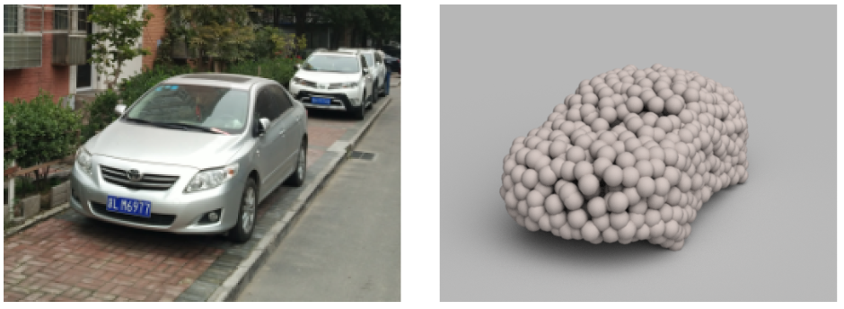

3D Deep Learning on Geometric Forms
Hao Su
Notes:
Thank you for the introduction! Hello everyone! Very glad to present my work here.
This talk has a focus on the exploration of 3D representations for neural networks, especially those that are natural for application tasks, but are unorthodox in the deep learning community.

Slide 2
Many 3D representations are available
Candidates:
  multi-view images
  depth map
  volumetric
  polygonal mesh
  point cloud
  primitive-based CAD models
Notes:
Unlike 2D images that have a dominate form of pixel arrays, 3D shapes have multiple candidates. For example, [read them]. We briefly go over them.

Slide 3
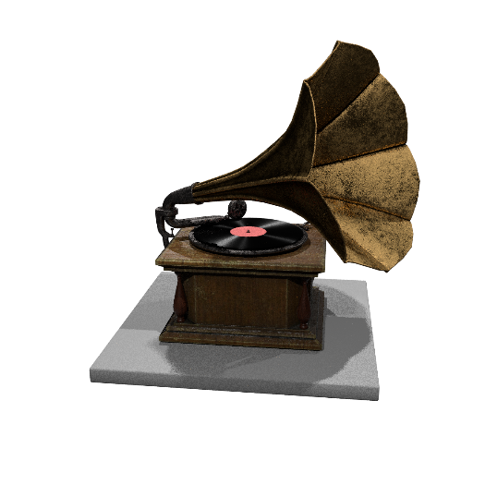
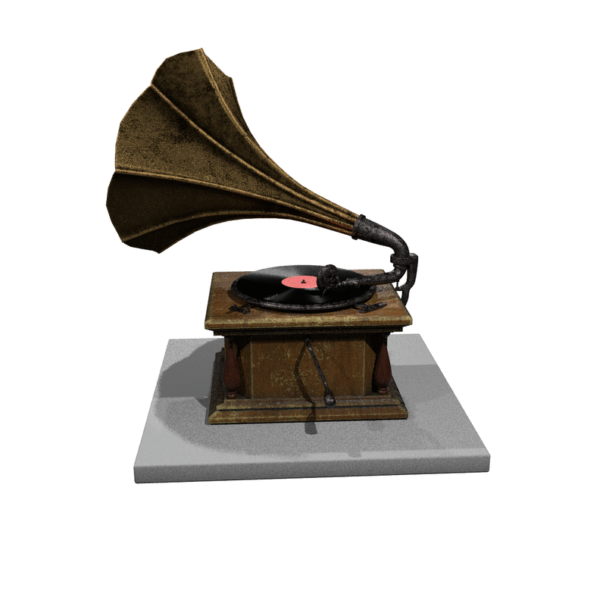
3D representation
Candidates:
  multi-view images
  depth map
  volumetric
  polygonal mesh
  point cloud
  primitive-based CAD models
Novel view image synthesis
[Su et al., ICCV15]
[Dosovitskiy et al., ECCV16]
Notes:
A 3D shape can be represented by a collection of images at different viewpoints. The 2D-3D lifting task can then be formulated as synthesizing novel views.

Slide 4

3D representation
Candidates:
  multi-view images
  depth map
  volumetric
  polygonal mesh
  point cloud
  primitive-based CAD models
Notes:
Depth map is a very common 3d representation

Slide 5
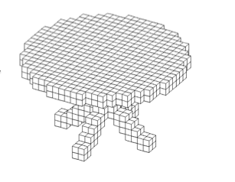
3D representation
Candidates:
  multi-view images
  depth map
  volumetric
  polygonal mesh
  point cloud
  primitive-based CAD models
Notes:
Volumetric representation encodes a shape as 3d volumetric occupancy

Slide 6
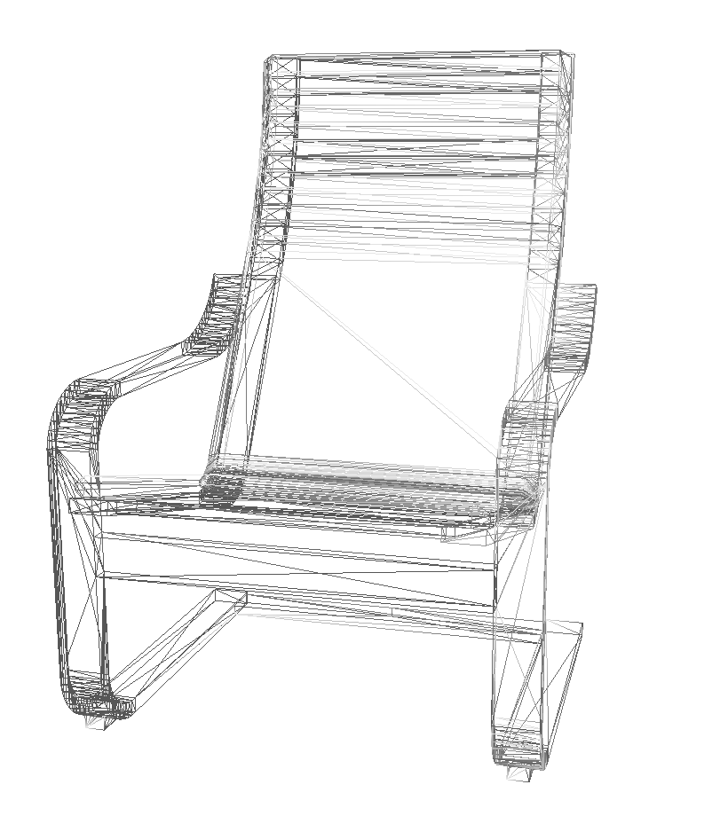
3D representation
Candidates:
  multi-view images
  depth map
  volumetric
  polygonal mesh
  point cloud
  primitive-based CAD models
Notes:
Polygonal mesh describes a shape by a set of polygonal faces.

Slide 7
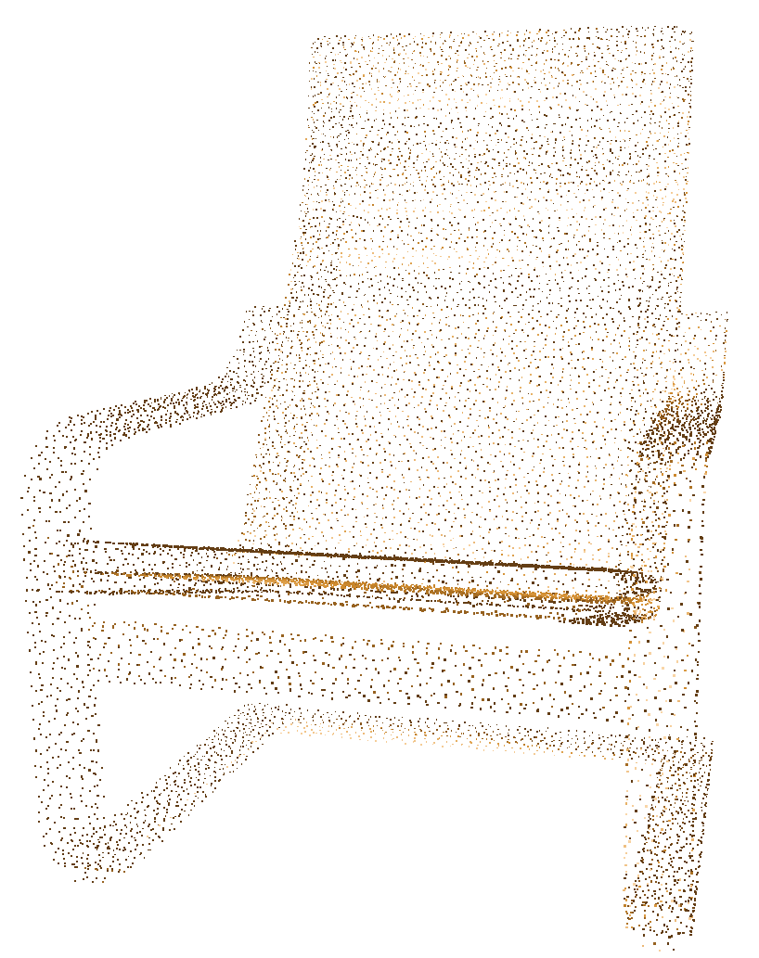
3D representation
Candidates:
  multi-view images
  depth map
  volumetric
  polygonal mesh
  point cloud
  primitive-based CAD models
Notes:
Point cloud represents shapes as a collection of unordered 3d coordinates.

Slide 8
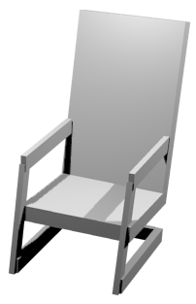
3D representation
Candidates:
  multi-view images
  depth map
  volumetric
  polygonal mesh
  point cloud
  primitive-based CAD models
a chair assembled by cuboids
Notes:
Primitive-based CAD models use simple geometry such as cuboids and cylinders to assemble 3d shapes.

Slide 9
Two groups of representations
Candidates:
  multi-view images
  depth map
  volumetric
  polygonal mesh
  point cloud
  primitive-based CAD models
Rasterized form
(regular grids)
Geometric form
(irregular)
Notes:
In general, these 3d representations can be divided into two families– the rasterized form as regular grids, and the geometric form, which lacks canonical and regular structures.

Slide 10
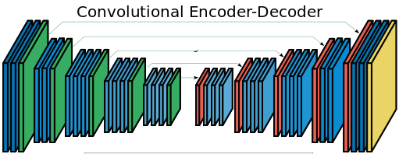
Extant 3D DNNs work on grid-like representations
Candidates:
  multi-view images
  depth map
  volumetric
  polygonal mesh
  point cloud
  primitive-based CAD models
Notes:
Almost all existing research in deep learning community focus on the representations in the first family, because the techniques developed for image generation can be directly transferred. Indeed, great progress has been made recently. However, a number of issues do persist for these grids representations.

Slide 11
Ideally, a 3D representation should be
Friendly to learning
  easily formulated as the input/output of a neural network
  fast forward-/backward- propagation
  etc.
Notes:
Before discussing these issues, let’s first think a bit more deeply and imagine what an ideal 3D representation should be.
First, it should be easy to be learned. In the context of neural network, it should be easily formulated as the output of a network, and to compute that, the involved operations should be efficient.

Slide 12
Ideally, a 3D representation should be
Friendly to learning
  easily formulated as the input/output of a neural network
  fast forward-/backward- propagation
  etc.
Flexible
  can precisely model a great variety of shapes
  etc.
Notes:
Second, they need to be flexible so that a great variety of shapes can be represented.

Slide 13
Ideally, a 3D representation should be
Friendly to learning
  easily formulated as the output of a neural network
  fast forward-/backward- propagation
  etc.
Flexible
  can precisely model a great variety of shapes
  etc.
Geometrically manipulable for networks
  geometrically deformable, interpolable and extrapolable for networks
  convenient to impose structural constraints
  etc.
Others
Notes:
Third, at a collection level, natural shapes under the representations should form a nice structured shape space, so that it should be easy to conduct geometric operations such as deformation, interpolation, extrapolation; and convenient to impose structural constraints.

Slide 14







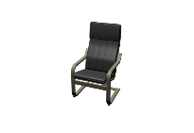











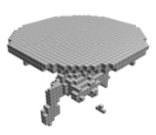
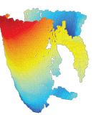
The problem of grid representations
 | Affability to learning | Flexibility | Geometric manipulability
Multi-view images
Volumetric occupancy | Expensive to compute: O(N³)
Depth map |  | Cannot model “back side”
Notes:
Verifying grid representations by these criterion, a number of issues reveal. For example, it would be computationally expensive to predict volumes of high spatial resolution, depth maps cannot model the back side of an object. More generally, those grid representations do not induce a structured shape space.

Slide 15
Typical artifacts of volumetric reconstruction
Missing or extra thin structures
Volumes are hard for the network to rotate / deform / interpolate
Notes:
In practice, we do observe problems. Take volumetric reconstruction as an example. Here, voxel occupancies are predicted independently. The outcome often misses thin structures, or contains flying voxels. In fact, volumetric representation obscure the natural invariance when it comes to geometric transformations and manipulations. Think a bit and you find it is not easy to build convolutional kernels to rotate/deform/interpolate a shape.

Slide 16

Learn to analyze / generate Geometric Forms?
Candidates:
  multi-view images
  depth map
  volumetric
  polygonal mesh
  point cloud
  primitive-based CAD models
Rasterized form
(regular grids)
Geometric form
(irregular)
Notes:
How about those geometric forms. Historically, these representations have almost never been used as the output in the deep learning community. We give them a try, focusing on point cloud and primitive-based CAD models.

Slide 17
Outline
Motivation
3D point cloud / CAD model reconstruction
3D point cloud analysis, e.g., segmentation
Notes:
Let’s first explore to reconstruct an object by point clouds.

Slide 18

3D perception from a single image
Notes:
The It is fascinating to ask, how humans infer and represent the 3D world in their mind? In fact, humans are so good at inferring 3D from even a single image. Look at this picture, you can’t help but worry for the boy.

Slide 19
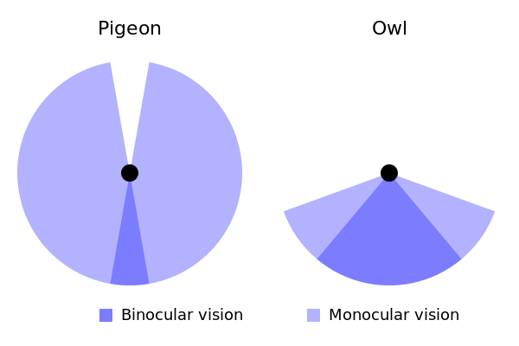
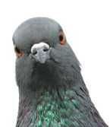
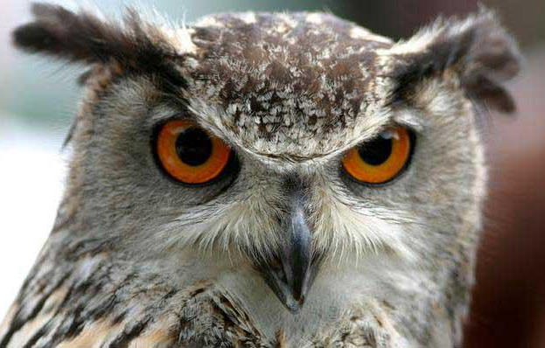
Monocular vision
a typical prey
a typical predator
Cited from https://en.wikipedia.org/wiki/Binocular_vision
Notes:
What is binocular vision for? A birds' eye view
In biology, monocular vision plays an important role for many animals, especially for preys. For example, for a pigeon, the visual fields of its eyes only have about 10-15 deg of overlap.

Slide 20
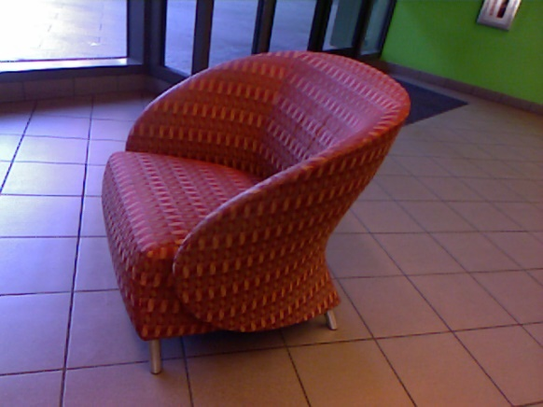
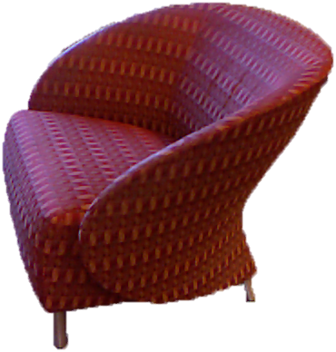


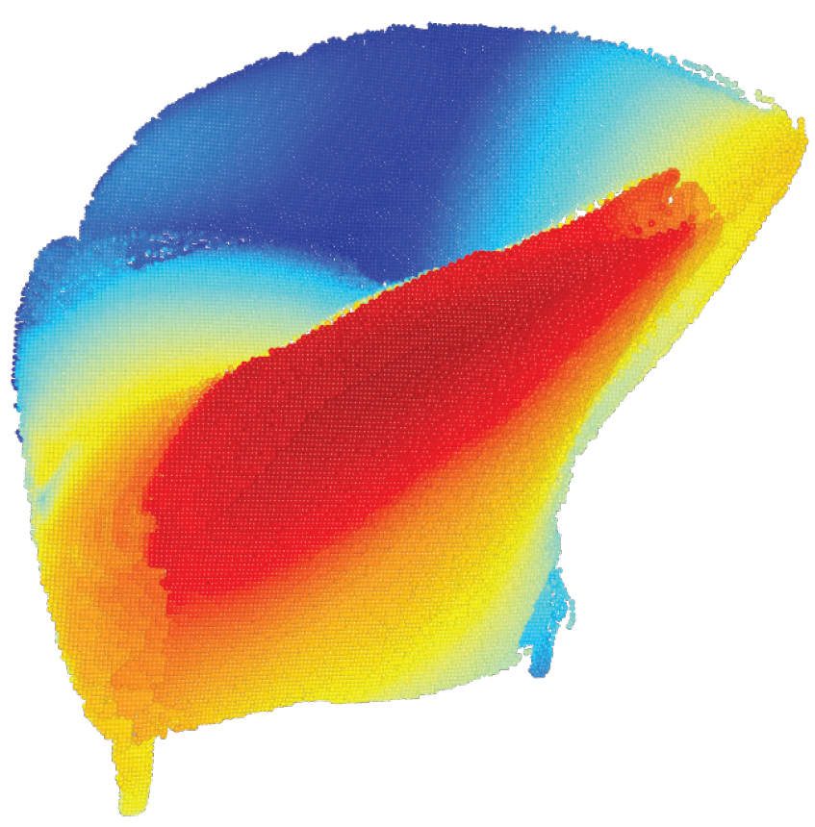
Visual cues are complicated
contrast
color
texture
motion
symmetry
part
category-specific 3D knowledge
……
Notes:
But how can we teach computers to do the same? 3D understanding involves many cues, like contrast, color, motion.
For the task of 2D to 3D lifting, for example, 3D reconstruction, explicitly modeling them all are computationally very challenging, as evidenced by the research of past decades.

Slide 21
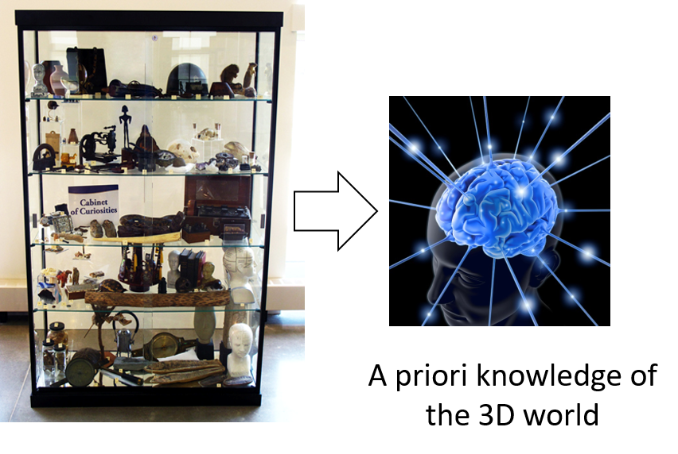
Data-driven 2D-3D lifting
Cabinet of things
Notes:
Inspired by the success of machine learning approaches, we attempt a data-driven strategy for the 2D-3D lifting task. Essentially, we show our algorithms a large variety of 3D shapes, in the hope that it learns the prior of 3d shapes.

Slide 22
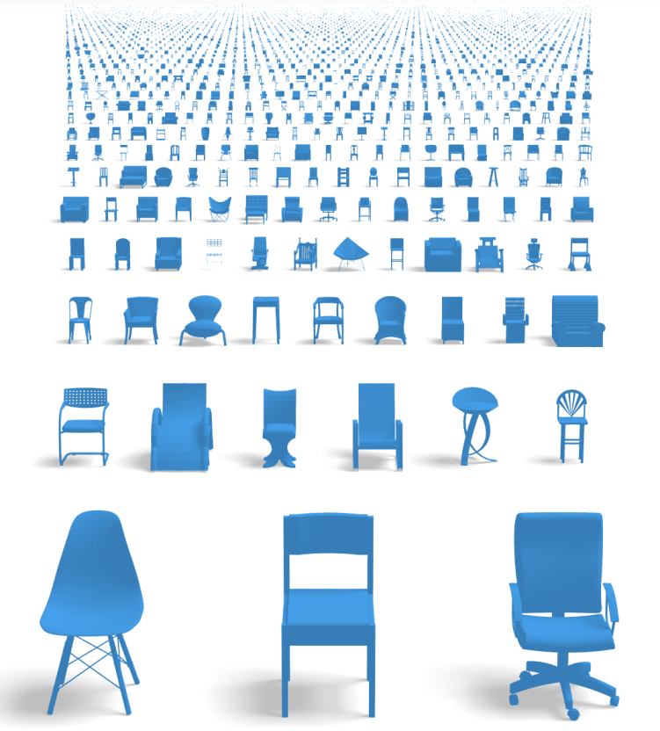
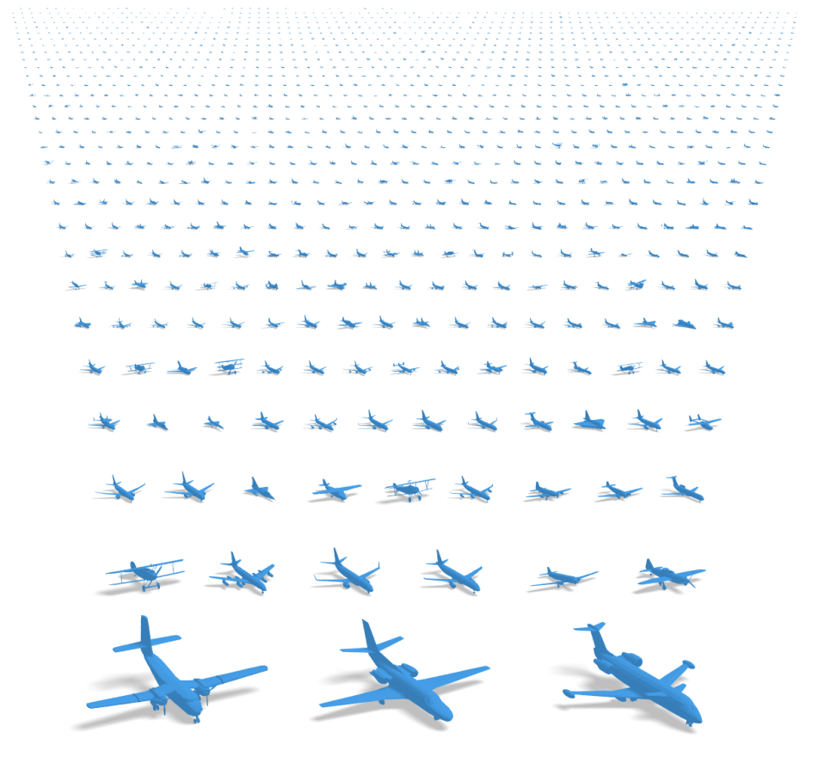
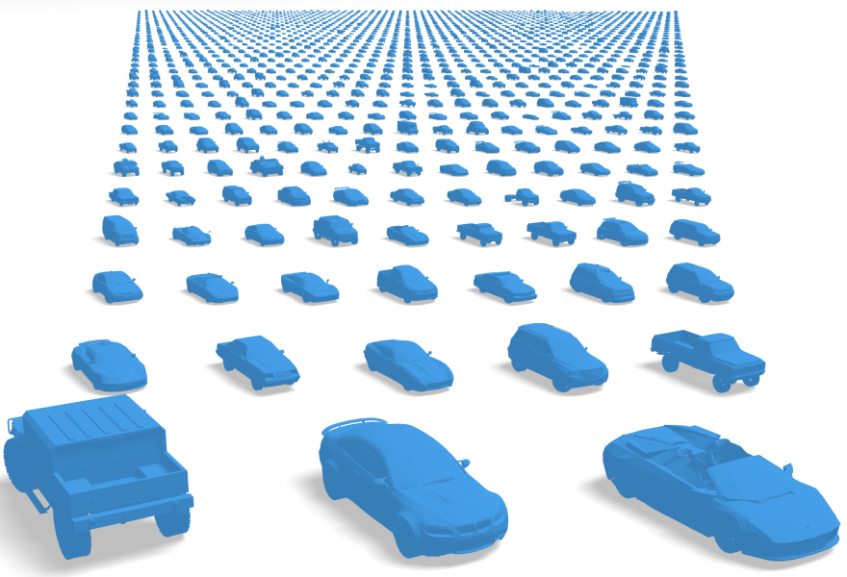
ShapeNet: a large-scale 3D datasets of objects
…
~3 million models in total
~2,000 classes
Rich annotations
(in progress)
Notes:
Towards this goal, I construct of a large-scale 3D shape database, named ShapeNet. The current version of ShapeNet covers most daily man-made objects, from indoor to outdoor.

Slide 23
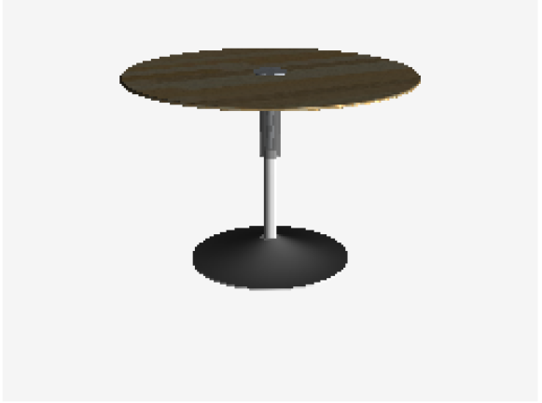
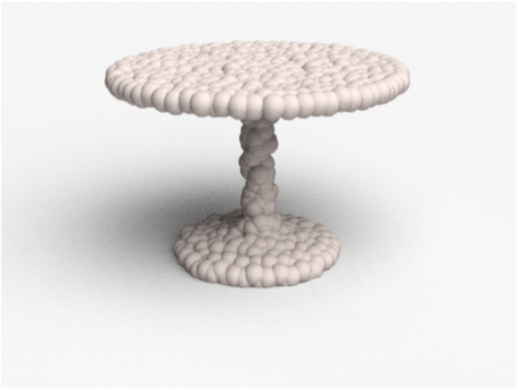
3D point clouds
A dual formulation of occupancy
Flexibility
Geometric manipulability
Affability to learning
Eulerian
Lagrangian
Prob. distribution
Particle filters
Volumetric
occupancy
Point
clouds
Notes:
Judged by the criterion we discussed before, point cloud is obviously a flexible representation. In practice, we find that a few thousand of points can well capture the basic shape of many objects. This figure contains 1000 points.

Slide 24
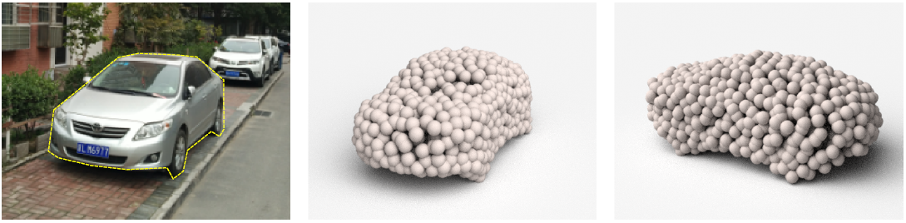
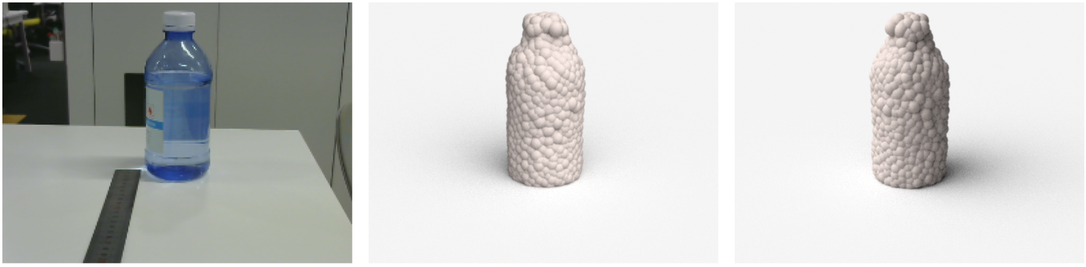
Result: 3D reconstruction from real Images
Input
Reconstructed 3D point cloud
Notes:
Let me show you some results of 3d reconstruction from two real images, given by our algorithm. On the top is a reconstructed car of point clouds, viewed from two perspectives, the observed view and 90 degree. Our system is trained with car models and images. Obviously, the outcome captures the basic structure.

Slide 25
Result: 3D reconstruction from real Images
Input
Reconstructed 3D point cloud
Notes:
It has also reasonably hallucinated the invisible parts.
On the bottom there is a triangular pyramid for traffic. Interestingly, we do not train our system with objects from this category. Yet our system is still able to reconstruct its shape correctly, and the reconstruction has rather reasonable symmetry structure.
Next we explain how we achieved it.

Slide 26
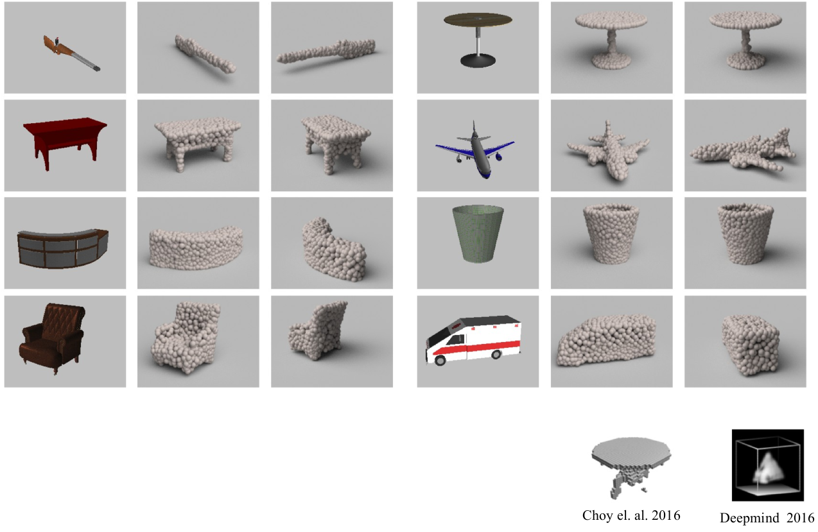
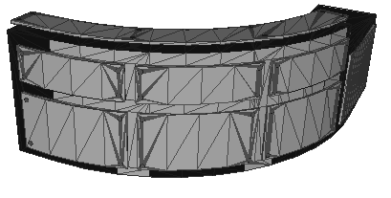
An end-to-end synthesis-for-learning system
Image
rendering
sampling
3D model
Groundtruth point cloud
Notes:
We build an end-to-end learning system but train it using synthetic data. For each 3D model in our shape repository, we render many images and sample point clouds at the corresponding view. Therefore, we can conduct supervised learning. The groundtruth point cloud is a set of 3D coordinates. Note that those points are unordered.

Slide 27
An end-to-end learning system
Image
Predicted set
Deep Neural Network
Groundtruth point cloud
Notes:
We design a neural network to predict a set of unordered points.

Slide 28
An end-to-end learning system
Image
Predicted set
Deep Neural Network
Point Set
Distance
Groundtruth point cloud
Notes:
Then we design a loss function to compare the two set of points. Some point set distance metric would have to be used.

Slide 29
An end-to-end learning system
Image
Predicted set
Deep Neural Network
Point Set
Distance
Groundtruth point cloud
Notes:
Let’s start from network architecture.

Slide 30
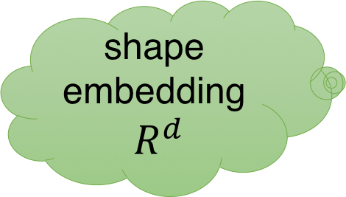
Network architecture: Vanilla version
Fully connected layer as predictor in standard classification network
conv
fully connected
Encoder
input
shape embedding
$R^{d}$
point
set
Predictor
Notes:
A straight-forward idea is to follow the standard architecture as in CNN. First we run an encoder to map an image to a space of shape embedding. Assume it is $d$ dimensional.

Slide 31



Network architecture: Vanilla version
Fully connected layer as predictor in standard classification network
conv
fully connected
Encoder
input
shape embedding
$R^{d}$
point
set
Predictor
$$d$$
$$R^{d}$$
Independently regress n*3 numbers from :
$$n×3$$
Notes:
Then we use a fully connected layer to regress all point coordinates. Essentially, you multiple the d-dimensional shape embedding vector by a weight matrix of n times 3 rows and d columns. Note that there is no explicit relations among the rows of this matrix, therefore, all points are predicted independently. This architecture works reasonably well in practice; however, it does not fully utilize the underlying structures of our training data.

Slide 32
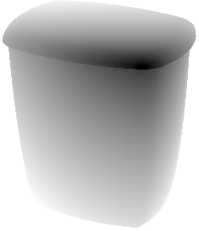
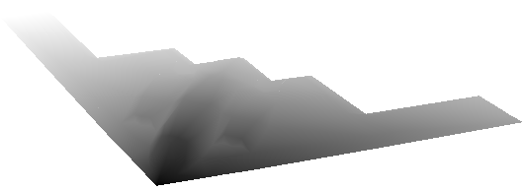
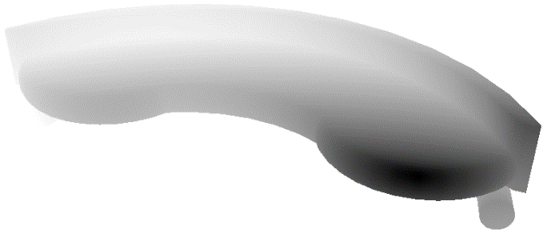
Natural statistics of geometry
Many objects, especially man-made objects, contain large smooth surfaces
Deconvolution can generate locally smooth textures for images
Notes:
In reality, we observe that there is natural statistics of geometry. For example, many objects contain large and smooth surfaces. On these surfaces, the coordinates of points change slowly. If we capture such statistics, we may do better.
Well, in image synthesis problems, people find that the deconvolution operation can better exploit local statistics. So we adopt this operation.

Slide 33


Network architecture: Output from deconv branch
Two branch version
conv
deconv
fully connected
set union
input
Encoder
point
set
$n_{1}$=24*32=768 points
Predictor
$n_{2}$=256 points
3-channel map of XYZ coordinates
Notes:
We add a deconvolution branch to our predictor. Through deconvolution operations, we generate a 3-channel map of XYZ coordinates from the shape embedding. Suppose we build an H times W coordinate map, then we collect H times W points. This set of points is merged with those predicted by the fully connected layer as the whole point set. Because deconvolution operation shares weights, it exploits local statistics better and also saves network parameters.

Slide 34

Network architecture: Output from deconv branch
Two branch version
conv
deconv
fully connected
set union
input
Encoder
point
set
$n_{1}$=24*32=768 points
Predictor
$n_{2}$=256 points
3-channel map of XYZ coordinates
Notes:
We visualize what’s learned by the deconvolution branch through an example. For this gun, the deconvolution branch predicts smooth varying coordinate maps, which correspond to gradually moving points on the shape.

Slide 35
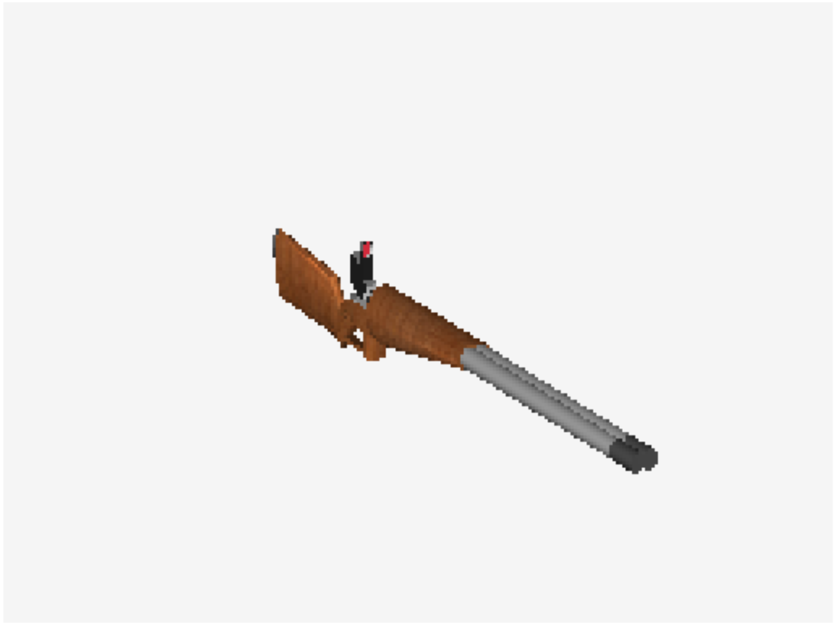
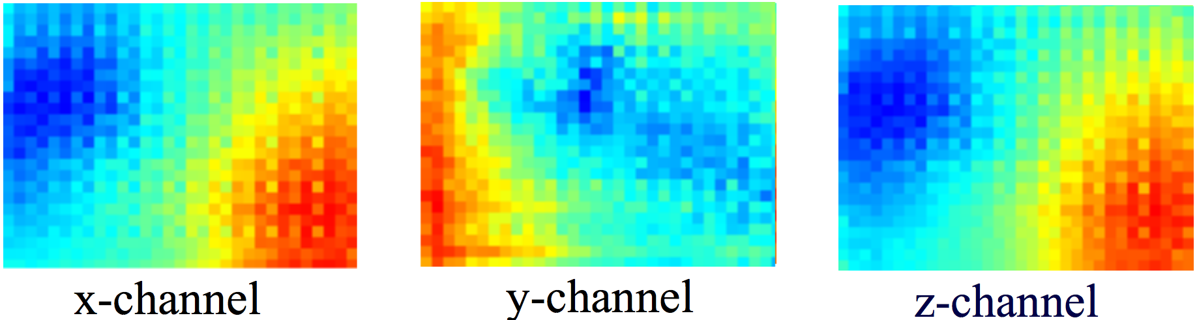
Network architecture: Output from deconv branch
Two branch version
conv
deconv
fully connected
set union
input
Encoder
point
set
$n_{1}$=24*32=768 points
Predictor
$n_{2}$=256 points
3-channel map of XYZ coordinates
Notes:
We visualize what’s learned by the deconvolution branch through an example. For this gun, the deconvolution branch predicts smooth varying coordinate maps, which correspond to gradually moving points on the shape.

Slide 36
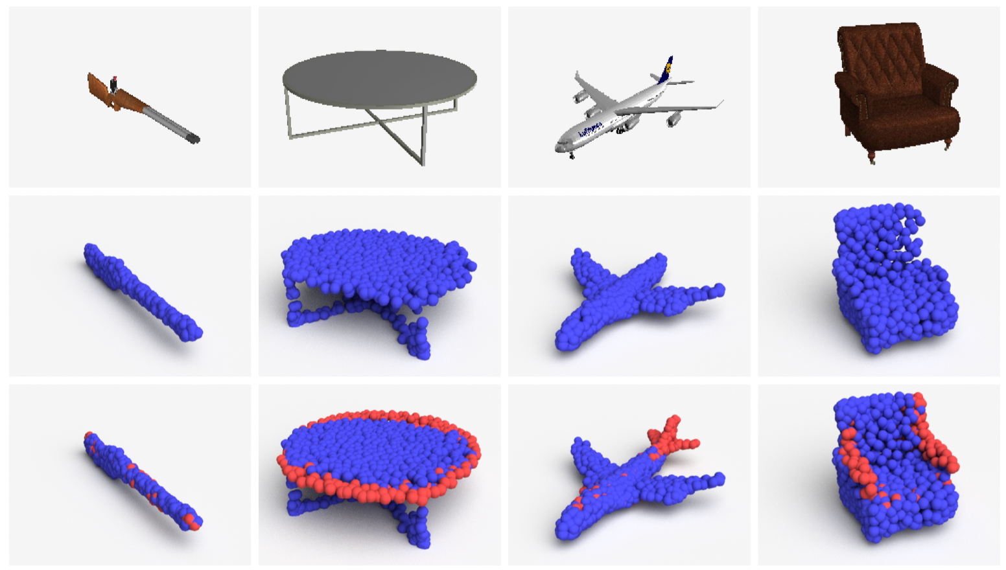
Network architecture: The role of two branches
blue: deconv branch – large, consistent, smooth structures
red: fully-connected branch – flexibly reconstruct intricate structures
Notes:
Here, we further compare the roles of the two branches. Blue points are predicted by the deconvolution branch, usually spread at large and smooth structures shared by many object instances; whereas red points are predicted by the fully connected branch, they serve as commandos to flexibility create those intricate and individual structures. Therefore, by keeping the two branches simultaneously, we model objects flexibly and efficiently. Note that the division of labor is learned by the network, not enforced explicitly.

Slide 37
An end-to-end learning system
Predicted set
Deep Neural Network
Point Set
Loss
Groundtruth point cloud
Notes:
Next we discuss the design of loss function. Our loss function is some distance metric between point sets.

Slide 38
Distance metrics between point sets
Given two sets of points, measure their discrepancy
Notes:
Given two sets of points, a distance metric measures their discrepancy.

Slide 39
Common distance metrics
Worst case: Hausdorff distance (HD)
Average case: Chamfer distance (CD)
Optimal case: Earth Mover’s distance (EMD)
Notes:
To set up the background, we go over a few common distance metrics.

Slide 40
Common distance metrics
Worst case: Hausdorff distance (HD)
A single farthest pair determines the distance.
In other words, not robust to outliers!
Notes:
A popular choice is the Hausdorff distance. Each point finds its nearest neighbor in the other set. We take the maximum of this nearest neighbor distance across all points. This is a worst case set comparison. For this distance, a single farthest pair can totally determine it, thus it is not robust to outliers.

Slide 41
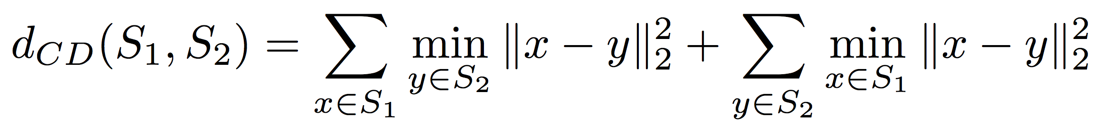
Common distance metrics
Worst case: Hausdorff distance (HD)
Average case: Chamfer distance (CD)
Average all the nearest neighbor distance by nearest neighbors
Notes:
If you take the mean over all nearest neighbor distances, you get the Chamfer distance. It is more robust to outliers.

Slide 42
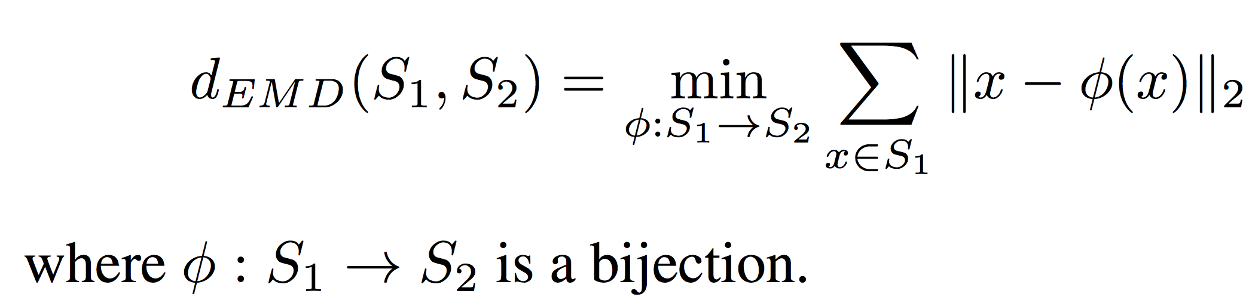
Common distance metrics
Worst case: Hausdorff distance (HD)
Average case: Chamfer distance (CD)
Optimal case: Earth Mover’s distance (EMD)
Solves the optimal transportation (bipartite matching) problem!
Notes:
A third metric is the Earth Mover’s distance. Here you solve an optimization problem and find the minimal cost to transport one set of points to the other set.

Slide 43
Required properties of distance metrics
Geometric requirement
  Induces a nice shape space
  In other words, a good metric should reflect the natural shape differences
Computational requirement
  Defines a loss that is numerically easy to optimize
Notes:
So, which one to choose? To be used as a loss function and guide neural network learning, the distance metric has to meet two types of requirements, geometric requirement and computational requirement.
Geometrically, a distance metric has to induce a nice shape space. In other words, a good metric should reflect the natural shape differences. Computationally, it should define a loss that is numerically friendly.

Slide 44
Required properties of distance metrics
Geometric requirement
  Induces a nice shape space
  In other words, a good metric should reflect the natural shape differences
Computational requirement
  Defines a loss that is numerically easy to optimize
Notes:
We first discuss the geometric requirement.

Slide 45
How distance metric affects the learned geometry?
A fundamental issue: there is always uncertainty in prediction
By loss minimization, the network tends to predict a “mean shape” that averages out uncertainty in geometry
Notes:
So how does a distance metric affects the learned geometry by neural networks? We have to realize a fundamental issue: there is always uncertain in the prediction by neural networks. By loss minimization, the network tends to predict a “mean shape” that averages out uncertainty in geometry.

Slide 46
How distance metric affects the learned geometry?
A fundamental issue: there is always uncertainty in prediction, due to
  limited network ability
  Insufficient training data
  inherent ambiguity of groundtruth for 2D-3D dimension lifting
  etc.
By loss minimization, the network tends to predict a “mean shape” that averages out uncertainty in geometry
Notes:
The source of uncertainty can be involved, but one issue needs further attention, that there is the inherent ambiguity of groundtruth for the problem of 2D-3D dimension lifting.

Slide 47
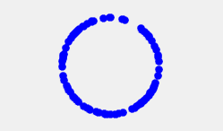
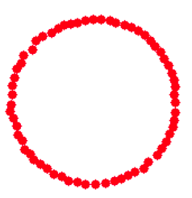
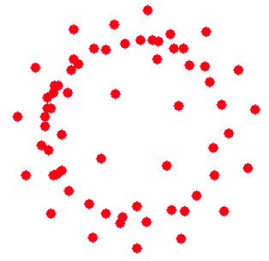
Mean shapes are affected by distance metric
The mean shape carries characteristics of the distance metric
continuous
hidden variable
(radius)
Input
EMD mean
Chamfer mean
Notes:
So, a distance metric affects the mean shape when there is uncertainty. Let’s take a look at some synthetic data and get some sense. On the top there is a circle, whose radius is sampled uniformly from 0 to 1, now we find a point cloud corresponding to the mean circle that closest to them all by optimization, using the distance metric. EMD gives nice result, but Chamfer gives a splashy result. This is because EMD solve the correspondence better than Chamfer.

Slide 48
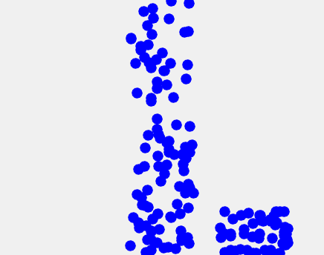
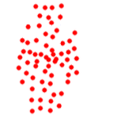
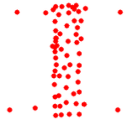
Mean shapes from distance metrics
The mean shape carries characteristics of the distance metric
continuous
hidden variable
(radius)
discrete
hidden variable
(add-on location)
Input
EMD mean
Chamfer mean
Notes:
A second example contains discrete uncertainty. The add-on appears randomly at four corners. This time, however, the output from EMD is considerably distorted, while Chamfer gives reasonable guess. In this scenario, the correspondence from Chamfer is in fact better.

Slide 49
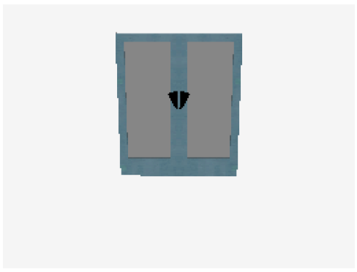
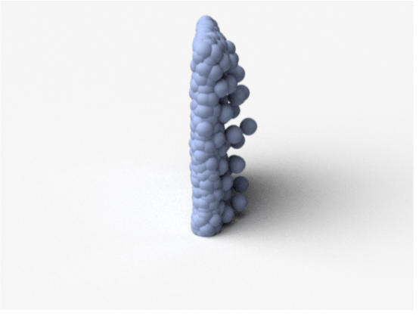
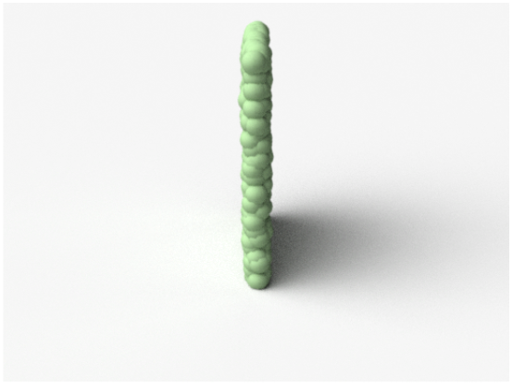
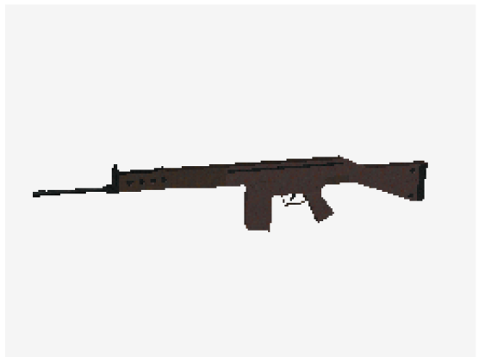
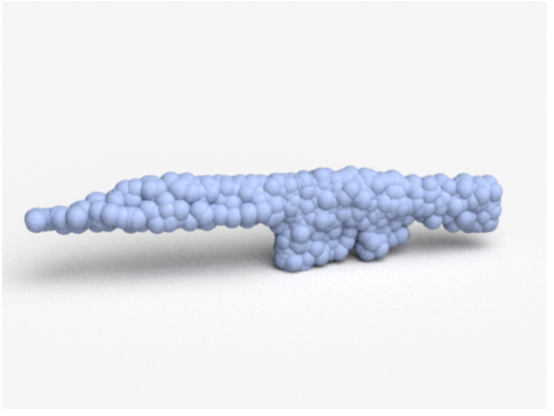
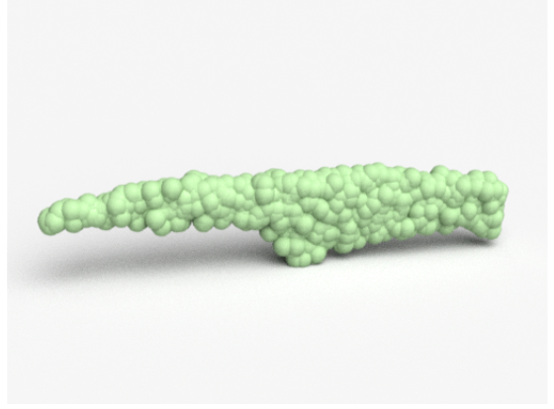
Comparison of predictions by CD versus EMD
Input
Chamfer
EMD
Notes:
If we plug Chamfer or EMD as a loss function, we can reconstruct 3D point clouds. We visually compare the 3D reconstruction results from Chamfer and EMD. For the door above, EMD actually predicts the backside very nicely. For the rifle below, it turns out that the Chamfer captures there are two protrusions; while the EMD overly smooth out the handle part.

Slide 50
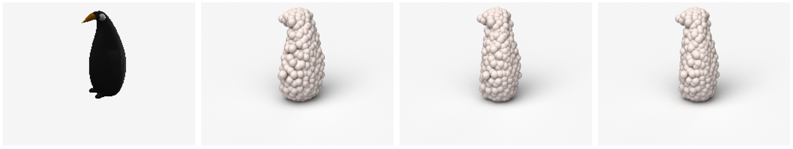
Lower prediction uncertainty, better mean shapes
Can we reduce prediction uncertainty by
factoring out the inherent ambiguity of groundtruth?
Input
Possible observations from a novel viewpoint
Notes:
As we have argued, lower prediction uncertainty will reduce the challenge in computing the mean shape. In order to produce higher quality predictions, we do hope to further reduce the possible uncertainty. To address network inability, we should improve the architecture; to overcome the insufficient training data, we should collect more data. How about the inherent ambiguity of the groundtruth? Can we factor it out?

Slide 51
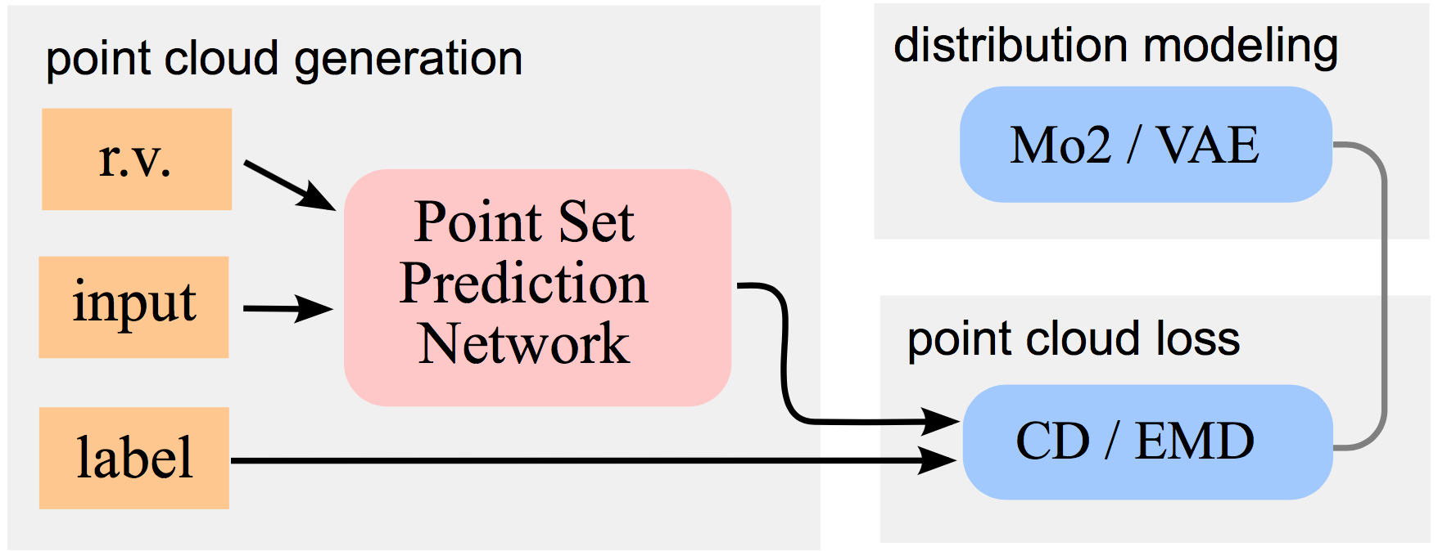

Predict multiple candidates
Build a conditional shape sampler
- $r$ is a random variable to perturb input
- Can navigate the groundtruth distribution
Can be trained by conditional VAE or our MoN loss
Notes:
The idea is to build a conditional shape sampler. We augment our network to take an additional input, a random variable r, which perturbs the input image I. We hope that this random variable will help to navigate the groundtruth distribution. This conditional shape sampler can be trained by variational autoencoder or our min-of-N loss. Since this deviates from today’s theme of 3D representations, I am not diving deep into it. We can discuss offline if you are interested.

Slide 52

Multiple plausible 3D shape predictions
45 deg
side view
Notes:
But I will show you some results. On the top we predict multiple 3D point cloud for a penguins, each has different fitness. On the bottom we predict a faucet, each has different length of the pipe.

Slide 53
Required properties of distance metrics
Geometric requirement
  Induces a nice shape space
  In other words, a nice metric should reflect the natural shape difference
Computational requirement
  Defines a loss function that is numerically easy to optimize
Notes:
Next we discuss the computation requirement. Basically, we hope that the loss functions are numerically easy to optimize.

Slide 54
Computational requirement of metrics
To be used as a loss function, the metric has to be
Differentiable with respect to point locations
Efficient to compute
Notes:
Essentially, the metric has to be differentiable with respect to point locations and efficient to compute.

Slide 55
Computational requirement of metrics
Differentiable with respect to point location
Chamfer distance
Earth Mover’s distance
Simple function of coordinates
In general positions, the correspondence is unique
With infinitesimal movement, the correspondence does not change
Conclusion: differentiable almost everywhere
Notes:
It is not hard to see, both Chamfer and EMD are simple functions of coordinates. For two sets of points generated uniformly, the correspondence is unique and does not change with infinitesimal movement of points. So, it is differentiable almost everywhere.

Slide 56
Computational requirement of metrics
Efficient to compute
Chamfer distance: trivially parallelizable on CUDA
Earth Mover’s distance:
Use coarse-to-fine approximation algorithm (Bertsekas, 1985)
Quite good approximation ratio
Parallelizable
Notes:
And for computation efficiency, they are both parallelizable. In particular, for earth mover’s distance, the efficiency is a bit of issue. We implement an approximation algorithm of (1+epsilon) approximation ratio. At runtime, we allocate a fixed amount of time for each minibatch.

Slide 57
Training
Implemented in TensorFlow (python)
Converge in ~2 days (the two branch version)
Trained on 4 GPUs in parallel
Training data rendered from 220K shapes in ShapeNet, covering ~2K categories
…
Notes:
The system is implemented in TensorFlow by python, and converges in 2 days. All our shapes are rendered from 200K shapes in ShapeNet.

Slide 58
More Results
Notes:
OK. Relax time, we see some results.

Slide 59

More visual results
Good symmetry
View 1
View 2
Input
Prediction
Notes:
We pick a few and look more closely. Looking from different viewpoints, the predicted object is rather symmetric.

Slide 60

More visual results
Good details
View 1
View 2
Input
Prediction
Notes:
Many details, like the engines and the rear wings, can be predicted.

Slide 61



Real-world results
input
observed view
$${90}^{∘}$$
input
observed view
$${90}^{∘}$$
Out of training categories
Notes:
Now we look at our real world results. It is interesting to see that they all perform reasonably well. What I like most are the two toys. The general structure is also correctly predicted.

Slide 62

Comparison with state-of-the-art (volumetric)
Notes:
Lastly we compare with state-of-the-art from volumetric predictions. Here are some cherry-picked illustrations but are typical. In general, our results are better at preserving the global structures.

Slide 63
Comparison with state-of-the-art (volumetric)
Error metric: Chamfer Distance
0.08
3D-R2N2
Ours
Ideal
(volumetric)

Slide 64

Shape completion from depth map

Slide 65
How about learning to predict geometric forms?
Candidates:
  multi-view images
  depth map
  volumetric
  polygonal mesh
  point cloud
  primitive-based CAD models
Rasterized form
(regular grids)
Geometric form
(irregular)
Notes:
Here, we study how use a neural network to generate primitive-based CAD models.

Slide 66














Primitive-based assembly
  We learn to predict a corresponding shape composed by primitives.
  It allows us to predict consistent compositions across objects.
Notes:
Given a collection of 3D shapes represented as polygonal meshes, we learn to abstract them. Here, abstracting a mesh means to predict a corresponding shape composed by primitives, such as cuboids. In addition, we require the configuration of primitives to be consistent across shapes. This way we also obtain part-level correspondences. For example, all chair backs are colored by green; and all animal heads are colored by red.

Slide 67

Unsupervised parsing
Each point is colored according to the assigned primitive
Notes:
By back projection our cuboids on shapes, we also obtain an unsupervised parsing of meshes.

Slide 68

Approach – predict a high-dimensional point set
  Primitive parameters as a point: size, rotation, translation of M cuboids.
  Variable number of parts? We predict “primitive existence probability”
Notes:
Here, given a mesh, we first convert it to a volumetric representation. Then we predict M cuboids, each parameterized by size, rotation and translation.
Recall our point cloud generation network. Here, you may think that each primitive is a high-dimensional point, whose dimensions correspond to those primitive parameters.

Slide 69




Loss function
Loss
Notes:
From the predicted primitive parameters we can assemble a shape. But we have to compare this shape with the polygonal mesh form. How do we design a good loss for this comparison?

Slide 70
Loss function construction
Basic idea: Chamfer distance!
Notes:
The basic idea is not that different from before! We’ve learned Chamfer distance. Now we want to use it again compare two surfaces!

Slide 71
Loss function construction
Sample points on the groundtruth mesh and predicted assembly
Each point is a linear function of mesh/primitive vertex coordinates
Differentiable!
Notes:
We can sample a finite set of points from the surfaces and compute the Chamfer distance. Because a sampled point is just a linear interpolation of face vertices, it does not affect the differentiability.

Slide 72
Loss function construction
Sample points on the groundtruth mesh and predicted assembly
Each point is a linear function of mesh/primitive vertex coordinates
Differentiable!
Speed up the computation leveraging parameterization of primitives
Notes:
In fact, we can speed up the computation leveraging the parameterization of primitives.

Slide 73
Consistent primitive configurations
Primitive locations are consistent due to
the smoothness of primitive prediction network
Notes:
We observe consistent distribution of primitives. The explanation is simple. Each primitive prediction network is a smooth function. Due to its smoothness, it tends to predict that primitives around similar locations in different shapes. It is a natural way to induce consistency.

Slide 74

Unsupervised parsing
Mean accuracy (face area) on Shape COSEG chairs.
Notes:
We ask humans to annotate shapes by parts and check the consistency of our parsing versus human annotations. Measured by face area, we surpass state-of-the-art methods. In fact, we achieve near 90% accuracy, indicating a semantically meaningful parsing.

Slide 75
















Image-based modeling
Notes:
We can even conduct some naïve image-based shape modeling. We train a mapping from images to the shape embedding.

Slide 76
Outline
Motivation
3D point cloud / CAD model reconstruction
3D point cloud analysis
Notes:
Above we have explored the generation of 3D forms. Given the rest of the time, I am showing you very briefly how to analyze 3D points.

Slide 77
Deep Learning on Point Sets
Notes:
The input to our network is a set of points, for example, 3D coordinates. They are unordered. The number of points can also be flexible. The output can be an object label, or a per-point label. For example, the part label for an object, or the object label for a scene.
The key technical challenge here is how we deal with the order invariance of points in the input set. If a network is invariant to input order of points, it can be very variable for applications such as online scanning.

Slide 78
Deep Nets for Unordered Point Set Input
Idea 1: Sort the input
No canonical order in high dim space..
Use lexsort, sort by multiple keys, 1st dim then 2nd dim, 3rd dim
(1,2,3)
(1,1,1)
(2,3,2)
(2,3,4)
(1,1,1)
(1,2,3)
(2,3,2)
(2,3,4)
FCs

Slide 79
Deep Nets for Unordered Point Set Input
Idea 2: Sequential model (RNN/GRU/LSTM)
LSTM
LSTM
LSTM
LSTM
FCs
FCs
FCs
FCs
FCs
(1,2,3)
(1,1,1)
(2,3,2)
(2,3,4)
Order Matters!
Order Matters: Sequence to Sequence for sets by Oriol Vinyals et al.

Slide 80
PointNet: deep net for unordered point set input
Idea 3: Use symmetry function
E.g. max, sum, weighted sum, L-norm, histogram, polynomial etc.
Notes:
We theoretically and experimentally checked the effectiveness of three strategies. We find that neither sorting nor training an RNN is a good option for this problem. Instead, we adopt a symmetry function based approach. So we aggregate information from independent points by a symmetry function.

Slide 81

Universal approximation to continuous set functions
Notes:
Theoretically, the symmetry function based design could approximate any set function that is continuous with respect to Hausdorff distance.

Slide 82
Robustness to data corruption
(on ModelNet40 classification benchmark)
Notes:
Compared with volumetric networks, the pointnet is surprisingly robust to data corruption. When there is no data corruption, the pointnet performs comparably to volumetric CNNs. But as the data corruption is getting worse and worse, there is a significant different between pointnet and volumetric CNN. Our pointnet loses its performance rather slowerly.

Slide 83
Partial object part segmentation
back
seat
legs
Notes:
Here are some representative examples. We see that objects are very incomplete, but the part segmentation still makes a lot of sense.

Slide 84
Visualization of what are learned, by reconstruction
A compact summarization of the input set. Saliency!
Notes:
We also visualize what the network has learned, similar to what people have done in diagnosing CNNs by reconstruction experiments. We find that the network actually has learned a compact summarization of the input point set, corresponding to salient areas.

Slide 85
To sum up
We explore geometric representations as input / output of networks
A space rich of open problems and opportunities
Papers:
  Hao Su*, Haoqiang Fan*, Leonidas Guibas, A Point Set Generation Network for 3D Object Reconstruction from a Single Image, arxiv
  Hao Su*, Charles Qi*, Kaichun Mo, Leonidas Guibas, PointNet: Deep Learning on Point Sets for 3D Classification and Segmentation, arxiv
  Shubham Tulsiani, Hao Su, Leonidas Guibas, Alexei Efros, Jitendra Malik, Learning Shape Abstractions by Assembling Volumetric Primitives, arxiv
Codes will be released soon!

Slide 86
Thank You!

