Slide 1
What Makes a Video a Video: Analyzing Temporal Information in Video Understanding Models and Datasets
De-An Huang, Vignesh Ramanathan, Dhruv Mahajan,
Lorenzo Torresani, Manohar Paluri, Li Fei-Fei, and Juan Carlos Niebles
Stanford University, Facebook

Slide 2
Videos Contain Much More Than Images
Source: YouTube
Image:
Video:
“a tiger attacking a person on a grass field”
“the tiger is being playful”

Slide 3
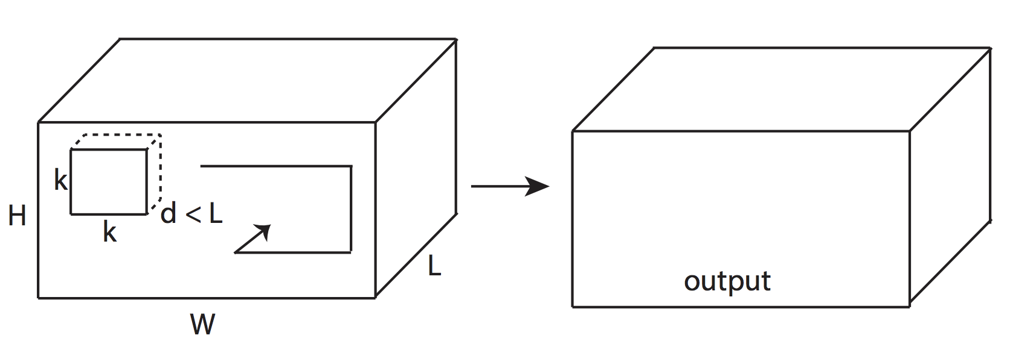
Temporal Modeling for Videos
Two-stream Networks
3D Convolution
Simonyan and Zisserman, NIPS 2014
B. Zhang et al., CVPR 2016
Feichtenhofer et al., CVPR 2017
…
Tran et al., ICCV 2015
Carreira and Zisserman, CVPR 2017
Qiu et al., ICCV 2017
…
Do these Models Really Capture Temporal Information?
Trajectory-based (iDT),
Recurrent Neural Networks…

Slide 4
Quantifying the Effect of Temporal Information
Conv 1
Conv 2
Conv 3
Conv 4
Conv 5
Test Video
C3D trained
on UCF101

Slide 5
Quantifying the Effect of Temporal Information
Conv 1
Conv 2
Conv 3
Conv 4
Conv 5
Frame
Selector
Remove Temporal Information
from Test Video
Middle
Frame
Temporal
Generator
Generated
Video
C3D trained
on UCF101
Test Video
?

Slide 6
Quantifying the Effect of Temporal Information
Conv 1
Conv 2
Conv 3
Conv 4
Conv 5
Frame
Selector
Remove Temporal Information
from Test Video
Middle
Frame
Temporal
Generator
Generated
Video
C3D trained
on UCF101
Test Video
?

Slide 7
Removing Temporal: Naïve Subsampling
Conv 1
Conv 2
Conv 3
Conv 4
Conv 5
Middle
Frame
Replicate
Frames
Test Video
Middle
Frame
Replicated
Frames
C3D trained
on UCF101

Slide 8
Removing Temporal: Naïve Subsampling
Conv 1
Conv 2
Conv 3
Conv 4
Conv 5
Middle
Frame
Replicate
Frames
Test Video
Middle
Frame
Replicated
Frames
C3D trained
on UCF101
Subsampling

Slide 9
Bridging the Temporal Distribution Shift
Conv 1
Conv 2
Conv 3
Conv 4
Conv 5
Middle
Frame
Middle
Frame
Temporal
Generator
Generated
Video
C3D trained
on UCF101
Test Video
Subsampling

Slide 10
Bridging the Temporal Distribution Shift
Conv 1
Conv 2
Conv 3
Conv 4
Conv 5
Middle
Frame
Middle
Frame
Temporal
Generator
Generated
Video
C3D trained
on UCF101
Test Video
Subsampling
Generator

Slide 11
Motion-Invariant Frame Selection
Conv 1
Conv 2
Conv 3
Conv 4
Conv 5
Frame
Selector
Selected
Frame
Temporal
Generator
Generated
Video
C3D trained
on UCF101
Test Video
Subsampling
Generator

Slide 12
Motion-Invariant Frame Selection
Conv 1
Conv 2
Conv 3
Conv 4
Conv 5
Frame
Selector
Selected
Frame
Temporal
Generator
Generated
Video
C3D trained
on UCF101
Test Video
6%
Subsampling
Generator
Selector

Slide 13
Upper Bound of Frame Selection
Conv 1
Conv 2
Conv 3
Conv 4
Conv 5
Oracle
Selector
Oracle
Frame
Temporal
Generator
Generated
Video
C3D trained
on UCF101
Test Video
Subsampling
Generator
Selector

Slide 14
Upper Bound of Frame Selection
Conv 1
Conv 2
Conv 3
Conv 4
Conv 5
Oracle
Selector
Oracle
Frame
Temporal
Generator
Generated
Video
C3D trained
on UCF101
Test Video
Subsampling
Generator
Oracle
Selector

Slide 15
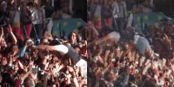
Conclusion
Video models do not see videos as we do
Temporal information in UCF101 C3D is bounded by 6%
Oracle key-frame can outperform full video
Come to our poster for more details!

