Slide 1
Planning, Running, and Analyzing Controlled Experiments on the Web
Part 2
Roger Longbotham,
Mgr Analytics, Experimentation Platform, Microsoft
Slides available at http://exp-platform.com

Slide 2
Planning and Analysis of Online Experiments
What to measure
How to compare Treatment to Control
How long to run test
Start up options
Good test design
Data validation and cleansing
Before your first experiment
Common errors
MultiVariable Tests

Slide 3
What to Measure
Start with objective
  Of the site (content, ecommerce, marketing, help/support,…)
  Of the experiment
What can you measure to tell you if you met your objective?
  Content site: clicks/user, pageviews/user, time on site
  Ecommerce: rev/visitor, units purchased/visitor, cart-adds/visitor
  Marketing: referrals/visitor, time on site
  Help/support: Pct of users engaged, Pct of users who print, email or download content, time on site

Slide 4
What to Measure
Measures of user behavior
  Number of events (clicks, pageviews, scrolls, downloads, etc)
  Time (minutes per session, total time on site, time to load page)
  Value (revenue, units purchased)
Experimental units
  Per user (e.g. clicks per user)
  Per session (e.g. minutes per session)
  Per user-day (e.g. pageviews per user per day)
  Per experiment (e.g. clicks per pageview)

Slide 5
Overall Evaluation Criterion
It is very helpful to have a single metric that summarizes whether the Treatment is successful or not – the Overall Evaluation Criterion, or OEC
Examples:
  Content site: OEC could be clicks/user or time on site
  Ecommerce: rev/user or lifetime value
  Help/support site: Survey responses or user engagement
OEC could also capture monetary value of the Treatment effect, aka ROI (return on investment)

Slide 6
Comparing Treatment to Control
Single Treatment
  Two-sample t test works well
    Large samples sizes => Normal distribution for means
    Calculate 95% Confidence Interval for difference in two means
    if zero not in the interval conclude Treatment mean different from Control
  May have many tests, OEC critical
Multiple Treatments
  Multiple applications of two-sample t test
  Analysis of Variance

Slide 7
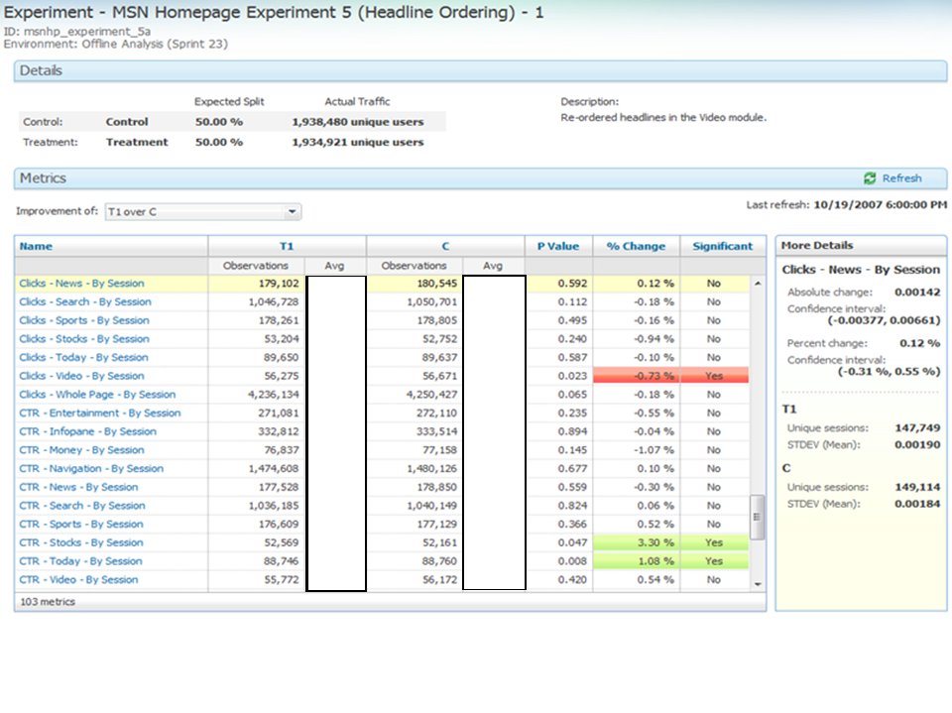
Sample UI for test results
Note:
Averages for
both variants
P-values
Percent change
Significance
Confidence
Intervals
103 metrics

Slide 8
Comparing Treatment to Control
P-value is the probability of getting a difference farther from zero than observed under assumption of no difference
CI for percent effect must use special formulas
Care must be taken in calculating standard deviations
  When randomization is by user, any metric that is not per user must take into account non-independence in calculating standard deviation
  We routinely use bootstrapping to estimate standard deviations

Slide 9
Power and Sample Size
The power of a test is the probability of detecting a difference (Δ) of a given size i.e., it is 1-Prob(Type II error)
Power depends on
  The size of effect you want to be able to detect, Δ
  Variability of the metric
  Number of users in each group (T/C)
It is typical to determine the sample size needed to achieve 80% power

Slide 10
Power and Sample Size
Example: Total number of users needed to achieve 80% power, with equal number of users in Treatment and Control and with standard deviation s is

Slide 11
Ramp up
Often good practice is to start with small percent in Treatment and increase when you have confidence Treatment is bug-free
Sample ramp up schedule:
  1% in Treatment for 4 hours
  5% in Treatment for 4 hours Ramp-up period
  20% in Treatment for 4 hours
  50 % in Treatment for 14 days

Slide 12
Simpson’s Paradox
Beware Simpson’s paradox when percent in Treatment changes
Example: data generated for 7day test with Treatment mean 5% higher than Control mean each day.
First 5 days Treatment had 20% of visitors/day (100,000 visitors/day)
Last 2 days Treatment had 50% of visitors (100,000/day)
(Assume last two days were weekend and averages dropped from about 1.7 to 1.2)

Slide 13
Simpson’s Paradox example
Metric is number of sessions per user per day
The Treatment effect each day is +5% but estimated cumulative effect is -7%

Slide 14
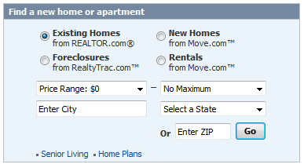
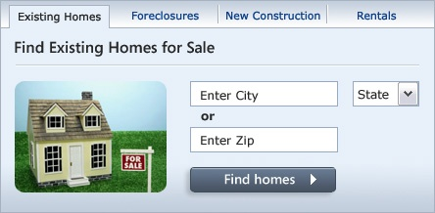
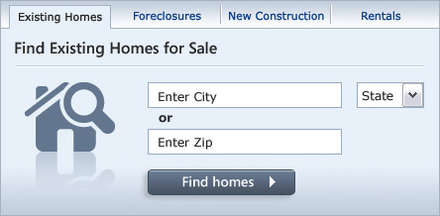
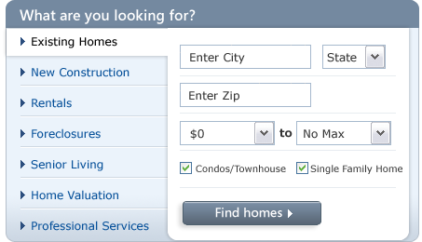
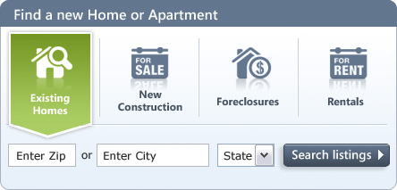
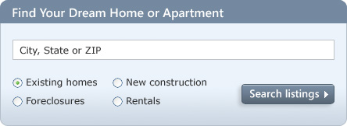
MultiTreatment Tests
Example: Real Estate widget design
  Test five alternatives to the current design
  OEC: clicks to links weighted by revenue per click
Control
T1
T2
T3
T4
T5

Slide 15

Real Estate Widget
  The widget that performed the best was the simplest
  Revenue increase over control: +9.7%
Note Ronny’s example earlier compared the best Treatment to another Treatment, not the Control

Slide 16
BREAK

Slide 17
Design of Experiments
Triggering
Blocking
Measuring non-test factors
Randomization

Slide 18
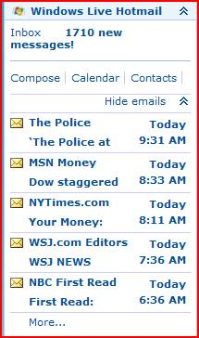
Triggering
Only allow users into your experiment if they “trigger” the experiment. i.e. a user’s data should only be used in the analysis of the experiment if they saw one of the variants
Example: MSN UK Hotmail experiment
Control: When user clicks on email
hotmail opens in same window
Treatment: Open hotmail in
separate window
Which users do you want to track as part of your experiment?
Notes:
Alternate example: PQO where they only showed the treatment to IE6 or IE7 users.

Slide 19
Blocking non-test Factors
Factor is controlled such that it affects both treatment and control equally, hence not affecting the estimate of the effect
Blocking on a factor is more common than keeping it fixed (keeping it constant throughout the experiment)
Advantages to blocking
  Can estimate the effect of the different levels of the factor, e.g. what is the effect on weekends/weekdays
  Can make inference to a broader population

Slide 20
Examples of Blocking
Time (time of day, day of week, etc.)
  Bad test design => run control at 100% M-W
  then treatment at 100% Th-Sa
  Always run treatment and control concurrently in online experiments
Content
  Ex: If content of a site changes during the experiment it must be the same for both Treatment and Control at all times

Slide 21
Design Principle
The Treatment and Control groups should be as alike as possible except for application of the treatment
  Who is in the experiment
  What is done during the experiment
  etc.
Updates to the site during the test must be applied to all variants in the test
Notes:
Blocking and Randomization are examples of things to do to satisfy this principle. However, there are other things that may need to be done. For example, 1) how you trigger (who is in the experiment), 2) make sure no one is using the treatment or control group for something else (another experiment or a launch of a feature). However, it’s OK if the launch or other experiment is affecting BOTH T and C equally.

Slide 22
Design Principle
Example: One partner was conducting an A/A test (same as an A/B test but no real change is made) What would you expect?
Results: Treatment very significant (much more than it should be) Why?
Found out another group was using their Treatment group to test something so there really was a difference between T and C
Notes:
An A/A test is one that is in all ways like an A/B test except that there is no change made to the treatment. An A/A test should be run prior to running your (first) A/B test to make sure all the pieces are in place and in working order. It’s like taking the car you’re looking out for a test drive before you buy it. It can help you see if there are any problems with test setup, data collection, triggering, etc.
i.e. the same set of users that were in the “treatment” of the A/A test were also in the treatment of the other group’s test so now there was a true difference between the search treatment and control even though there should not have been.
What if this had happened to an A/B test? Would they have found out? How could they separate out the effect of the other test?

Slide 23
Design Principle
Ex: A site was testing a change to the layout of their page
  Content to T and C was not the same for a 7 hour period
Notes:
This is a common problem. If you want to test how the layout change affects user behavior, then everything else must be the same (unless this is part of a MultiVariable Test with the other changes being controlled factors.)
Since content differences can have a huge effect on CTR and other metrics, any observed difference between T and C could be due to the layout change or the content differences. If this error is not recognized incorrect conclusions could easily be made. In both these experiments we recognized the problem and omitted the data for the time periods where the content was not the same. For one experiment we had to omit over half the data, greatly impacting the power and jeopardizing the validity of the test.

Slide 24
Measure non-test Factors
Measuring the value of non-test factors allows you to
  Delve into why the treatment had the effect it did (e.g. more PVs are correlated with faster load time which explains almost all the effect of the Treatment)
  Determine if subpopulations behave the same (e.g. did the Treatment have the same effect for new users as for returning users?)

Slide 25
Randomize
Why randomize?
So that those factors you can’t control (or don’t know about) don’t bias your results
“Randomization is too important to be left to chance” Robert Coveyou, ORNL
Unknown
Factors
Notes:
Control and measure everything you can then randomize to take care of everything you can’t control.
Randomizing does nothing for variability (that’s why we should fix or block on those factors we can). Its sole purpose is to reduce bias due to uncontrolled factors.

Slide 26
Randomize
How to randomize? (online tests)
Randomly assign T or C to user (alternately could use user-session, search query, page view or product/SKU)
Usually best by user (store UserID in cookie)
How persistent is the UID?
Ideally user always gets same treatment group
Limitations:
Clearing cookies => can change treatment
Different computer/browser => may get different treatment
Can’t allow opt-in or opt-out
Notes:
If a user goes back and forth from T to C should you use their data? (For example, if a user has either a PUID or ANID you may be able to detect if the same user sees multiple treatments because MUID changes.)
May allow limited opt-outs if customer complains (i.e. don’t give them an “opt-out” button on the page, only do it if they take the trouble to complain.) These should be very few, hence not affecting results. If there are more than just a few, this is a good indication that something’s wrong anyway.

Slide 27
Representative Test
Make sure users and conditions are as representative of launch environment as possible
  Time period: not holiday (unless holiday factor), pre-holiday, complete cycle (day, week)
  Users: all users who would see T in the future,
  not robots, not internal testers, outliers(?)
  Not during special events
Notes:
Pre-holiday - You may want to test jewelry promotions prior to Valentines day as opposed to mid-April
Complete cycle – only afternoons or only weekends would not be representative if the treatment would be launched full-time if successful
Robots may be detected because they make themselves known as robots. Others disguise themselves and are harder to detect.
Outliers are an interesting case because there are several types of outliers and many opinions on how to treat them. 1) determine if it is a legitimate user or not (not – robot, fraud, hacker) 2) if not, eliminate that user’s data completely 3) if legitimate user could a) eliminate user’s data completely, b) eliminate that metric’s data only (i.e. any metric value that is an outlier) c) truncate the outlying value (e.g. set any value >20 to 20) or d) transform the metric (common transformations are log or square root).
Special events could be annual promotional period (“white sale”) or major product launch or other major site changes

Slide 28
Robot Detection and Removal
Remove robots (web crawlers, spiders, etc.) from analysis
  They can generate many pageviews or clicks in Treatment or Control skewing the results
  Remove robots with known identifiers (found in the user agent)
  Develop heuristics to identify robots with many clicks or pageviews in short period of time
  Other patterns may be used to identify robots as well, such as very regular activity

Slide 29
Effect of Robots on A/A Experiment
Each hour
represents
clicks from
thousands
of users
The “spikes”
can be traced
to single “users”
(robots)

Slide 30
Data Validation checks
Carry out checks to make sure data is not affected by some unknown factor
  Check that percentage of users in each variant is not different from planned (statistical test)
  Check that number of users in the experiment is approximately what was expected (and doesn’t change too much during experiment)
  Check that the Treatment effect does not change too much during experiment
  Check that means for primary metrics do not change unexpectedly
Always plot the data over time

Slide 31
Before Your First Experiment
Conduct logging audit
  Compare data collected for experiment to system of record
  Should have approximately same number of users, clicks, pageviews, orders, etc.
Conduct A/A test
  Split users into two groups that get same experience
  Should have about 5% of tests significant
  p-values should have U(0,1) distribution
  No p-values should be extremely small (say <.001)

Slide 32
Common Errors
Not conducting logging or A/A tests
  Find caching issues, UID reassignment
Not keeping all factors constant or blocking
  Content changes to site
  Redirect for Treatment but not for Control
Sample size too small
Not measuring correct metric for OEC
  Measure clicks to buy button (instead of revenue)
  Clicks to download button (instead of completed downloads)

Slide 33
MultiVariable Tests (MVTs)
Several factors/variables, each of which has two or more levels (C/T1/T2/…)
Main effects: Comparison of Treatments to Control for each variable (i.e. compare means for T and C same as before)
Interactions: Determine if combinations of variables have different effect than adding main effects

Slide 34

Example: MultiVariable Test on MSN HP
Factors/variables
F1: Size of Right col ad
C = current size
T1 = 10% larger
T2 = 10% smaller
F1
F2: MSNBC news stories
C = Top international
T = Specific to country ID’d
F2
F3: Sports/Money placement
C = Sports above Money
T = Money above Sports
OEC: Clicks per User
Other metrics: PVs, CTR
F3
(This is for illustration purposes only, it does not reflect any previous or planned test on MSN HP)
Notes:
Instead of testing only one change to the homepage we are now testing three changes (factors) in the same test.

Slide 35
Multivariable Tests
Advantages:
  Can test many things at once, accelerating innovation
  Can estimate interactions between factors
Disadvantages
  Some combinations of factors may give negative customer experience
  Analysis and interpretation is more difficult
  May take longer to set up test
Notes:
If power calc says we need to run experiment for one month, can test 7 things with one month of data. If run tests one at a time it would take 7 months.
In some cases interactions are needed, in other cases they are only nice to have. I have found that interactions are not as common as people expect.
Must check all combinations of factors (not just QA, but for UX as well)
More involved analysis (may be non-standard, hence more labor-intensive) and interpretation can be trickier
If 7 factors involved, have to wait until you can turn ALL these on before you can start the test.

Slide 36
Designs for Multivariable Tests
Off-line experimental designs use specific subsets of all combinations (fractional factorials, Plackett-Burman,…)*
Example: Test 7 factors each at 2 levels
2⁷ = 128 combinations (full factorial)
2⁷⁻⁴ fractional factorial has 8 combinations
can estimate main effects, but in order to
estimate two-factor interactions need
2⁷⁻¹ fractional factorial with 64 combinations
*sometimes known as Taguchi designs
Notes:
Optional Slide
Off-line it is almost always more expensive to run a test with more combinations so one emphasis in designing an experiment is to minimize the number of combinations you have to test in order to answer the business questions you have.
On-line tests don’t have the same cost-per-combination issue.
However, some vendors of online MVT services claim that you need these specialized designs (and their advanced capabilities to sort through them and choose the right one for you) but that’s not the case. See next slide.

Slide 37
Designs for Multivariable Tests
On-line experiments can simply run overlapping, concurrent, independently randomized experiments
Example: Test 7 factors each at 2 levels
Set up 7 separate experiments to run at the same time with the same users. Get all 128 combinations in the results.
Advantages:
  Easier to implement
  Can turn off one experiment if negative
  Get all interactions
Notes:
In fact, it is easier (and less costly) to simply run overlapping tests, so to test 7 factors you set up 7 treatments as if for separate experiments and run those 7 tests at the same time. (You can only estimate interactions for the time period where the tests overlap so it is preferred if all tests start and stop on the same days.)
Note that if you are allocating only a portion of users to your experiment then all 7 of these experiments must be running for those users. (Ex: if 10% of MSN Money traffic is allocated to this MVT all 7 tests have to be running with the same 10% of users.)
It is much preferred that all treatments are allocated 50% of the total in the experiment, otherwise the interactions will get short-changed. For example, if you have two factors each with the treatments at 10%, then only 1% of users will get both treatments which will make the confidence interval for the estimate of the interaction effect quite large.

Slide 38
Analysis for Interactions
Procedure for analyzing an MVT for interactions
Since there are potentially a vary large number of interactions among the variables being tested, restrict the ones you will look at to a few you suspect may be present. (If 7 factors, 21 two-factor interactions, 35 three-factor interactions, etc.)
Conduct the test to determine if the interaction between two factors is present or not
If interaction is not significant, stop!
  If the interaction IS significant, look at the graphical output to interpret.

Slide 39
Analysis for Interactions
Example: Factors from MSN HP illustration
Hypothesis tests for interactions similar to main effects (details omitted)
F2: MSNBC news stories
C = Top international
T = Specific to country ID’d
F3 Sports/Money placement
C = same order every day
T = Sports higher on wkends
and Money higher wkdays

Slide 40
Example: MVT Experiment on MSN HP
Factors/variables
F2: MSNBC news stories
C = Top international
T = Specific to country ID’d
F3: Sports/Money placement
C = Sports above Money
T = Money above Sports
F2
OEC: Clicks per User
Other metrics: PVs, CTR
F3
(This is for illustration purposes only, it does not reflect any previous or planned test on MSN HP)
Notes:
Next we’ll look at possible interactions between these two test factors.

Slide 41
Graphical Analysis of Interactions
If hypothesis test for interaction is not significant
  Assume no interaction present
  Interaction graph would show lines approximately parallel
If interaction is statistically significant
  Plot interaction to interpret
Notes:
The interaction may be 0 (or non-significant) regardless of whether the main effects are significant.
If there is no interaction an interaction graph will have lines that are approximately parallel

Slide 42
Graphical Analysis of Interactions
Case 1: No Interaction (parallel lines)
Data Table Main Effects Results
Notes:
In the data table we have the average clicks per user for the 14 day test under the 4 conditions listed.
The main effects table shows the percent effect of each factor and the p-values. Both are significant.
The interaction plot shows no interactions because the lines are approximately parallel.

Slide 43
Graphical Analysis of Interactions
When interaction is statistically significant
Two types of interactions:
  Synergistic – when the presence of both is more than the sum of the individual treatments
  Antagonistic – when the presence of both is less than the sum of the individuals
Notes:
Another way to think of this is that the two factors could be supporting each other (synergistic) i.e. increasing the effectiveness, or fighting each other (antagonistic) decreasing the overall effectiveness.

Slide 44
Graphical Analysis of Interactions
Case 2: Synergistic Interaction
Data Table Main Effects Results
Notes:
The effect of F2 when F3 is in the control is 4.09-4.08=.01 (0.24% not significant) and the interaction of F3 when F2 is in the control is 4.08-4.08=0, so alone neither factor is effective. However, when both are working together, from the control in both to the treatment of both the effect is 4.13-4.08=.05, or 1.23% (very significant)
This example highlights the difference in results you would get with one-factor-at-a-time versus multivariable testing (testing factors together)
The lines may be crossing or not with a synergistic interaction.

Slide 45
Graphical Analysis of Interactions
Case 3: Antagonistic Interaction
Data Table Main Effects Results
Notes:
The effect of F2 when F3 is in the control is 4.11-4.08=.03 (0.74% Sig) and the effect of F3 when F2 is in the control is 4.12-4.08=.04 (0.98% Sig), so both factor are effective when tested alone. However, when both are working together, from the control in both to the treatment of both the effect is 4.11-4.08=.03, which is much less than the sum of the two effects by themselves (.03+.04=.07). In fact, it is less than the effect of F3 alone.
This example highlights the difference in results you would get with one-factor-at-a-time versus multivariable testing (testing factors together)
The lines may be crossing or not with an antagonistic interaction.

Slide 46
Case Study: EVS Experiment
Current Model
Pre-roll ad played before first content stream
Don’t disturb users by playing ad when a content stream is playing
Ad stream played before the content stream when content streams played for more than 180 seconds continuously

Slide 47
Case Study: EVS Experiment (cont.)
Business Questions
Could removing pro-roll ad stream attract more returning users?
Could shortening the minimum time between two ad streams attract more returning users?
Would ad stream gain from returning users offset the loss of not playing pre-roll or playing ad less frequently?

Slide 48
Case Study: EVS Experiment (cont.)
Experiment Design
Factor 1: Play (Control) or Do Not Play pre-roll
Factor 2: 5 levels of minimum time between two ad streams
  90, 120, 180 (Control), 300, 900 seconds
Users who received treatments in two week observation window continued to receive treatments and were monitored for the following six weeks for their return rate

Slide 49
Case Study: EVS Experiment (cont.)
Assuming the Overall Evaluation Criterion (OEC) is Percent of Returning Users
Vote for result on Factor 1:
  Playing pre-roll is statistically significantly better
  Flat (no statistical difference)
  Playing pre-roll is statistically significantly worse

Slide 50
Case Study: EVS Experiment (cont.)
Vote for result on Factor 2: which of the following attract statistically significantly more returning users
  90 seconds
  120 seconds
  180 seconds
  300 seconds
  900 seconds
  Flat (no difference)

Slide 51
EVS Experiment: Effect of Factor 1
Notes:
Result of test for Factor 1
For each of the 6 weeks following the initial two week period the percent of users returning for the Treatment (no pre-roll ad) was greater (statistically significant for all weeks except the fifth). The return rate for the Treatment was about 2% higher than the Control, on average. (Actual percent differences were 2.8%, 2.7%, 1.7%, 2.5%, 1.2%, 2.6% for weeks 1-6 respectively.)

Slide 52
EVS Experiment: Effect of Factor 2
Notes:
Result of test for Factor 2
There was no statistically significant difference between the levels of Factor 2.

Slide 53
EVS Experiment: Interaction between
Factors 1 and 2
Content First
Ads First
Notes:
Interaction effect
Since the lines are (piecewise) parallel, there is no interaction between these two factors. A statistical test was also not significant.

Slide 55
Appendix: Challenges and Advanced Statistical Concepts
Variance calculations for metrics
Non-parametric alternatives to t-test, ANOVA
Robot detection
Automatic detection of interesting population segments
Experimentation with exploration/exploitation schemes
Predicting when a metric will be significant

Slide 56
Variance calculations for metrics
Metrics that are not “per user” currently use bootstrap to estimate variance
  Can we get a formula to take into account correlation of experimental units?
  Example: Clickthrough rate (CTR) per experiment
  True variance is much larger than that from Binomial distribution

Slide 57
Non-parametric alternatives to t-test, ANOVA
Permutation or Mann-Whitney tests are natural
Pros
  Can get a p-value
  May have better power for some metrics
  Works better for small sample sizes
Cons
  Understandability by business managers
  Can be computationally intensive
  Confidence intervals for effect not straight-forward

Slide 58
Robot filtering
What is “best” way to develop heuristics to detect robots?
What is “best” way to assess how well heuristics are doing?
How to adjust robot detection parameters based on site in the test?
  For example
  Sites with low traffic may need more aggressive robot filtering
  Sites that expect active users (e.g. many clicks per hour) need less aggressive robot filtering
  Sites that have more robot traffic may need more aggressive robot filtering

Slide 59
Automatic detection of interesting population segments
A population segment is interesting if their response to the Treatment is different from the overall response
Segments can be defined by a number of variables
  Browser or operating system
  Referrer (e.g. from search engine, etc.)
  Signed-in status
  Loyalty
  Demographics
  Location – country, state, size of city (use IP lookup)
  Bandwidth

Slide 60
Experimentation with exploration/exploitation schemes
Want to automatically display best content based on exploration/exploitation strategy
Is this strategy better than editor-placed content?
What are the optimal parameter values?
  Percent in exploration group?
  How long to test content in exploration group?
  What level of significance is needed?

Slide 61
Predicting when a metric will be significant
After experiment has run for some period of time and have estimates of effect and standard deviation can we give a helpful estimate of how long experiment needs to run in order to get a significant result for a particular metric?
  Statistical philosophical issues
  Technical issues

