Slide 1

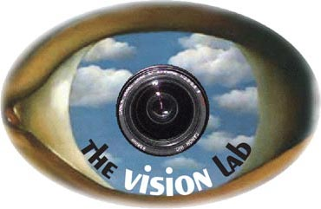

Understanding Human Actions in Still Images: Classification and Beyond
PhD Thesis Proposal
Computer Science Department, Stanford University
February 08, 2013
Bangpeng Yao
Advisor: Prof. Fei-Fei Li

Slide 2

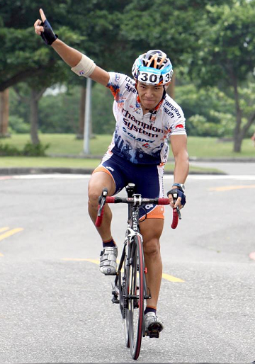
Humans recognize action easily
Riding bike
Notes:
Given this image. No motion information. Humans recognize the action very easily.

Slide 3
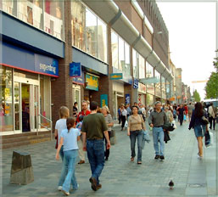
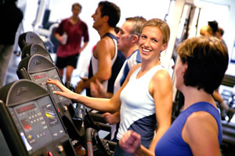
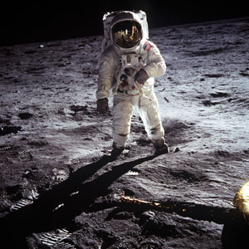
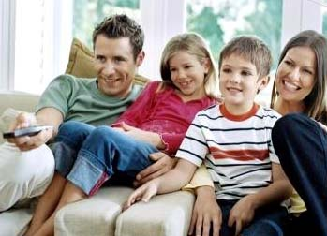
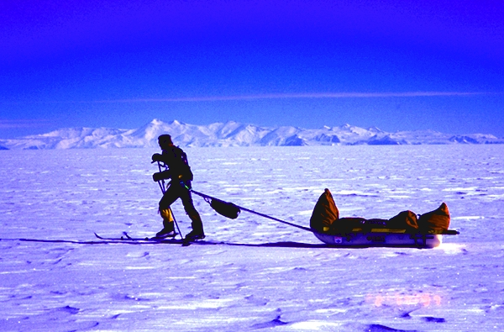
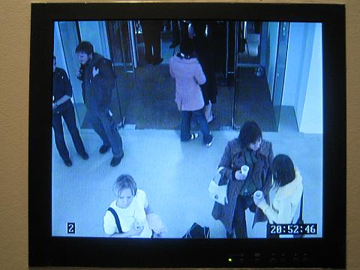
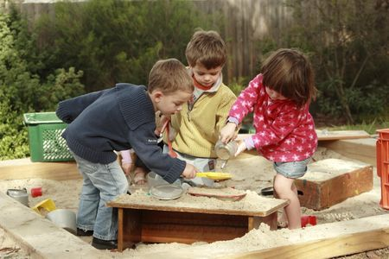
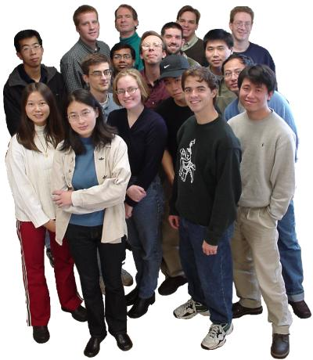
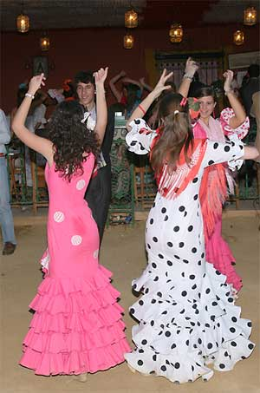
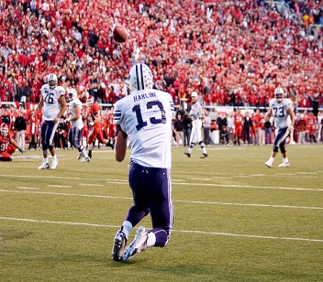
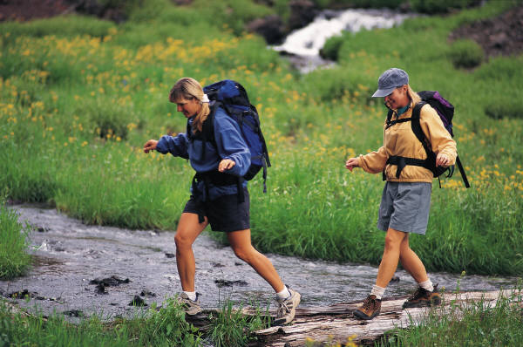
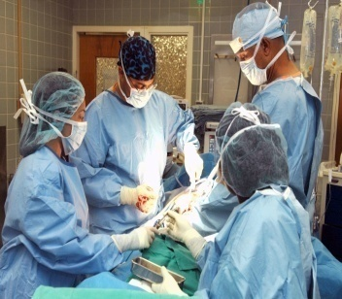
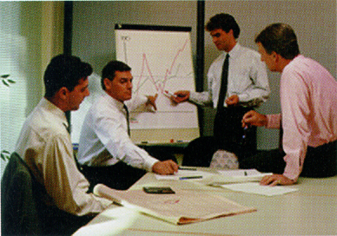
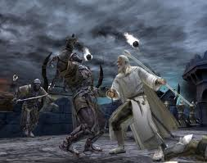
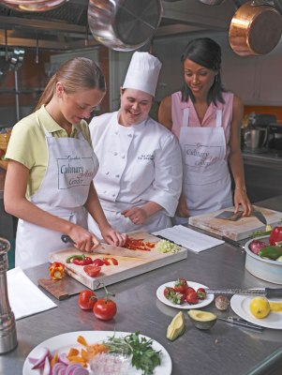
Action images are everywhere
Notes:
Humans are everywhere …

Slide 4
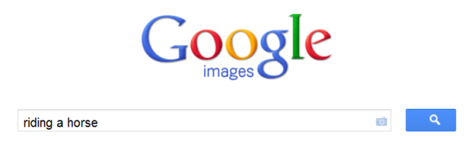

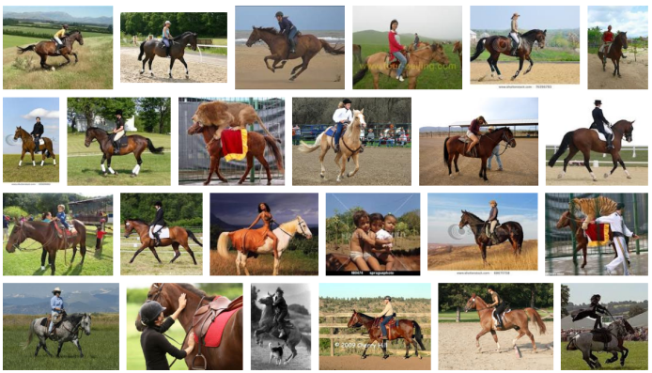

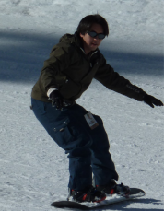
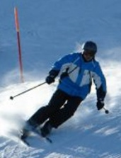





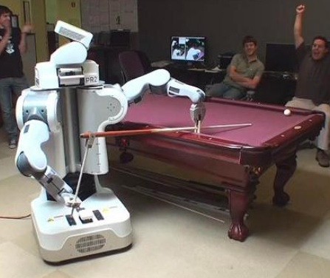
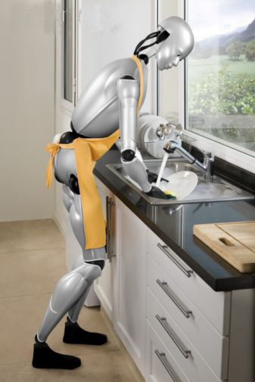
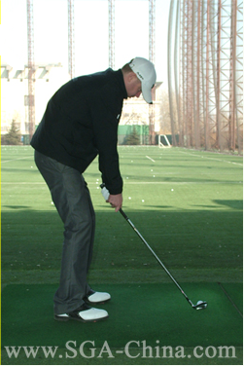
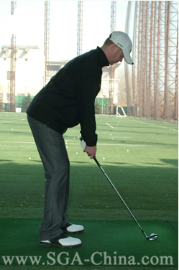
Potential applications
Notes:
Humans are everywhere …

Slide 5
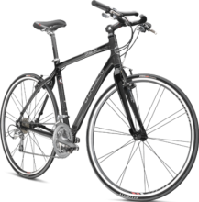
Outline
Riding bike
Action Classification
  Combining discrimination and randomization
Beyond action classification
  Mutual context modeling
Ongoing Work
  Unsupervised discovery of object functions
Summary

Slide 6
Outline
Riding bike
Action Classification
  Combining discrimination and randomization
Beyond action classification
  Mutual context modeling
Ongoing Work
  Unsupervised discovery of object functions
Summary

Slide 7

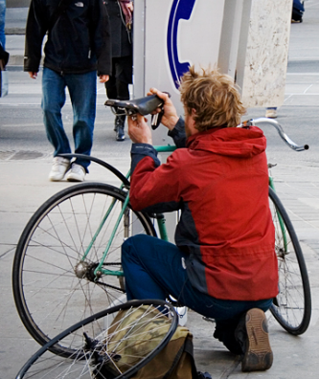
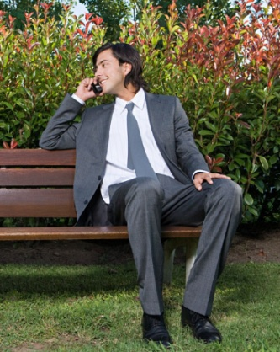
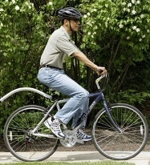
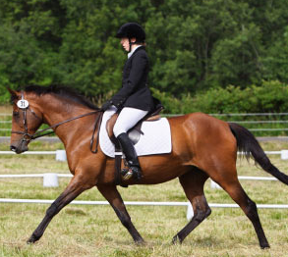
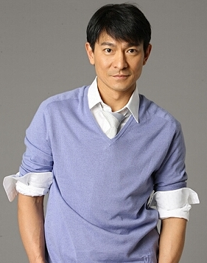
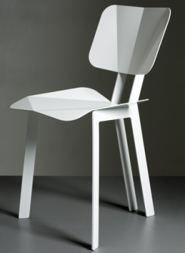
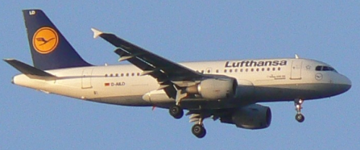
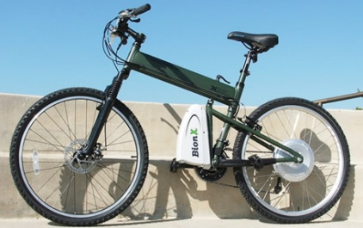
Challenge of action classification
Pose variation
Similar pose, different action
Same object, different action
Object small
Object classification:
Presence of parts and their spatial configurations.
Fergus et al, 2003
Lazebnik et al, 2006
Felzenszwalb et al, 2008

Slide 8


Intuition: Focus on most discriminative distinctions
Object classification:
Presence of parts and their spatial configurations.
Fergus et al, 2003
Lazebnik et al, 2006
Felzenszwalb et al, 2008

Slide 9
The Grouplet representation
Location
W.r.t. the face
Appearance
Visual codeword
Shape
Gaussian dist
The number of grouplets is very huge
Mining discriminative grouplets → SVM
[Yao & Fei-Fei, CVPR10a]

Slide 10
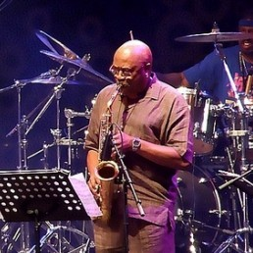
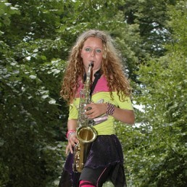
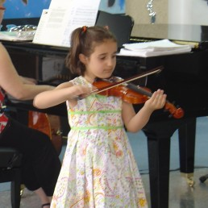
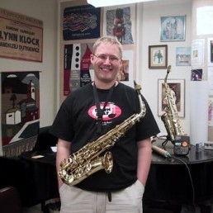
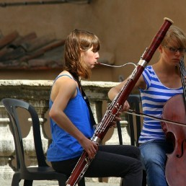
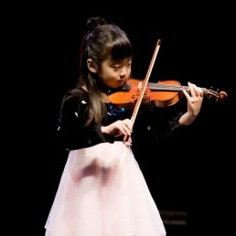
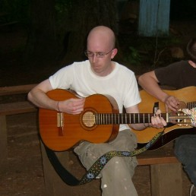
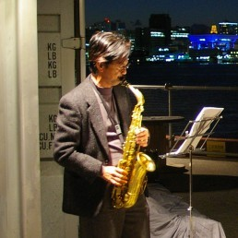
Grouplet: Examples
A discriminative grouplet for “playing saxophone”.
Discriminative grouplets for different actions.

Slide 11
Grouplet: Classification results
On People-Playing-Musical Instrument (PPMI) Dataset:
denseSIFT+LLC+SPM
Wang et al 2010
denseSIFT+SPM
Delaitre et al 2010
Grouplet
~5%
SIFT+SPM
Lazebnik et al 2006
Bag-of-Words
Constellation model
Fergus et al 2003
Mean Average Precision
PPMI website: http://ai.stanford.edu/~bangpeng/ppmi.html

Slide 12

Grouplet: How to improve?
Appearance, shape & location;
Part-based, discriminative.
No global information;
Appearance cues in each grouplet is limited;
Feature mining and classifier learning are separated.
No pose variation handling.

Slide 13
Improve Grouplet, better classifier
Appearance, shape & location;
Part-based, discriminative.
Random image regions; global and local information;
No global information;
Appearance cues in each grouplet is limited;
Feature mining and classifier learning are separated.
No pose variation handling.

Slide 14

Improve Grouplet, better classifier
Appearance, shape & location;
Part-based, discriminative.
Random image regions; global and local information;
Appearance cues in each grouplet is limited;
SPM classifiers in each region;
Lazebnik et al, 2006
Wang et al, 2010
Feature mining and classifier learning are separated.
Joint feature selection and classifier training:
Random forest
No pose variation handling.
Breiman, 2001

Slide 15
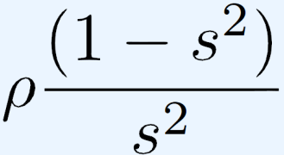
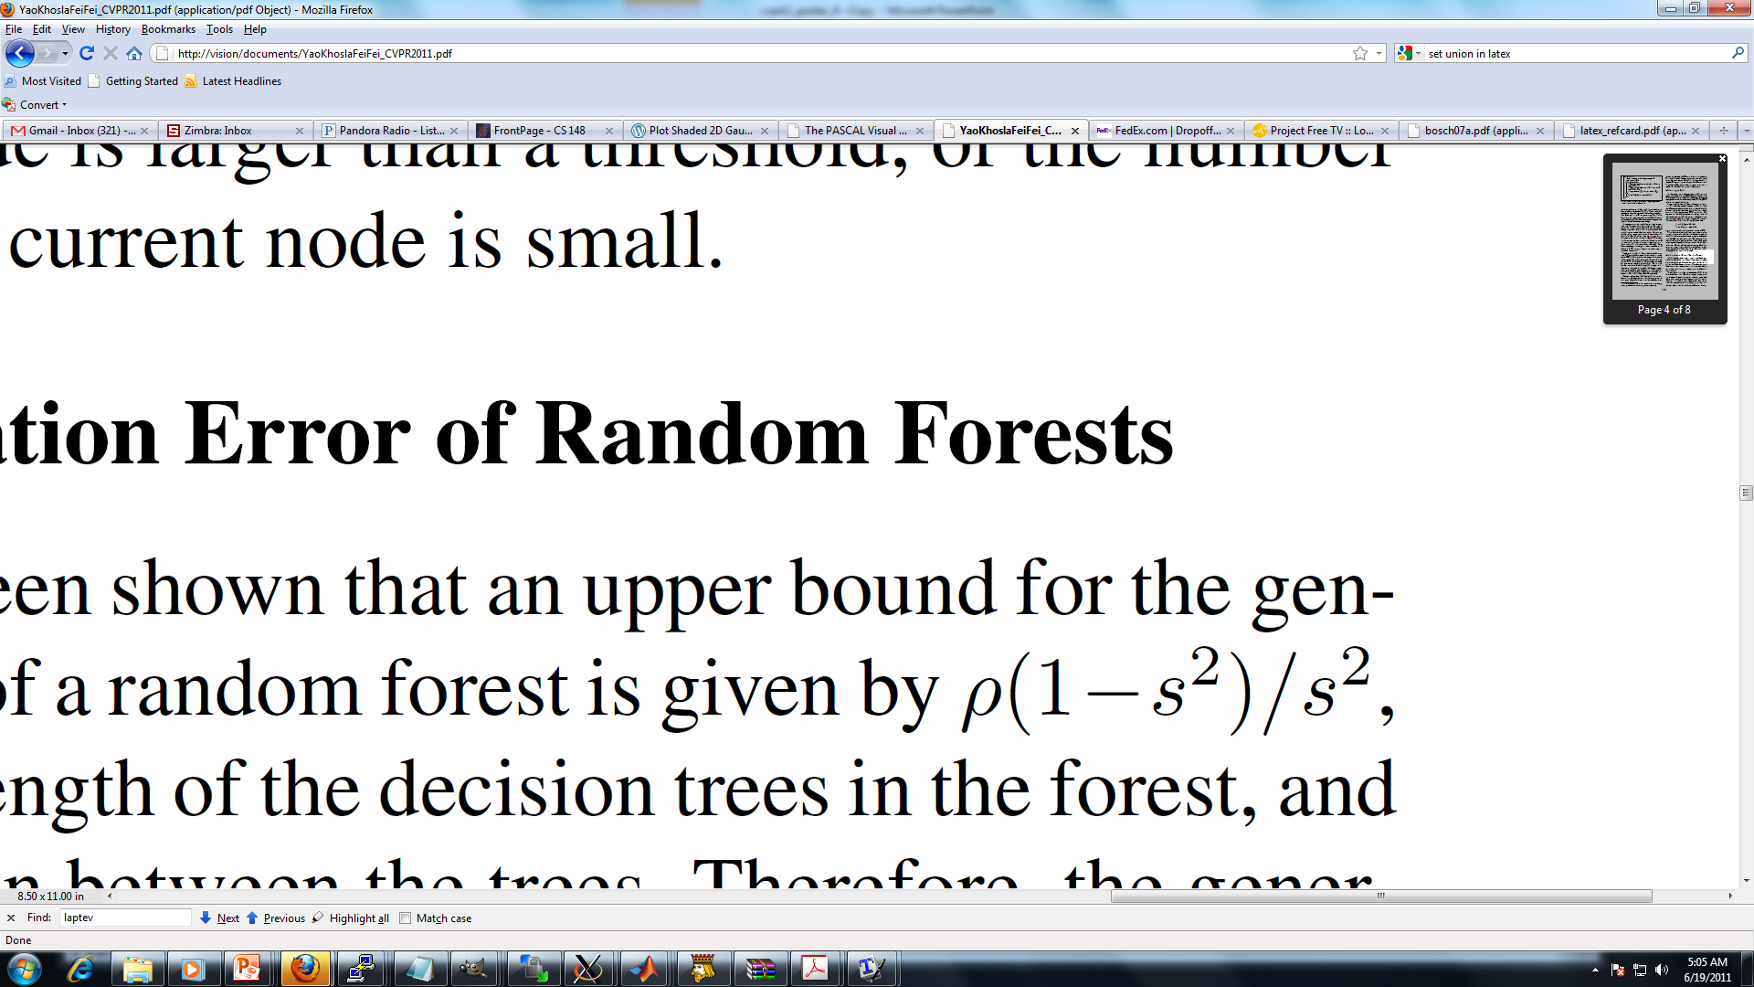
Combining randomization and discrimination
Generalization error of a random forest:
…
…
…
…
: strength of the decision trees
: correlation between decision trees
[Yao, Khosla, & Fei-Fei, CVPR11]

Slide 16
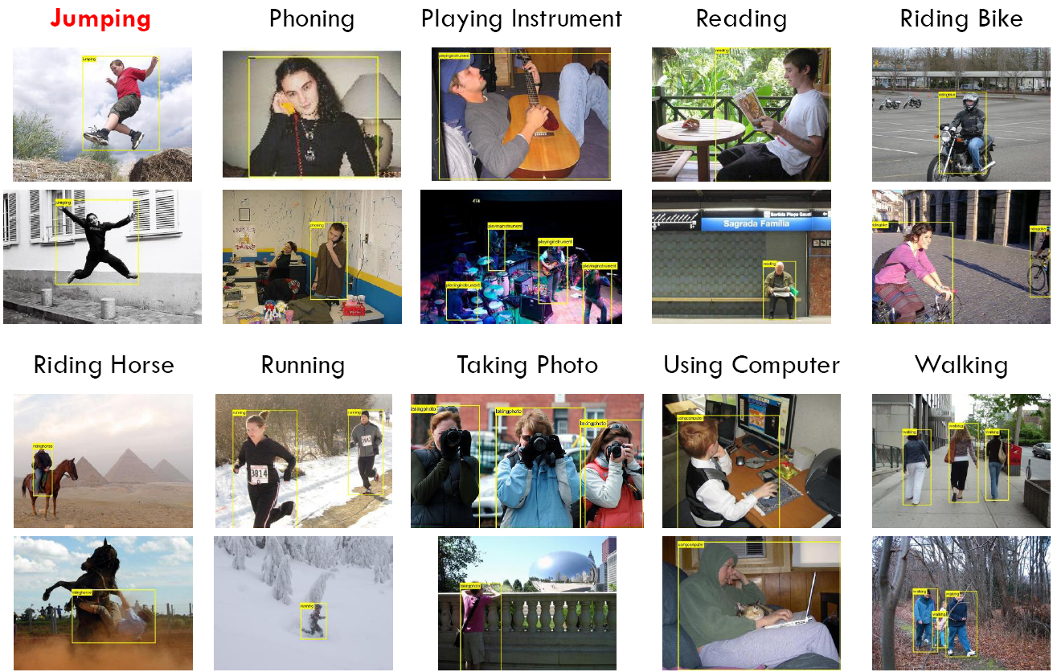
Winner on PASCAL VOC 2011, 2012
2772 training images, 2788 test images
Slides credit: M. Everyingham

Slide 17
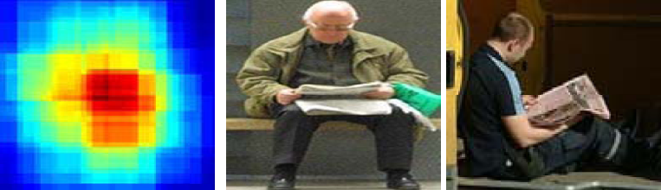
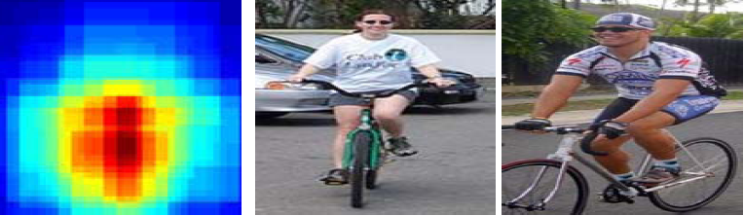
Winner on PASCAL VOC 2011, 2012
 | jumping | phoning | playing instrument | reading | riding bike | riding horse | running | taking photo | using computer | walking
CAENLEAR1 | 62.1 | 39.7 | 60.5 | 33.6 | 80.8 | 83.6 | 80.3 | 23.2 | 53.4 | 50.2
CAENLEAR2 | 71.6 | 50.7 | 77.5 | 37.8 | 86.5 | 89.5 | 83.8 | 25.1 | 58.9 | 59.2
MISSOURI | 58.8 | 36.8 | 48.5 | 30.6 | 81.5 | 83.0 | 78.5 | 21.3 | 50.7 | 53.8
NUDT1 | 65.9 | 41.5 | 57.4 | 34.7 | 88.8 | 90.2 | 87.9 | 25.7 | 54.5 | 59.5
NUDT2 | 66.3 | 41.3 | 53.9 | 35.2 | 88.8 | 90.0 | 87.6 | 25.5 | 53.7 | 58.2
WVU | 42.5 | 29.5 | 32.1 | 26.7 | 48.5 | 46.3 | 59.2 | 13.5 | 24.3 | 35.6
Our Method | 66.0 | 41.0 | 60.0 | 41.5 | 90.0 | 92.1 | 86.6 | 28.8 | 62.0 | 65.9

Slide 18
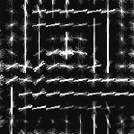

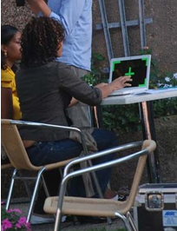
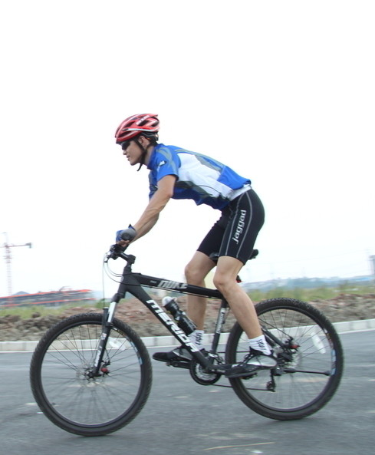









More on classification
2.5D action graph
Action attributes & parts
Riding bike
Using
computer
wearing a helmet
sitting on bike seat
Peddling the pedal
riding a bike
[Yao & Fei-Fei, ECCV’12]
[Yao, Fei-Fei, et al, ICCV’11]

Slide 19
Outline
Action Classification
  Combining discrimination and randomization
Beyond action classification
  Mutual context modeling
Ongoing Work
  Unsupervised discovery of object functions
Summary

Slide 20
Beyond action classification
Riding bike
Modeling objects and human poses in actions
  Mutual context model: Joint object detection, pose estimation, and action recognition.
[Yao & Fei-Fei, CVPR10b]
[Yao, Khosla, & Fei-Fei, ICML11]
[Yao, Khosla, & Fei-Fei, PAMI12]

Slide 21


Intuition: Mutual context
Human pose estimation is challenging.
Difficult part appearance
Self-occlusion
Image region looks like a body part
Felzenszwalb & Huttenlocher, 2005
Ren et al, 2005
Ramanan, 2006
Ferrari et al, 2008
Yang & Mori, 2008
Andriluka et al, 2009
Eichner & Ferrari, 2009

Slide 22
Intuition: Mutual context
Object detection is challenging
Small, low-resolution, partially occluded
Image region similar to detection target
Viola & Jones, 2001
Lampert et al, 2008
Felzenszwalb et al, 2008
Divvala et al, 2009
Vedaldi et al, 2009

Slide 23
Intuition: Mutual context
Objects and human poses mutually serve as context and facilitate the recognition of each other.

Slide 24


Method: Mutual context modeling
Conditional random field.
Two types of context:
  Co-occurrence context;
  Spatial context.
[Yao, Khosla, & Fei-Fei, PAMI12]

Slide 25

Result: Model visualization
On the six-sports dataset (Gupta et al, 2009):
[Yao, Khosla, & Fei-Fei, PAMI12]

Slide 26


Result: Model visualization
On the PPMI dataset (Yao & Fei-Fei, CVPR10a):
Playing erhu
With erhu
Playing trumpet
With trumpet
[Yao, Khosla, & Fei-Fei, PAMI12]

Slide 27


Result: Action retrieval
SPM: Lazebnik et al, 2006
[Yao, Khosla, & Fei-Fei, ICML11]

Slide 28
Outline
Action Classification
  Combining discrimination and randomization
Beyond action classification
  Mutual context modeling
Ongoing Work
  Unsupervised discovery of object functions
Summary

Slide 29


Motivation
What we have done is to recognize pre-defined actions…
How about the actions we have not seen before, e.g. interacting with unfamiliar objects?

Slide 30







Motivation
For a robot, dealing with any unseen object can be difficult.
Goal: Unsupervised learning of “typical” human-object interaction (object functionality).

Slide 31





Previous Work
Our Goal
Grabner et al, 2011
Fouhey et al, 2012
General human-object interactions;
Apply to any object;
Weakly supervised.
Pre-defined object;
Limited pose;
Heavy supervision.

Slide 32

Problem formulation
Input:
Desired output:
Model

Slide 33

Assumption in our method

Slide 34
Our Approach
Iterative model learning & action recognition
Model
Conditional random field;
3D human pose and their spatial relationship between object.
Probability of whether an image represents the “typical” interaction.
“Typical” or “non-typical” interactions

Slide 35


(Planned) Experiments - PPMI
Unsupervised learning of “typical” human-object interactions and object functionality.
People Interacting with Musical Instrument dataset.
Twelve instruments
400 images per instrument

Slide 36

(Planned) Experiments – Online Images
Learn from internet which images represent the object functionality.

Slide 37

Summary
Riding bike

Slide 38
References
[NIPS09] B. Yao, D. Walther, D. Beck, and L. Fei-Fei. “Hierarchical mixture of classification experts uncovers interactions between brain regions.” NIPS 2009.
[CVPR10a] B. Yao and L. Fei-Fei. “Grouplet: A structured image representation for recognizing human and object interactions.” CVPR 2010. (Oral)
[CVPR10b] B. Yao and L. Fei-Fei. “Modeling mutual context of object and human pose in human-object interaction activities.” CVPR 2010. (Oral)
[CVPR11] B. Yao, A. Khosla, and L. Fei-Fei. “Combining randomization and discrimination for fine-grained image categorization.” CVPR 2011.
[ICML11] B. Yao, A. Khosla, and L. Fei-Fei. “Classifying actions and measuring action similarity by modeling the mutual context of objects and human poses.” ICML 2011. (Invited paper)

Slide 39
References
[ICCV11a] S. Nowozin, C. Rother, S. Bagon, T. Sharp, B. Yao, and P. Kohli. “Decision tree fields.” ICCV 2011. (Oral)
[ICCV11b] B. Yao, X. Jiang, A. Khosla, A. Lin, L. Guibas, and L. Fei-Fei. “Human action recognition by learning bases of action attributes and parts.” ICCV 2011. (Oral)
[PAMI12] B. Yao and L. Fei-Fei. “Recognizing human-object interactions in still images by modeling the mutual context of objects and human poses.” PAMI 2012.
[CVPR12] B. Yao, G. Bradski, and L. Fei-Fei. “A codebook-free and annotation-free approach for fine-grained image categorization.” CVPR 2012.
[ECCV12] B. Yao and L. Fei-Fei. “Action recognition with exemplar based 2.5D graph matching.” ECCV 2012. (Oral)

Slide 40

















Acknowledgement

