Slide 1
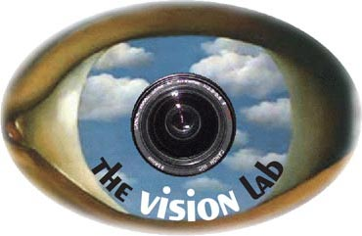


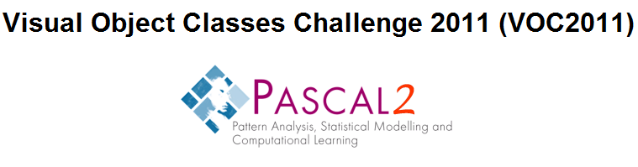
Action Classification: An Integration of Randomization and Discrimination in A Dense Feature Space
Bangpeng Yao, Aditya Khosla, and Li Fei-Fei
Computer Science Department, Stanford University
{bangpeng,aditya86,feifeili}@cs.stanford.edu
Notes:
So here we are. I am …, this is … We are going to present our CVPR work which you might have seen from the poster sessions. So you might be familiar with this already. Please bear us.

Slide 2
Outline
Action Classification & Intuition
Our Method
Our Results
Conclusion

Slide 3
Outline
Action Classification & Intuition
Our Method
Our Results
Conclusion

Slide 4
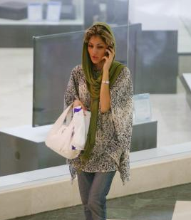
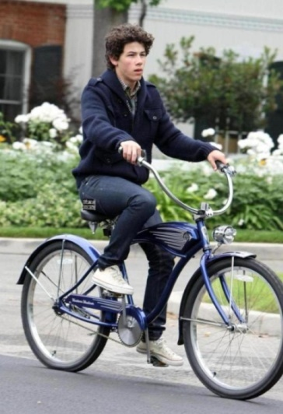
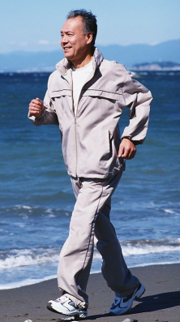
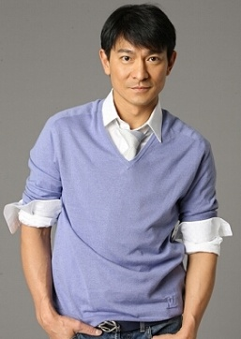
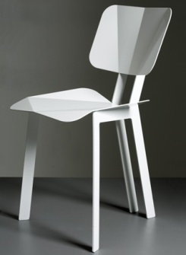
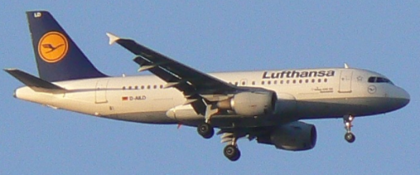
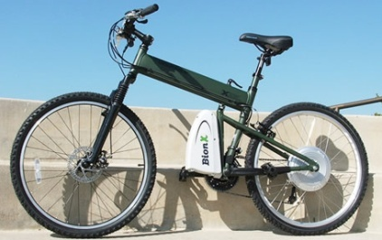
Action Classification
Phoning
RidingBike
Running
Object classification:
[Lazebnik et al, 2006]
[Fergus et al, 2003]
…
Presence of parts and their spatial configurations.

Slide 5

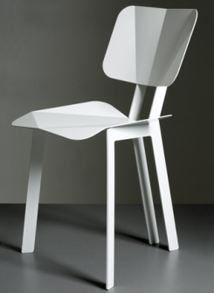

Action Classification
All images contain humans;
Object classification:
[Lazebnik et al, 2006]
[Fergus et al, 2003]
…
Presence of parts and their spatial configurations.

Slide 6
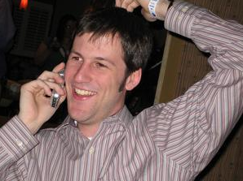
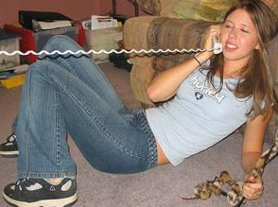
Action Classification
All images contain humans;
Large pose variation;
Object classification:
[Lazebnik et al, 2006]
[Fergus et al, 2003]
…
Presence of parts and their spatial configurations.

Slide 7
Action Classification
All images contain humans;
Large pose variations;
Objects small or absent;
Background clutter.
Challenging…
Object classification:
[Lazebnik et al, 2006]
[Fergus et al, 2003]
…
Presence of parts and their spatial configurations.

Slide 8
Our Intuition
Focus on image regions that contain the most discriminative information.

Slide 9
Our Intuition
Focus on image regions that contain the most discriminative information.
Dense feature space
How to represent the features?
Randomization & Discrimination
How to explore this feature space?

Slide 10
Outline
Action Classification & Intuition
Our Method
Our Results
Conclusion

Slide 11
Dense Feature Space
...
Region Height
...
...
...
...
...
...
Region Width
Normalized Image
Size of image region

Slide 12
Dense Feature Space
...
Region Height
...
...
...
...
...
...
Region Width
Normalized Image
Size of image region
Center of image region

Slide 13
Dense Feature Space
...
Region Height
...
...
...
...
...
...
Region Width
Normalized Image
Size of image region
Center of image region

Slide 14
Dense Feature Space
...
Region Height
...
...
...
...
...
...
Region Width
Image size: N×N
Image regions: O(N⁶)
Normalized Image
How can we identify the discriminative regions efficiently and effectively?
Size of image region
Center of image region

Slide 15
Dense Feature Space
...
Region Height
...
...
...
...
...
...
Region Width
Apply randomization to sample a subset of image patches
Normalized Image
Size of image region
Center of image region
Random Forest

Slide 16
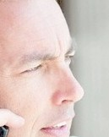





Dense Feature Space
...
Region Height
...
...
...
...
...
...
Region Width
This class
Other classes
Normalized Image
Size of image region
Center of image region
Random Forest

Slide 17
Dense Feature Space
...
Region Height
...
...
...
...
...
...
Region Width
This class
Other classes
Normalized Image
Size of image region
Center of image region
Random Forest with discriminative classifiers

Slide 18
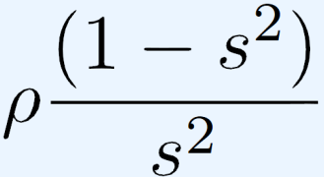
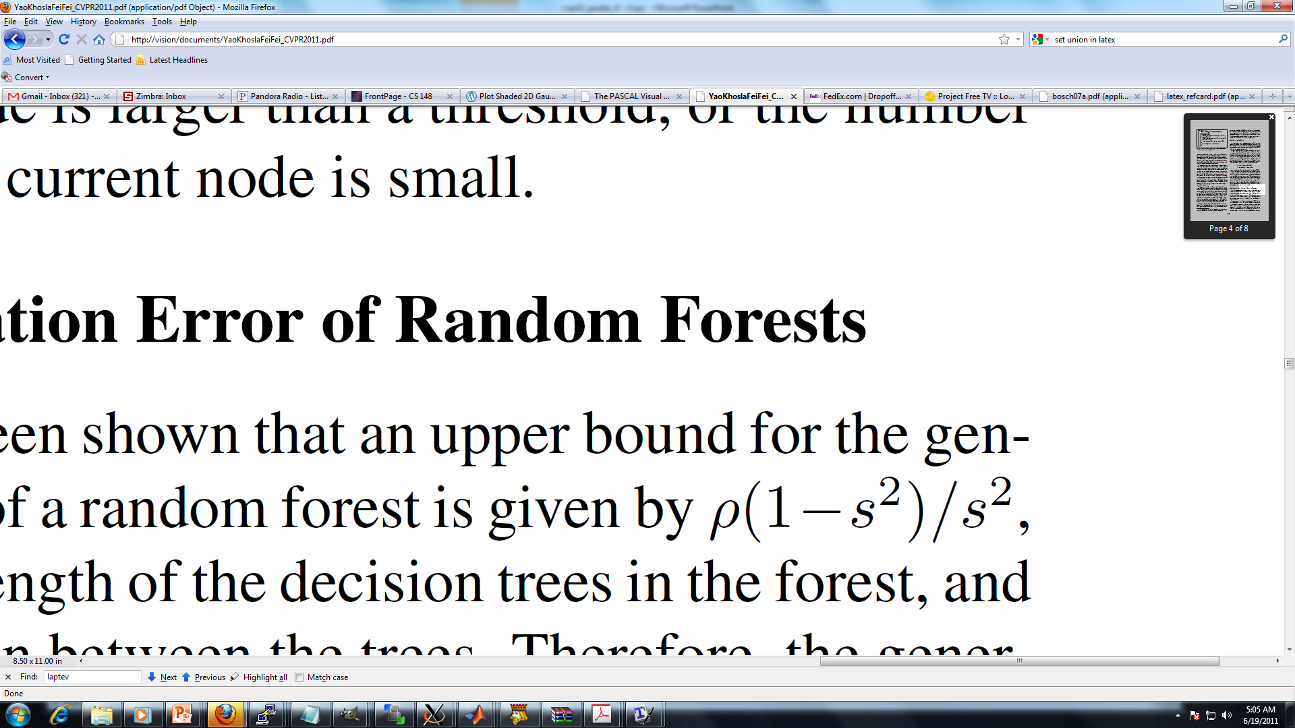
Generalization of Random Forest
Generalization error of a Random Forest (Breiman, 2001):
: strength of the decision trees
: correlation between decision trees
Discriminative classifiers
increases
Dense feature space
decreases
Better generalization

Slide 19
Random Forest with Discriminative Classifiers
…
…
…
…

Slide 20



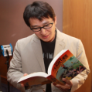

Random Forest with Discriminative Classifiers
…
…
…
…
1
0
4
1
Train a binary SVM
2
1
5
0
3
1
BoW or SPM of SIFT-LLC features

Slide 21




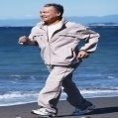
Random Forest with Discriminative Classifiers
…
…
…
…
1
0
4
1
Train a binary SVM
2
1
5
0
3
1
Biggest information gain

Slide 22
Random Forest with Discriminative Classifiers
…
…
…
…

Slide 23
Random Forest with Discriminative Classifiers
…
…
…
…
We stop growing the tree if:
The maximum depth is reached;
There is only one class at the node;

Slide 24
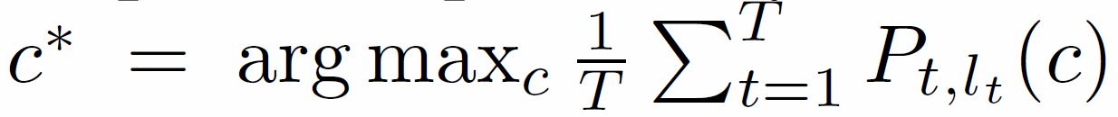
Classification With Random Forest
…
…
…
…
Class Label
Number of trees

Slide 25
Outline
Action Classification & Intuition
Our Method
Our Results
Conclusion

Slide 26
Results on VOC 2011 Action Comp9
Action | Others’ Best | Our Method
Jumping | 71.6 | 66.0
Phoning | 50.7 | 41.0
Playing instrument | 77.5 | 60.0
Reading | 37.8 | 41.5
Riding bike | 88.8 | 90.0
Riding horse | 90.2 | 92.1
Running | 87.9 | 86.6
Taking photo | 25.7 | 28.8
Using computer | 58.9 | 62.0
Walking | 59.5 | 65.9
Our method ranks the first in six out of ten classes.

Slide 27
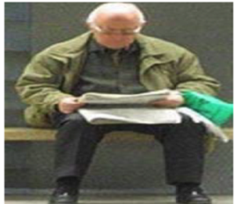
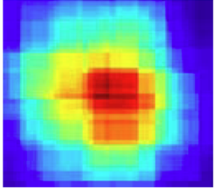
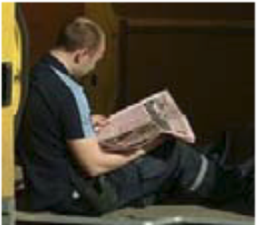
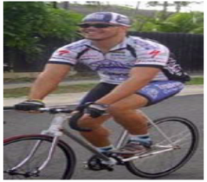
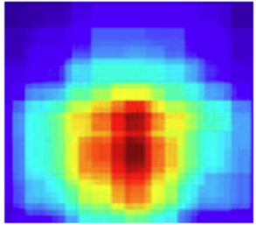
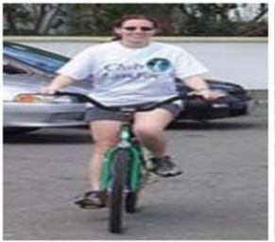
Results on VOC 2011 Action Comp9
Action | Others’ Best | Our Method
Jumping | 71.6 | 66.0
Phoning | 50.7 | 41.0
Playing instrument | 77.5 | 60.0
Reading | 37.8 | 41.5
Riding bike | 88.8 | 90.0
Riding horse | 90.2 | 92.1
Running | 87.9 | 86.6
Taking photo | 25.7 | 28.8
Using computer | 58.9 | 62.0
Walking | 59.5 | 65.9

Slide 28
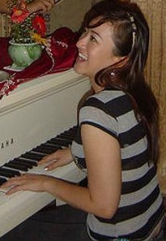
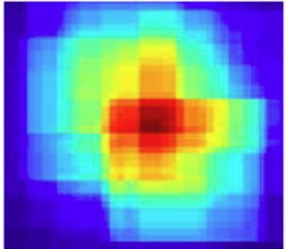
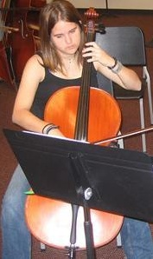
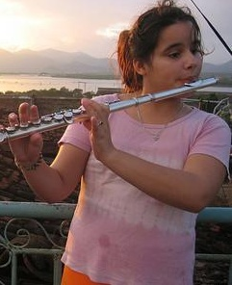
Results on VOC 2011 Action Comp9
Action | Others’ Best | Our Method
Jumping | 71.6 | 66.0
Phoning | 50.7 | 41.0
Playing instrument | 77.5 | 60.0
Reading | 37.8 | 41.5
Riding bike | 88.8 | 90.0
Riding horse | 90.2 | 92.1
Running | 87.9 | 86.6
Taking photo | 25.7 | 28.8
Using computer | 58.9 | 62.0
Walking | 59.5 | 65.9

Slide 29
Generalization Ability of RF
Dense feature space
Tree correlation decreases
Discriminative classifiers
Tree strength increases
Better generalization
(spatial pyramid)
SPM feature
Vs.
dense feature
Generate feature weights randomly
Train discriminative SVM classifiers
weak classifier
Vs.
strong classifier
(Results on PASCAL VOC 2010)

Slide 30
Outline
Action Classification & Intuition
Our Method
Our Results
Conclusion

Slide 31
Conclusion
Exploring dense image features can benefit action classification;
Combining randomization and discrimination is an effective way to explore the dense image representation;
Achieves very good performance based on only one type of image descriptor;
Code will be available soon.

Slide 32
PASCAL VOC 2011 Result Comp10
 | Others’ best | Our method
Jumping | 59.5 | 66.7
Phoning | 31.3 | 41.1
Playing instrument | 45.6 | 60.8
Reading | 27.8 | 42.2
Riding bike | 84.4 | 90.5
Riding horse | 88.3 | 92.2
Running | 77.6 | 86.2
Taking photo | 31.0 | 28.8
Using computer | 47.4 | 63.5
Walking | 57.6 | 64.2
Wednesday 9th November, 12:00-12:30

Slide 33



Acknowledgement
…
…
…
…
Thanks to Su Hao, Olga Russakovsky, and Carsten Rother.
1
0
4
1
Train a binary SVM
Reference:
2
1
5
0
Bangpeng Yao, Aditya Khosla, and Li Fei-Fei. “Combining Randomization and Discrimination for Fine-Grained Image Categorization.” CVPR 2011.
3
1

