Slide 1

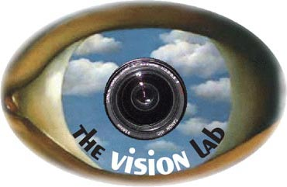
Human Action Recognition by Learning Bases of Action Attributes and Parts
Bangpeng Yao¹, Xiaoye Jiang², Aditya Khosla¹,
Andy Lai Lin³, Leonidas Guibas¹, and Li Fei-Fei¹
Computer Science Department, Stanford University
Institute for Computational & Mathematical Engineering, Stanford University
Electrical Engineering Department, Stanford University
{bangpeng,aditya86,guibas,feifeili}@cs.stanford.edu
{xiaoye,ydna}@stanford.edu

Slide 2
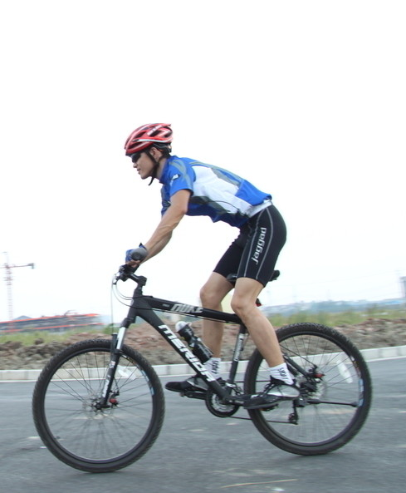
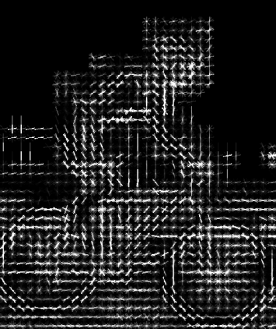


Action Classification in Still Images
Riding bike
Directly using low level feature for classification:
Grouplet (Yao & Fei-Fei, 2010)
Multiple kernel learning (Koniusz et al., 2010)
Spatial pyramid (Delaitre et al., 2010)
Random forest (Yao et al., 2011)

Slide 3
Action Classification in Still Images
Riding bike
Human actions are more than just a class label:
Riding a bike
Sitting on a bike seat
Wearing a helmet
Peddling the pedals
…
High-level concepts - Attributes

Slide 4
Action Classification in Still Images
Riding bike
Human actions are more than just a class label:
Riding a bike
Sitting on a bike seat
Wearing a helmet
Peddling the pedals
…
High-level concepts – Attributes
Objects

Slide 5
Action Classification in Still Images
Riding bike
Human actions are more than just a class label:
Riding a bike
Sitting on a bike seat
Wearing a helmet
Peddling the pedals
…
High-level concepts – Attributes
Objects
Human poses
Parts

Slide 6
Action Classification in Still Images
Riding bike
Riding
Human actions are more than just a class label:
Riding a bike
Sitting on a bike seat
Wearing a helmet
Peddling the pedals
…
High-level concepts – Attributes
Objects
Human poses
Interactions of attributes & parts
Parts

Slide 7
Attributes & Parts for Classification
wearing a helmet
Riding bike
sitting on bike seat
Peddling the pedal
riding a bike
Human actions are more than just a class label.
Attributes, objects, and human poses in visual recognition:
Farhadi et al., 2009
Lampert et al., 2009
Berg et al., 2010
Parikh & Grauman, 2011
Liu et al., 2011
Gupta et al., 2009
Yao & Fei-Fei, 2010
Torresani et al., 2010
Li et al., 2010
Yao & Fei-Fei, 2010
Yang et al., 2010
Maji et al., 2011

Slide 8


Benefits of the Attribute & Part Rep.
Incorporate more human knowledge;
Produce more descriptive intermediate outputs;
Allow more discriminative classifiers;
Farhadi et al., 2009
Lampert et al., 2009
Berg et al., 2010
Parikh & Grauman, 2011
Torresani et al., 2010
Li et al., 2010
Maji et al., 2011
Liu et al., 2011
Complementary information in attributes and parts, hence improve classification performance.

Slide 9
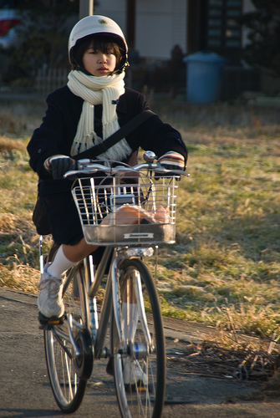
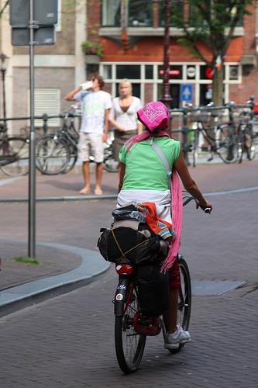
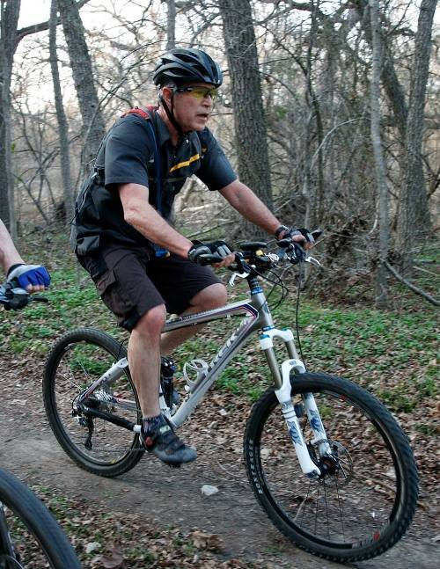
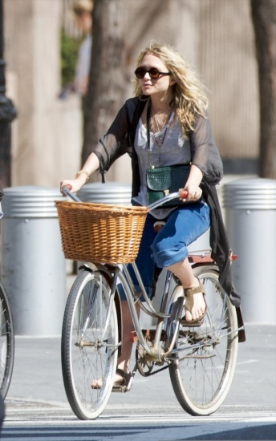
Challenges We Need to Address
How to model attributes and parts (objects & poses)?
How to model their interactions?
How to eliminate noise or inconsistency in the data?
How to use attributes and parts for recognition?
Unexpected object
Errors in detection
Object does not appear

Slide 10
Outline
Attributes and Parts in Human Actions
Learning Bases of Attributes and Parts
(modeling the interactions)
Dataset & Experiments
Conclusion

Slide 11
Outline
Attributes and Parts in Human Actions
Learning Bases of Attributes and Parts
(modeling the interactions)
Dataset & Experiments
Conclusion

Slide 12
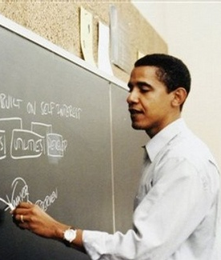
Action Attributes
Semantic descriptions of actions;
Usually related to verbs.
Cycling
Peddling
Writing
Phoning
Jumping
…
Cycling
Peddling
Writing
Phoning
Jumping
…

Slide 13
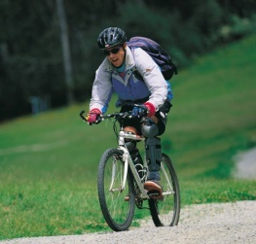

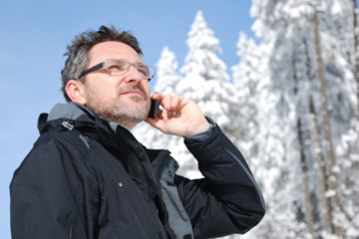

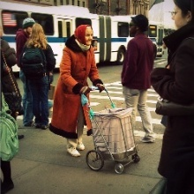
Action Attributes
Semantic descriptions of actions;
Usually related to verbs.
A discriminative classifier for each attribute:
Cycling
Peddling
Writing
Phoning
Jumping
…
Cycling
Peddling
Writing
Phoning
Jumping
…

Slide 14
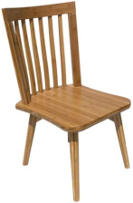
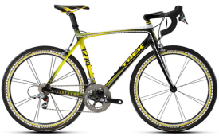

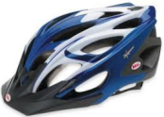




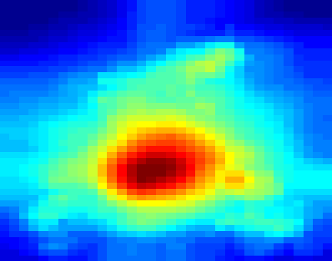

Action Parts – Objects and Poses
Objects:
Human poses – poselets:
…
(Bourdev & Malik, 2010)
bike detector
…
For each part (object or poselet), we have a pre-trained detector.
(Li et al., 2010
Bourdev & Malik, 2010)

Slide 15



Putting Attributes and Parts Together
Confidence scores
Cycling
Peddling
Writing
Phoning
Attribute classification
…
…
SVM Classifier
Object detection
Low
High
…
…
Poselet detection
…
…

Slide 16
Challenges We Need to Address
How to model attributes and parts (objects & poses)?
How to model their interactions?
How to eliminate noise or inconsistency in the data?
How to use attributes and parts for recognition?
Unexpected object
Errors in detection
Object does not appear

Slide 17
Challenges We Need to Address
How to model attributes and parts (objects & poses)?
How to model their interactions?
How to eliminate noise or inconsistency in the data?
How to use attributes and parts for recognition?
Unexpected object
Errors in detection
Object does not appear

Slide 18
Outline
Attributes and Parts in Human Actions
Learning Bases of Attributes and Parts
(modeling the interactions)
Dataset & Experiments
Conclusion

Slide 19
Bases of Atr. & Parts: Motivation
Ideal vector
Cycling
Peddling
Writing
Phoning
Low
High
…
…
…
…
…
…

Slide 20
Bases of Atr. & Parts: Motivation
Real vector
Ideal vector
Cycling
Cycling
Peddling
Peddling
Writing
Writing
Phoning
Phoning
Low
High
…
…
…
…
…
…
…
…
…
…
…
…

Slide 21


Bases of Atr. & Parts: Motivation
Real vector
Action bases
Ideal vector
…
Cycling
Cycling
Peddling
Peddling
Writing
Writing
Phoning
Phoning
Low
High
…
…
…
…
…
…
…
…
…
…
…
…
…
…
…
…
…
…
…
…
…
…
…
…
…

Slide 22
Bases of Atr. & Parts: Motivation
Real vector
Action bases
Reconstruction coefficients
Ideal vector
…
Cycling
Cycling
Peddling
Peddling
Writing
Writing
Phoning
Phoning
Low
High
…
…
…
…
…
…
…
…
…
…
…
…
…
…
…
…
…
…
…
…
…
…
…
…
…
…

Slide 23
Bases of Atr. & Parts: Motivation
Real vector
Action bases
Reconstruction coefficients
Ideal vector
Action bases (sparse)
…
Cycling
Cycling
Peddling
Peddling
Writing
Writing
Phoning
Phoning
Low
High
…
…
…
…
…
…
…
…
…
…
…
…
…
…
…
…
…
…
…
…
…
…
…
…
…
…

Slide 24
Bases of Atr. & Parts: Motivation
Real vector
Reconstruction coefficients (sparse)
Action bases (sparse)
Reconstruction coefficients
Ideal vector
…
Cycling
Cycling
Peddling
Peddling
Writing
Writing
Phoning
Phoning
Low
High
…
…
…
…
…
…
…
…
…
…
…
…
…
…
…
…
…
…
…
…
…
…
…
…
…
…

Slide 25
Bases of Atr. & Parts: Training
Real vector
Action bases (sparse)
Reconstruction coefficients (sparse)
(N images)
(M bases)
Input
Output
Low
High
L1 regularization, sparsity of W
Accurate reconstruction
Elastic net, sparsity of
[Zou & Hasti, 2005]

Slide 26
Bases of Atr. & Parts: Testing
Real vector
Action bases (sparse)
Reconstruction coefficients (sparse)
(M bases)
Input
Output
Low
High
L1 regularization, sparsity of W
Accurate reconstruction

Slide 27
Bases of Atr. & Parts: Benefits
Real vector
Action bases (sparse)
Reconstruction coefficients (sparse)
Ideal vector
…
Cycling
Cycling
Peddling
Peddling
Writing
Writing
Phoning
Phoning
Low
High
…
…
…
…
…
…
…
…
Co-occurrence context;
…
…
…
…
…
…
…
…
…
…
…
…
…
…
…
…
…
…

Slide 28
Bases of Atr. & Parts: Benefits
Real vector
Action bases (sparse)
Reconstruction coefficients (sparse)
Ideal vector
…
Cycling
Cycling
Peddling
Peddling
Writing
Writing
Phoning
Phoning
Low
High
…
…
…
…
…
…
…
…
Co-occurrence context;
…
…
Reduce noise;
…
…
…
…
…
…
…
…
…
…
…
…
…
…
…
…

Slide 29
Bases of Atr. & Parts: Benefits
Real vector
Action bases (sparse)
Reconstruction coefficients (sparse)
Ideal vector
…
Cycling
Cycling
Peddling
Peddling
Writing
Writing
Phoning
Phoning
Low
High
…
…
…
…
…
…
…
…
Co-occurrence context;
…
…
Reduce noise;
…
…
…
…
…
…
…
…
Improve performance.
SVM Classifier
…
…
…
…
…
…
…
…

Slide 30
Outline
Attributes and Parts in Human Actions
Learning Bases of Attributes and Parts
(modeling the interactions)
Datasets & Experiments
Conclusion

Slide 31
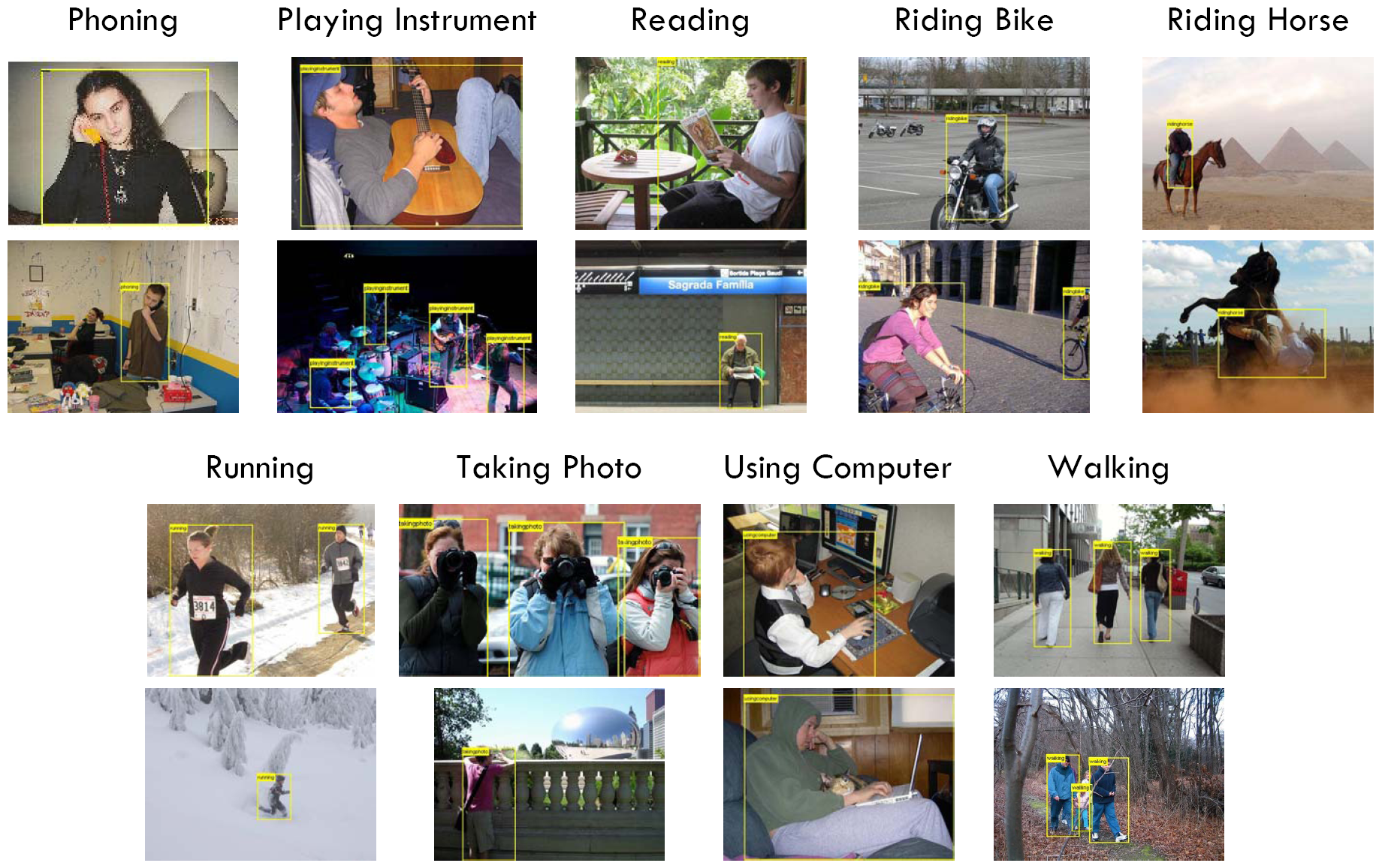
PASCAL VOC 2010 Action Dataset
9 classes, 50-100 training / testing images per class
Slide credit: Ivan Laptev

Slide 32
PASCAL VOC 2010 Action Dataset
Average precision (%)
 | Phoning |  | Reading | Riding bike | Riding horse | Running | Taking photo |  | Walking
SURREY_MK | 52.6 | 53.5 | 35.9 | 81.0 | 89.3 | 86.5 | 32.8 | 59.2 | 68.6
UCLEAR_DOSP | 47.0 | 57.8 | 26.9 | 78.8 | 89.7 | 87.3 | 32.5 | 60.0 | 70.1
POSELETS | 49.6 | 43.2 | 27.7 | 83.7 | 89.4 | 85.6 | 31.0 | 59.1 | 67.9
 | 49.5 | 56.6 | 31.4 | 82.3 | 89.3 | 87.0 | 36.1 | 67.7 | 73.0
Playing
instrument
Using computer
Ours Conf_Score
SURREY_MK, UCLEAR_DOSP: Best results from the challenge;
POSELETS: Results from Maji et al, 2011;
Ours Conf_Score: Concatenating attributes classification and parts detection scores.
14 attributes – trained from the trainval images;
27 objects – taken from Li et al, NIPS 2010;
150 poselets – taken from Bourdev & Malik, ICCV 2009.

Slide 33
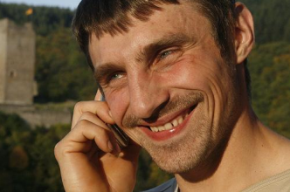

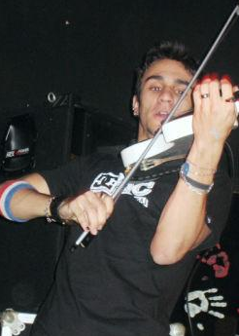
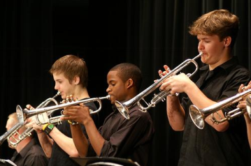
PASCAL VOC 2010 Action Dataset
Average precision (%)
 | Phoning |  | Reading | Riding bike | Riding horse | Running | Taking photo |  | Walking
SURREY_MK | 52.6 | 53.5 | 35.9 | 81.0 | 89.3 | 86.5 | 32.8 | 59.2 | 68.6
UCLEAR_DOSP | 47.0 | 57.8 | 26.9 | 78.8 | 89.7 | 87.3 | 32.5 | 60.0 | 70.1
POSELETS | 49.6 | 43.2 | 27.7 | 83.7 | 89.4 | 85.6 | 31.0 | 59.1 | 67.9
 | 49.5 | 56.6 | 31.4 | 82.3 | 89.3 | 87.0 | 36.1 | 67.7 | 73.0
Playing
instrument
Using computer
Ours Conf_Score

Slide 34
PASCAL VOC 2010 Action Dataset
Average precision (%)
 | Phoning |  | Reading | Riding bike | Riding horse | Running | Taking photo |  | Walking
SURREY_MK | 52.6 | 53.5 | 35.9 | 81.0 | 89.3 | 86.5 | 32.8 | 59.2 | 68.6
UCLEAR_DOSP | 47.0 | 57.8 | 26.9 | 78.8 | 89.7 | 87.3 | 32.5 | 60.0 | 70.1
POSELETS | 49.6 | 43.2 | 27.7 | 83.7 | 89.4 | 85.6 | 31.0 | 59.1 | 67.9
 | 49.5 | 56.6 | 31.4 | 82.3 | 89.3 | 87.0 | 36.1 | 67.7 | 73.0
 | 42.8 | 60.8 | 41.5 | 80.2 | 90.6 | 87.8 | 41.4 | 66.1 | 74.4
Playing
instrument
Using computer
Ours Conf_Score
Ours Sparse_Base
Ours Sparse_Base: Using the reconstruction coefficients as the input of SVM classifiers.

Slide 35
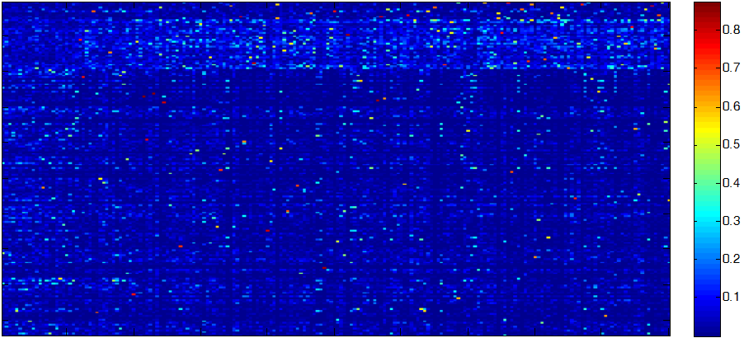
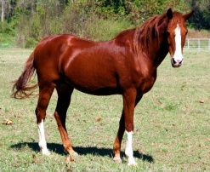
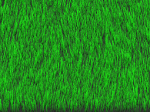
PASCAL VOC 2010 Action Dataset
Average precision (%)
 | Phoning |  | Reading | Riding bike | Riding horse | Running | Taking photo |  | Walking
SURREY_MK | 52.6 | 53.5 | 35.9 | 81.0 | 89.3 | 86.5 | 32.8 | 59.2 | 68.6
UCLEAR_DOSP | 47.0 | 57.8 | 26.9 | 78.8 | 89.7 | 87.3 | 32.5 | 60.0 | 70.1
POSELETS | 49.6 | 43.2 | 27.7 | 83.7 | 89.4 | 85.6 | 31.0 | 59.1 | 67.9
 | 49.5 | 56.6 | 31.4 | 82.3 | 89.3 | 87.0 | 36.1 | 67.7 | 73.0
 | 42.8 | 60.8 | 41.5 | 80.2 | 90.6 | 87.8 | 41.4 | 66.1 | 74.4
Playing
instrument
Using computer
Ours Conf_Score
Ours Sparse_Base
attributes
objects
riding
poselets
400 action bases

Slide 36
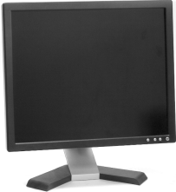
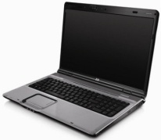
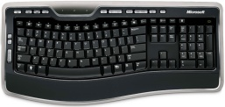
PASCAL VOC 2010 Action Dataset
Average precision (%)
 | Phoning |  | Reading | Riding bike | Riding horse | Running | Taking photo |  | Walking
SURREY_MK | 52.6 | 53.5 | 35.9 | 81.0 | 89.3 | 86.5 | 32.8 | 59.2 | 68.6
UCLEAR_DOSP | 47.0 | 57.8 | 26.9 | 78.8 | 89.7 | 87.3 | 32.5 | 60.0 | 70.1
POSELETS | 49.6 | 43.2 | 27.7 | 83.7 | 89.4 | 85.6 | 31.0 | 59.1 | 67.9
 | 49.5 | 56.6 | 31.4 | 82.3 | 89.3 | 87.0 | 36.1 | 67.7 | 73.0
 | 42.8 | 60.8 | 41.5 | 80.2 | 90.6 | 87.8 | 41.4 | 66.1 | 74.4
Playing
instrument
Using computer
Ours Conf_Score
Ours Sparse_Base
attributes
objects
Using
Sitting
poselets
400 action bases

Slide 37
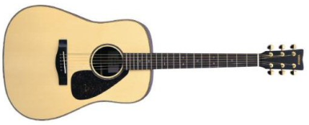
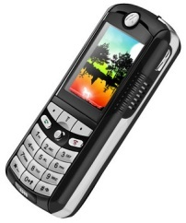

PASCAL VOC 2010 Action Dataset
Average precision (%)
 | Phoning |  | Reading | Riding bike | Riding horse | Running | Taking photo |  | Walking
SURREY_MK | 52.6 | 53.5 | 35.9 | 81.0 | 89.3 | 86.5 | 32.8 | 59.2 | 68.6
UCLEAR_DOSP | 47.0 | 57.8 | 26.9 | 78.8 | 89.7 | 87.3 | 32.5 | 60.0 | 70.1
POSELETS | 49.6 | 43.2 | 27.7 | 83.7 | 89.4 | 85.6 | 31.0 | 59.1 | 67.9
 | 49.5 | 56.6 | 31.4 | 82.3 | 89.3 | 87.0 | 36.1 | 67.7 | 73.0
 | 42.8 | 60.8 | 41.5 | 80.2 | 90.6 | 87.8 | 41.4 | 66.1 | 74.4
Playing
instrument
Using computer
Ours Conf_Score
Ours Sparse_Base
attributes
objects
Phoning
poselets
400 action bases

Slide 38
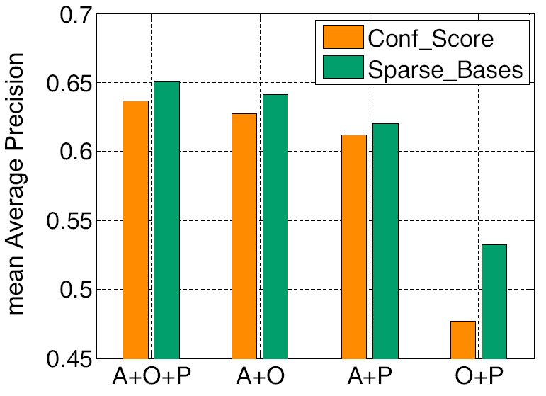
PASCAL VOC 2010 Action Dataset
Average precision (%)
 | Phoning |  | Reading | Riding bike | Riding horse | Running | Taking photo |  | Walking
SURREY_MK | 52.6 | 53.5 | 35.9 | 81.0 | 89.3 | 86.5 | 32.8 | 59.2 | 68.6
UCLEAR_DOSP | 47.0 | 57.8 | 26.9 | 78.8 | 89.7 | 87.3 | 32.5 | 60.0 | 70.1
POSELETS | 49.6 | 43.2 | 27.7 | 83.7 | 89.4 | 85.6 | 31.0 | 59.1 | 67.9
 | 49.5 | 56.6 | 31.4 | 82.3 | 89.3 | 87.0 | 36.1 | 67.7 | 73.0
 | 42.8 | 60.8 | 41.5 | 80.2 | 90.6 | 87.8 | 41.4 | 66.1 | 74.4
Playing
instrument
Using computer
Ours Conf_Score
Ours Sparse_Base
attributes
objects
poselets
400 action bases

Slide 39
PASCAL VOC 2011 Action Dataset
 | Others’ best in comp9 | Others’ best in comp10 | Our method
Jumping | 71.6 | 59.5 | 66.7
Phoning | 50.7 | 31.3 | 41.1
Playing instrument | 77.5 | 45.6 | 60.8
Reading | 37.8 | 27.8 | 42.2
Riding bike | 88.8 | 84.4 | 90.5
Riding horse | 90.2 | 88.3 | 92.2
Running | 87.9 | 77.6 | 86.2
Taking photo | 25.7 | 31.0 | 28.8
Using computer | 58.9 | 47.4 | 63.5
Walking | 59.5 | 57.6 | 64.2
Our method ranks the first in nine out of ten classes in comp10;
Our method achieves the best performance in five out of ten classes if we consider both comp9 and comp10.

Slide 40
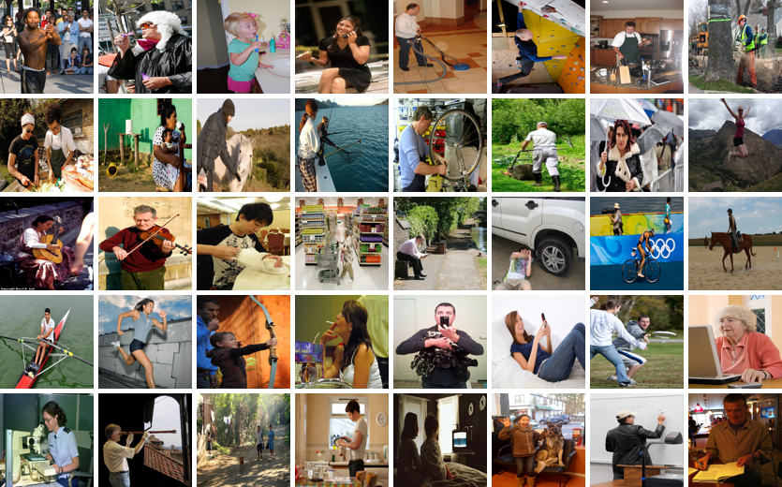
Stanford 40 Actions
Applauding
Blowing bubbles
Brushing teeth
Calling
Cleaning floor
Climbing wall
Cooking
Cutting trees
Cutting vegetables
Drinking
Feeding horse
Fishing
Fixing bike
Gardening
Holding umbrella
Jumping
Playing guitar
Playing violin
Pouring liquid
Pushing cart
Reading
Repairing car
Riding bike
Riding horse
Rowing
Running
Shooting arrow
Smoking cigarette
Taking photo
Texting message
Throwing frisbee
Using computer
Using microscope
Using telescope
Walking dog
Washing dishes
Watching television
Waving hands
Writing on board
Writing on paper
http://vision.stanford.edu/Datasets/40actions.html

Slide 41
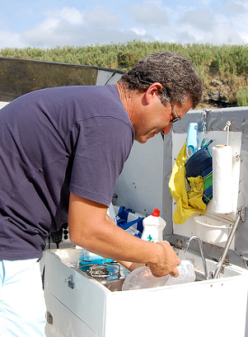
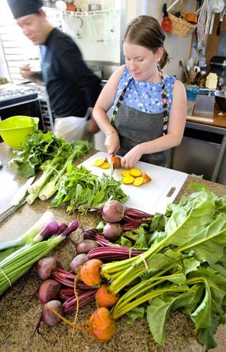
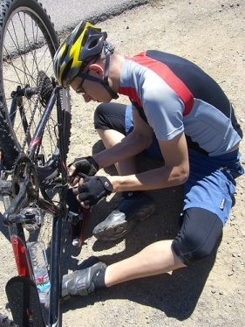



Stanford 40 Actions
40 actions – the largest number of action classes.
Opportunity to study the relationships between actions.
washing dishes
cutting vegetables
fixing a bike
fiding bike
writing on a board
writing on a paper
http://vision.stanford.edu/Datasets/40actions.html

Slide 42
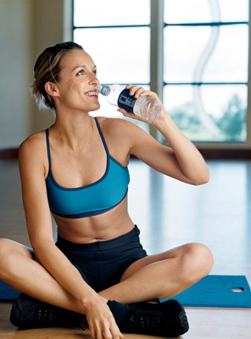
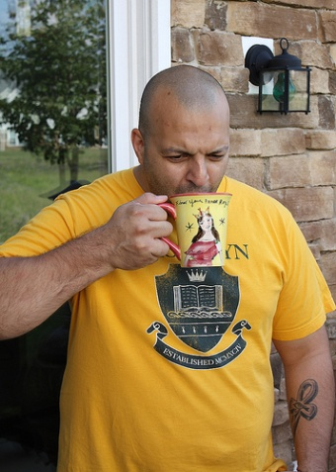
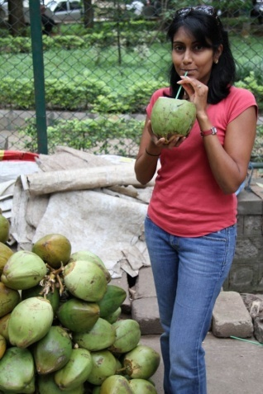

Stanford 40 Actions
40 actions – the largest number of action classes.
Opportunity to study the relationships between actions.
9532 images from Google, Flickr – The largest action dataset.
Large pose variation and background clutter.
Bounding boxes annotations of humans.
Upper-body visible, possible to explore human poses.
More annotations are coming ...
http://vision.stanford.edu/Datasets/40actions.html

Slide 43
Stanford 40 Actions
We use 45 attributes, 81 objects, and 150 poselets.
Compare our method with the Locality-constrained Linear Coding (LLC, Wang et al, CVPR 2010) baseline.
Average precision

Slide 44
Stanford 40 Actions
Compare with PASCAL VOC 2011 results:
Riding horse:
Riding bike:
92.2
90.5
Running:
Jumping:
86.2
66.7
Using computer:
63.5
Reading:
Phoning:
Taking photo:
42.2
41.1
28.8
Average precision

Slide 45
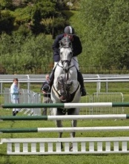
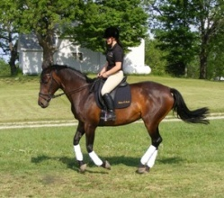
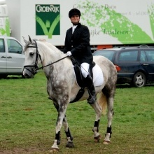
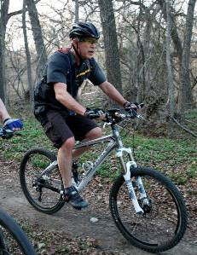


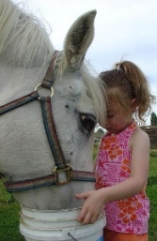
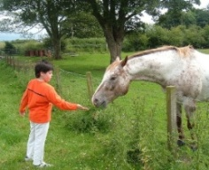
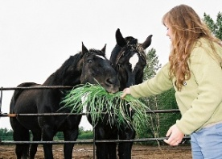
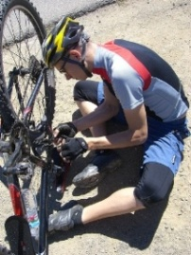
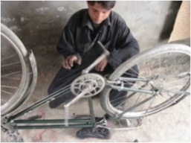
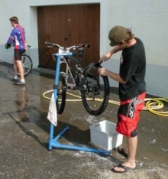
Stanford 40 Actions
Poses are relatively consistent
Very large pose variation
Average precision

Slide 46
Outline
Attributes and Parts in Human Actions
Learning Bases of Attributes and Parts
(modeling the interactions)
Dataset & Experiments
Conclusion

Slide 47
Conclusion
Real vector
Action bases
Reconstruction coefficients
Ideal vector
…
Cycling
Cycling
Peddling
Peddling
Writing
Writing
Phoning
Phoning
Low
High
…
…
…
…
…
…
…
…
…
…
…
…
…
…
…
…
…
…
Sparse
…
…
…
…
…
…
Sparse
…
…

Slide 48
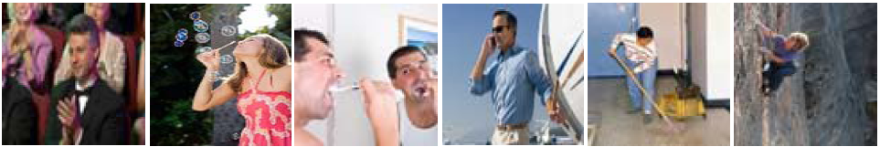
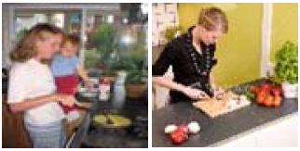
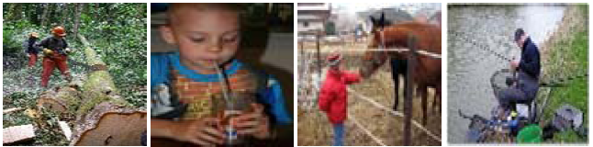


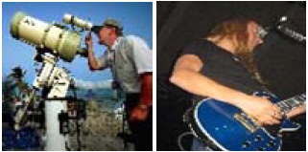
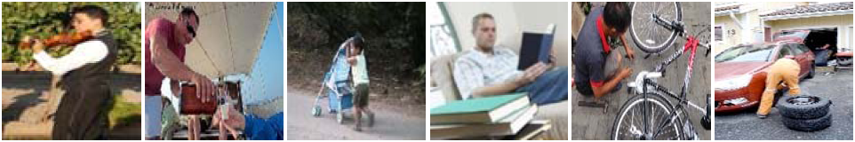








Acknowledgement

