Slide 1

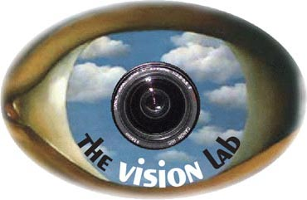

Human Action Recognition by Learning Bases of Action Attributes and Parts
Bangpeng Yao, Xiaoye Jiang, Aditya Khosla,
Andy Lai Lin, Leonidas Guibas, and Li Fei-Fei
Stanford University

Slide 2
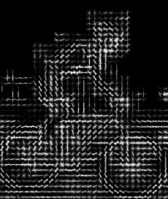
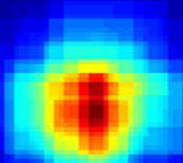
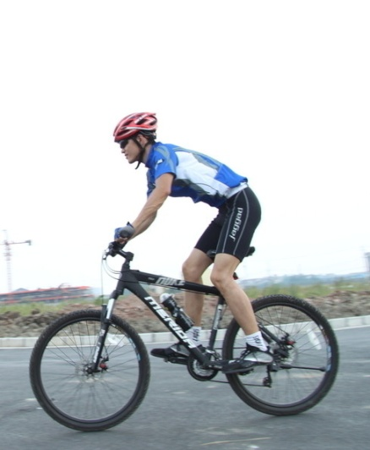

Action Classification in Still Images
Low level feature
Riding bike
Yao & Fei-Fei, 2010
Koniusz et al., 2010
Delaitre et al., 2010
Yao et al., 2011

Slide 3


Action Classification in Still Images
Low level feature
High-level representation
Riding bike
- Semantic concepts – Attributes
Riding a bike
Sitting on a bike seat
Wearing a helmet
Peddling the pedals
…
Yao & Fei-Fei, 2010
Koniusz et al., 2010
Delaitre et al., 2010
Yao et al., 2011

Slide 4
Action Classification in Still Images
Low level feature
High-level representation
Riding bike
- Semantic concepts – Attributes
Objects
Riding a bike
Sitting on a bike seat
Wearing a helmet
Peddling the pedals
…
Yao & Fei-Fei, 2010
Koniusz et al., 2010
Delaitre et al., 2010
Yao et al., 2011

Slide 5
Action Classification in Still Images
Low level feature
High-level representation
Riding bike
- Semantic concepts – Attributes
- Objects
- Human poses
Parts
Riding a bike
Sitting on a bike seat
Wearing a helmet
Peddling the pedals
…
Yao & Fei-Fei, 2010
Koniusz et al., 2010
Delaitre et al., 2010
Yao et al., 2011

Slide 6
Action Classification in Still Images
Low level feature
High-level representation
Riding bike
- Semantic concepts – Attributes
Objects
- Human poses
- Contexts of attributes & parts
Parts
Riding
Riding a bike
Sitting on a bike seat
Wearing a helmet
Peddling the pedals
…
Yao & Fei-Fei, 2010
Koniusz et al., 2010
Delaitre et al., 2010
Yao et al., 2011

Slide 7
Action Classification in Still Images
Low level feature
High-level representation
Riding bike
wearing a helmet
- Semantic concepts – Attributes
Objects
- Human poses
- Contexts of attributes & parts
sitting on bike seat
Parts
Peddling the pedal
riding a bike
Yao & Fei-Fei, 2010
Koniusz et al., 2010
Delaitre et al., 2010
Yao et al., 2011
Farhadi et al., 2009
Lampert et al., 2009
Berg et al., 2010
Parikh & Grauman, 2011
Gupta et al., 2009
Yao & Fei-Fei, 2010
Torresani et al., 2010
Li et al., 2010
Yang et al., 2010
Maji et al., 2011
Liu et al., 2011
Incorporate human knowledge;
More understanding of image content;
More discriminative classifier.

Slide 8
Outline
Intuition: Action Attributes and Parts
Algorithm: Learning Bases of Attributes and Parts
Experiments: PASCAL VOC & Stanford 40 Actions
Conclusion

Slide 9
Outline
Intuition: Action Attributes and Parts
Algorithm: Learning Bases of Attributes and Parts
Experiments: PASCAL VOC & Stanford 40 Actions
Conclusion

Slide 10


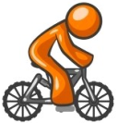





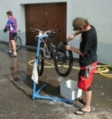
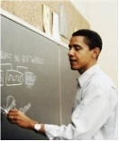



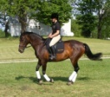
Action Attributes and Parts
Attributes:
semantic descriptions of human actions
…
…

Slide 11
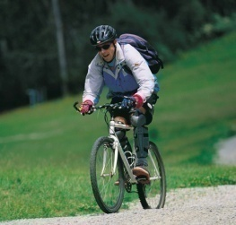

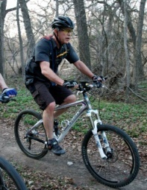
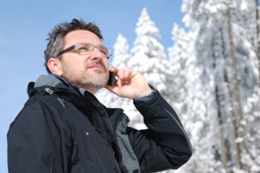

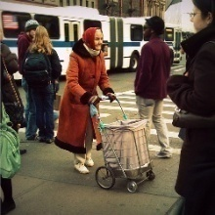
Action Attributes and Parts
Attributes:
semantic descriptions of human actions
…
…
Discriminative classifier, e.g. SVM
Riding bike
Not riding bike
Lampert et al., 2009
Berg et al., 2010

Slide 12

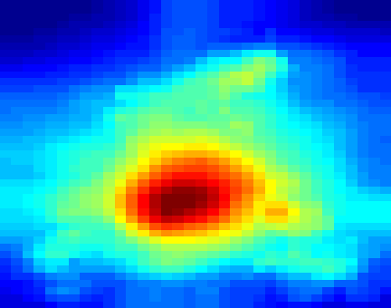

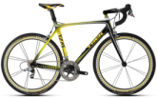








Action Attributes and Parts
Attributes:
A pre-trained detector
…
…
Parts-Objects:
…
…
Parts-Poselets:
…
…
Object Bank, Li et al., 2010
Poselet, Bourdev & Malik, 2009

Slide 13



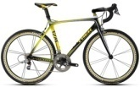

Action Attributes and Parts
Attributes:
a: Image feature vector
…
…
Attribute classification
Parts-Objects:
Object detection
…
…
Parts-Poselets:
Poselet detection
…
…

Slide 14

Action Attributes and Parts
Attributes:
Action bases
Φ
a: Image feature vector
…
…
Attribute classification
Parts-Objects:
…
Object detection
…
…
Parts-Poselets:
Poselet detection
…
…

Slide 15



Action Attributes and Parts
Attributes:
Action bases
Φ
a: Image feature vector
…
…
Parts-Objects:
…
…
…
Parts-Poselets:
…
…

Slide 16



Action Attributes and Parts
Attributes:
Action bases
Φ
a: Image feature vector
…
…
Parts-Objects:
…
…
…
Parts-Poselets:
…
…

Slide 17
Action Attributes and Parts
Attributes:
Action bases
Φ
a: Image feature vector
…
…
Parts-Objects:
…
…
…
Parts-Poselets:
…
…
Bases coefficients w

Slide 18

Action Attributes and Parts
Attributes:
Action bases
Φ
a: Image feature vector
…
…
Parts-Objects:
…
…
…
Parts-Poselets:
…
…
Sparse
Encodes context
Robust to initially weak detections
Bases coefficients w

Slide 19
Outline
Intuition: Action Attributes and Parts
Algorithm: Learning Bases of Attributes and Parts
Experiments: PASCAL VOC & Stanford 40 Actions
Conclusion

Slide 20


Bases of Atr. & Parts: Training
a
Φ
Input:
Output:
…
sparse
Jointly estimate and :
Φ
W
w
Accurate approximation
L1 regularization, sparsity of W
Elastic net, sparsity of
Φ
[Zou & Hasti, 2005]
Optimization: stochastic gradient descent.

Slide 21
Bases of Atr. & Parts: Testing
a
Φ
Input:
…
Output:
sparse
Estimate w:
w
Accurate approximation
L1 regularization, sparsity of W
Optimization: stochastic gradient descent.

Slide 22
Outline
Intuition: Action Attributes and Parts
Algorithm: Learning Bases of Attributes and Parts
Experiments: PASCAL VOC & Stanford 40 Actions
Conclusion

Slide 23
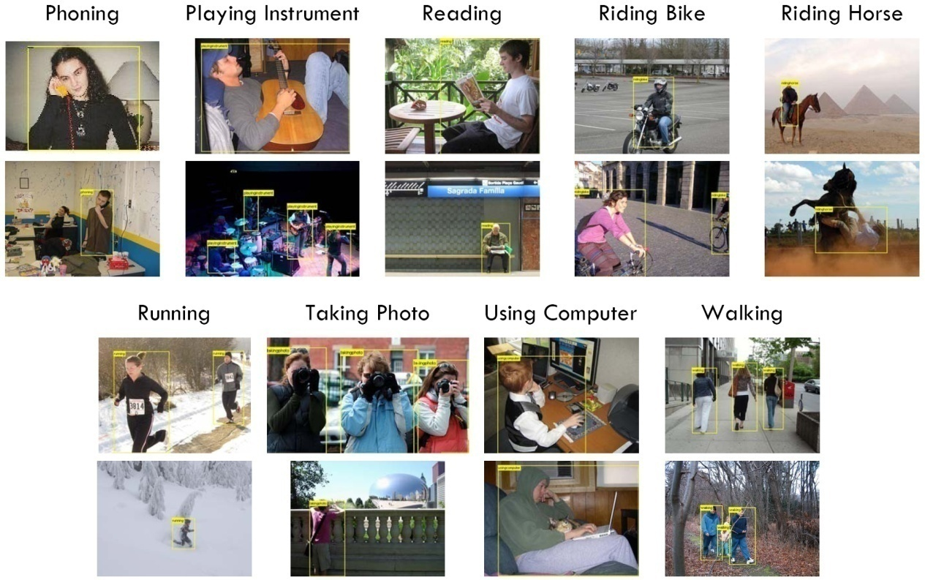
PASCAL VOC 2010 Action Dataset
9 classes, 50-100 trainval / testing images per class
Figure credit: Ivan Laptev
14 attributes – trained from the trainval images;
27 objects – taken from Li et al, NIPS 2010;
150 poselets – taken from Bourdev & Malik, ICCV 2009.

Slide 24
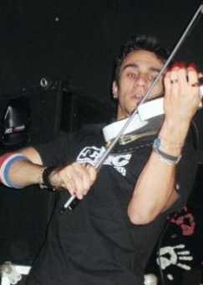
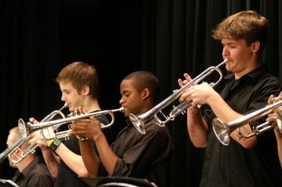
VOC 2010: Classification Result
SURREY_MK
UCLEAR_DOSP
Poselet, Maji et al, 2011
Our method, use “a”
Average precision
Phoning
Playing instrument
Reading
Riding bike
Riding horse
Running
Taking photo
Using computer
Walking
a
Φ
…
w

Slide 25
VOC 2010: Classification Result
SURREY_MK
UCLEAR_DOSP
Poselet, Maji et al, 2011
Our method, use “a”
Our method, use “w”
Average precision
Phoning
Playing instrument
Reading
Riding bike
Riding horse
Running
Taking photo
Using computer
Walking
a
Φ
…
w

Slide 26
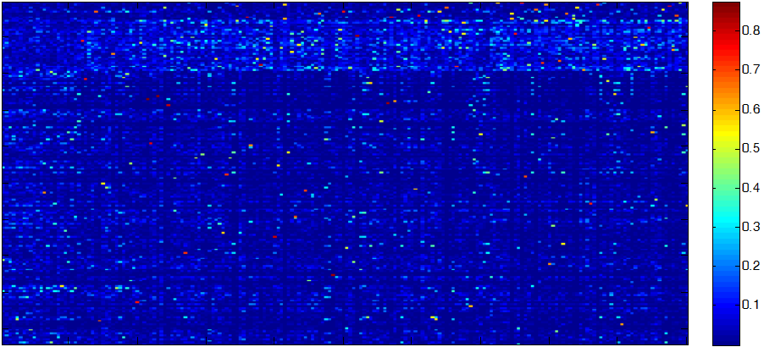
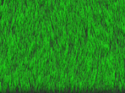
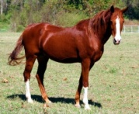
VOC 2010: Analysis of Bases
SURREY_MK
UCLEAR_DOSP
Poselet, Maji et al, 2011
Our method, use “a”
Our method, use “w”
Average precision
Phoning
Playing instrument
Reading
Riding bike
Riding horse
Running
Taking photo
Using computer
Walking
a
Φ
attributes
objects
…
poselets
w
400 action bases

Slide 27
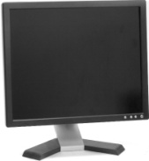
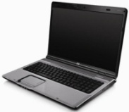
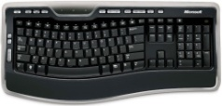
VOC 2010: Analysis of Bases
SURREY_MK
UCLEAR_DOSP
Poselet, Maji et al, 2011
Our method, use “a”
Our method, use “w”
Average precision
Phoning
Playing instrument
Reading
Riding bike
Riding horse
Running
Taking photo
Using computer
Walking
a
Φ
attributes
objects
…
poselets
w
400 action bases

Slide 28

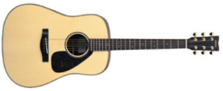
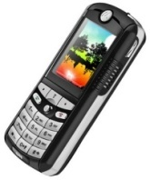

VOC 2010: Analysis of Bases
SURREY_MK
UCLEAR_DOSP
Poselet, Maji et al, 2011
Our method, use “a”
Our method, use “w”
Average precision
Phoning
Playing instrument
Reading
Riding bike
Riding horse
Running
Taking photo
Using computer
Walking
a
Φ
attributes
objects
…
poselets
w
400 action bases

Slide 29
VOC 2010: Control Experiment
Use “a”
Use “w”
Mean average precision
a
Φ
…
A: attribute
O: object
P: poselet
w

Slide 30
PASCAL VOC 2011 Result
Our method ranks the first in nine out of ten classes in comp10.
 | Others’ best in comp9 | Others’ best in comp10 | Our method
Jumping | 71.6 | 59.5 | 66.7
Phoning | 50.7 | 31.3 | 41.1
Playing instrument | 77.5 | 45.6 | 60.8
Reading | 37.8 | 27.8 | 42.2
Riding bike | 88.8 | 84.4 | 90.5
Riding horse | 90.2 | 88.3 | 92.2
Running | 87.9 | 77.6 | 86.2
Taking photo | 25.7 | 31.0 | 28.8
Using computer | 58.9 | 47.4 | 63.5
Walking | 59.5 | 57.6 | 64.2

Slide 31
PASCAL VOC 2011 Result
Our method achieves the best performance in five out of ten classes if we consider both comp9 and comp10.
 | Others’ best in comp9 | Others’ best in comp10 | Our method
Jumping | 71.6 | 59.5 | 66.7
Phoning | 50.7 | 31.3 | 41.1
Playing instrument | 77.5 | 45.6 | 60.8
Reading | 37.8 | 27.8 | 42.2
Riding bike | 88.8 | 84.4 | 90.5
Riding horse | 90.2 | 88.3 | 92.2
Running | 87.9 | 77.6 | 86.2
Taking photo | 25.7 | 31.0 | 28.8
Using computer | 58.9 | 47.4 | 63.5
Walking | 59.5 | 57.6 | 64.2

Slide 32
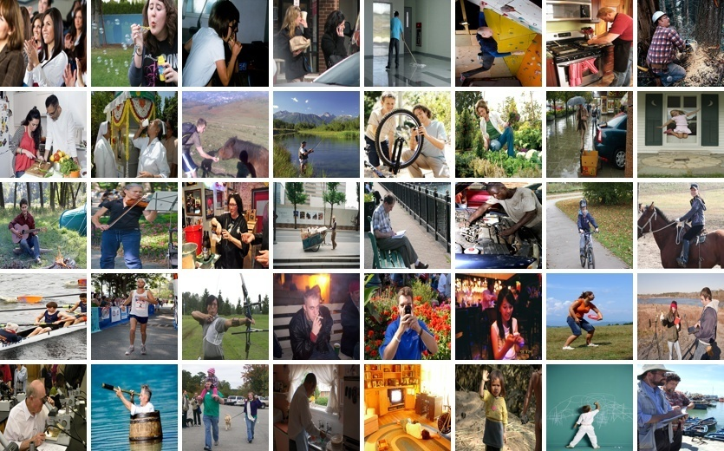
Stanford 40 Actions
40 actions classes, 9532 real world images from Google, Flickr, etc.
Applauding
Blowing bubbles
Brushing teeth
Calling
Cleaning floor
Climbing wall
Cooking
Cutting trees
Cutting vegetables
Drinking
Feeding horse
Fishing
Fixing bike
Gardening
Holding umbrella
Jumping
Playing guitar
Playing violin
Pouring liquid
Pushing cart
Reading
Repairing car
Riding bike
Riding horse
Rowing
Running
Shooting arrow
Smoking cigarette
Taking photo
Texting message
Throwing frisbee
Using computer
Using microscope
Using telescope
Walking dog
Washing dishes
Watching television
Waving hands
Writing on board
Writing on paper
http://vision.stanford.edu/Datasets/40actions.html

Slide 33
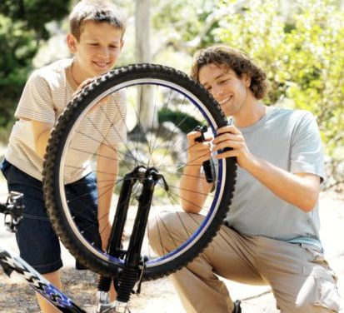
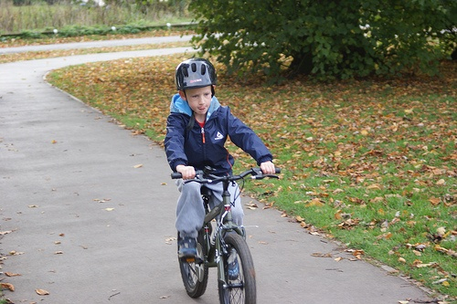
Stanford 40 Actions
40 actions classes, 9532 real world images from Google, Flickr, etc.
Applauding
Blowing bubbles
Brushing teeth
Calling
Cleaning floor
Climbing wall
Cooking
Cutting trees
Fixing bike
Cutting vegetables
Drinking
Feeding horse
Fishing
Fixing bike
Gardening
Holding umbrella
Jumping
Riding bike
Playing guitar
Playing violin
Pouring liquid
Pushing cart
Reading
Repairing car
Riding bike
Riding horse
Rowing
Running
Shooting arrow
Smoking cigarette
Taking photo
Texting message
Throwing frisbee
Using computer
Using microscope
Using telescope
Walking dog
Washing dishes
Watching television
Waving hands
Writing on board
Writing on paper
http://vision.stanford.edu/Datasets/40actions.html

Slide 34

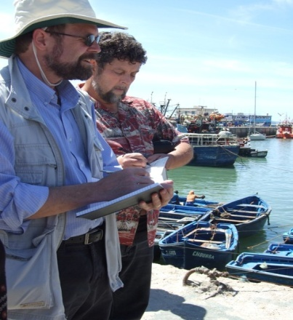
Stanford 40 Actions
40 actions classes, 9532 real world images from Google, Flickr, etc.
Applauding
Blowing bubbles
Brushing teeth
Calling
Cleaning floor
Climbing wall
Cooking
Cutting trees
Cutting vegetables
Drinking
Feeding horse
Fishing
Fixing bike
Gardening
Holding umbrella
Jumping
Playing guitar
Playing violin
Pouring liquid
Pushing cart
Reading
Repairing car
Riding bike
Riding horse
Rowing
Running
Shooting arrow
Smoking cigarette
Taking photo
Texting message
Throwing frisbee
Using computer
Writing on board
Writing on paper
Using microscope
Using telescope
Walking dog
Washing dishes
Watching television
Waving hands
Writing on board
Writing on paper
http://vision.stanford.edu/Datasets/40actions.html

Slide 35
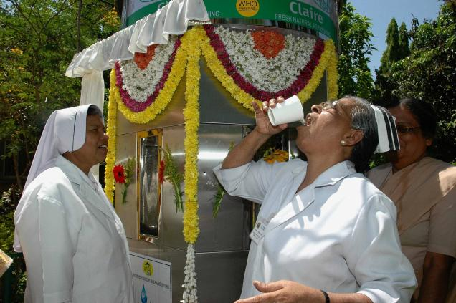
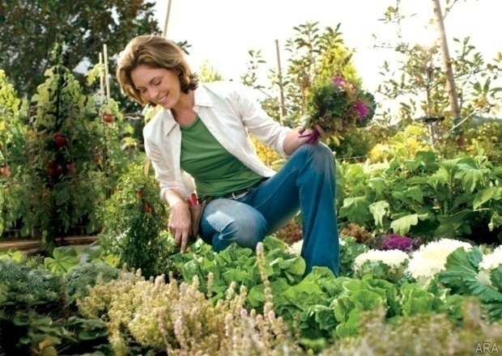

Stanford 40 Actions
40 actions classes, 9532 real world images from Google, Flickr, etc.
Applauding
Blowing bubbles
Brushing teeth
Calling
Cleaning floor
Climbing wall
Cooking
Cutting trees
Drinking
Gardening
Cutting vegetables
Drinking
Feeding horse
Fishing
Fixing bike
Gardening
Holding umbrella
Jumping
Playing guitar
Playing violin
Pouring liquid
Pushing cart
Reading
Repairing car
Riding bike
Riding horse
Smoking Cigarette
Rowing
Running
Shooting arrow
Smoking cigarette
Taking photo
Texting message
Throwing frisbee
Using computer
Using microscope
Using telescope
Walking dog
Washing dishes
Watching television
Waving hands
Writing on board
Writing on paper
http://vision.stanford.edu/Datasets/40actions.html

Slide 36
Stanford 40 Actions: Result
We use 45 attributes, 81 objects, and 150 poselets.
Compare our method with the Locality-constrained Linear Coding (LLC, Wang et al, CVPR 2010) baseline.
Average precision

Slide 37
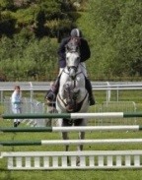

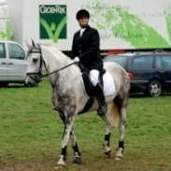
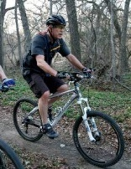

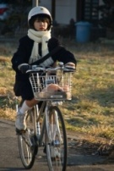
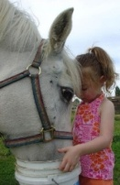
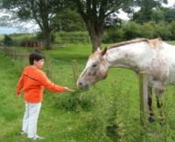
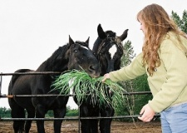

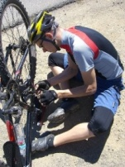
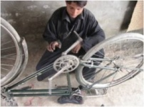
Stanford 40 Actions: Result
Average precision

Slide 38
Outline
Intuition: Action Attributes and Parts
Algorithm: Learning Bases of Attributes and Parts
Experiments: PASCAL VOC & Stanford 40 Actions
Conclusion

Slide 39
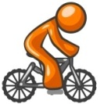





Conclusion
Attributes:
Action bases
Φ
a: Image feature vector
…
…
Parts-Objects:
…
…
…
Parts-Poselets:
…
…
Bases coefficients w

Slide 40






Acknowledgement

