Slide 1

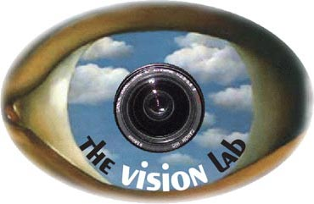
Recognizing Human-Object Interaction Activities
Action Classification
Action Retrieval
Bangpeng Yao and Li Fei-Fei
Computer Science Department, Stanford University
{bangpeng,feifeili}@cs.stanford.edu

Slide 2
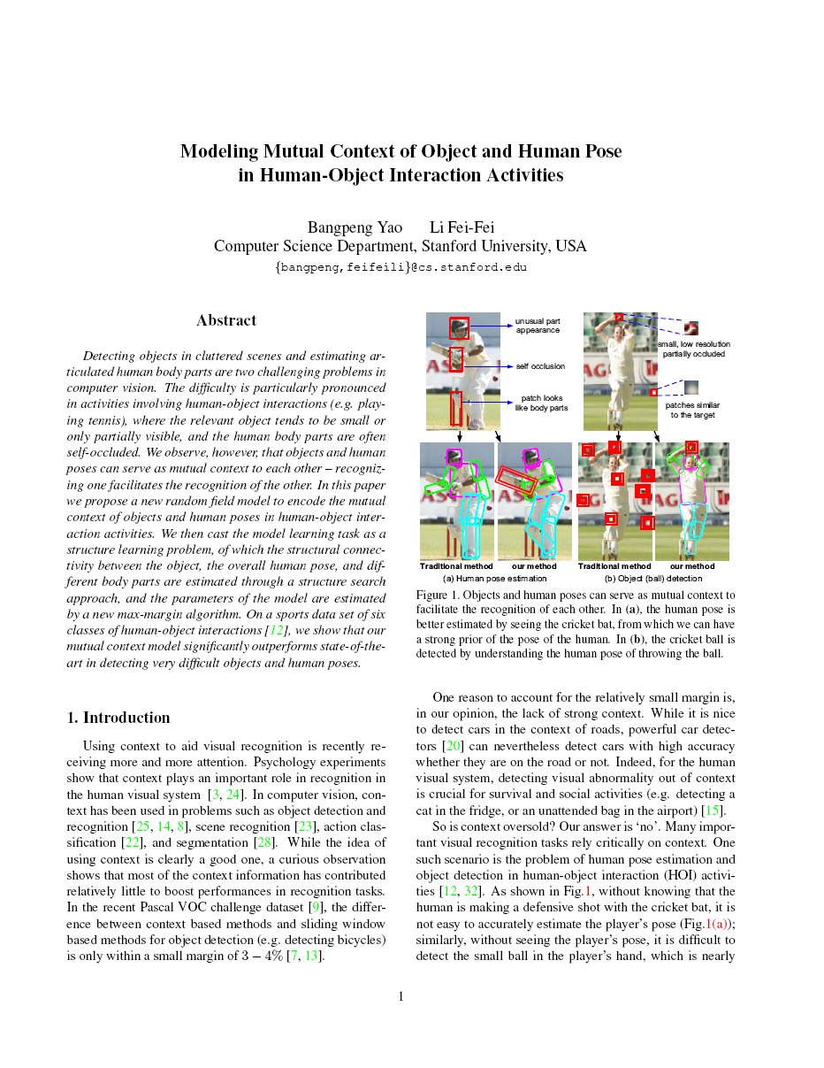
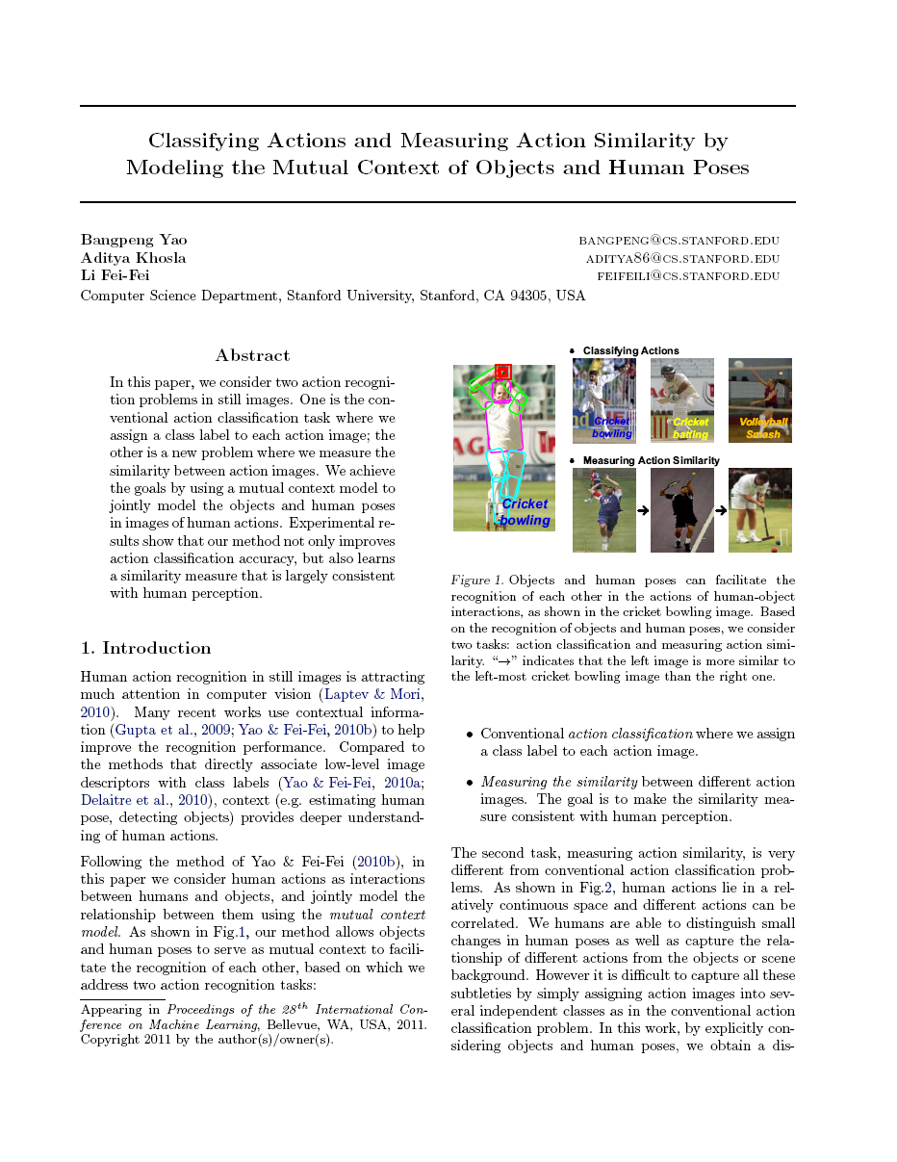
B. Yao and L. Fei-Fei. “Modeling Mutual Context of Object and Human Pose in Human-Object Interaction Activities.” CVPR 2010.
B. Yao, A. Khosla, and L. Fei-Fei. “Classifying Actions and Measuring Action Similarity by Modeling the Mutual Context of Objects and Human Poses.” ICML 2011.
Notes:
This talk is based on our CVPR and ICML work.

Slide 3
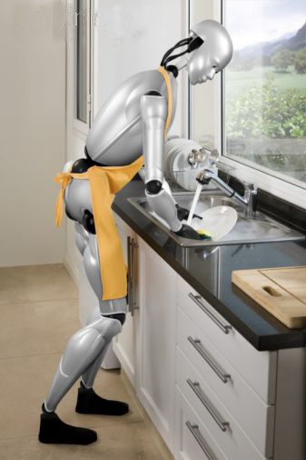
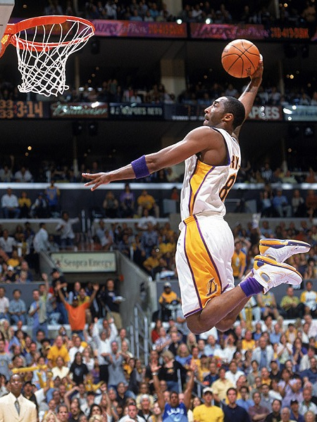
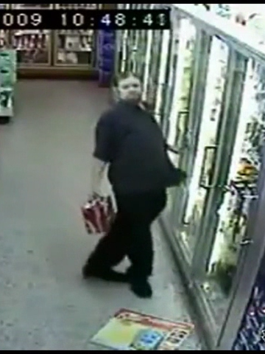
Human-Object Interaction
Robots interact with objects
Automatic sports commentary
Security – Drunk people detection
Notes:
Following our work in CVPR’10 and ICML’11, we treat humans actions as interactions between humans and objects so as to have deeper understandings of different actions.

Slide 4
Outline
Mutual context model for Action Recognition
Recognition I: Action Classification, Object Detection, and Pose Estimation
Recognition II: Action Retrieval by Matching Action Similarity
Conclusion

Slide 5

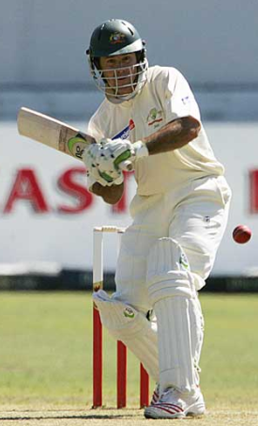
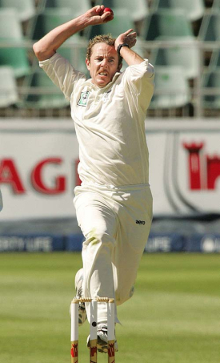
Human pose estimation & Object detection
Mutual Context

Slide 6

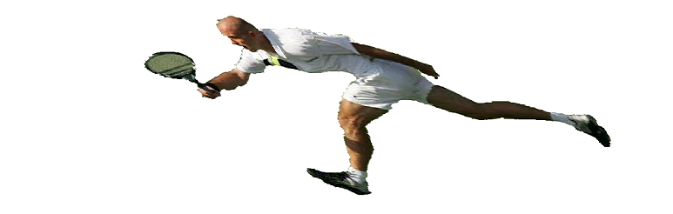
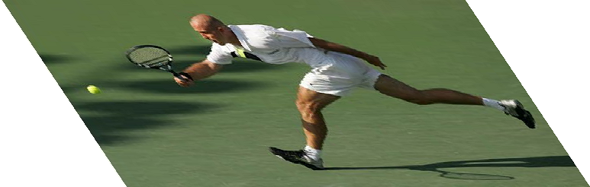
Mutual Context Model Representation
Conditional Random Field:
Activity
A
Human pose
Objects
H
Compatibility between actions, objects, and human poses:
O^{M}
O¹
Body parts
P₁
P₂
P_{L}
I
[Yao et al, 2011]
Notes:
The compatibility between actions, objects, and human poses are parameterized by simply counting the co-occurrence statistics among the three concepts. \zeta_{I,j,k} represents the strength of the interaction between atomic pose h_i, object o_j, and action class a_k.

Slide 7
Mutual Context Model Representation
Conditional Random Field:
Activity
A
Human pose
Objects
H
Modeling actions:
O^{M}
O¹
Body parts
P₁
P₂
P_{L}
N_{a}-dimensional output of an action classifier
I
[Yao et al, 2011]
Notes:
The human action is modeled by a discriminative classifier, whose output is denoted by s(I). \eta_k is the weight of the classifier output for the k-th action.

Slide 8
Mutual Context Model Representation
Conditional Random Field:
Activity
A
Human pose
Objects
H
Modeling objects:
O^{M}
O¹
Body parts
P₁
P₂
P_{L}
Object detection scores
Spatial relationship between two object windows
I
[Yao et al, 2011]
Notes:
As for the objects, we consider both independent object detection scores as well as spatial relationship between different object detection windows. In this equation, \gamma_j is the weight template for object class o_j. \gamma_{j,j\prime} is the weights for the geometric relationships between o_j and o_j\prime.

Slide 9
Mutual Context Model Representation
Conditional Random Field:
Activity
A
Human pose
Objects
H
Modeling human poses:
O^{M}
O¹
Body parts
P₁
P₂
P_{L}
Location of the l-th body part with the prior of atomic pose h_{i}
Detection score of the l-th body part
I
[Yao et al, 2011]
Notes:
The human poses are parameterized by considering the visual appearance and location of different body parts. We model the appearance and body parts in each atomic pose separately. In this equation, f indicates the detection score of the corresponding body part, which encodes the appearance information. We also estimate the distribution of each body part with respect to the prior of each atomic pose represented by h_i. \alpha_{I,l} and \beta_{I,l} are the feature weights for the location and appearance information of the l-th body part in atomic pose I respectively.

Slide 10
Mutual Context Model Representation
Conditional Random Field:
Activity
A
Human pose
Objects
H
Modeling human poses:
O^{M}
O¹
Body parts
P₁
P₂
P_{L}
Spatial relationship between the l-th body part and the m-th object window
I
[Yao et al, 2011]
Notes:
We also model the spatial relationship between the objects and different body parts. \lambda is the corresponding feature weight.

Slide 11
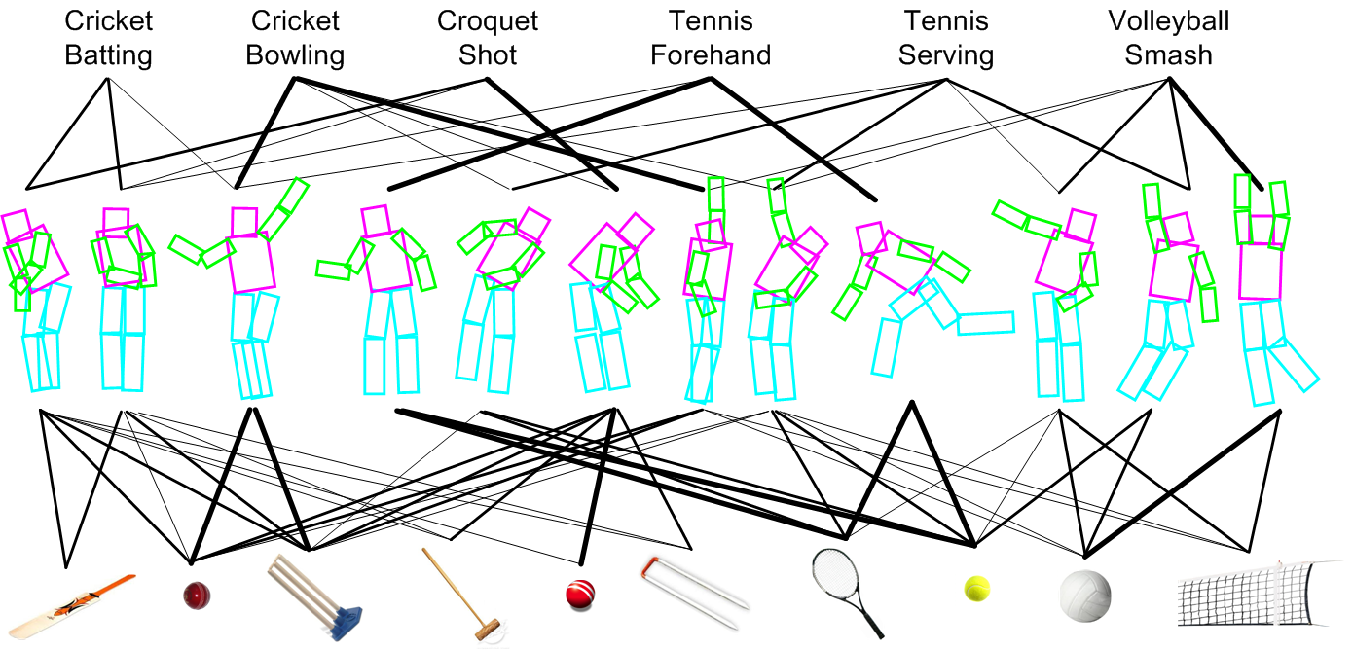
Model Learning Result
Activity classes:
Atomic poses:
Objects:

Slide 12
Outline
Mutual context model for Action Recognition
Recognition I: Action Classification, Object Detection, and Pose Estimation
Recognition II: Action Retrieval by Matching Action Similarity
Conclusion

Slide 13
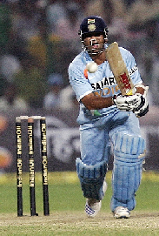
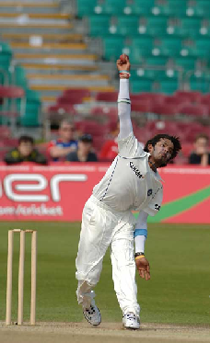
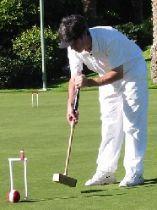
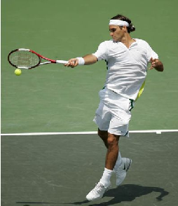
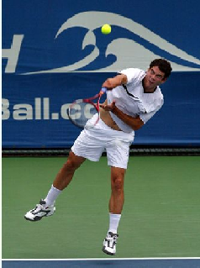
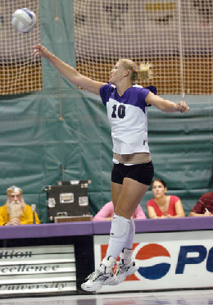
Sports Dataset
6 classes, 180 training (supervised with object and body part locations) & 120 testing images
Cricket batting
Cricket bowling
Croquet shot
Tennis forehand
Tennis serve
Volleyball smash
[Gupta et al, 2009]

Slide 14
Action Classification Results
Yao & Fei-Fei, (2010)
Yao et al, (2011)
Notes:
Our ICML results outperforms others by 4%, and achieves the best result in 3 out of 6 classes. Note that in our 2010 work, we did not use the overall image information.

Slide 15
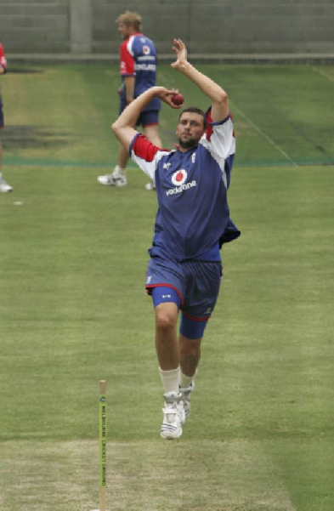
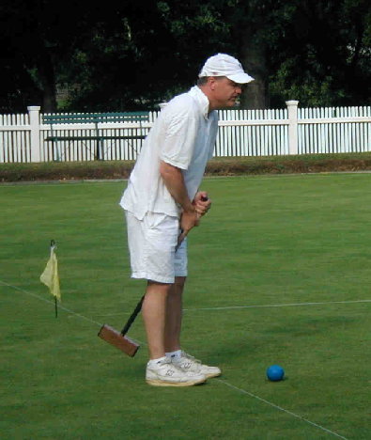
Object Detection Results
Method | Felzensz-walb et al. (2010) | Desai et al. (2009) | Yao et al. (2011)
cricket bat | .17 | .18 | .20
cricket ball | .24 | .27 | .32
cricket stump | .77 | .78 | .77
croquet mallet | .29 | .32 | .34
croquet ball | .50 | .52 | .58
croquet hoop | .15 | .17 | .22
tennis racket | .33 | .31 | .37
tennis ball | .42 | .46 | .49
volleyball | .64 | .65 | .67
volleyball net | .04 | .06 | .09
overall | .36 | .37 | .41

Slide 16
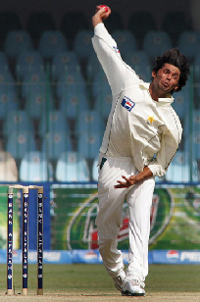
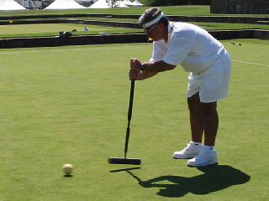
Human Pose Estimation Results
Method | Yao & Fei-Fei (2010) | Andrilu-ka et al. (2009) | Yao et al. (2011)
head | .58 | .71 | .76
torso | .66 | .69 | .77
left/right upper arms | .44 | .44 | .52
 | .40 | .40 | .45
left/right lower arms | .27 | .35 | .39
 | .29 | .36 | .37
left/right upper legs | .43 | .58 | .63
 | .39 | .63 | .61
left/right lower legs | .44 | .59 | .60
 | .34 | .71 | .77
overall | .42 | .55 | .59

Slide 17
Outline
Mutual context model for Action Recognition
Recognition I: Action Classification, Object Detection, and Pose Estimation
Recognition II: Action Retrieval by Matching Action Similarity
Conclusion

Slide 18
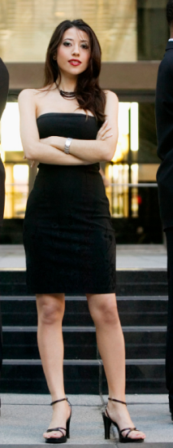

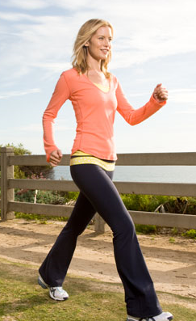
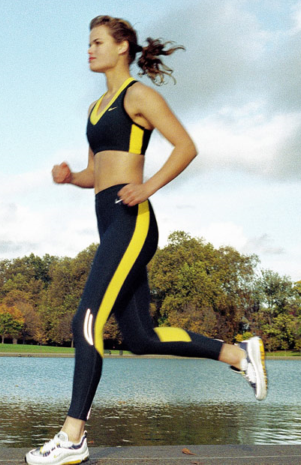
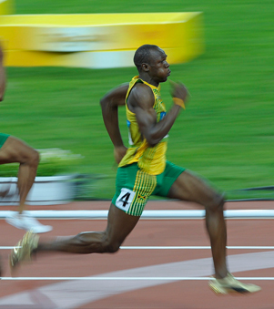
Is Classification the End?
stand
run
Actions in a continuous space

Slide 19
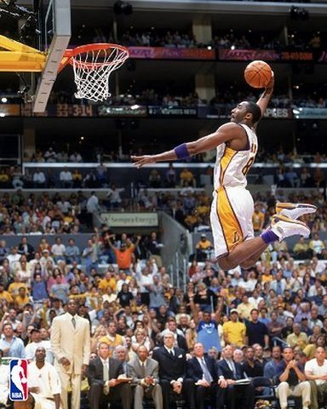
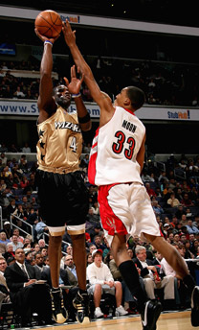
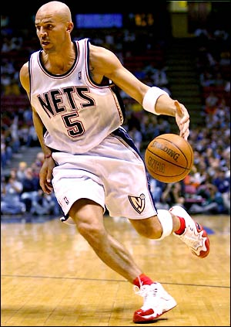
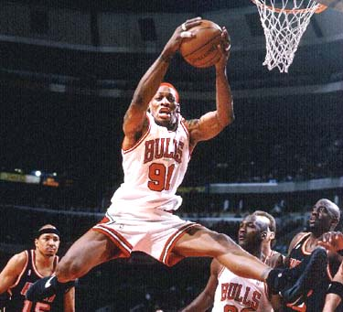
Is Classification the End?
Same action,
Different meanings

Slide 20

Is Classification the End?
More than one action at the same time
Calling
Shopping

Slide 21


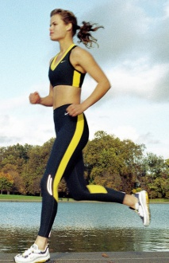
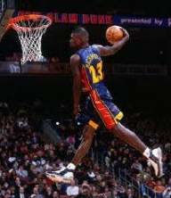
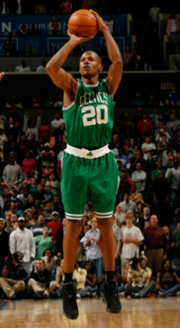


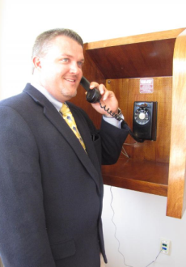

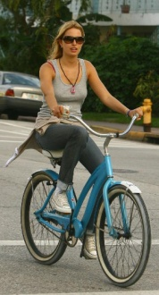
Retrieval Instead of Classification
>
>
>
>
>
>
>
>

Slide 22
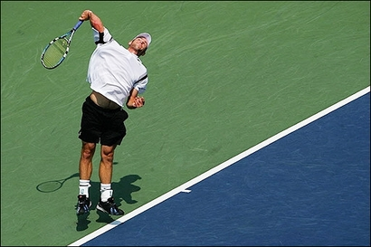
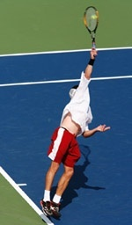
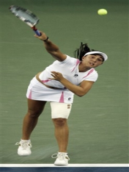
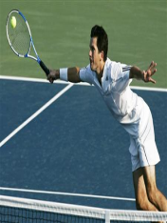
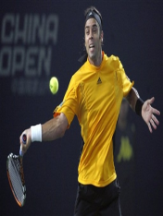
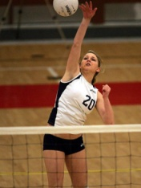

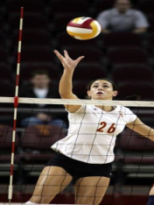
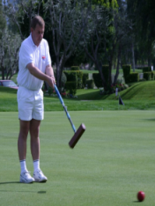
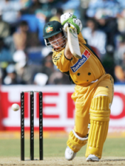
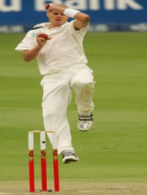
Retrieval as Similarity Ranking
Challenges:
  How to obtain the ground-truth?
  How to perform automatic retrieval?
  How to evaluate a retrieval system?
Ref.
Decreasing of similarity value

Slide 23
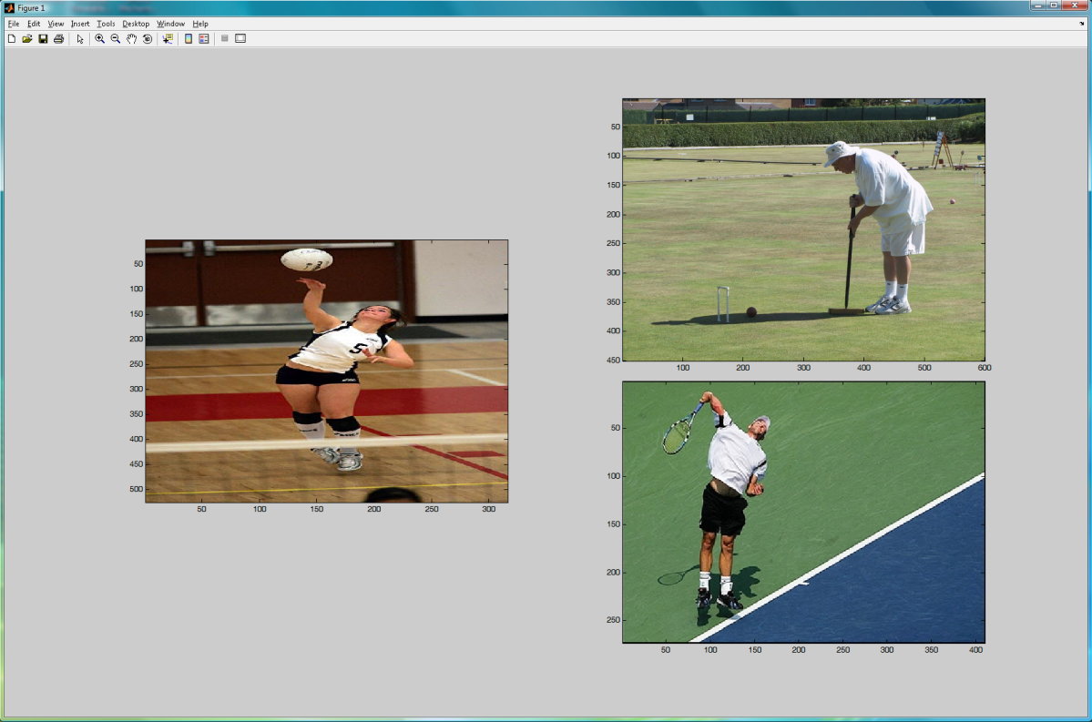

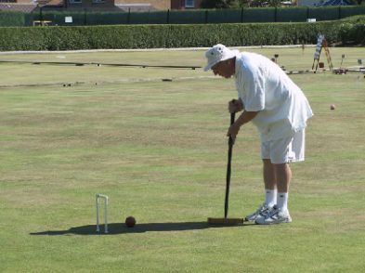
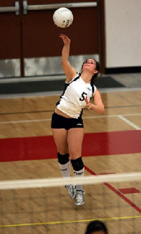

Action Retrieval: Obtaining Ground Truth
Human annotation experiment:
  Eight human subjects, the same set of 252 trials.
One trial:
Comparison images
Reference image
Reference image

Slide 24
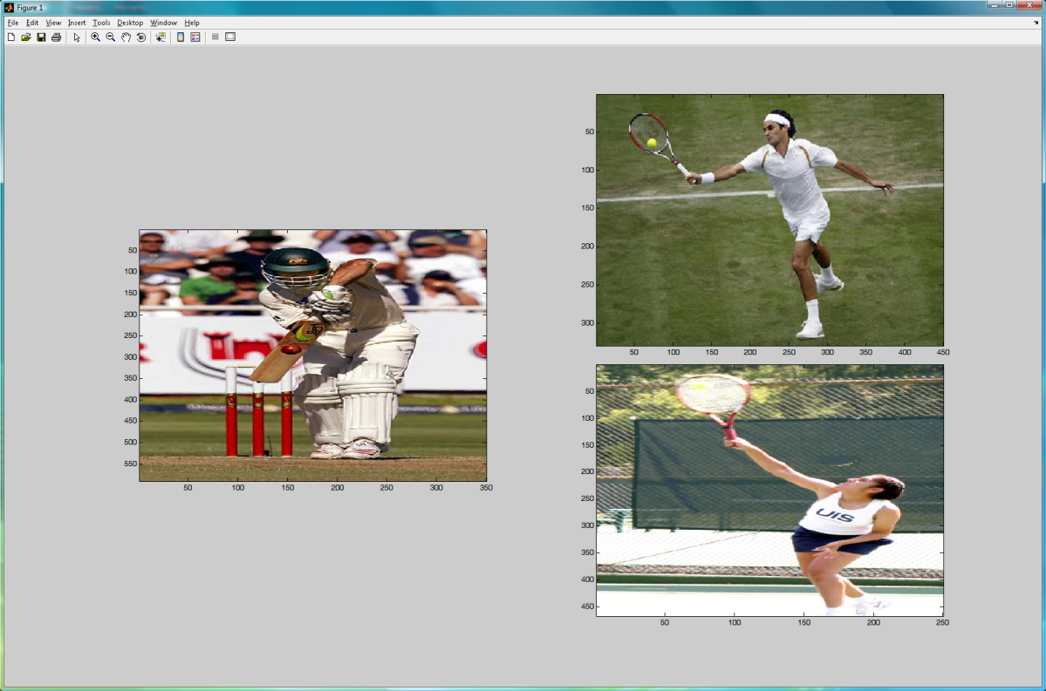
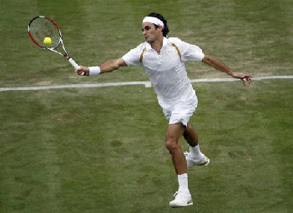
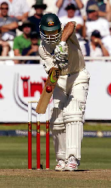


Action Retrieval: Obtaining Ground Truth
Human annotation experiment:
  Eight human subjects, the same set of 252 trials.
One trial:
Comparison images
Reference image
?
?
?

Slide 25
Action Retrieval: Obtaining Ground Truth
Human annotation experiment:
  Eight human subjects, the same set of 252 trials.

Slide 26






Action Retrieval: Obtaining Ground Truth
From pairwise annotation to overall similarity:
Pairwise
Similarity
Human annotation
vector
Sim( , )
-1 0 1 0 0
0 1 0 0 -1
Ref.
Notes:
Consider all the annotations, we have this optimization problem.

Slide 27














Action Retrieval: Obtaining Ground Truth
From pairwise annotation to overall similarity:
0.260
0.227
0.145
0.135
0.112
0.085
0.075
0.041
0.012
0.006
Ref.
0.002
0.000
0.000
0.000
0.000

Slide 28









Action Retrieval: Our Approach
Action class
Distance between two images I and I’:
>
Human pose
>
Total variance:
Object
>
Chi-square statistics:
Notes:
We use larger weights to action classes and human poses because the action classification and pose estimation results are more reliable than object detection.

Slide 29





Action Retrieval: Evaluation Metric
Ranking from an algorithm:
Ranking by ground-truth similarity:
Ref.
Accuracy
: ground-truth similarity
Number of Neighborhoods

Slide 30


Action Retrieval: Result

Slide 31
Action Retrieval: Result

Slide 32

Acknowledgment

