Slide 1
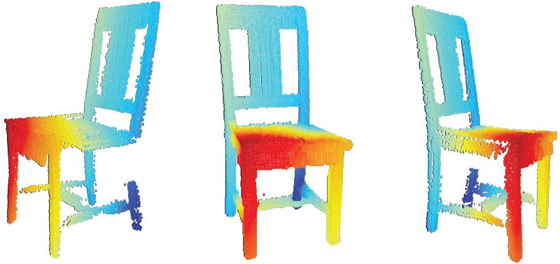
Estimating Image Depth from Shape Collections
Hao Su Qixing Huang Niloy Mitra
Yangyan Li Leonidas Guibas

Slide 2
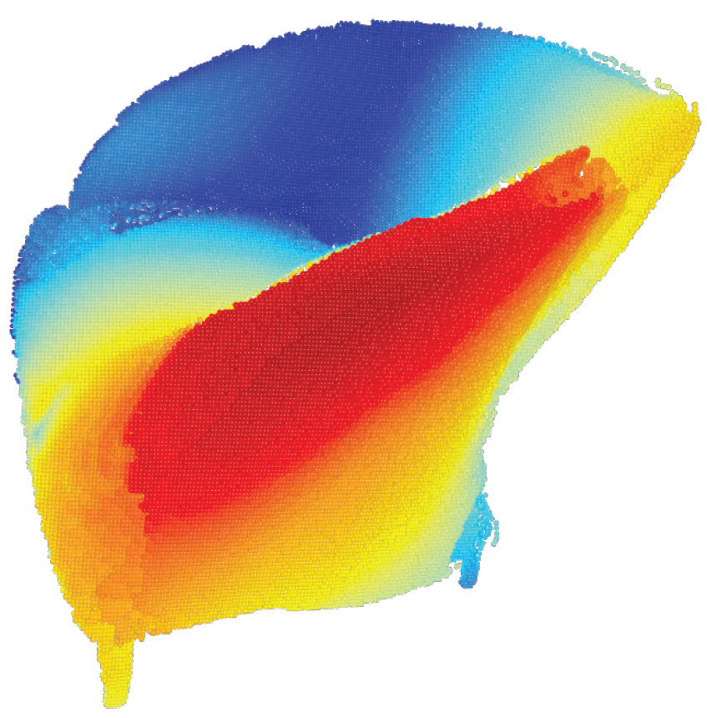
Depth Estimation From a Single Image
Notes:
Suppose that we have an image from the web. We can segment the foreground object from the background, automatically or manually. Our problem is, can we estimate the depth and even rebuid the model? We all know that this problem is physically ill-defined and extremely challenging.

Slide 3
High-quality Point Cloud Reconstruction
Notes:
Using our algorithms, we can obtain rather accurate results, at the quality even comparable to Kinect for common man-made objects.
And based upon the depth estimation, we can show a lot of interesting applications, such as depth aware image composition, novel view synthesis based upon a single image, and relight the object with simulated light source.

Slide 4
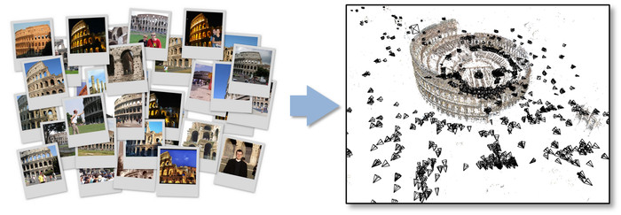
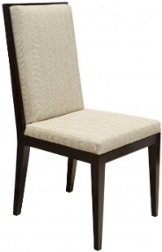
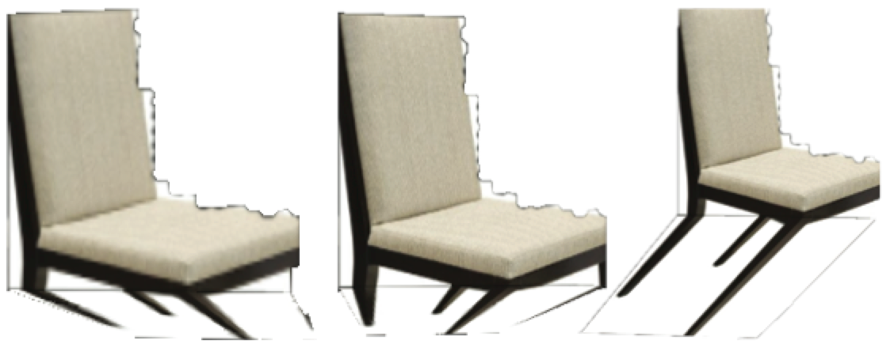
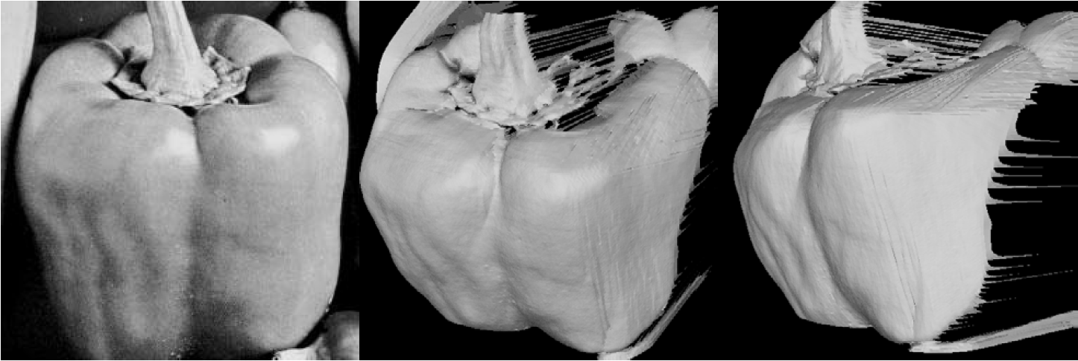
Related work
Multi-view: SfM
Single-view: learning-based
Snavely et al, TOG’06
Hartley et al
…
Hoiem et al, ICCV’05
Saxena et al, NIPS’05
…
Single-view: SfS
Single-view: shape-guided
Horn et al, ’89
Xu et al, SIGGRAPH’11
Efros et al, CVPR’14
…
Notes:
In fact, image-based 3D reconstruction is a long-standing problem in the heart of computer vision and graphics.
Because the problem is ill-defined, various prior and constraints have been tried to restrict the solution space.
For example, structure from uses multiple images from different views to constrain the solution space. But it requires more than one views, which is not quite applicable for web photos.
For single view reconstruction, an important idea is shape from shading. This approach makes assumptions over surface reflective property. But again, it does not work for generic photos with unknown reflectance.
Another approach is learning based. These works try to predict geometrical properties of pixels. This works well for scene with simple layout, but fails for indoor objects with thin and fine structure.
Recently, shape-guided approach seems to be promising. This is also very relevant to our work. We will review this line of work with more details.

Slide 5
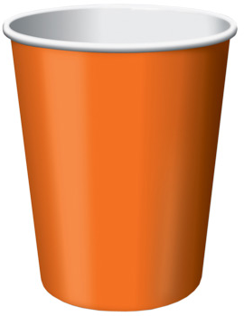
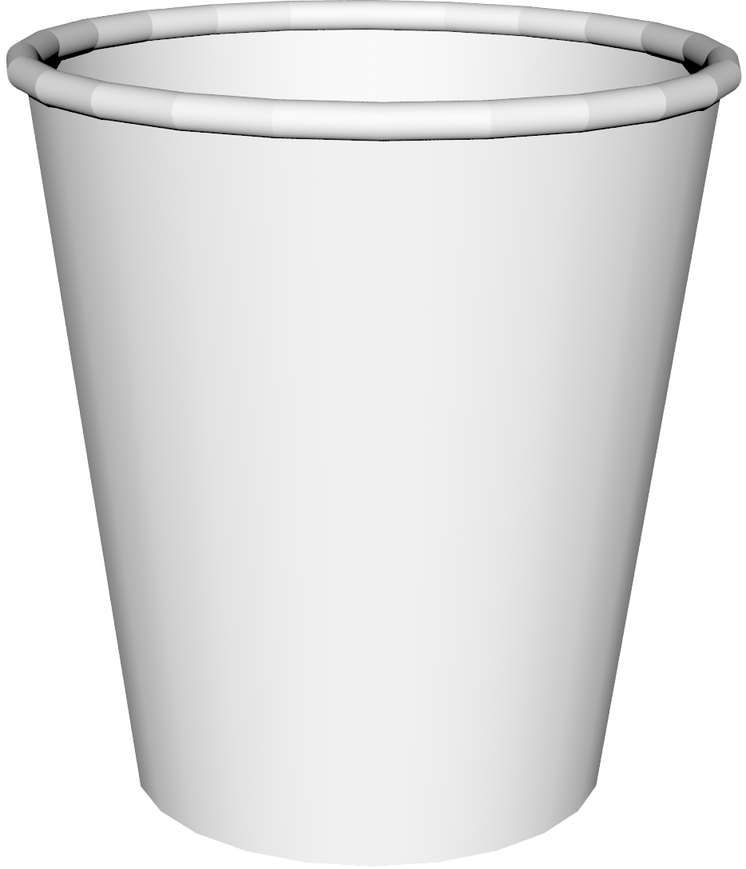
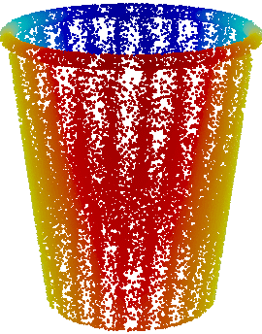
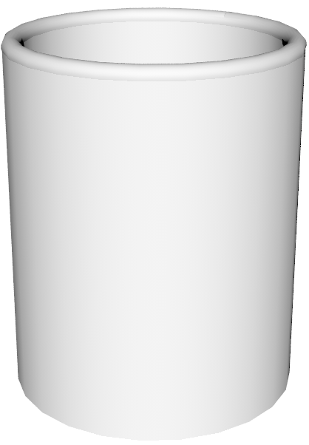
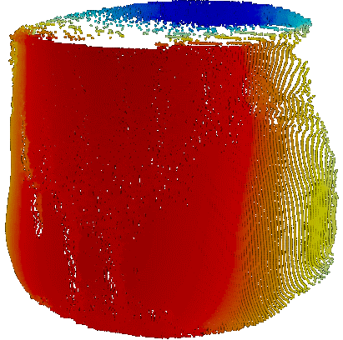
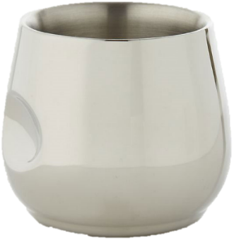
Shape-guided depth estimation
Input Image
Similar Model
Depth Estimation
A single model is insufficient!
Notes:
We start with a very simple example. Given this cup, if we can find a very similar shape, then we can simply estimate the viewpoint and do a virtual scan as its depth estimation.
However, if we cannot find a shape very similar to the input, we will have to deform the model. It is natural to constrain the shape contour at the estimated viewpoint to fit the image contour. But from other views, the depth estimation may be miserable.

Slide 6
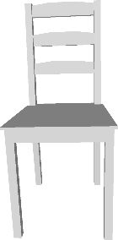
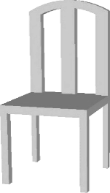
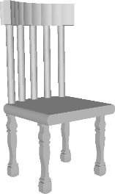
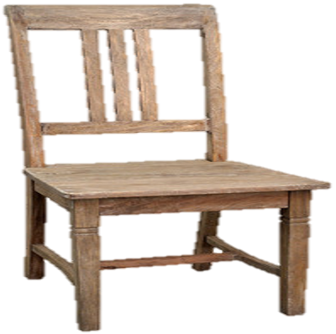
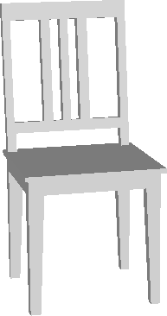
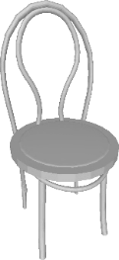
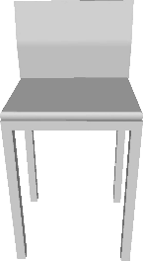
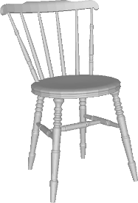
Fundamental Challenges
Require Similar Models
Deformation ill-Posed
Corresp. Challenging
Notes:
We summarize that there are three fundamental challenges for shape-guide image depth estimation
-- a very similar model is needed
-- when deforming the shape, constraints from a single view is insufficient
-- when image and shape topologies are different, the correspondence problem is difficult.

Slide 7
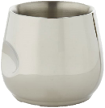
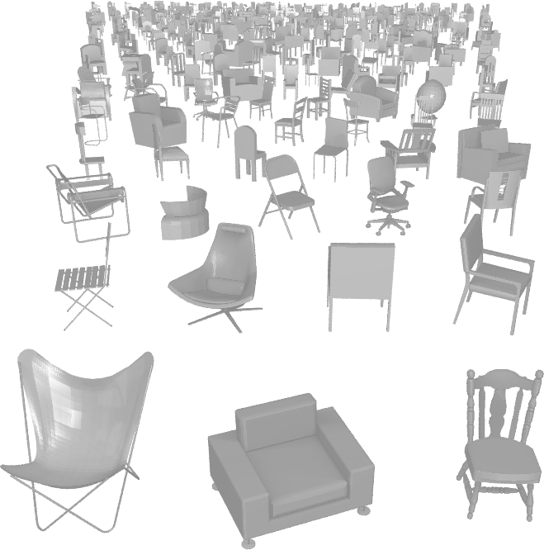
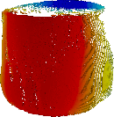
Solution: Guidance from Shape Collection
Diverse Topology
Notes:
We propose to solve the above challenges by information extracted from shape collection.
For the first problem, if we cannot find a very similar model, we can consider to composite parts from different models.

Slide 8
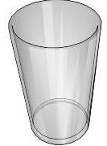
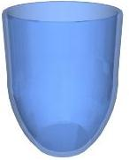
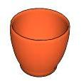
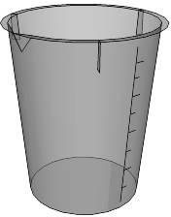
Solution: Guidance from Shape Collection
Deformation Modes Learning
Notes:
If we known how to deform from one model towards many neighbors of it, then we can infer common global deformation modes, such as symmetry preservation.

Slide 9
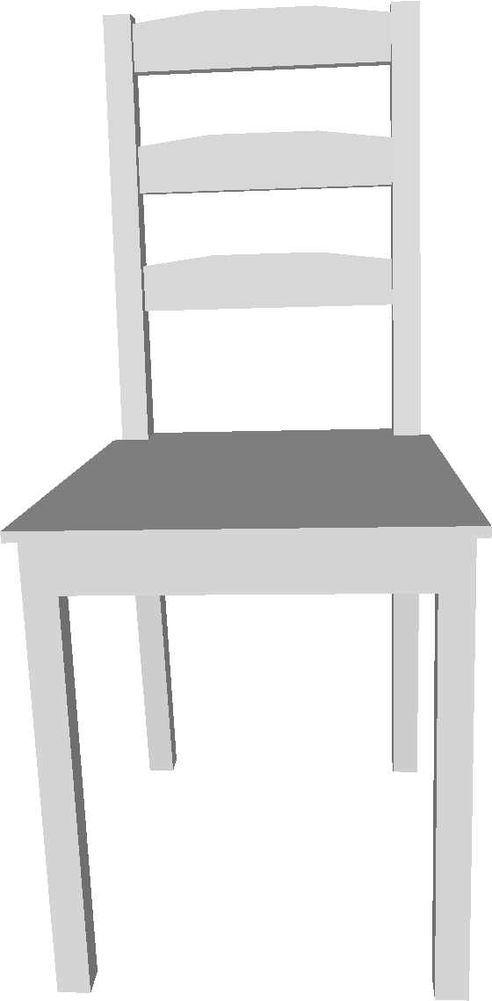
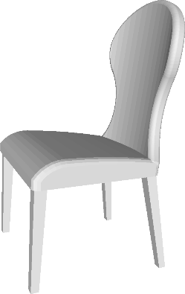
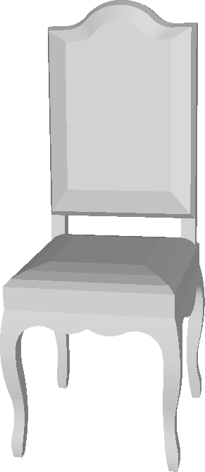
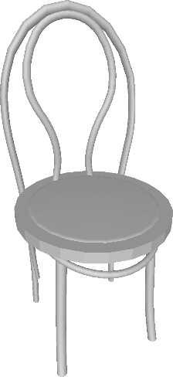
Solution: Guidance from Shape Collection
Consistent Corresp. by Shape Maps
Notes:
Lastly, we know that reliable maps among shapes can be computed, from the previous talks this morning. Therefore, though matching a single image-shape pair is difficult, we can take advantage of mappings among shapes to enforce that correspondences are consistent in the collection.

Slide 10
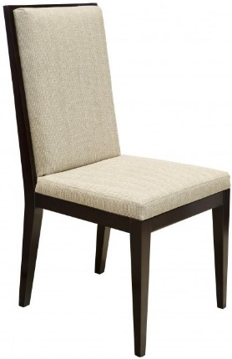
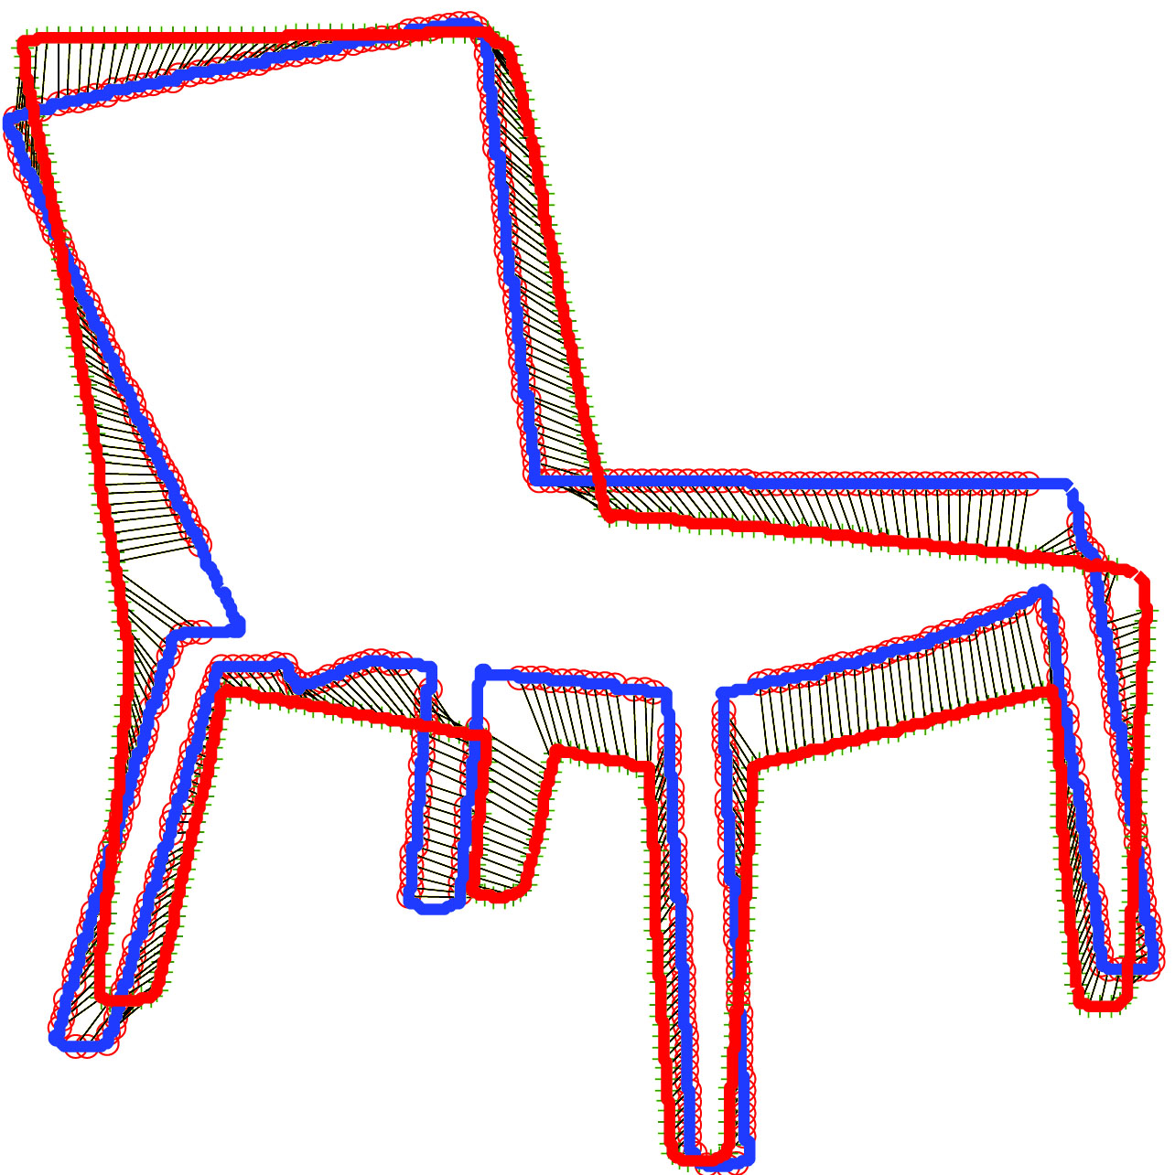
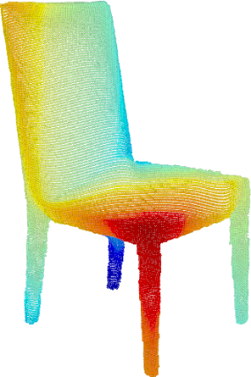
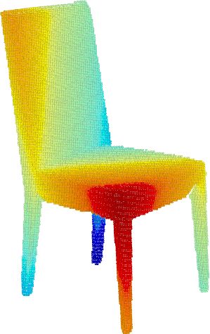
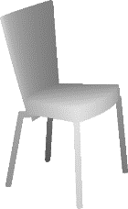
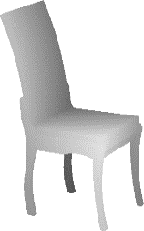
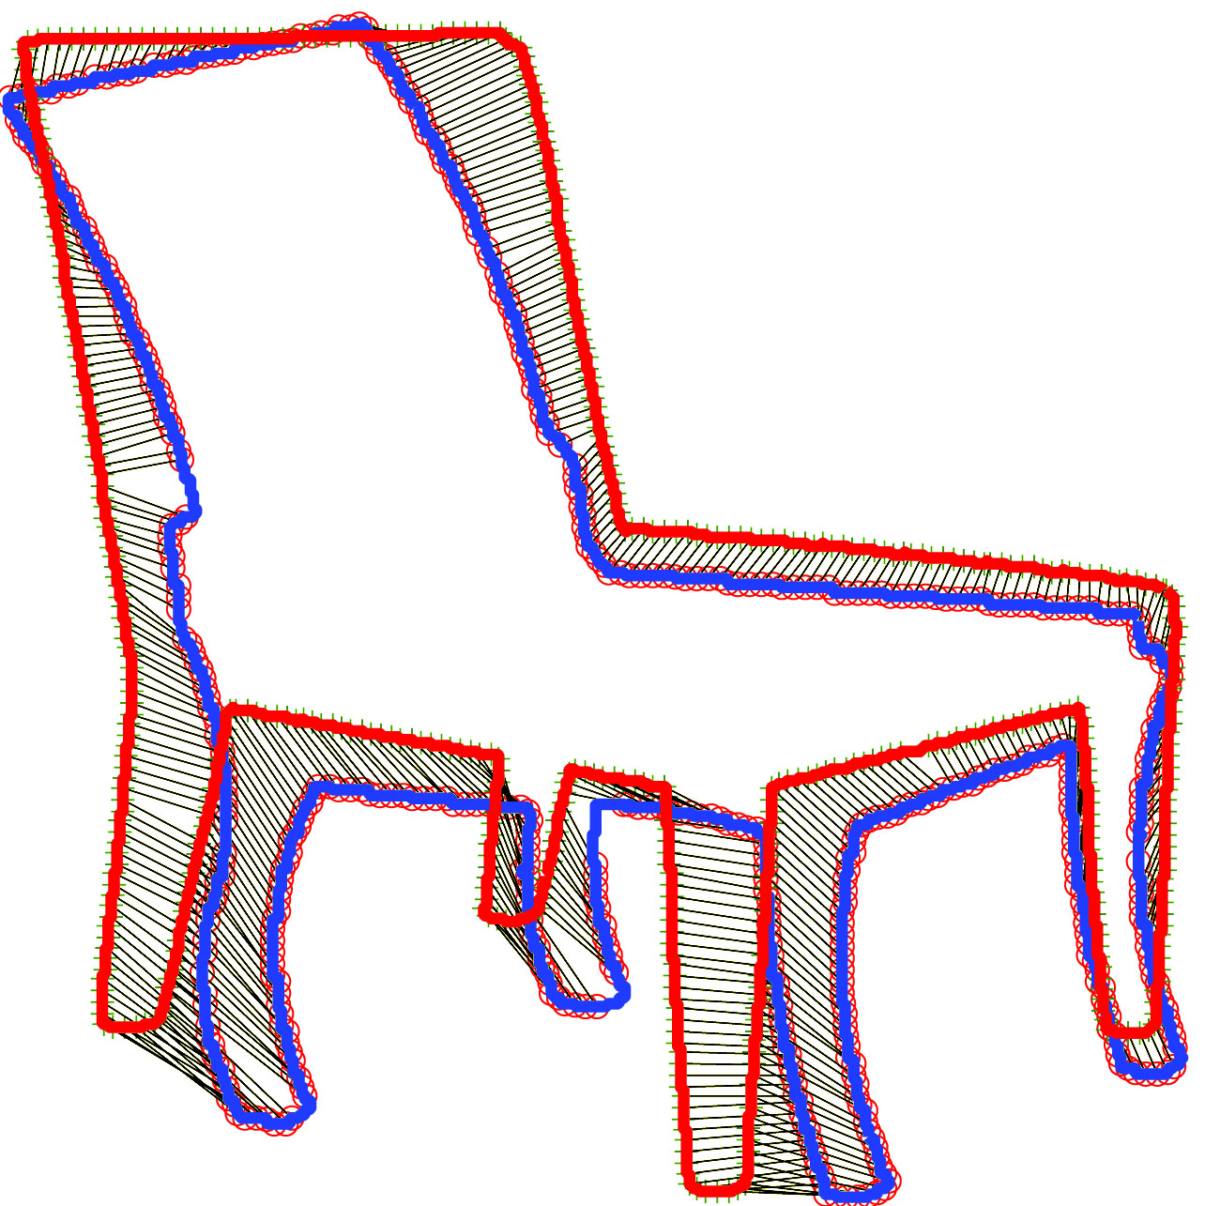
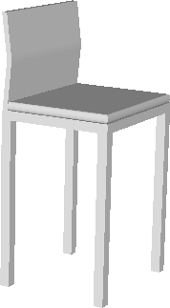
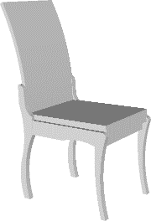
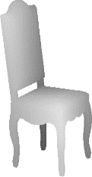
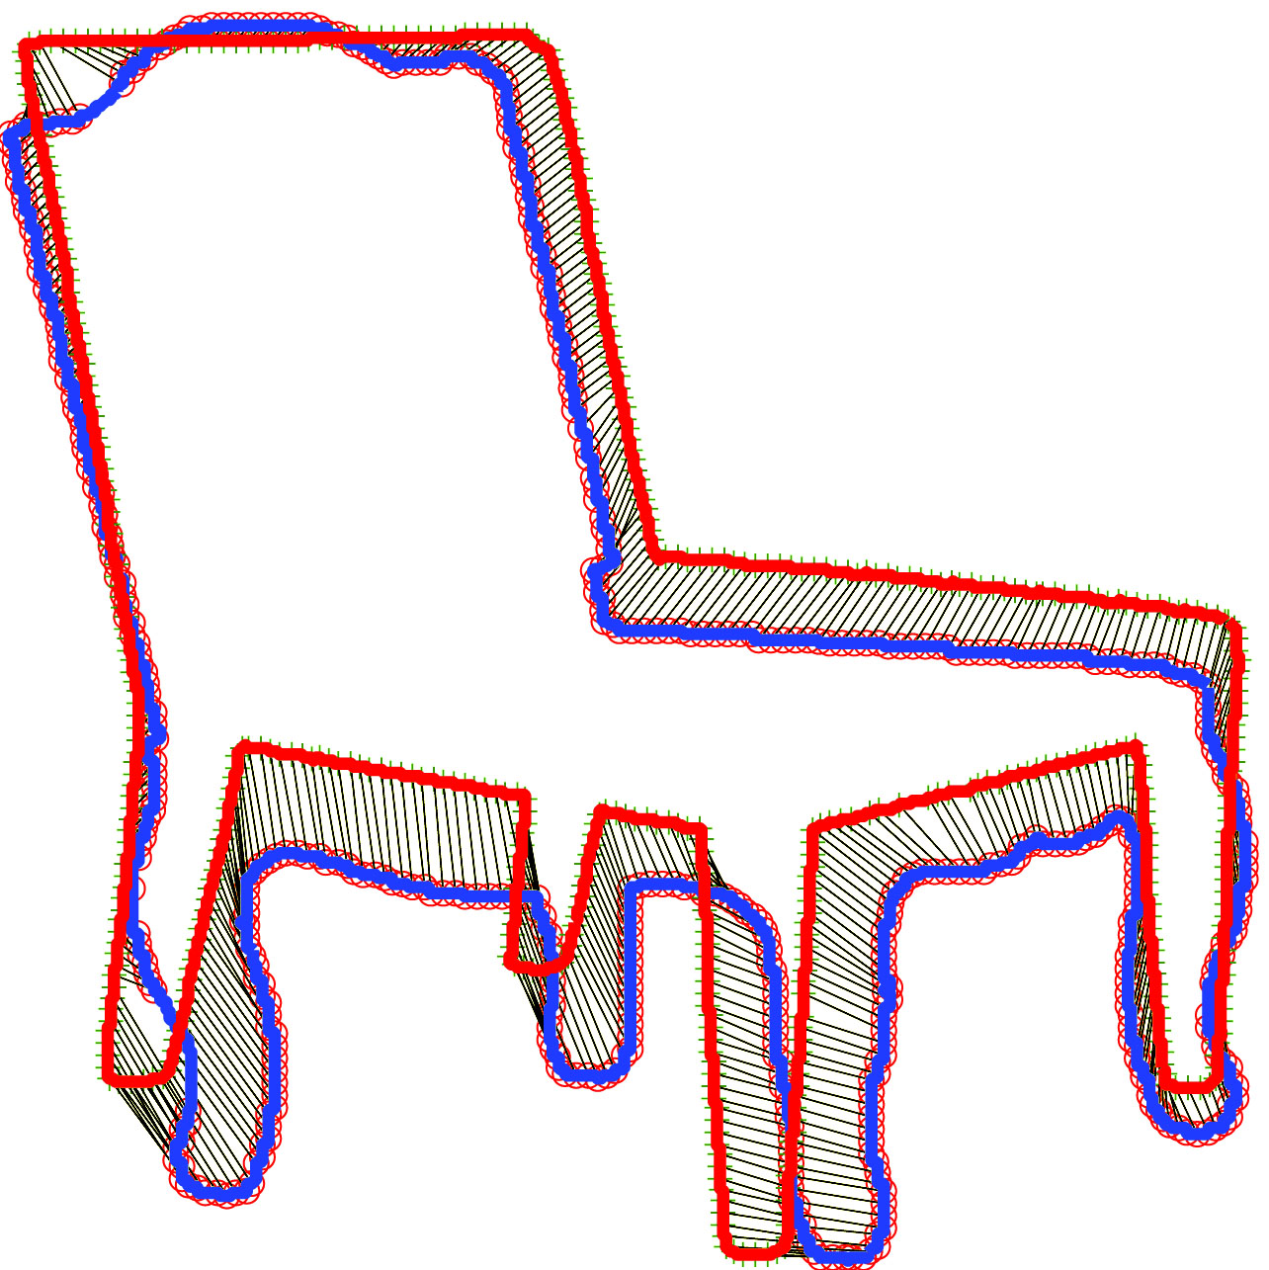
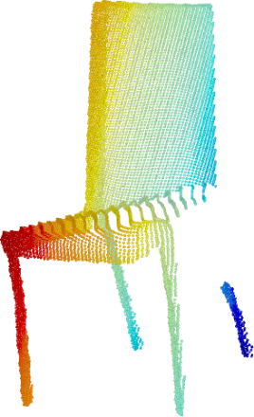
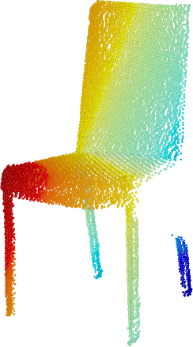
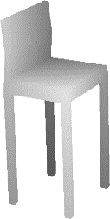
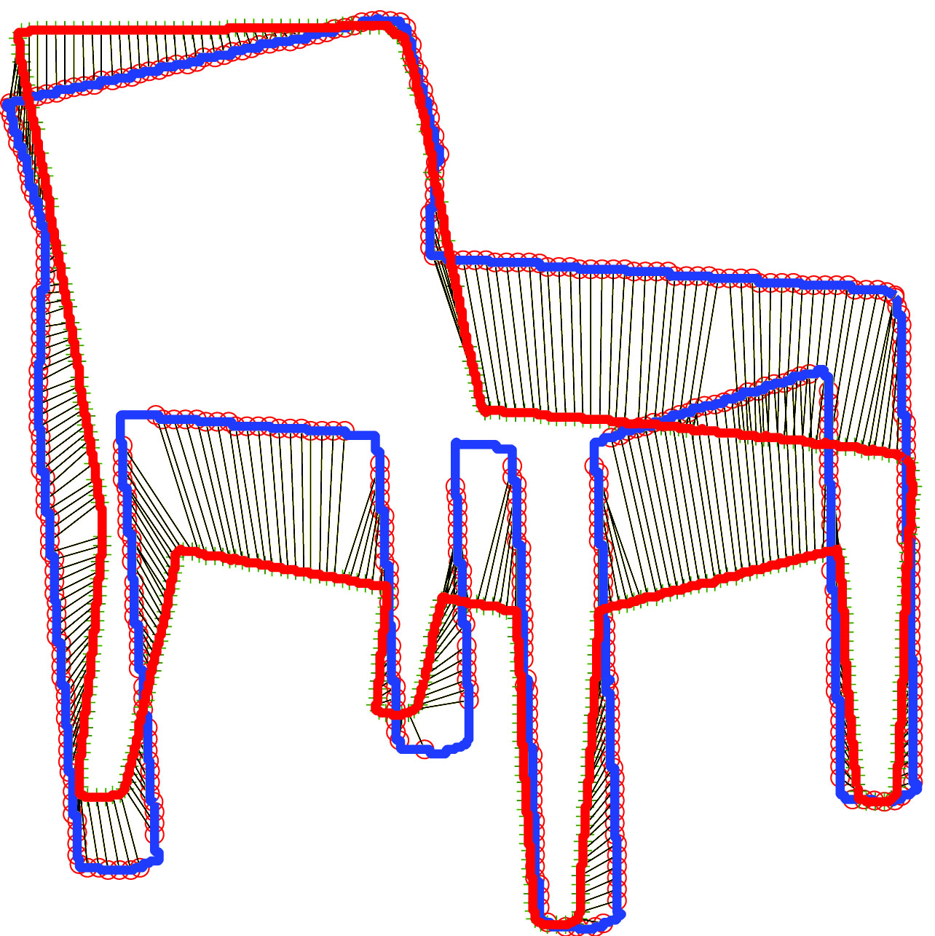
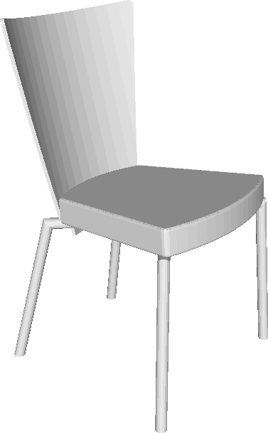
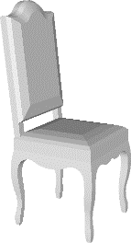
Pipeline
Init. Depth Estimation
Depth Refinement
Pose Est.
2D Matching
Re-estimate depth
Matching in 3D
Deform shapes
Init. Depth Est.
Final Depth Est.
Notes:
Based upon the above observation, we propose our pipeline.
It has two main steps, building initial depth estimation and refine the depth estimation.
The first step has two sub steps. For pose estimation, we find a set of similar shapes and optimal view estimation. Based upon the view estimation, we can do 2D matching and transfer depth from sets of similar shapes to the images.
After this step, we have the initial depth estimation, thus a point cloud in 3D. In the next step, we do non-rigid ICP among the lifted point cloud and similar shapes. This outputs a refined depth estimation.
We will further explain key steps as follows.

Slide 11
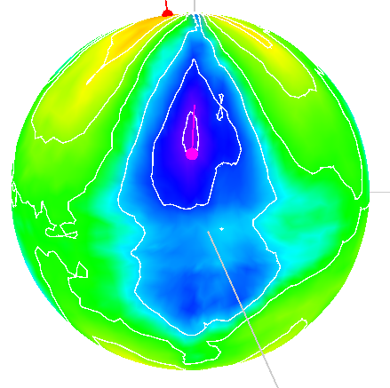
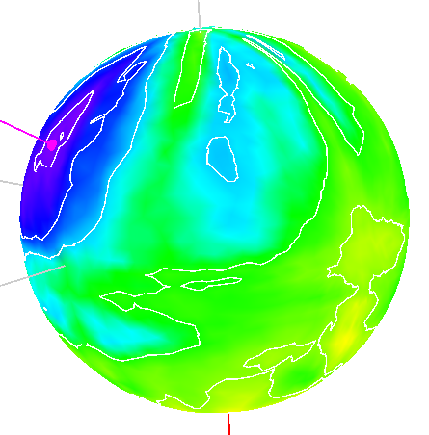
Pose Estimation
HoG Lightfield
Notes:
The first step is pose estimation.
Given an image, we can compare it with rendered views of a shape by image features, such as HoG. We use the sphere to indicate the similarity of the image and every view of the shape. Blue means higher similarity. It can be seen that relying a single for pose estimation is not robust. However, if we can compare the image with multiple shapes, we can incorporate mappings among the shape network and find the pose that is the most consistent with all shape candidates.

Slide 12
2D Matching
Notes:
We have seen the power of shape network in pose estimation. Here, we again use it in the 2D matching step. Just as before, we can take advantage of mappings in the shape network to enforce that depth estimation agrees with all shapes.

Slide 13
Deformable Matching
Re-estimate depth
Matching in 3D
Deform shapes
Init. Depth Est.
Final Depth Est.
Notes:
After initial depth estimation step, we have lifted the input from 2D image to 3D point cloud. Starting from this moment, we can do matching in 3D among reconstructed point clouds and similar shapes. We adopt an iterative procedure to refine it.
Remember that the point cloud comes from an ill-defined problem, therefore, we cannot truly trust it. As a key novelty of this work, we introduce a method to deform shape with regularities learned from shape collection.

Slide 14
Deformation Prior
With Prior
Notes:
Again, we use a simple example to illustrate it.
As we showed before, deforming a single shape towards the image by contour matching may give you bad result for views other than the one to be matched. But after seeing neighbor shapes in the collection, we can learn that, a natural deformation should preserve the circular symmetry. That will generate an improved result for all views.
This inspires us to infer a shape deformation prior from the shape collection and use it to guide the deformation towards the image.

Slide 15
Deformation model
Another Chair
𝓓$\left(x\right)=\sum_{α∈J}{B_{α}\left(x\right)p_{α}}$
$$\text{𝓓}\left(x\right)=\sum_{α∈J}{B_{α}\left(x\right)p_{α}}$$
$$\text{𝓓}\left(x\right)=\sum_{α∈J}{B_{α}\left(x\right)p_{α}}$$
Another Chair
$$𝓓_{i}^{∗}:opt. deformation for shape i$$
Notes:
Formally, we consider to represent shape deformation using deformation fields. Therefore, the deformation can be parameterized as the movement of “control points”. By checking how one model deforms to many neighbors, we can discover the common subspace these deformation shares.

Slide 16
Shape deformation subspace
$$Prior\left(𝓓_{i}\right)=\sum_{j=1}^{M}{\frac{σ_{1}}{σ_{j}+ε}}{({(c_{i}−c_{i}^{0})}^{T}u_{j})}^{2}$$
$$σ_{1}≥σ_{2},…,≥σ_{M}−principal values, u_{1},u_{2},…,u_{M}−principal directions$$
$$c_{i}−control points, c_{i}^{0}−initial control points$$
Notes:
In fact, when assuming the deformation subspace to be linear, our experiment shows that, it is quite a low-dimensional. In the plot, x-axis is the rank of principal values and y-axis is the principal values, which shows the variance of shape in the principal direction. As shown in the top-right figures, the first deformation mode tends to grow a shape taller, while the fourth deformation mode tends to shrink the model towards the center. We build a prior of quadratic form to enforce that shape deformation lives in this low-dimensional space when fitting images.

Slide 17
Optimization Objective
← small scale
← sparse
Re-estimate depth
$f_{data}$: Deformed models should fit depth estimation
$f_{regu}$: Depth estimation should be spatially smooth
Matching in 3D
$f_{prior}$: Deformation should agree with shape collection
Deform shapes

Slide 18
Experiment results
Notes:
Next, we show some experiment results

Slide 19
Point Cloud Reconstruction
Our
Notes:
Our first result is point cloud reconstruction. It can be seen that we can build pretty decent point cloud, comparable to Kinect scan. For the base of the lamp, because of the reflectance, Kinect misses certain area, while ours is more smooth.
However, because we introduced an L2 smooth term, we have some flying points at the neck. Using L1 smooth term may eliminate them.

Slide 20
Point Cloud Reconstruction
Our
Notes:
This is again a point cloud reconstruction example. Our recovery is close to Kinect. Because the image is taken from high elevation, our reconstruction also looks better from above. But we also see that when looked from below, our seat estimation is too thick. This is the perspective effect.

Slide 21
Mesh Completion
(TODO: use a high-res img)
Mesh Completion
Notes:
By learning symmetry patterns from the shape collection, we can also complete the invisible part of the shape and reconstruct the surface.

Slide 22
Towards Scalable Shape Modeling
Image world
Shape world
10¹²
2014
10¹⁰
10⁸
10⁶
10⁴
Images
3D Models
Notes:
Traditionally, building 3D models is a highly skilled task and can only be done by professionals. We know that there are way more shapes than 3D models in the world, hence, we envision that our tool is a key step towards scalable shape modeling.

Slide 23
Complementary Information Transportation
Image world
Shape world
Diversity
High: fine-grained
Medium: common objects
Attribute
color & texture
geometry
Notes:
In addition to transporting depth from shapes to images, with the bridge built by our tool, we can also transport useful information from images to shapes, such as semantic labels, color and texture.

Slide 24
Limitation & Future Work
Image-Shape Matching Problem
Assuming no occlusion to image object
Difficult to match interior points of image and shapes
Need better feature for comparing images and rendered views
Fine structure recovery
Interactions may help
Deformation Subspace Learning
Linear subspace may be insufficient
Notes:
The key challenge for current system is “image-shape matching” part.

Slide 25
Acknowledgement
Anonymous Reviewers
Sponsors

Slide 26
Thank you!

Slide 27
ShapeNet: A Large-scale Shape Network
>250,000 models
>2,000 classes
Structured by WordNet
Human verified
Pose aligned*
Point matched*
* In progress, a subset of categories have finished

