Slide 1
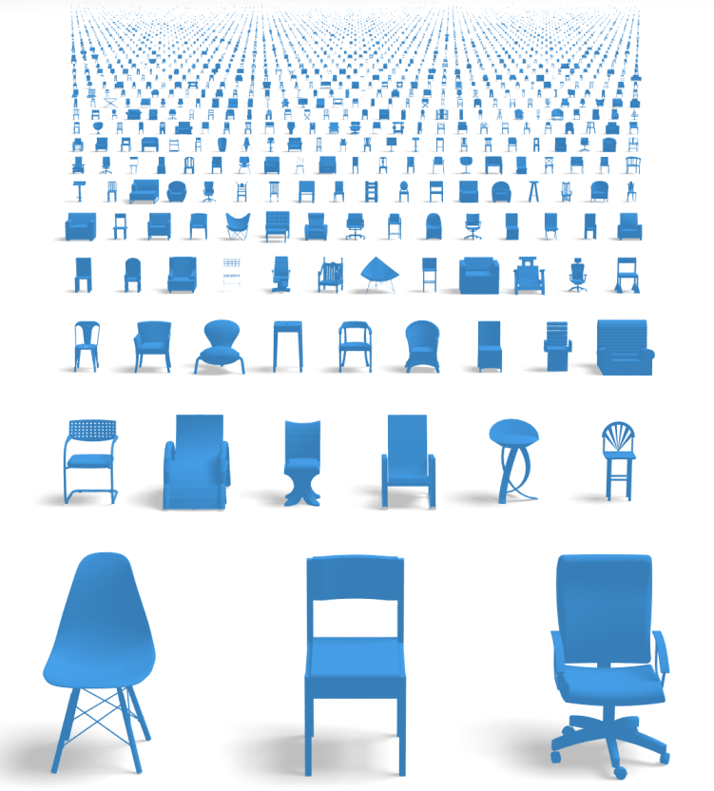
Synthesize for Learning: Joint analysis of 2D images and 3D shapes
Hao Su
Image world
Shape world
Notes:
In this talk, I will introduce my latest work on how I bridge the virtual world of 3d shapes and real world of 2d images. This is a interdisciplinary study across computer vision, computer graphics, and machine learning.

Slide 2
How humans represent 3D in mind?
Notes:
It is fascinating to ask, how humans infer and represent 3D in their mind? In fact, humans are so good at inferring 3D from even a single image. Look at this picture, you can’t help but worry for the boy.

Slide 3
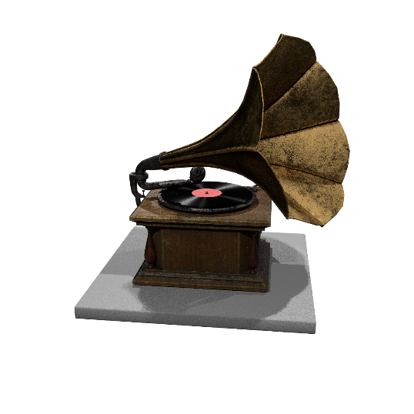
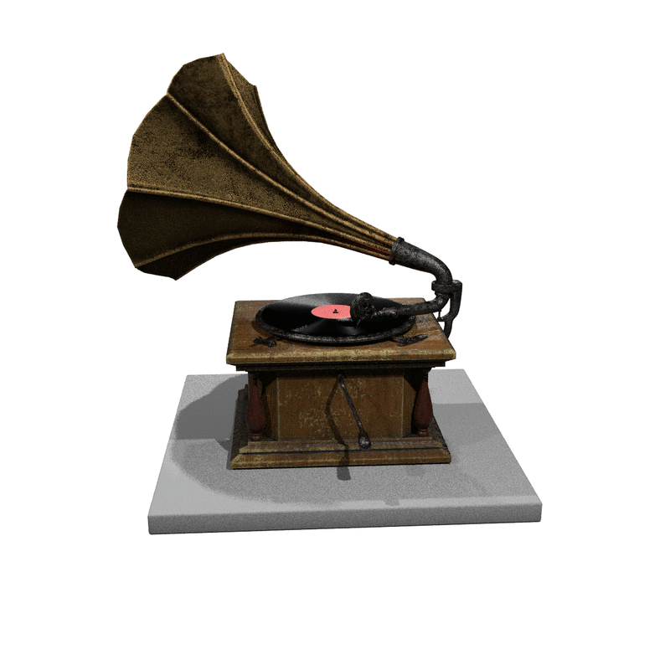
Mental rotation
by Roger N. Shepard, National Science Medal Laurate, Stanford
and Lynn Cooper, Professor at Columbia University
Notes:
According to psychological studies, the perceptual representation of 3D shapes in the human mind is three-dimensional. For example, humans are able to mentally rotate 3D objects, as shown by Shepard and his colleagues.

Slide 4
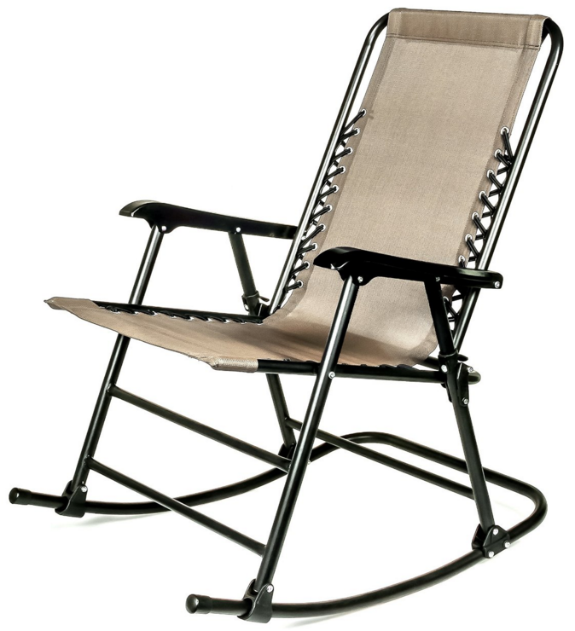
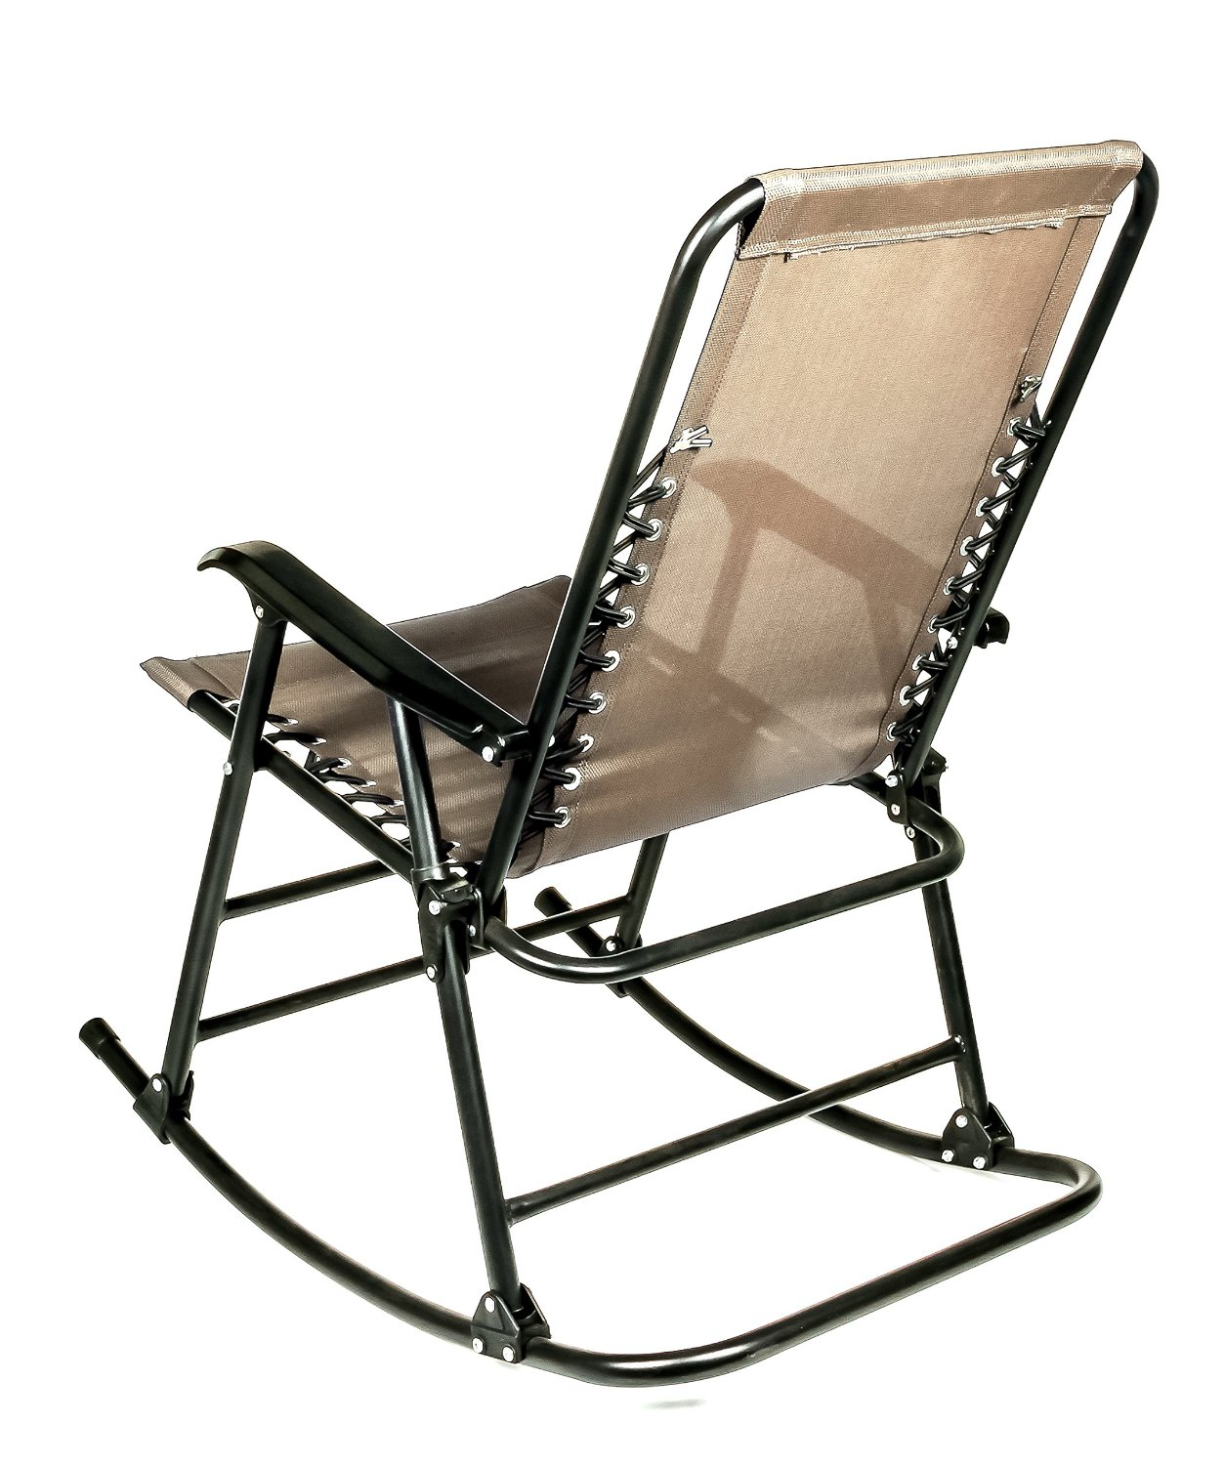
Shape constancy
Notes:
Similarly, given two different views of the same 3D object, the observer has no difficulty recognizing that they represent the same object.

Slide 5
3D Perception is important for robots
Cosimo Alfredo Pina, “The domestic robots are getting closer”
Notes:
So, to have robots that would behave as well as we humans do, we have to grant them the full ability of 3D perception.

Slide 6
3D Perception is important for robots
Notes:
To serve the coffee, this robot must he smart enough to understand the room layout,

Slide 7
3D Perception is important for robots
Notes:
which part of the coffee tray is graspable, how slippery the tray material might be,

Slide 8
3D Perception is important for robots
Notes:
how heavy the cups should be,

Slide 9
3D Perception is important for robots
Notes:
what is the height and pose of the table and its master. Based upon all the understandings, the robot conducts planning.

Slide 10
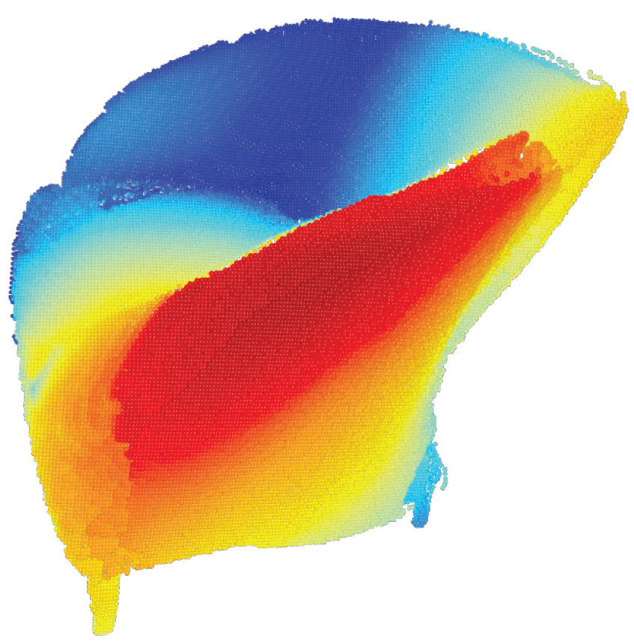
2D-3D lifting by machine learning
contrast
color
texture
motion
symmetry
part
category-specific 3D knowledge
……
Notes:
But how can we teach computers to do the same? 3D understanding involves many cues. Besides, like we showed before, 3D attributes in an image is very rich, such as depth, pose, 3D symmetry, etc.
Explicitly modeling them seems extremely challenging, if possible.
In this context, we explore a data-driven approach, that learns to lift 2D images to 3D, under a unified framework that I call it “render for cnn”.

Slide 11
Synthesize for learning: from virtual world to real world
First build & learn in a 3D Virtual Environment,
Shape
Database
A shape repository
with rich annotation
Notes:
In this framework, we first build a virtual environment using 3D shapes. The shapes are annotated with rich attributes.

Slide 12
Synthesize for learning: from virtual world to real world
First build & learn in a 3D Virtual Environment,
Class,
Viewpoint,
Material,
Symmetry,
…
Object attributes
Shape
Database
Simulator
…
A shape repository
with rich annotation
Synthetic sensory data
Notes:
Then, we use a simulation engine to acquire many synthetic data. In the image setting, along with the simulation process, annotations on 3D shapes are projected to each pixel of the synthetic images.
So we have quite a large volume of data with annotations. In fact, manually annotating many detailed object attributes, such as viewpoints, is extremely expensive. But through this pipeline, this is almost no time and money investment.

Slide 13
Synthesize for learning: from virtual world to real world
First build & learn in a 3D Virtual Environment,
Training
Class,
Viewpoint,
Material,
Symmetry,
…
Object attributes
Shape
Database
Learning algorithms
Simulator
…
A shape repository
with rich annotation
Synthetic sensory data
Notes:
Then we use this set of synthetic data to train learning algorithms, which predicts the labels that can be as dense as per-pixel from the synthetic images.

Slide 14
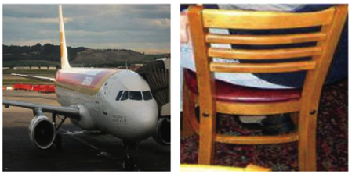
Synthesize for learning: from virtual world to real world
Then adapt to 2D Real World
Testing
Object attributes
Learning algorithms
Real data
Notes:
At test time, we adapt the trained deep learning system to predict object attributes for unseen real data. [click next]

Slide 15
Machine learning is data hungry
Review: image classification dataset
ImageNet
$${10}^{8}$$
$${10}^{7}$$
$${10}^{6}$$
CIFAR
$${10}^{5}$$
Caltech 256
LabelMe
$${10}^{4}$$
Caltech 101
2000
2002
2004
2006
2008
2010
Notes:
To build such a system, the key is to collect enough high-quality 3D data, because learning methods, especially deep learning, are data hungry... This is already evidenced by the progress of image classification. The great progress in the last few years is actually backed by the emergence of big datasets, containing millions of images.

Slide 16
Status review of 3D datasets
<= 10,000 models in total
<= 100 models in total
<= 60 models per class (average)
Notes:
However, if we review the 3D shape dataset, they are much smaller in scale and limited in diversity. For example, the largest datasets have less than 10K models, as opposed to 20 million images indexed by ImageNet.

Slide 17
Status review of 3D datasets
ImageNet
$${10}^{8}$$
Limited in
scale
object classes
diversity
$${10}^{7}$$
# images
$${10}^{6}$$
CIFAR
$${10}^{5}$$
Caltech 256
LabelMe
Caltech 101
State-of-the-art 3D shape dataset
$${10}^{4}$$
2000
2002
2004
2006
2008
2010
Notes:
If we image dataset and shape dataset in the same graph, then we that 3d shape dataset is at its infant stage.

Slide 18
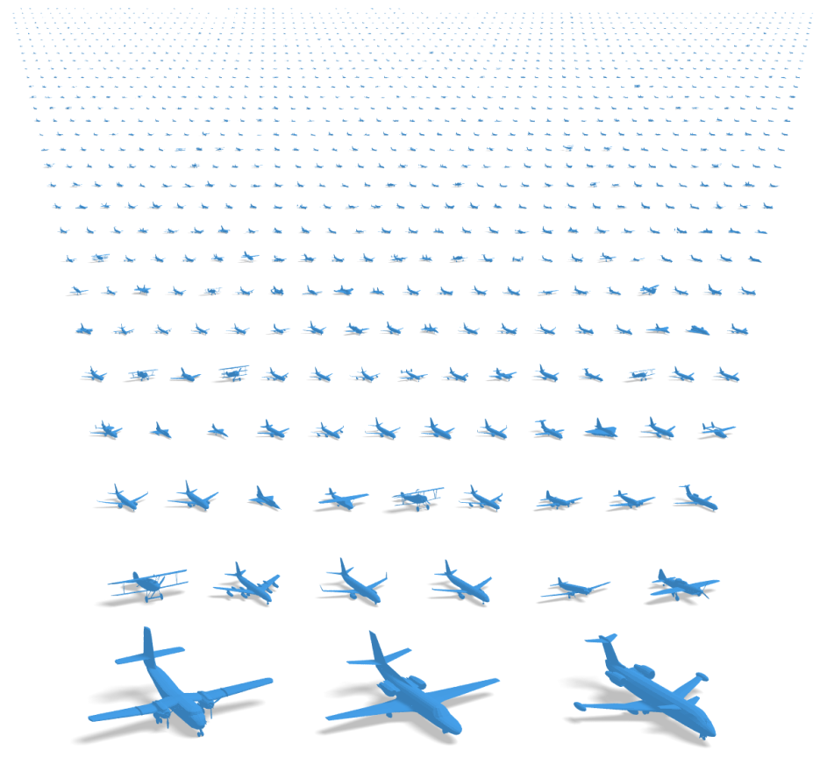
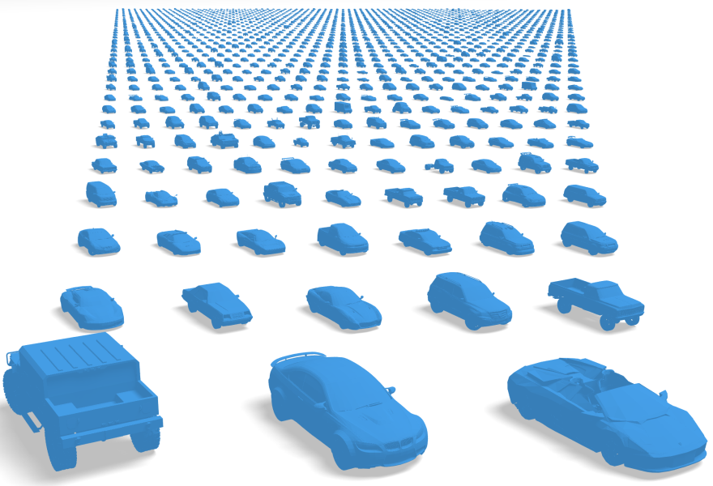
My work: Build large-scale 3D datasets of objects
…
~3 million models in total
~2,000 classes
Rich annotations
(in progress)
Notes:
This observation inspires me to construct of a large-scale 3D object database, named ShapeNet. This is a cross-group cross-institute collaboration, with Pat, Silvio here, and Prof. Funkhouser from Princeton and Prof. Huang from UT Austin.
The current version of ShapeNet covers most daily man-made objects, from indoor to outdoor.

Slide 19
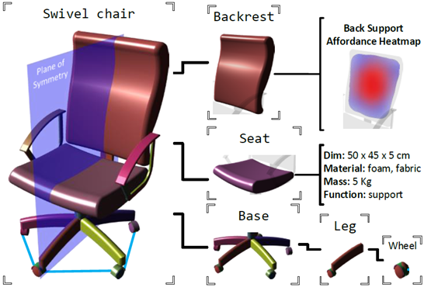
An object-centric 3D knowledge-base
Part
decomposition
Symmetry
Affordance
Physical
properties
Material
Images
Semantics
Notes:
And, it is richly annotated with many properties, such as symmetry, parts, affordance, and materials.

Slide 20
ShapeNet: a large-scale 3D datasets of objects
$${10}^{4}$$
ShapeNet
$${10}^{3}$$
# models per classes
$${10}^{2}$$
ESB
SHREC12
MSB
SHREC14
$$10$$
WMB
BAB
TSB
CCCC
PSB
$$10$$
$${10}^{2}$$
$${10}^{3}$$
$${10}^{4}$$
$${10}^{5}$$
$${10}^{6}$$
$${10}^{7}$$
# models
Notes:
Compared with state-of-the-art, this database is much larger in scale and diversity.

Slide 21
My work: Develop data-driven 3D learning algorithms
Training
Class,
Viewpoint,
Material,
Symmetry,
…
Object attributes
ShapeNet
Neural Network
Simulator
…
A shape repository
with rich annotation
Synthetic sensory data
Notes:
With this database, we build a 3D virtual world with geometry and physics attributes. And we can explore the SynthesizeForLearning idea to bridge the virtual world and real world. I will show you various applications following this paradigm.

Slide 22
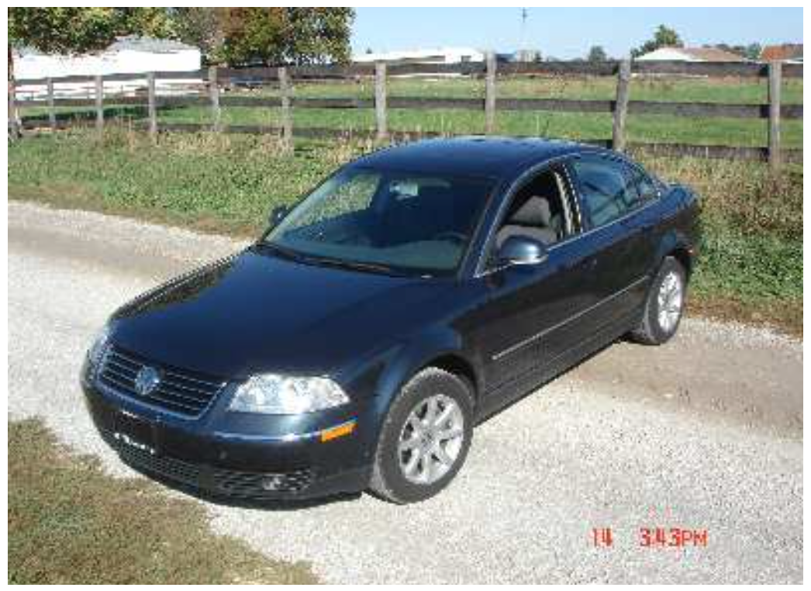
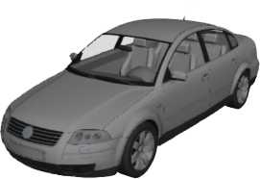
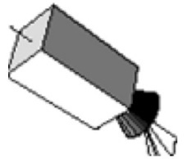
Application 1: 3D viewpoint estimation
ICCV 2015 oral: Render for CNN: Viewpoint Estimation in Images
Using CNNs Trained with Rendered 3D Model Views
3D Viewpoint Estimation
car
in-plane rotation
elevation
azimuth
Notes:
For many 3D perception tasks, accurate 3D viewpoint estimation is a critical component. This work will focus on this key module. [click next]

Slide 23
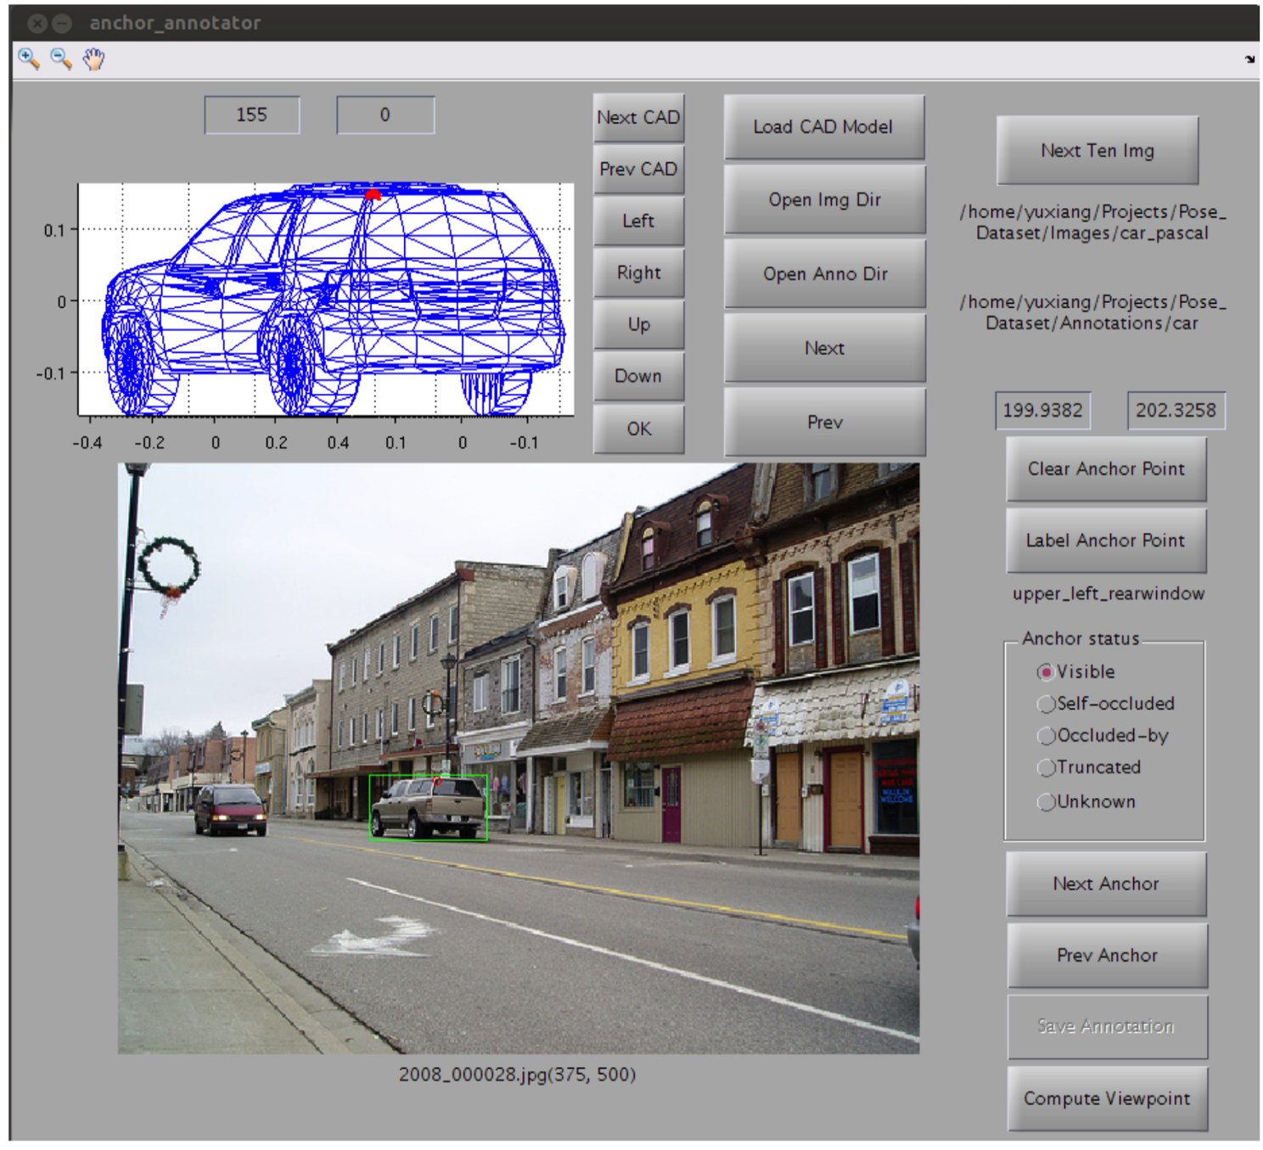
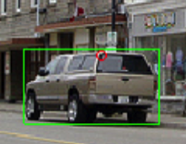
Accurate viewpoint label acquisition is expensive
PASCAL3D+ dataset [Xiang et al.]
Annotation takes
~1 min per object
Notes:
To acquire accurate viewpoint from humans, researchers built a special annotation pipeline. Annotators need to manually find a similar 3D model and manipulate it till it matches the imaged object. This step takes roughly 1 minute per object. [click next]

Slide 24
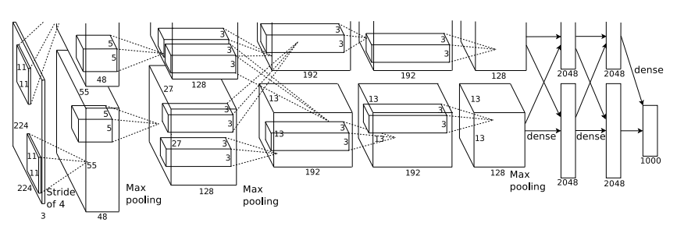
High-cost Label Acquisition
High-capacity Model
Mismatch!
30K images with viewpoint labels in PASCAL3D+ dataset [Xiang et al.]
60M parameters. AlexNet [Krizhevsky et al.]
How to get MORE images with ACCURATE viewpoint labels?
High-cost Label Acquisition
High-capacity Model
Mismatch!
30K images with viewpoint labels in PASCAL3D+ dataset [Xiang et al.]
60M parameters. AlexNet [Krizhevsky et al.]
Notes:
So we notice that for 3d task like viewpoint estimation, on one hand label acquisition is expensive,
[click] on the other hand we’d like to leverage on powerful deep learning models which require a lot of training data.
[click] How to design a scalable approach to get more images with accurate viewpoint labels?

Slide 25
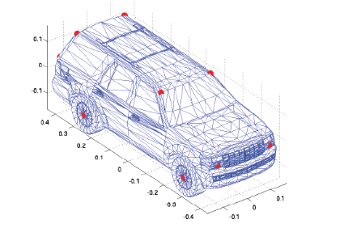
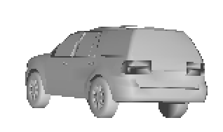
Manual alignment
by annotators
Auto alignment through rendering
Notes:
So instead of manual alignment by annotators, if we render images from the CAD model, alignment is automatically obtained.
However, one concern still remains. Images have very high diversity – containing all kinds of objects, can we achieve similar level of diversity by rendering? [click next]

Slide 26
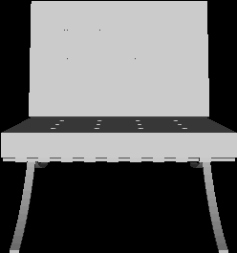
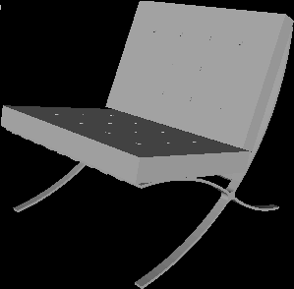
A “Data Engineering” journey
95% on synthetic val set
47% on real test set ☹
ConvNet:
Ah ha, I know! Viewpoint is just the brightness pattern!
Notes:
Please join me on a journey of exploring the synthesis process. At beginning, 4 fixed point light sources are used and the background is clean. Here are some sample images generated by this setting. ConvNet quickly reached over 95% accuracy on synthetic validation set. It says, “viewpoint is just the brightness pattern, a piece of cake!”
[click] However, when tested on real images, it failed miserably. [click next]

Slide 27
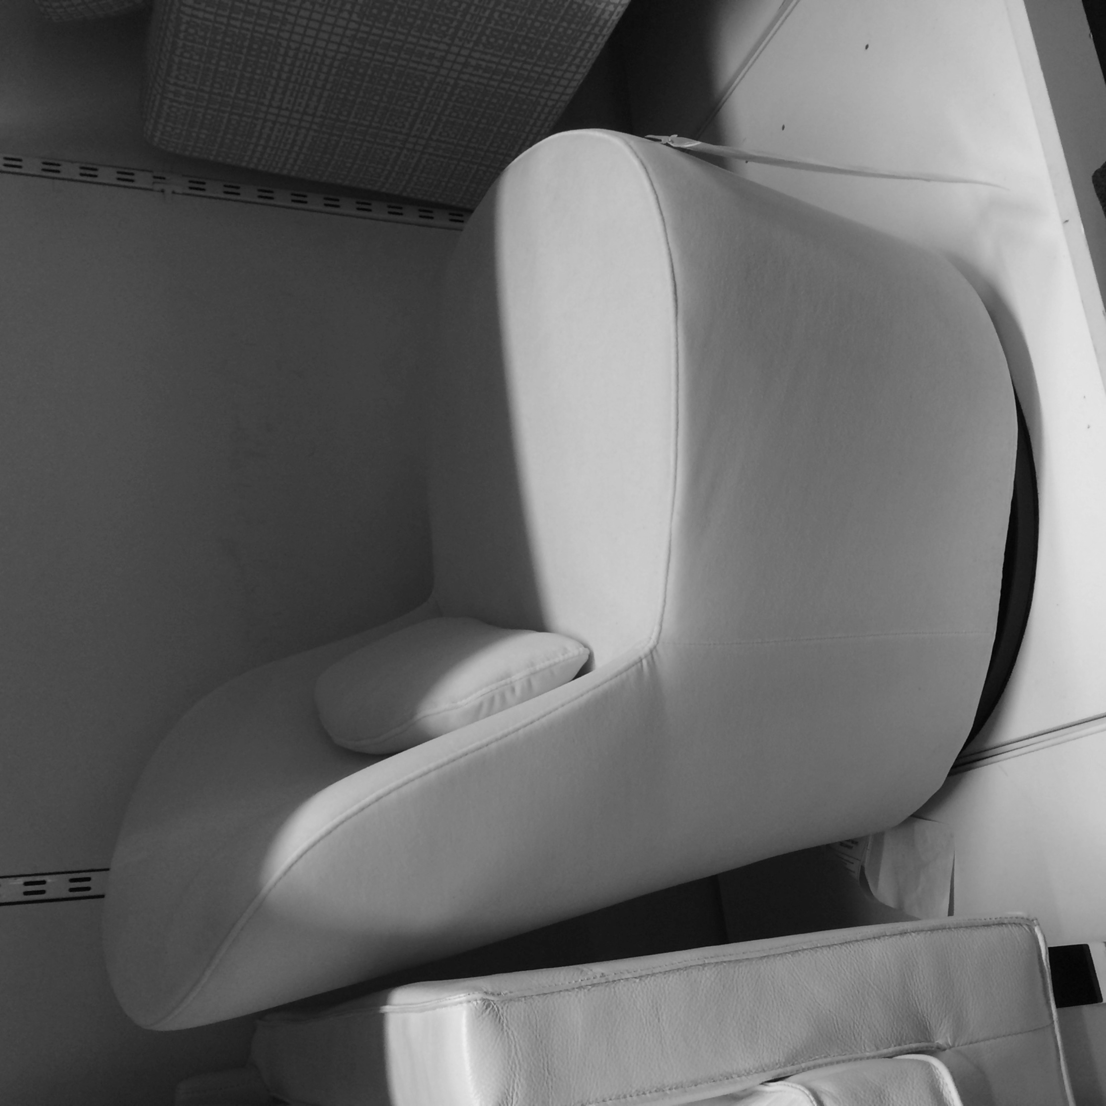
A “Data Engineering” journey
95% on synthetic val set
47% on real test set ☹
ConvNet:
Ah ha, I know! Viewpoint is just the brightness pattern!
Notes:
The reason for failure is simple, the ConvNet learns the wrong pattern. Lighting and viewpoint have no correlation in real images. [click next]

Slide 28
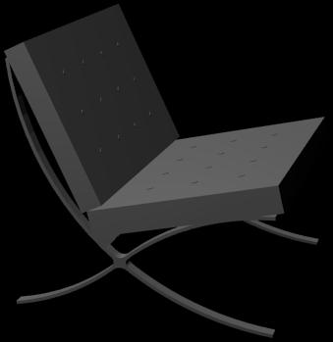
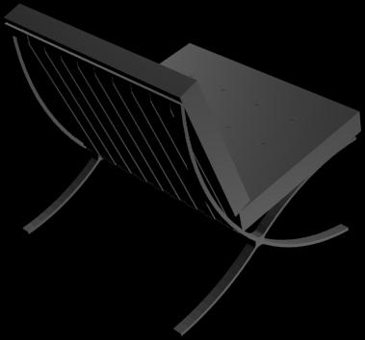
A “Data Engineering” journey
Randomize
lighting
47% -> 74%
ConvNet: hmm.. viewpoint is not the brightness pattern. Maybe it’s the contour?
Notes:
Instead of assigning fixed positions for light sources, we uniformly sampled light source positions on a sphere.
[click] This simple change increases accuracy dramatically. [click next]

Slide 29
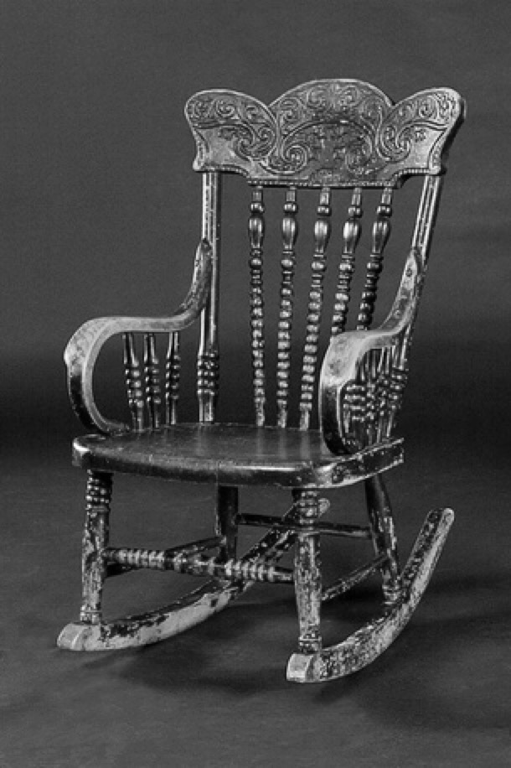
A “Data Engineering” journey
Randomize
lighting
47% -> 74%
ConvNet: hmm.. viewpoint is not the brightness pattern. Maybe it’s the contour?
Notes:
Another observation is that objects in real scenes often have clutter backgrounds. [click next]

Slide 30
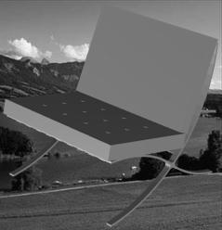
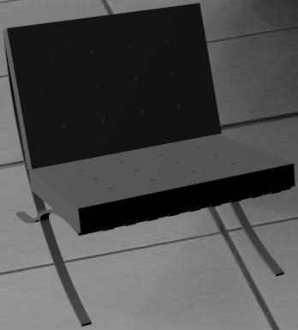
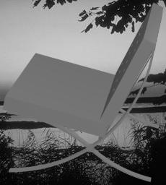
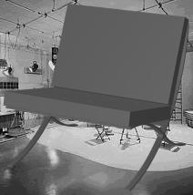
A “Data Engineering” journey
Add
backgrounds
74% -> 86%
ConvNet: It becomes really hard! Let me look more into the picture.
Notes:
After adding backgrounds, it becomes harder to map images to viewpoints. For example, object contour patterns become more difficult to capture. However, it turns out to be a good thing, CNN is pushed to learn more robust features.
[click] Another 12% accuracy improvement is achieved. [click next]

Slide 31
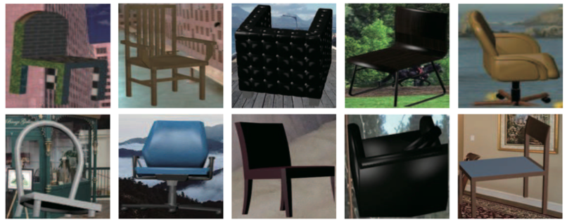
A “Data Engineering” journey
bbox crop
texture
86% -> 93%
Notes:
by introducing more complexities like truncations and textures, CNN is pushed to learn even harder and ultimately reached 93% accuracy. [click next]

Slide 32
A “Data Engineering” journey
bbox crop
texture
86% -> 93%
ConvNet: the mapping becomes hard. I have to learn harder to get it right!
Key Lesson: Don’t give CNN a chance to “cheat” - it’s very good at it. When there is no way to cheat, true learning starts.
Notes:
To summarize the lesson learned here: Don’t give CNN a chance to “cheat” - it’s very good at it. When there is no way to cheat, true learning starts.

Slide 33
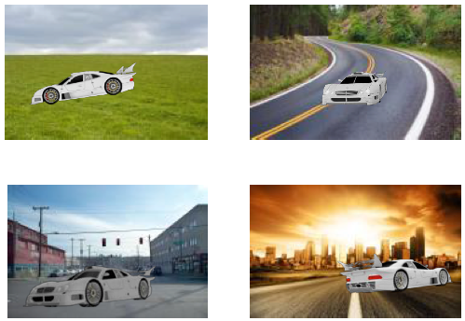
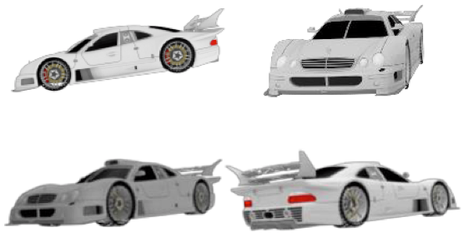
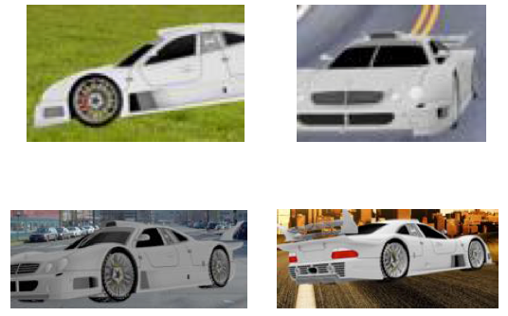
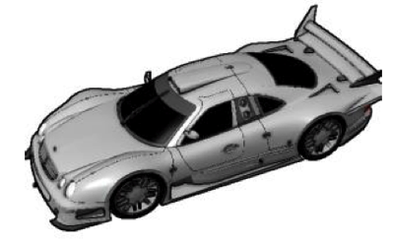
Render for CNN Image Synthesis Pipeline
Rendering
Add bkg
Crop
3D model
Hyper-parameters estimation from real images
Notes:
Based on the lessons learnt from the journey, we propose an image synthesis pipeline, as shown here. Data generated from this pipeline cannot be easily overfit and is very effective for training CNNs. Also, the system is highly scalable since no human intervention is required. [click next]

Slide 34
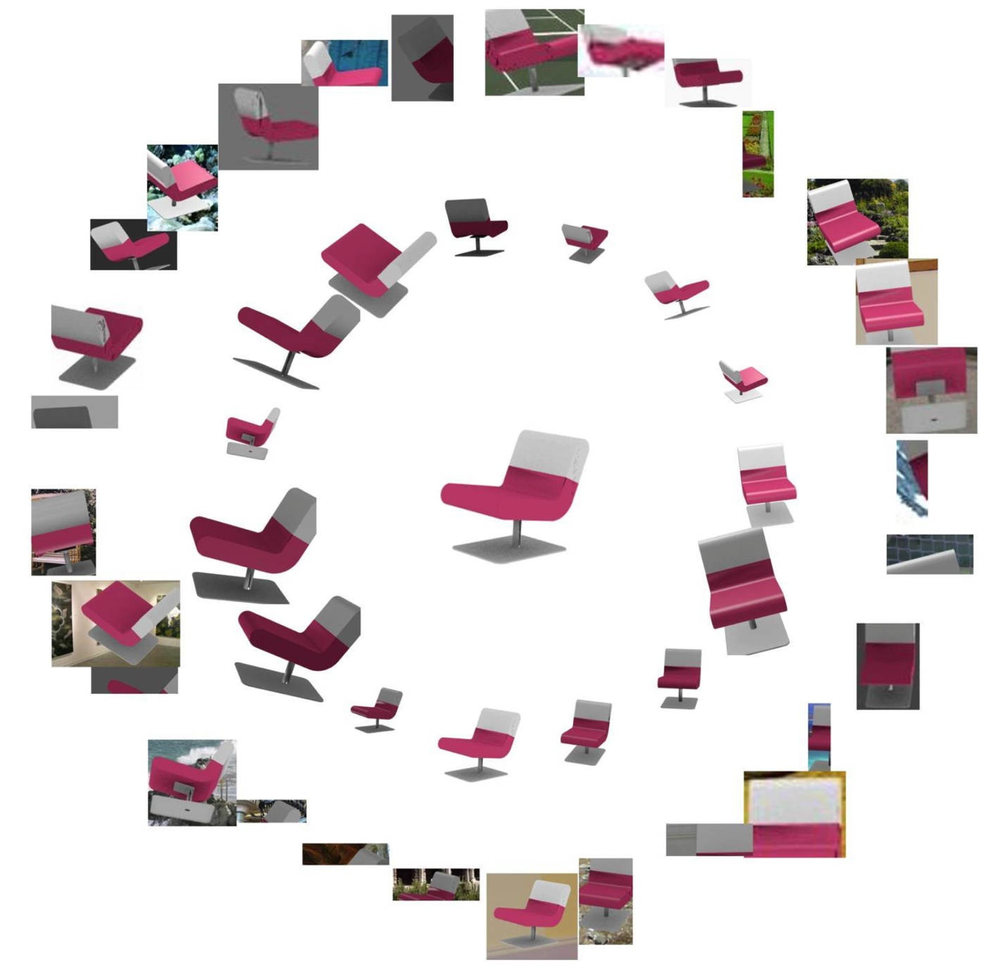
2.4M synthesized images for 12 categories
High scalability
High quality
Overfit-resistant
Accurate labels
Notes:
By adopting this synthesis pipeline, we achieve both scalability and quality. Finally 2.4M images are synthesized and we will soon see that models trained using this synthetic data set can perform surprisingly well on real test images. [click next]

Slide 35
Our model trained on rendered images outperforms state-of-the-art model trained on real images in PASCAL3D+.
Metric: viewpoint accuracy and median angle error (lower the better)
Real test images from PASCAL3D+ dataset
25% Error Reduction
Notes:
Our model trained on *rendered* images can outperform state-of-the-art CNN model trained on *real* images.
Better performance is achieved because our model benefits from large number of training images, also the labels from rendering system are more accurate. [click next]

Slide 36
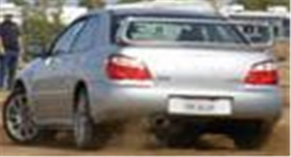
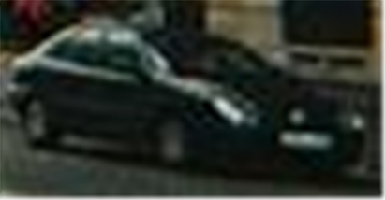
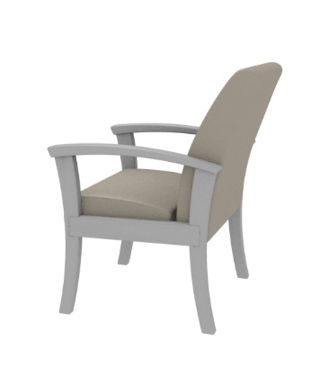
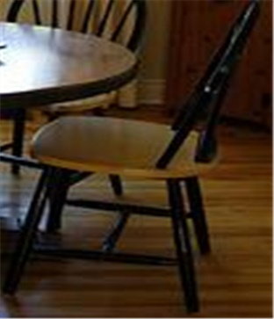
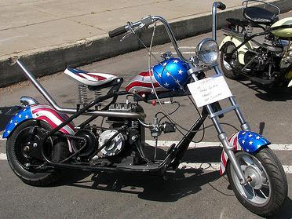
Results
Notes:
Now let’s look at some qualitative results on PASCAL VOC images. Here we render 3D models from estimated 3d viewpoint for visualization. It even works for some very low resolution cases or cluttered cases.
[click next]

Slide 37
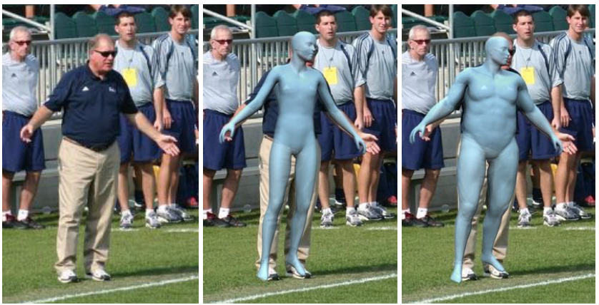
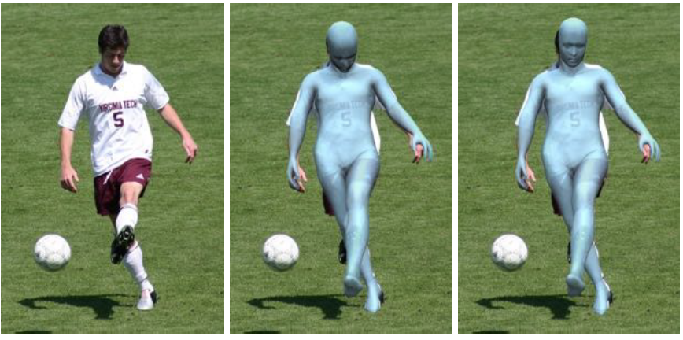
Application 2: 3D human pose estimation
3DV 2015 oral: Synthesizing Training Images for Boosting Human 3D Pose Estimation
Notes:
In a second application, we show how to estimate the pose and even fitness of 3D human bodies.

Slide 38
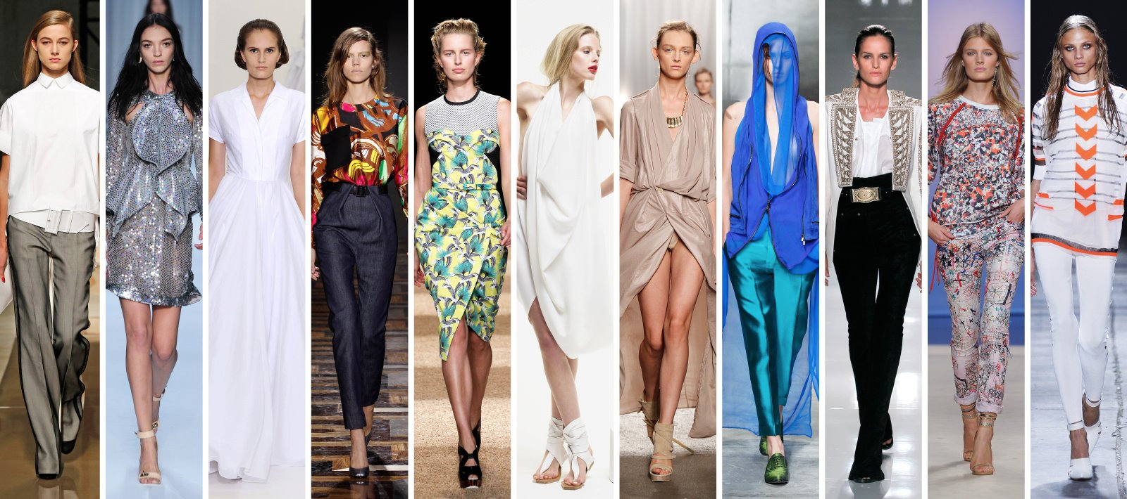
Challenge: clothing variation
3DV 2015 oral: Synthesizing Training Images for Boosting Human 3D Pose Estimation
Notes:
Again, we render images of human bodies and train. But here, the critical challenge is the clothing diversity. This may be achieved if we have 3D human body models with many different cloth textures.

Slide 39
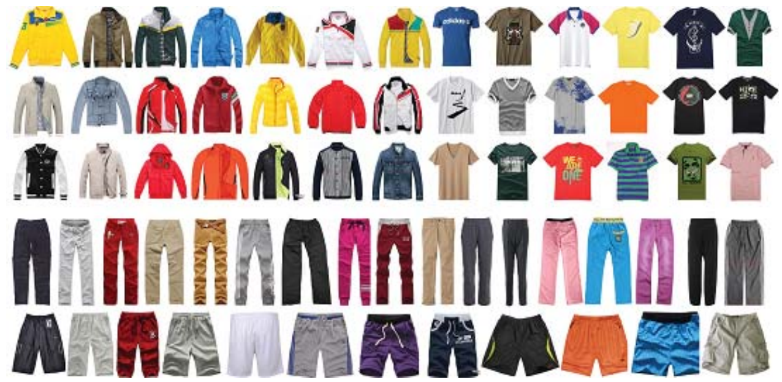
Automatic texture transfer from images to shapes
3DV 2015 oral: Synthesizing Training Images for Boosting Human 3D Pose Estimation
Notes:
However, high-quality cloth modeling is often very costly and challenging. In this work, we try a very cheap but scalable approach.
We search and filter product photos from Google.

Slide 40
Notes:
Then, we automatically transfer the texture in these photos to 3D models by contour matching.

Slide 41
Effectiveness of texture augmentation
Notes:
Even with such a simple method, we witness that the data generated is effective for deep learning. The more clothes we use, the better the system performs.

Slide 42
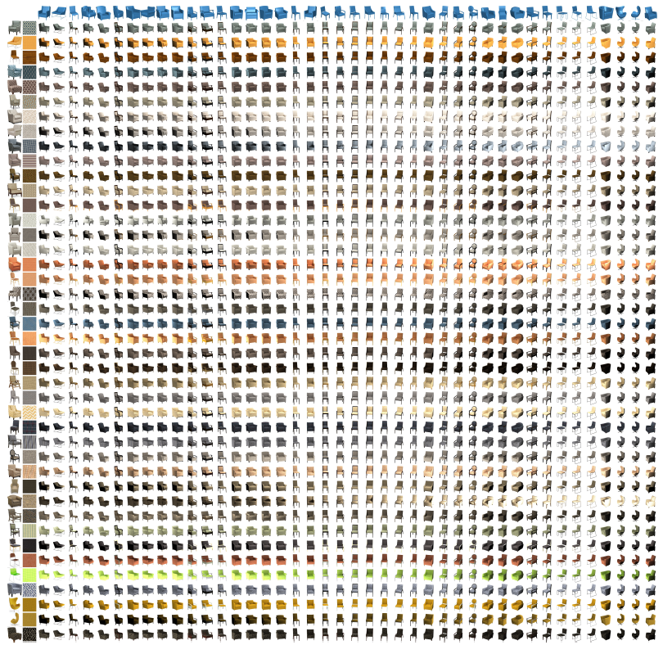
Texture transfer for rigid objects
SIGGRAPH Asia 16: Unsupervised Texture Transfer from Images to Model Collections
Product photos
Automatically textured shapes
Notes:
For objects with more regular geometric structures, such as furniture, we actually can deliver even higher quality results for texture transfer. This is because 3D models in shapenet can be used as geometry priors, and help us to extract high quality textures by removing nuisances, such as lighting, tilt, and occlusion.

Slide 43
Domain adaptation between Virtual and Reality
3DV 2015 oral: Synthesizing Training Images for Boosting Human 3D Pose Estimation
Map features from real and synthetic images to the same domain

Slide 44
Adversarial learning based domain adaptation
3DV 2015 oral: Synthesizing Training Images for Boosting Human 3D Pose Estimation

Slide 45
Domain adaptation between Virtual and Reality

Slide 46
Results: 3D human pose estimation
Notes:
Here we show more examples of single-image based 3D human pose estimation. The system works under different backgrounds. It also works for some very rare poses.

Slide 47
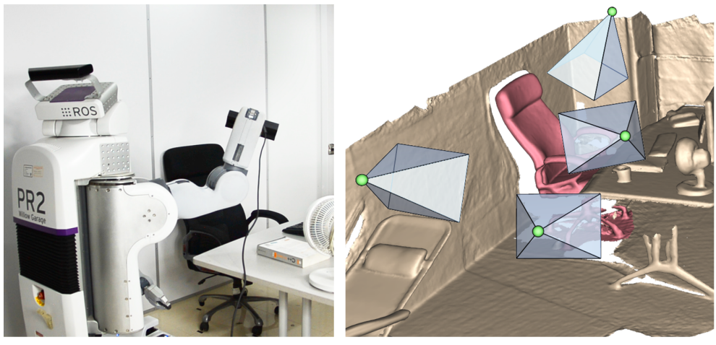
Application 3: Attention-based object identification
SIGGRAPH Asia 2016: 3D Attention-Driven Depth Acquisition for Object Identification
Notes:
Lastly, we can apply the idea to train robots.

Slide 48
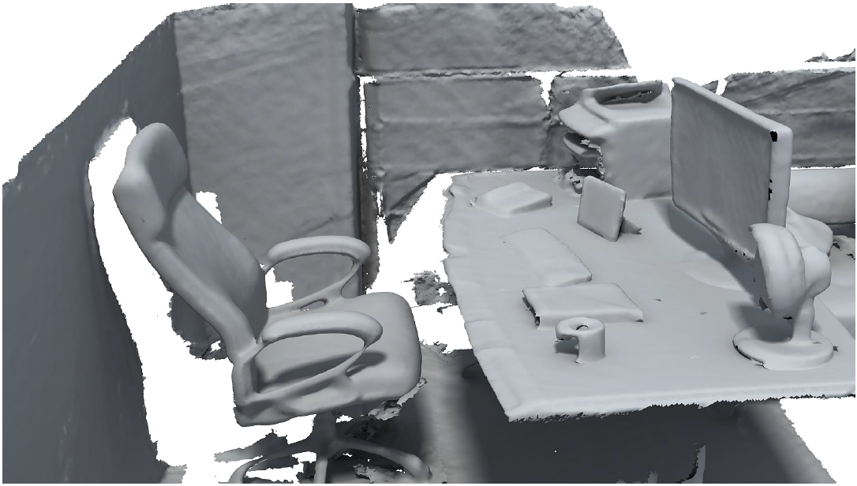
Background
How is the scene composited?
What are these?
Notes:
Recently, the progress of real-time scanning technique is fast. However, we do not just want to scan the scene and perform a holistic reconstruction. We also want to know the object composition of the scene.

Slide 49
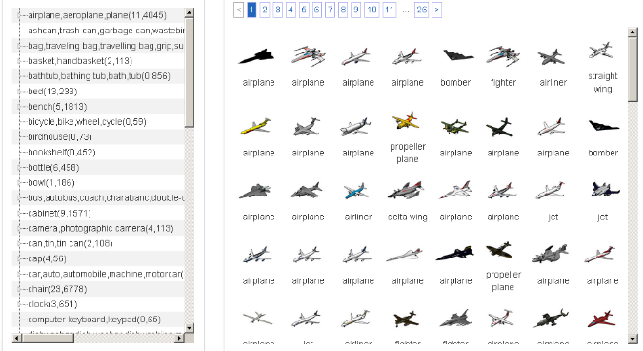
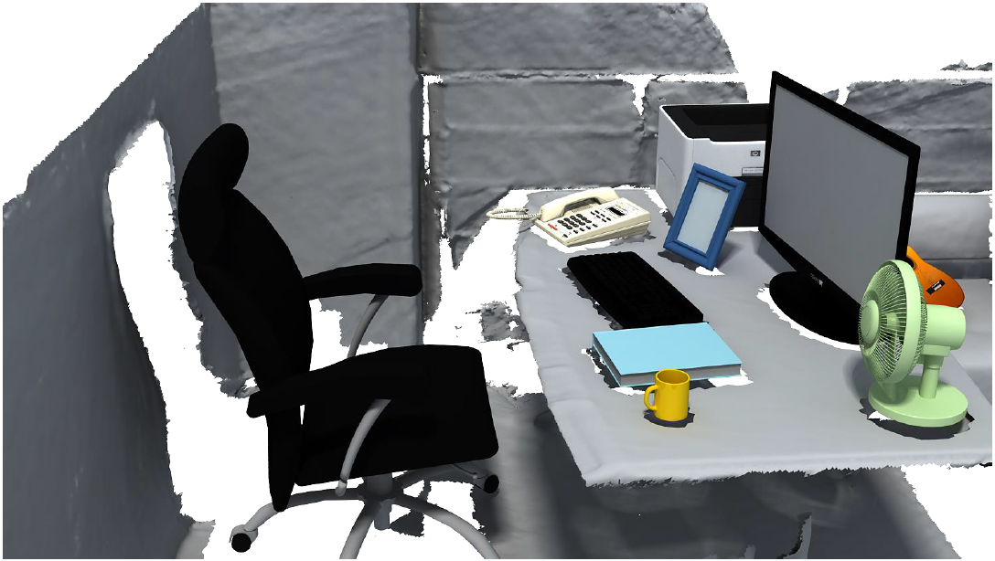
Background
ShapeNet
Object identification
Notes:
Meaning that we want to extract the individual objects

Slide 50
Autonomous object identification

Slide 51
The main challenge – next-best-view problem
Observation is partial and progressive
→ View planning
Assessing views whose observation is unknown
?
Observed view
Unobserved views
?
?
How can you know which view is better without knowing its observation?
Notes:
The main challenge is that observations are often partial and progressive. In order to recognize objects efficiently and effectively, the robot has to find the next-best-view to move to and scan. This is a planning problem. Naturally we choose to solve it by reinforcement learning. Through exploration and exploitation to scanning strategies, we find the way to recognize objects with minimal number of scans.

Slide 52
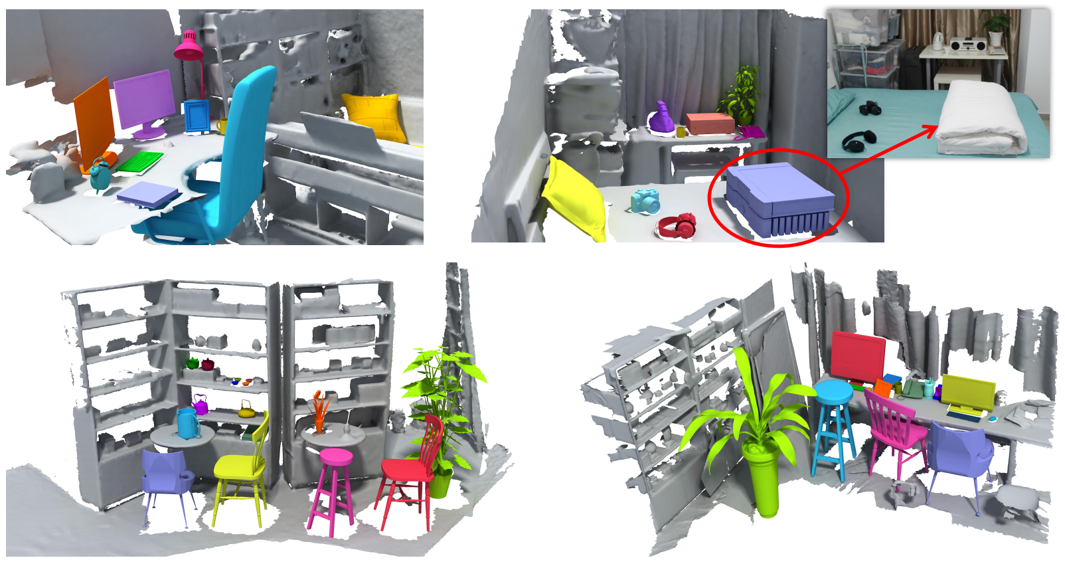
Simulate For Reinforcement learning
Train from virtual scanned ShapeNet models using Reinforcement Learning
Test in a real environment
Notes:
Training in the real world is very time-consuming. Again, we learn in a virtual environment but test in reality. In the virtual indoor scene, we simulate the scanning and use reinforcement learning to explore the scanning strategy.

Slide 53
The general framework
Notes:
Here let me show you the general framework for solving the active recognition problem

Slide 54
The general framework
Goal
Action
Recognition:
Incremental classification based on history
View planning:
Evaluate a view based on history
Belief
Observe
Notes:
First of all, the robot keeps a goal in mind, for our case, it is object recognition
To achieve this goal, the robot can perform different actions, or take different views,
to actively acquire observations.
Based on the observations, the robot can build up an internal representation, or belief, about the object being observed, which is in turn used to predict object class and the next best views.

Slide 55
Attention mechanism
Goal-oriented and stimulus-driven
Control of goal oriented and stimulus driven attention mechanisms in the brain, Nature Review Neuroscience. 2002
Glimpse
Fixate
Internal Representation
Update
Perform
Update
Task
Stores the info. of history
Integrate
Supervision or reward
Notes:
Our task fits well into the attention mechanism that has been actively developed in the machine learning and vision community.
The brain of the robot maintains an internal representation of the environment. Based upon the representation, the robot decides where to look at, in our case, find the next-best-view and scan the object. Then, it tries to perform the task, to identify the object. In turn, the observation and the result of the scanning action update the internal representation.

Slide 56
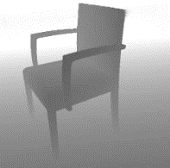
3D Recurrent Attention Model
$$θ^{\left(1\right)},φ^{(1)}$$
$$θ^{\left(2\right)},φ^{(2)}$$
$$θ^{\left(3\right)},φ^{(3)}$$
Discriminative view selection
NBV emission
NBV emission
NBV emission
$$h_{2}^{(1)}$$
$$h_{2}^{(2)}$$
$$h_{2}^{(3)}$$
…
View aggregation
classify
classify
classify
$$h_{1}^{(1)}$$
$$h_{1}^{(2)}$$
$$h_{1}^{(3)}$$
…
initial view
$$θ^{\left(0\right)},φ^{(0)}$$
$$θ^{\left(1\right)},φ^{(1)}$$
$$θ^{\left(2\right)},φ^{(2)}$$
Feature extraction
Feature extraction
Feature extraction
$$I^{(0)}$$
$$I^{(1)}$$
$$I^{(2)}$$
Notes:
Because this is a sequence generation task, we model it by recurrent neural network and train it by reinforcement learning.
Here is the architecture of our 3D recurrent attention model. I am not going to give much details. If you are interested, please refer to the original paper.

Slide 57
Reinforcement learning needs LOTS of data to train!
Simulate many many scan sequences in virtual environment
Notes:
One lesson we learned is that, in order to train this model, we do need quite a lot of data. We simulate many many scan sequences in the virtual environment. Practically, it takes us 49 hours to simulate and train for recognizing 60 classes from ShapeNet. A majority of time is spent in simulation.

Slide 58
Results
Notes:
Here we show a sequence of next best views, for a given scene to the left,
The best matched 3D model is shown to the right.
For each view, we show the matched models of the current step,
as you can see, with more views being observed, the matched models are more and more similar to the ground-truth.

Slide 59
Results

Slide 60
Quantitative results

Slide 61
Reconstructed 3D scene
SIGGRAPH Asia 2016: 3D Attention-Driven Depth Acquisition for Object Identification
Notes:
In real scenes, the trained system can work well. Here shows our result in a real scene, by inserting the most similar 3D shapes for each real object. On average you usually need to scan at 2 to 3 viewpoints for each object.

Slide 62
Summary
Key theme: learn in a virtual environment of 3D shapes, test in real scenes of 2D RGB(D) images
Data: build a large-scale 3D database (ShapeNet) with rich annotations
Synthesize training data for deep learning, applicable for many tasks
ML
CG
CV
Notes:
To sum up, my research lies in the intersection of computer vision, computer graphics, and machine learning. The key theme is to learn in a virtual environment of 3D shapes, and test in real scenes of 2D images. Towards this goal, I build a large-scale 3d shape database with annotations, named shapenet. So we can synthesize a lot of images with accurate annotations, for training deep learning systems for many applications.

Slide 63
Thank you!

