Slide 1
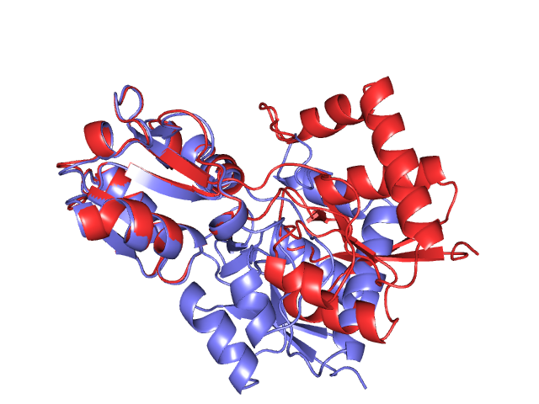
Study of Protein Motion

Slide 2
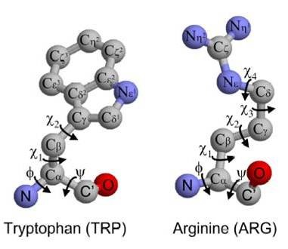
Protein
Long sequence of amino-acids (dozens to thousands)
SC
C_{α}
C_{α}
N
C’
H
O

Slide 3
Protein
Long sequence of amino-acids (dozens to thousands)
SC
SC
SC
main chain or
backbone
…
C’
C_{α}
C_{α}
C_{α}
C_{α}
C_{α}
C_{α}
peptide
bond
N
C_{α}
N
C’
C’
N
H
O
H
O
H
O

Slide 4
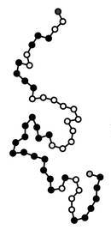
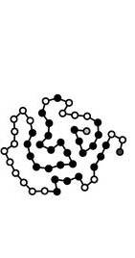
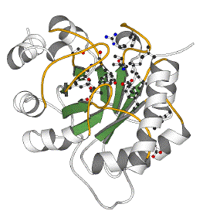
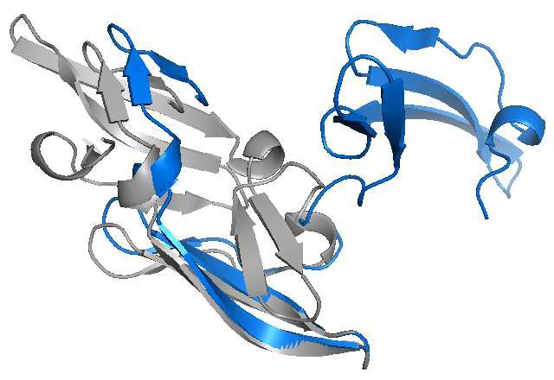
Protein Folding
Physiological conditions:
aqueous solution, 37°C, pH 7,
atmospheric pressure
The folded structure is uniquely determined by the protein sequence but is not fully rigid
2EZM
(HIV-inactivating protein)

Slide 5
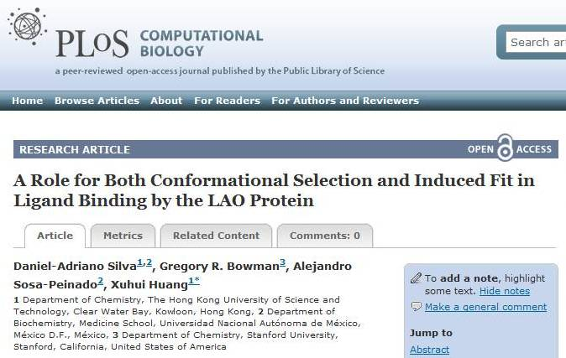
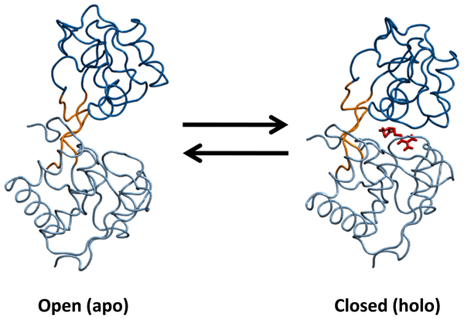
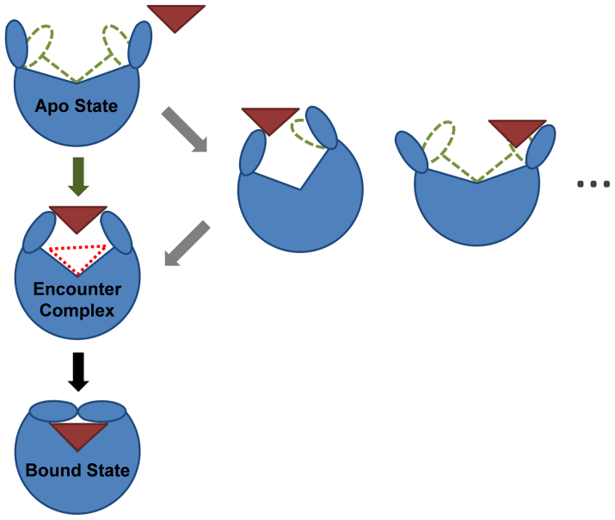
Flexibility is necessary ...
... for a protein to achieve its biochemical functions by binding against other molecules (ligands, proteins)
Binding models:
Induced fit model
Conformational selection model
arginine

Slide 6
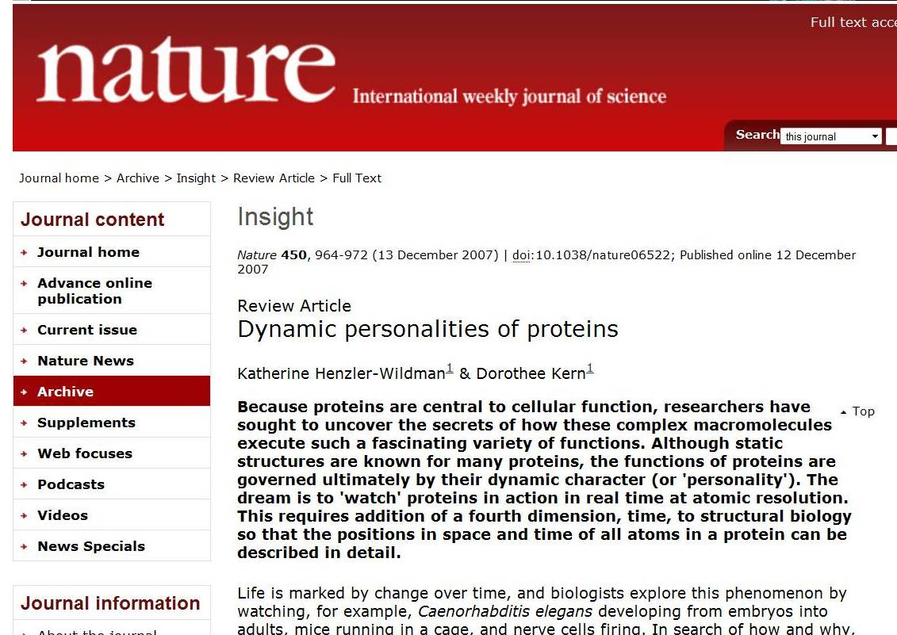

Slide 7
Experimental Methods
Protein Data Bank (PDB):
Repository of folded structures of 74,732 proteins (August 2011)
X-ray crystallography (65,195 entries)
→ high resolution, but one or few conformations
NMR spectroscopy (9,014 entries)
→ multiple conformations, but for small proteins
Cryo-electron microscopy (373 entries)
→ multiple conformations, but low resolution

Slide 8
Energy-Based Computer Simulation
  Molecular Dynamics simulation
  Monte Carlo simulation
  Others:
    coarse-grained force fields,
    multi-scale modeling,
    replica exchange,
    normal mode analysis,
    elastic network models, …
  Advantages: produce time-dependent information at atomic resolution
  Drawbacks: huge running times, enormous amount of data, delicate setup

Slide 9
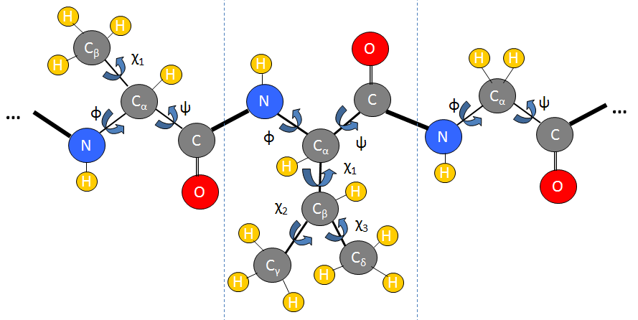
Application of Robotics and Motion Planning Techniques
Kinematic/Geometric models of proteins
Develop algorithm-friendly models that directly encode dominant energy terms.
Kino-Geometric Conformational Sampling
Use these models to sample conformations and represent a protein’s folded state by a cloud of points.
Graph-Based Models of Protein Motion
Transform a cloud representation into a
probabilistic roadmap representing protein kinetics.

Slide 10
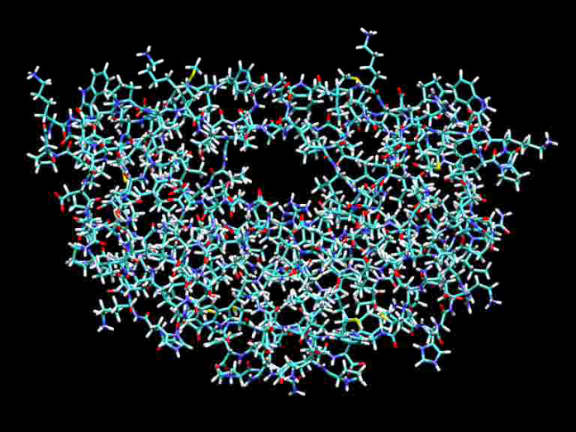
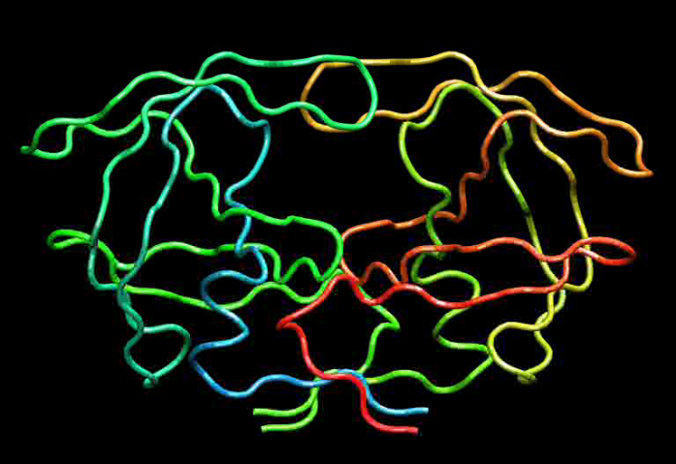
Timescales of Protein Motion
Bond/atomic
vibration
Water
dynamics
Helix
forms
Fast correlated
conf change
Slow
conf change
10⁻¹⁵
femtosec
10⁻¹²
picosec
10⁻⁹
nanosec
10⁻⁶
microsec
10⁻³
millisec
10⁰
seconds
MD step
one-day
MD run
long
MD run
where we
need to be
where we’d
love to be
[Pande]
HIV-1 protease
[courtesy L.E. Kavraki]

Slide 11
How can one access directly to relevant timescales?
Bond/atomic
vibration
Water
dynamics
Helix
forms
Fast correlated
conf change
Slow
conf change
10⁻¹⁵
femtosec
10⁻¹²
picosec
10⁻⁹
nanosec
10⁻⁶
microsec
10⁻³
millisec
10⁰
seconds
MD step
one-day
MD run
long
MD run
where we
need to be
where we’d
love to be
[Pande]
Simulating a protein over a nanosecond timescale is like simulating human locomotion over a tiny fraction of a footstep, or like trying to understand how to reach the Moon by jumping 1.5 feet in the air.

Slide 12
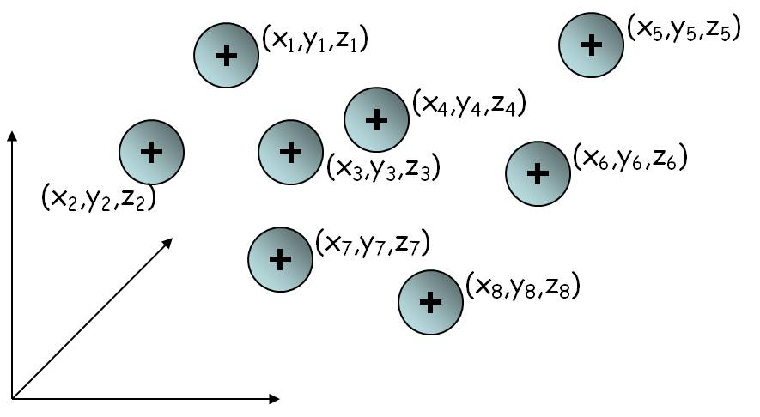
Kinematic Model #1:
Collection of independent atoms
[Quick reminder: Kinematics studies the motion of objects without consideration
of the forces that cause the motion.]
Atoms can move independently,
i.e., all constraints between atoms
are eventually represented in a force
field function
A conformation is defined by 3×n
parameters (the coordinates of the
atom centers)
All motion frequencies can be
simulated

Slide 13
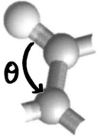
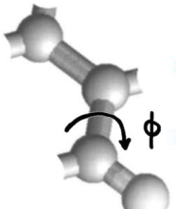
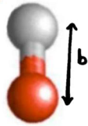
Kinematic Model #1:
Collection of independent atoms
Atoms can move independently,
i.e., all constraints between atoms
are eventually represented in a force
field function
F = F_{bonded} + F_{non-bonded}
stretching
bending
torsion
ξ

Slide 14
Over picosecond timescales bond lengths and angles average to constants
R
H
…
C_{α}
…
123dg
114dg
1.47Å
1.32Å
1.53Å
C
1.47Å
N
121dg
125dg
114dg
123dg
O
H

Slide 15
Kinematic Model #2:
Linkage of connected atoms
Bonded atoms are connected by links of fixed lengths
The only degrees of freedom
are the dihedral angles around
the simple bonds

Slide 16
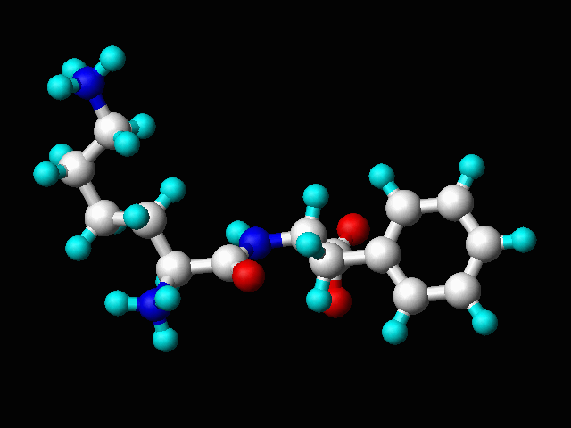
Kinematic Model #2:
Linkage of connected atoms
Bonded atoms are connected by links of fixed lengths
The only degrees of freedom
are the dihedral angles around
the simple bonds

Slide 17
Kinematic Model #2:
Linkage of connected atoms
Bonded atoms are connected by links of fixed lengths
The only degrees of freedom
are the dihedral angles around
the simple bonds
Free vibrations of the atoms can no longer be generated
The linkage model
  encodes terms of the force field,
  filters out free atomic vibrations,
  retains long timescale motions

Slide 18
Kinematic Model #2:
Linkage of connected atoms
Bonded atoms are connected by links of fixed lengths
The only degrees of freedom
are the dihedral angles around
the simple bonds
Free vibrations of the atoms can no longer be generated
The linkage model
  encodes terms of the force field,
  filters out free atomic vibrations,
  retains long timescale motions
How can one encode other terms of
the force field into the linkage model?

Slide 19
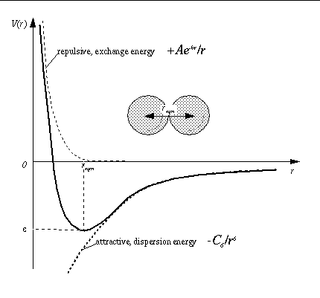

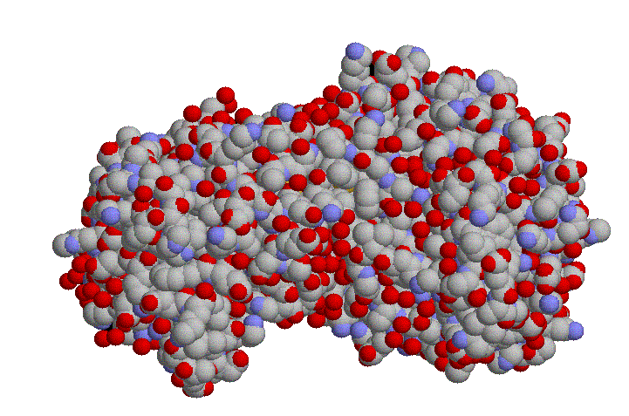
Van der Waals Forces
F_{non-bonded} = F_{van der Waals} + F_{Coulomb}
In a folded conformation, atoms are densely
packed against one another. Small perturbations
can result into large repulsive vdW terms.
→ Atoms are modeled as hard spheres with
radii ≈ α⋅vdWradii, where α = 0.7 to 0.8
+ no two hard spheres are allowed to overlap
(volume exclusion constraint)
Van der Waals forces between two atoms result from induced polarization effect(formation of electric dipoles). They are weak, except at close range.
12-6 Lennard-Jones potential:

Slide 20
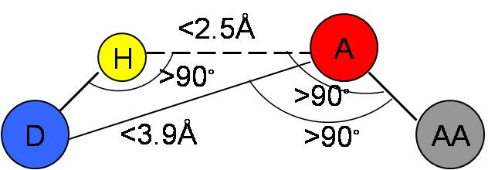
Hydrogen Bonds
F_{non-bonded} = F_{van der Waals} + F_{Coulomb}
H-bonds stabilize secondary structure elements and tertiary structure
electronegative
(often N or O)
electronegative

Slide 21
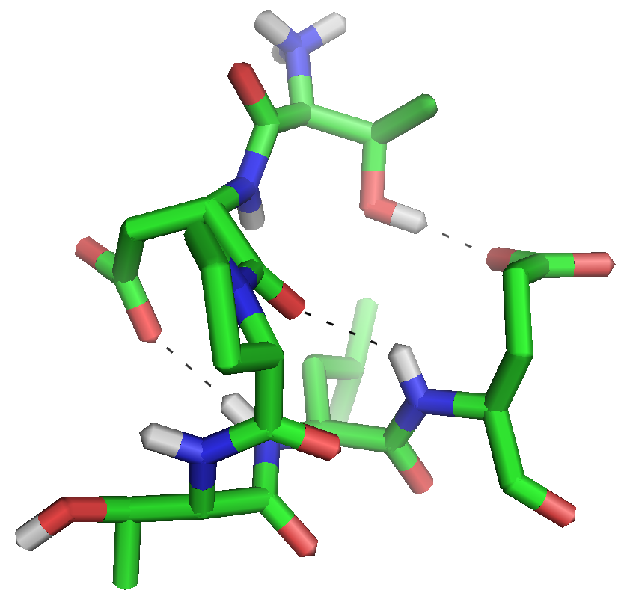
Hydrogen Bonds
F_{non-bonded} = F_{van der Waals} + F_{Coulomb}
electronegative
(often N or O)
electronegative
H-bond
H-bonds rigidify portions of the
protein and create closed
cycles in linkage model
Protein
fragment

Slide 22
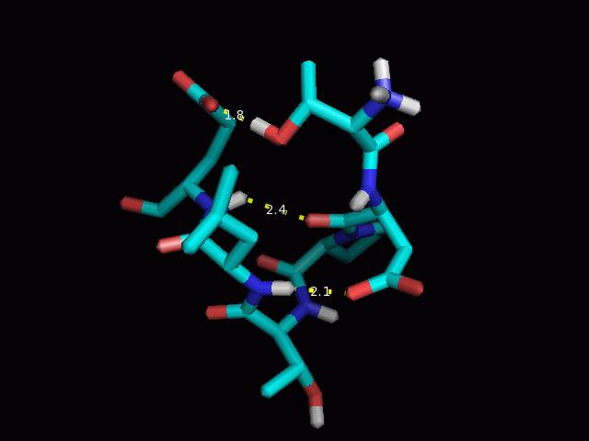
Hydrogen Bonds
F_{non-bonded} = F_{van der Waals} + F_{Coulomb}
electronegative
(often N or O)
electronegative
H-bonds rigidify portions of the
protein and create closed
cycles in linkage model

Slide 23
Advantages/Drawbacks of Linkage Model
Fewer DOFs, hence smaller dimensionality of the conformational space
Many force terms are directly encoded in representation, hence the model can’t create motion that would violate these terms
Most high-frequency motions are de facto filtered out
But:
Generating kinematically valid conformations can be more difficult

Slide 24
Inverse Kinematics Problem
How does a change in the position of an atom affect the rest of the protein?

Slide 25
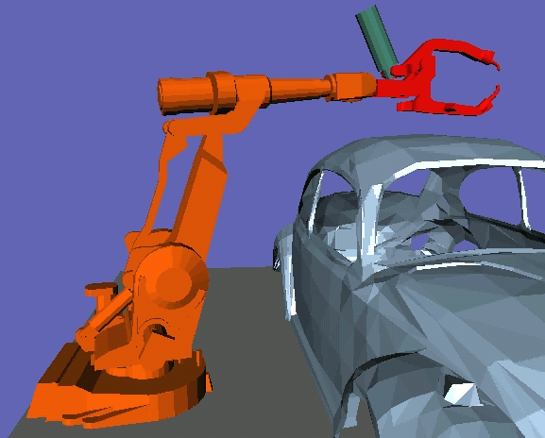
Analogy with Robotics

Slide 26
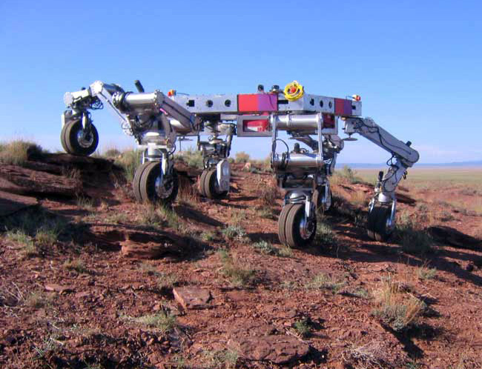
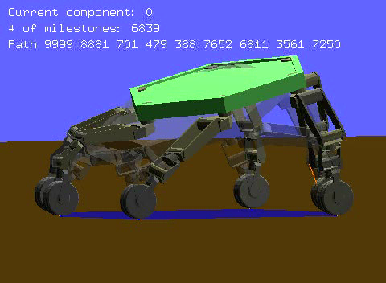
Analogy with Robotics

Slide 27
Inverse Kinematics Methods
Null-space motion
How to deform a subset of a protein with more than 6 φ and ψ angles without breaking cycles?
SVD method:
  Cycle closure constraints →F(q) = 0
  Differentiation → J_{F} × dq = 0
  SVD of J_{F} → Basis of tangent space at q
q
Cartesian space
of variable
dihedral angles

Slide 28
Checking Volume-Exclusion Constraint: Grid Method
~vdW
diameter
Subdivide 3-space into
cubic cells
Compute cell that
contains each atom
center
Represent grid as hashtable

Slide 29
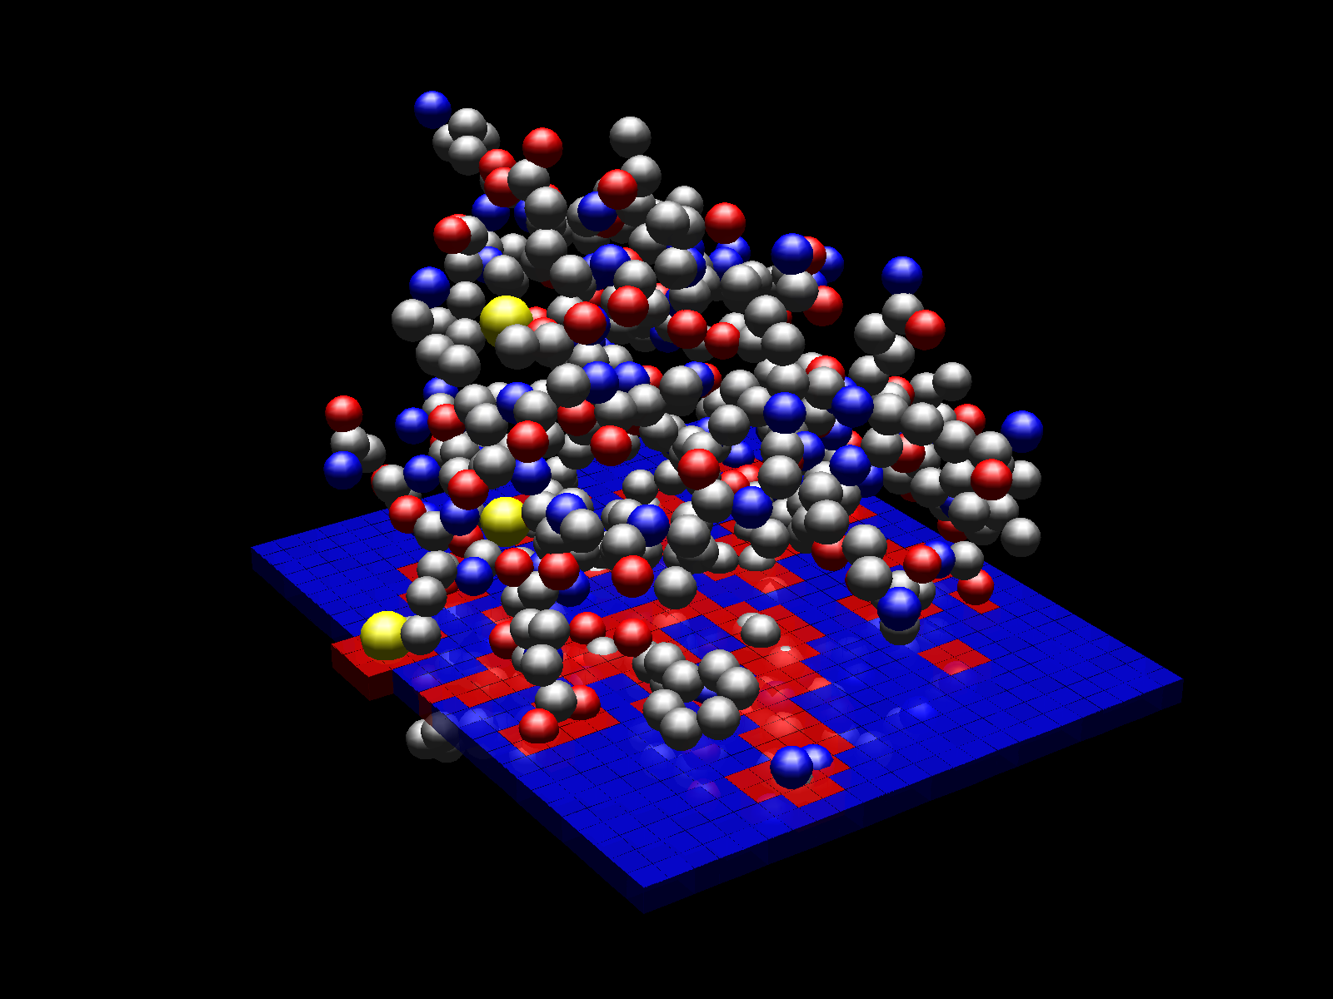
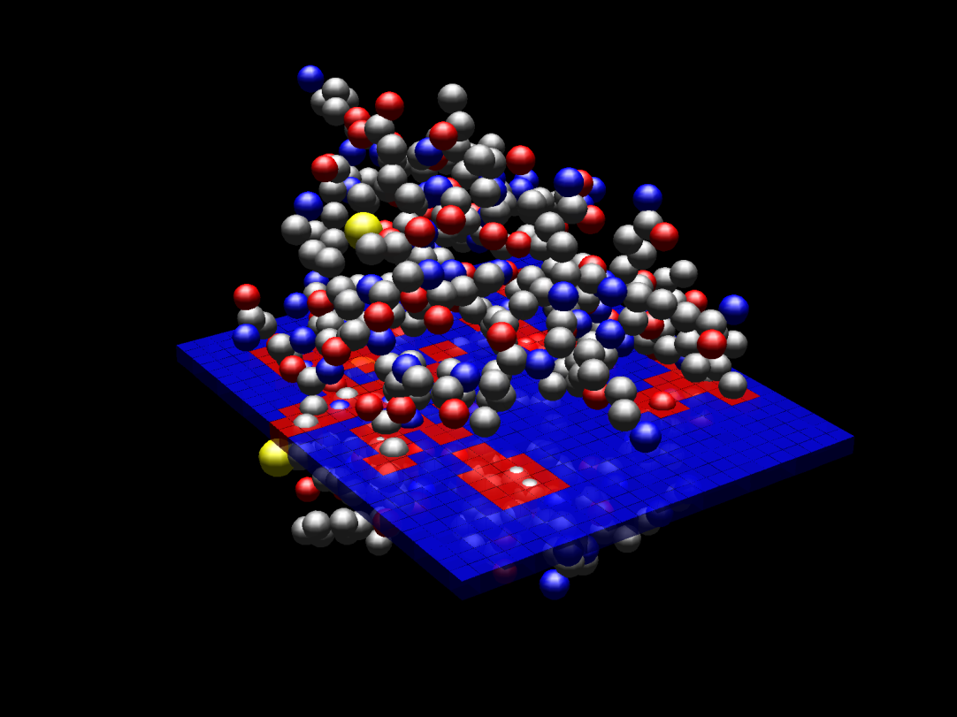
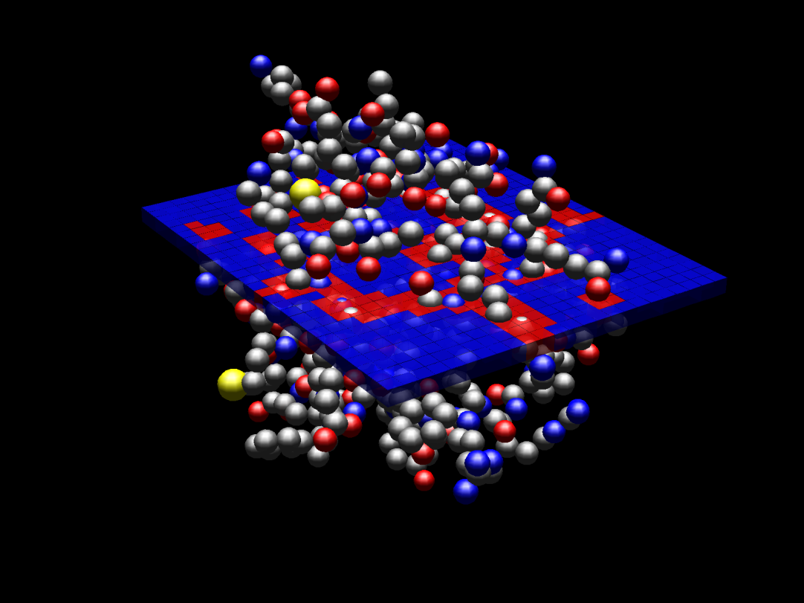
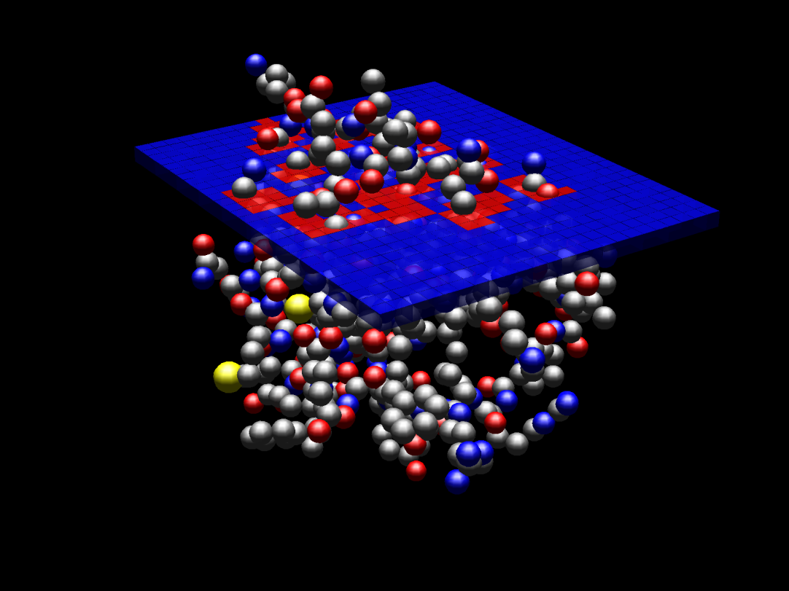

Slide 30
Beyond Simulation
Kinematic/Geometric models of proteins
Develop algorithm-friendly models that directly encode dominant energy terms.
Kino-Geometric Conformational Sampling
Use these models to sample conformations and represent a protein’s folded state by a cloud of points.
Graph-Based Models of Protein Motion
Transform a cloud representation into a
probabilstic representing protein kinetics.

Slide 31
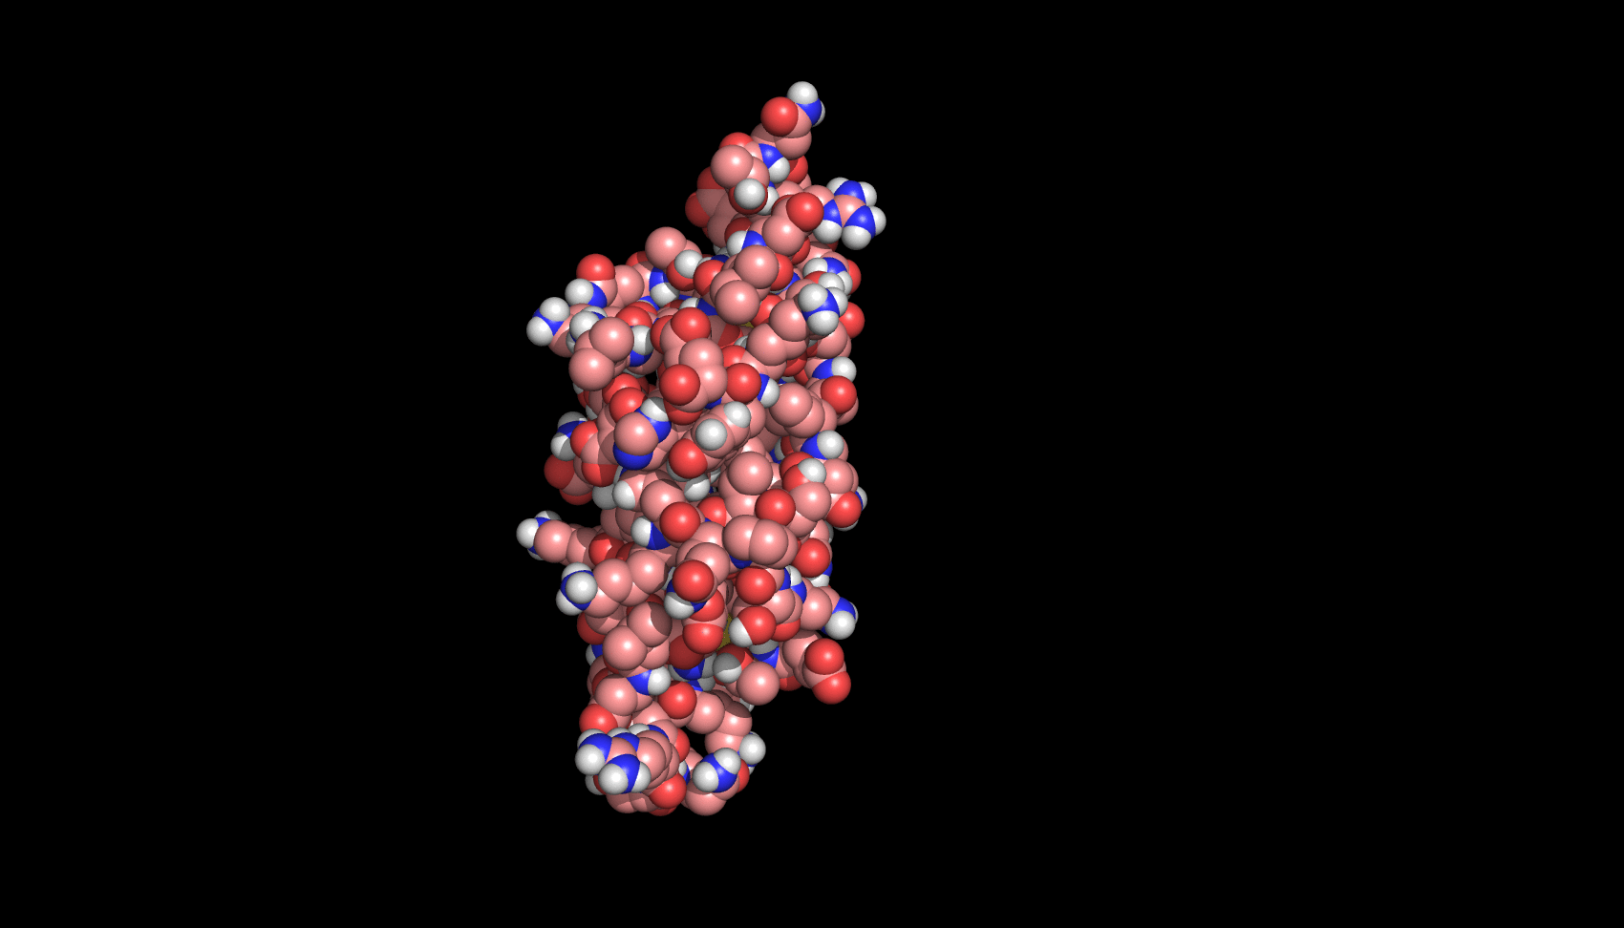
Kino-Geometric Conformational Sampling
Computational challenges:
Requires satisfying often antagonistic constraints:
kinematic and volume exclusion constraints
Folded conformations form a relatively tiny region
of the conformational space. How to hit this region?
D_{n}
D₁
Conformation space
…
…
Folded state
D_{i}
…
D_{k}
D_{j}

Slide 32
Kino-Geometric Conformational Sampling
— ROCK (Rigidity Optimized Conformational Kinetics) [Zavodsky et al., 2004]
— FRODA (Framework Rigidity Optimized Dynamic Algorithm) [Wells et al., 2005, Farrell et al., 2010]
— KGS (Kino-Geometric Sampling) [Yao et al. 2011]
— PEM (Protein Ensemble Method) [Shehu et al., 2006]
Initialize conformation distribution Δ to {q_{given}}
Iterate
  Pick q from Δ
  Deform q into new conformation q_{new}

Slide 33
Kino-Geometric Conformational Sampling
— ROCK (Rigidity Optimized Conformational Kinetics) [Zavodsky et al., 2004]
— FRODA (Framework Rigidity Optimized Dynamic Algorithm) [Wells et al., 2005, Farrell et al., 2010]
— KGS (Kino-Geometric Sampling) [Yao et al. 2011]
— PEM (Protein Ensemble Method) [Shehu et al., 2006]
Initialize conformation distribution Δ to {q_{given}}
Iterate
  Pick q from Δ
  Deform q into new conformation q_{new}

Slide 34
Kino-Geometric Conformational Sampling
— ROCK (Rigidity Optimized Conformational Kinetics) [Zavodsky et al., 2004]
— FRODA (Framework Rigidity Optimized Dynamic Algorithm) [Wells et al., 2005, Farrell et al., 2010]
— KGS (Kino-Geometric Sampling) [Yao et al. 2011]
Select conformation q in Δ
ROCK and FRODA: q is most recent conformation on Δ
KGS: q is picked at random with probability inverse to sampling density
Select stable H-bonds in q
ROCK and FRODA: select H-bonds with energy less than a threshold
KGS: uses a regression tree trained from Molecular Dynamics data
Perform rigidity analysis in q
ROCK, FRODA, and KGS: transform kinematic constraints into distance constraints between atoms,
run Pebble Game algorithm to identify all rigid groups of atoms
Deform q into q_{new}
ROCK: Perturb dihedral angles and close cycles by minimizing to zero a measure of closure violation
FRODA: Perturb all atom positions and reform rigid groups of atoms
KGS: Perturb dihedral angles in null space
Check q_{new} for volume exclusion

Slide 35
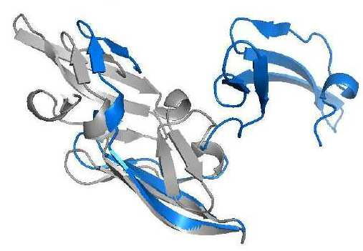
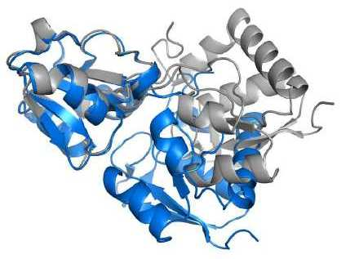
Statistics for Two Proteins
2EZM
# atoms: 992
# rigid groups: 503
# cycles: 47
2LAO 84
# atoms: 3649
# rigid groups: 1023
# cycles: 84

Slide 36
Kino-Geometric Conformational Sampling
— ROCK (Rigidity Optimized Conformational Kinetics) [Zavodsky et al., 2004]
— FRODA (Framework Rigidity Optimized Dynamic Algorithm) [Wells et al., 2005, Farrell et al., 2010]
— KGS (Kino-Geometric Sampling) [Yao et al. 2011]
Select conformation q in Δ
ROCK and FRODA: q is most recent conformation on Δ
KGS: q is picked at random with probability inverse to sampling density
Select stable H-bonds in q
ROCK and FRODA: select H-bonds with energy less than a threshold
KGS: uses a regression tree trained from Molecular Dynamics data
Perform rigidity analysis in q
ROCK, FRODA, and KGS: transform kinematic constraints into distance constraints between atoms,
run Pebble Game algorithm to identify all rigid groups of atoms
Deform q into q_{new}
ROCK: Perturb dihedral angles and close cycles by minimizing to zero a measure of closure violation
FRODA: Perturb all atom positions and reform rigid groups of atoms
KGS: Perturb dihedral angles in null space
Check q_{new} for volume exclusion

Slide 37
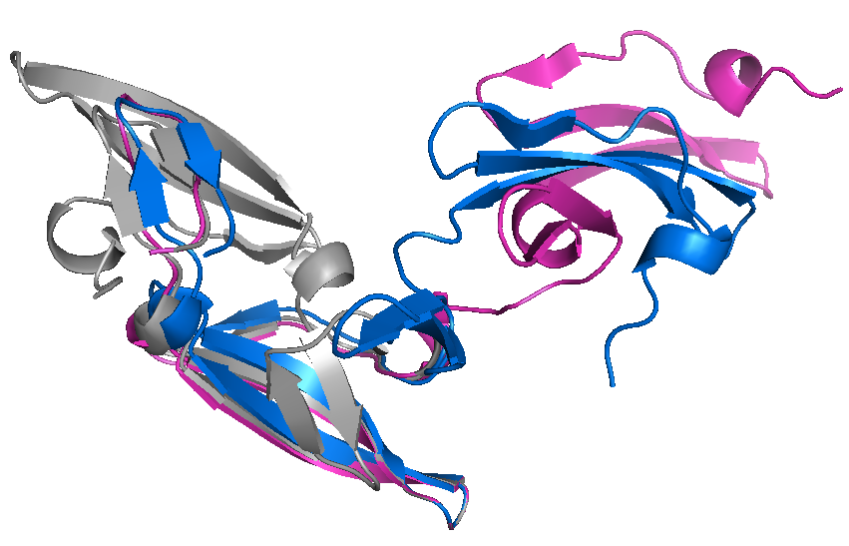
KGS Sampling: 2EZM
992 atoms
Given conformation in grey
Target conformation in blue
at RMSD 16Å from given
conformation (hinge and twist)
diffusion
(distance from q_{given})
convergence
(distance from target)
Running time on a dual quad-core 3GHz computer: 93 minutes, 1.12 seconds per sample

Slide 38
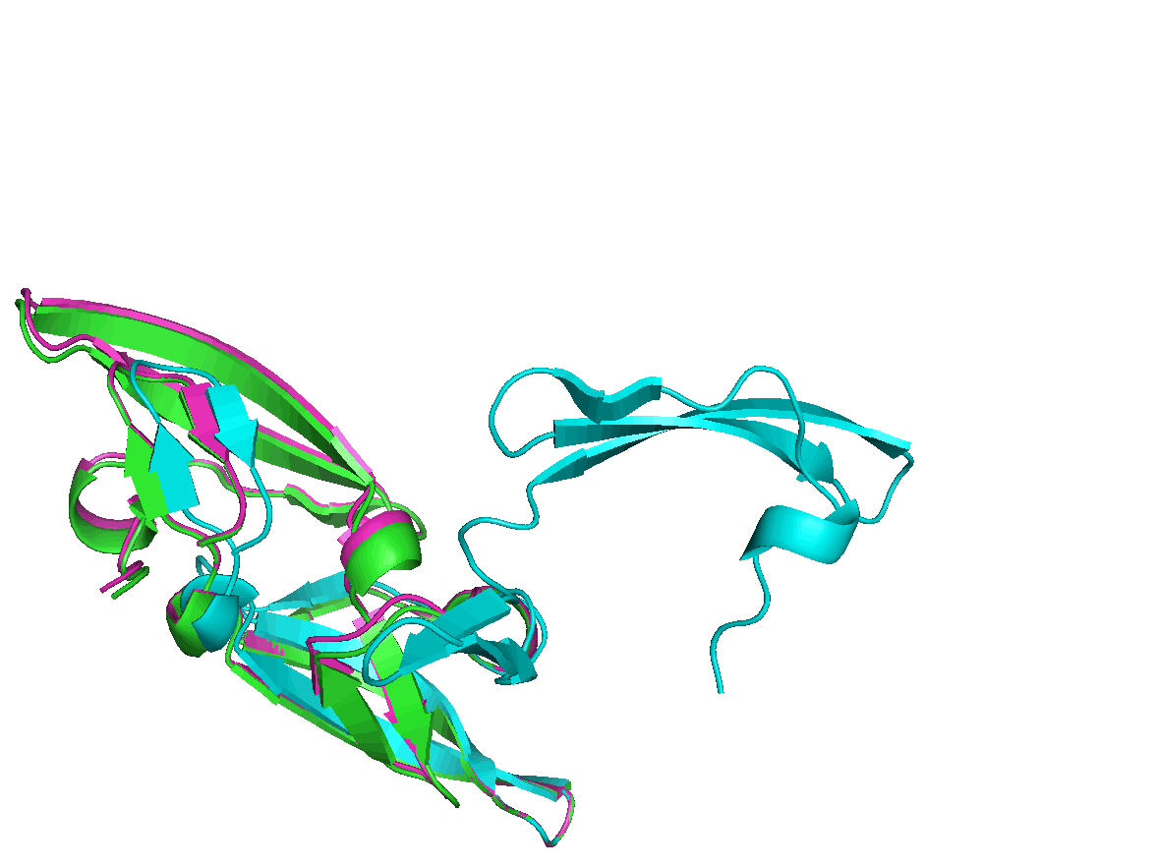
KGS Sampling: 2EZM
“Path” from given conformation to sampled conformation closest to target:

Slide 39
Beyond Simulation
Kinematic/Geometric models of proteins
Develop algorithm-friendly models that directly encode dominant energy terms.
Kino-Geometric Conformational Sampling
Use these models to sample conformations and represent a protein’s folded state by a cloud of points.
Graph-Based Models of Protein Motion
Transform a cloud representation into a
motion network representing protein kinetics.

Slide 40
Graph-Based Model:
States and Transitions
U
B
s_{k}
p_{ik}
s_{i}
State: conformation or conformation set
Transition: probability of going from one state to another (Markov model)
Compact representation of a huge collection of possible motion paths
P_{B}(s) = probability that protein reaches B from s before reaching U
P_{B}(s_{i}) = Σ_{k}p_{ik}× P_{B}(s_{k})

Slide 41
States are conformations
Sampling distribution can be generated using
kino-geometric methods, or by sub-sampling many short MD simulation trajectories, or by other methods
[Apaydin et al., 2003] [Singhal et al., 2004]

Slide 42
States are conformation sets
Sampled conformations are clustered to produce a more compact model and better satisfy the Markov assumption
Each cluster is computed to approximately match a basin of attraction of the energy landscape
[Chodera et al., 2007] [Chiang et al., 2010]

Slide 43
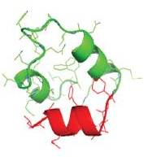
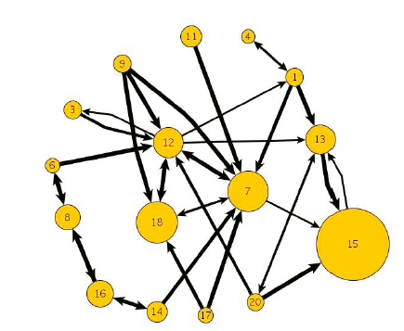
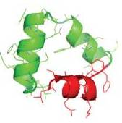
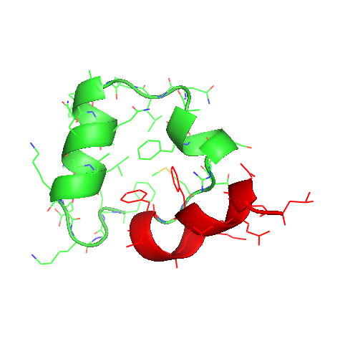
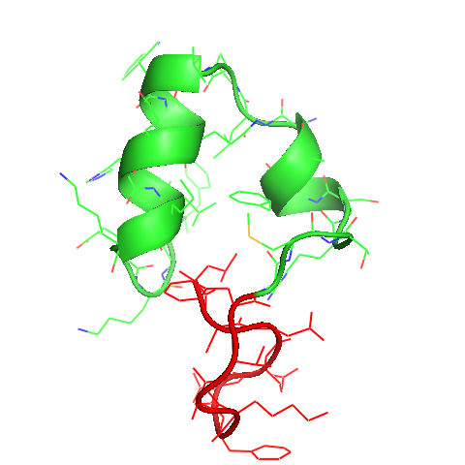
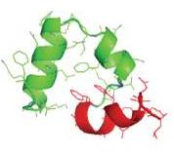
Applications
Analysis of the dynamics of small proteins: alinine dipeptide, villin, tryptophan zipper beta hairpin
12
7
13
18
15

Slide 44
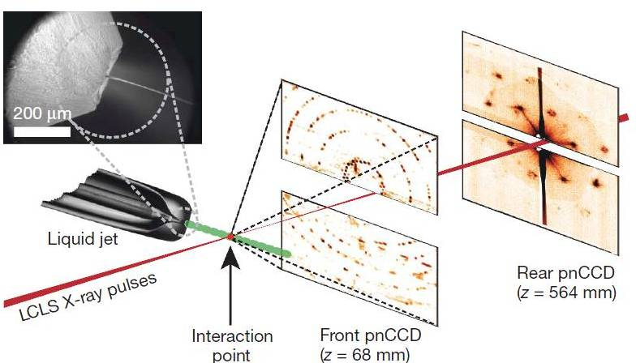
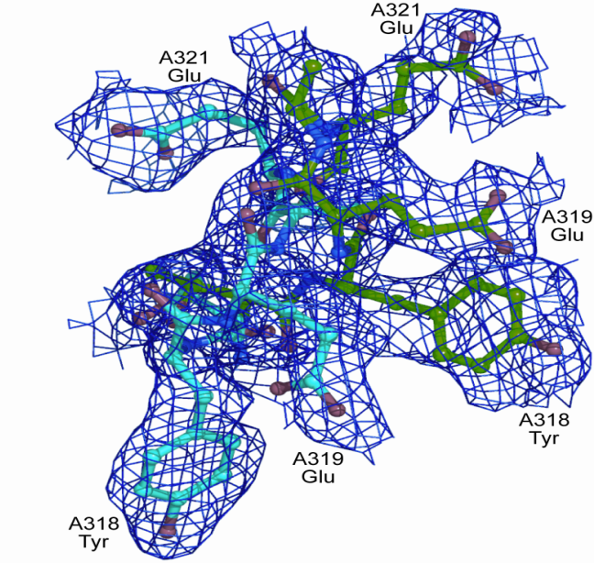
New Project (with SLAC)
Interpretation of electron-density maps generated with femtosecond X-ray protein nanocrystallography
[Chapmann et al., Nature, Feb 2011]
Combination of state-of-the-art kino-geometric sampling with a (hopefully) revolutionary experimental method

