Slide 1
Learning to See and Hear with Unlabeled Video
Sight and Sound, June 2019
Ruohan Gao
Department of Computer Science
The University of Texas at Austin

Slide 2
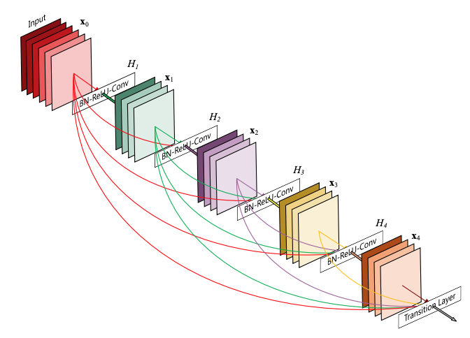
Visual recognition: significant recent progress
AlexNet
ImageNet top-5 error (%)
VGG
GoogLeNet
ResNet
DenseNet

Slide 3
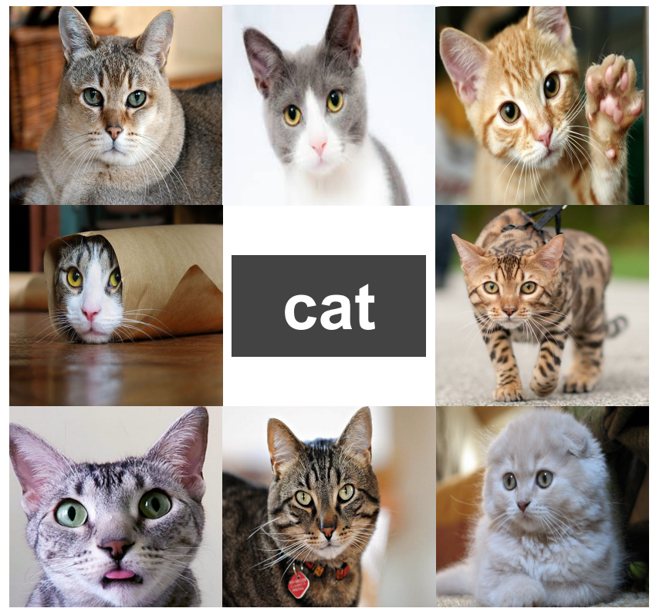
How do recognition systems typically learn today?
Status quo: Learning from bags of labeled snapshots

Slide 4
Big picture goal: Learning with unlabeled video
Status quo: Learning from bags of labeled snapshots
On the horizon: Learning from unlabeled videos

Slide 5
Sight and Sound in Unlabeled video

Slide 6
Sight and Sound in Unlabeled video
parrot
Semantics
violin

Slide 7
Sight and Sound in Unlabeled video
right
Location
left

Slide 8
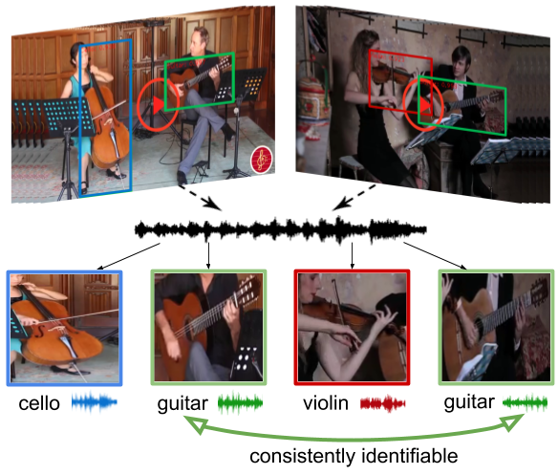
This talk
Learning to see and hear with unlabeled video
1. Separating object sounds from unlabeled video
co-separation
2. Audio spatialization by watching unlabeled video
Video frames
Monaural
Binaural
“Lift”

Slide 9
Existing approaches: Mix-and-Separate
Audio-Only methods
Audio-Visual methods
Audio 1
Video 1
Mixed audio
Mixed audio
Audio 2
Video 2
Limitations:
Require a large number of single-source training audio/video clips
Assume that the sources in a audio/video recording are independent
Simpson et al. 2015; Huang et al. 2015; Yu et al. 2017; Ephrat et al. 2018; Owens & Efros 2018; Zhao et al. 2018; Afouras et al. 2018; Zhao et al. 2019; Gao & Grauman 2019

Slide 10
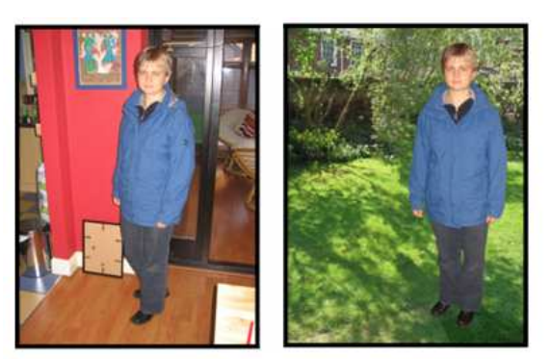
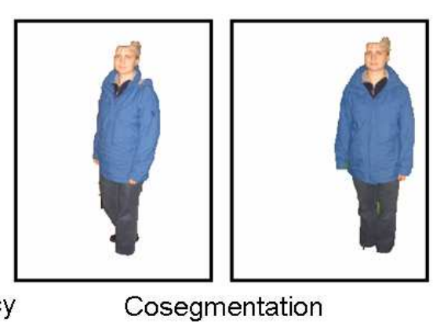
Image Co-Segmentation
Input image pair
Co-segmentation
Rother et al., Cosegmentation of Image Pairs by Histogram Matching — Incorporating a Global Constraint into MRFs, CVPR 2006

Slide 11
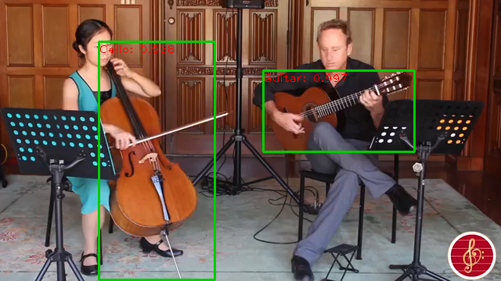
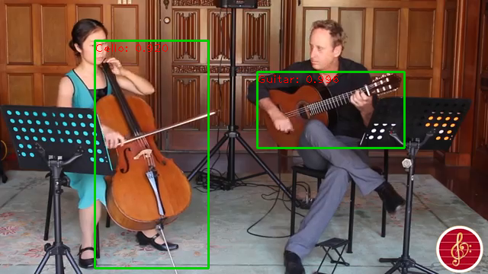
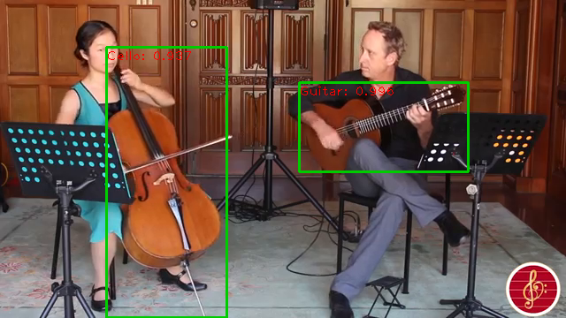
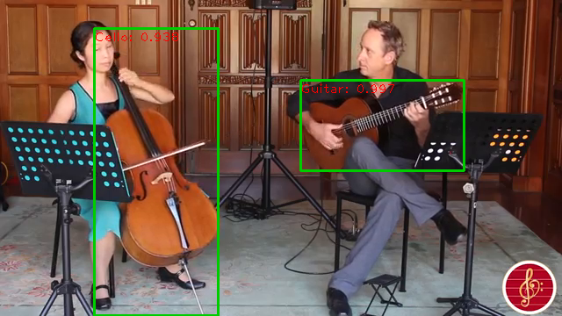
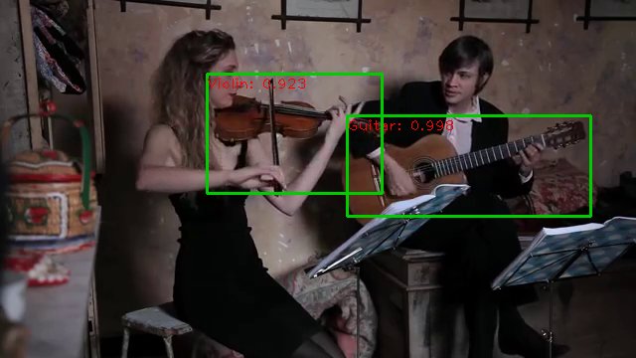
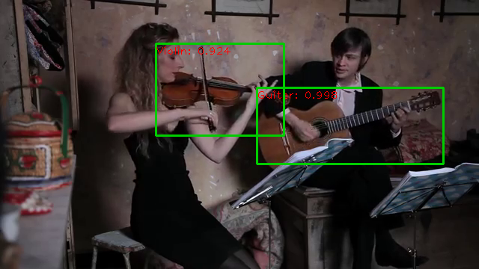
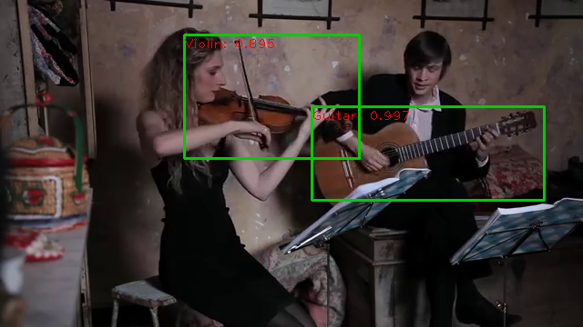
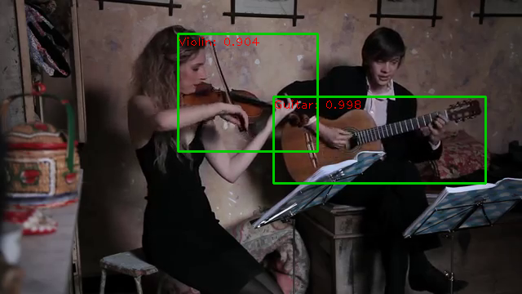
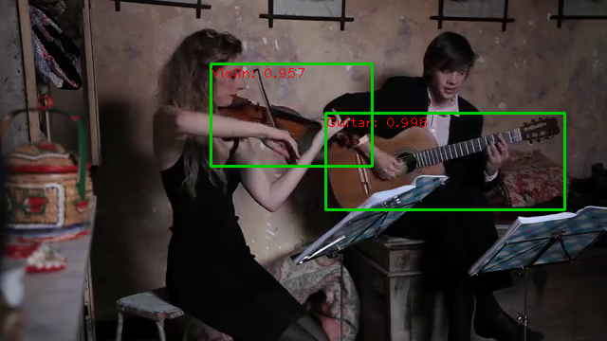
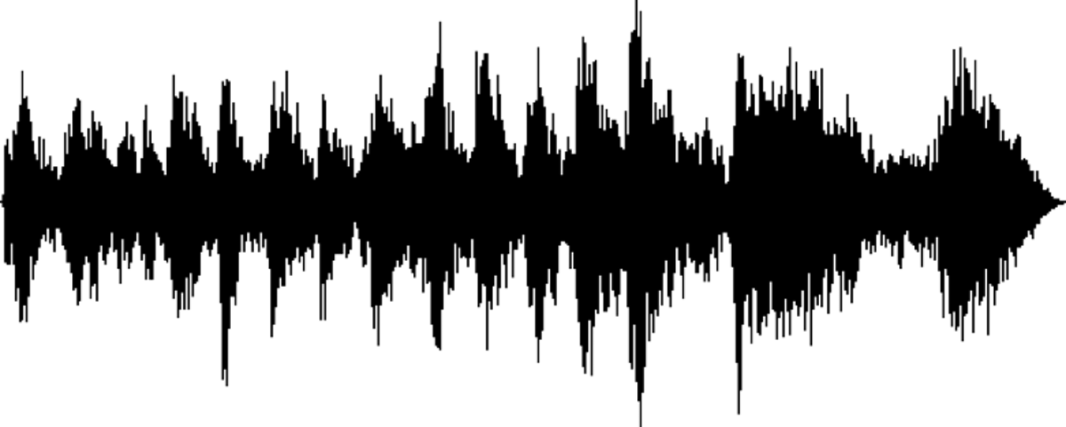
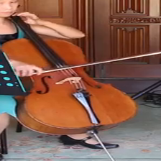
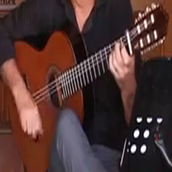
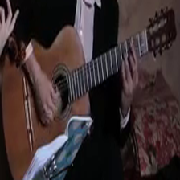
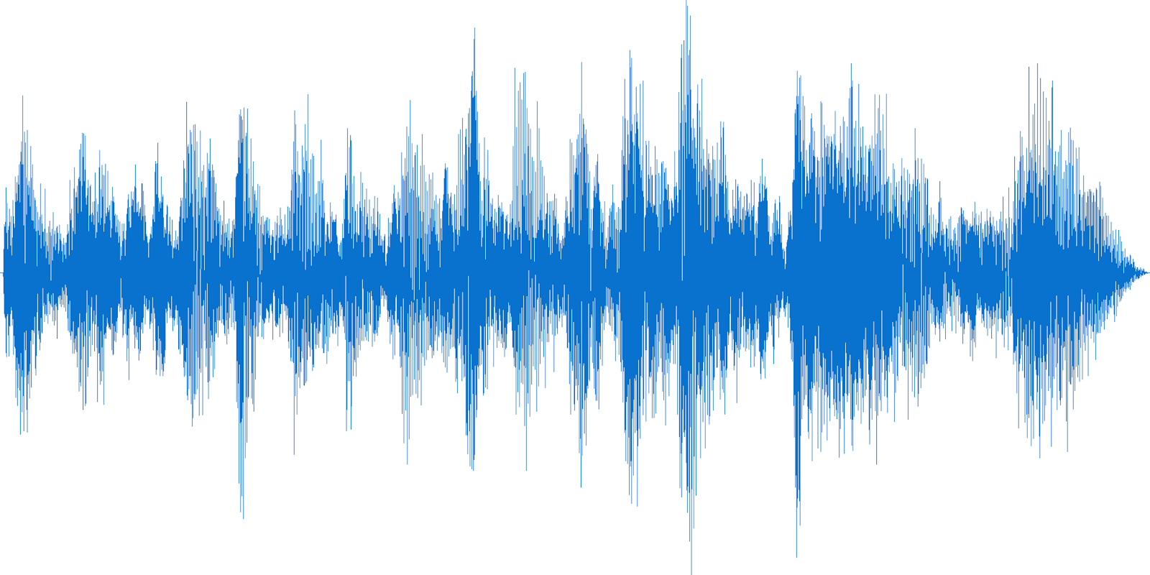
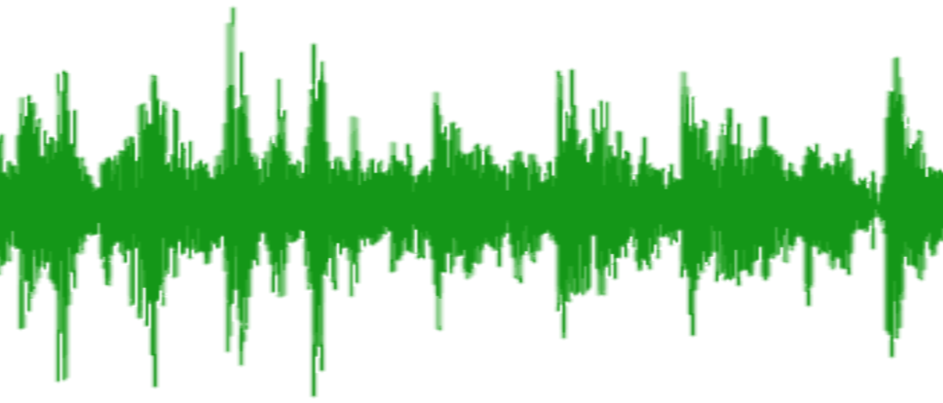
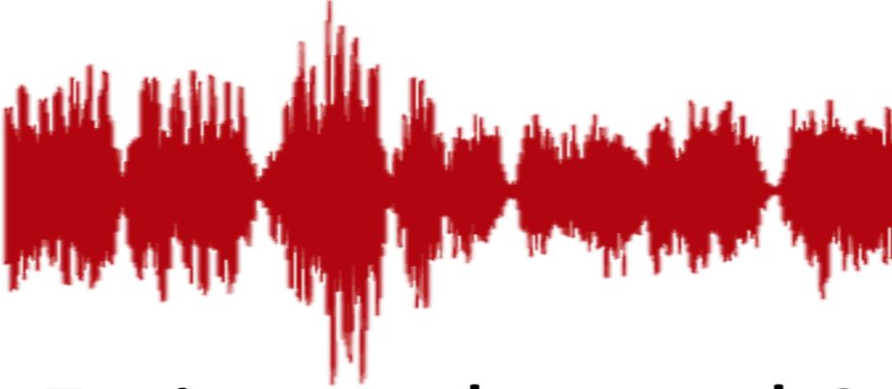
Our idea: Co-Separation Training
cello
guitar
violin
guitar
consistently identifiable
[Gao & Grauman, arXiv 2019]

Slide 12
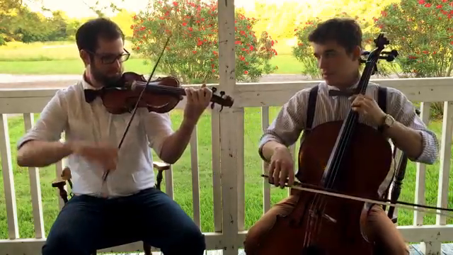
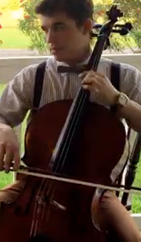
Our idea: Inference
Single novel test video
Violin
Cello
[Gao & Grauman, arXiv 2019]

Slide 13
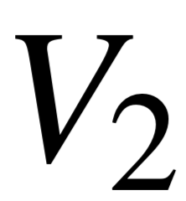
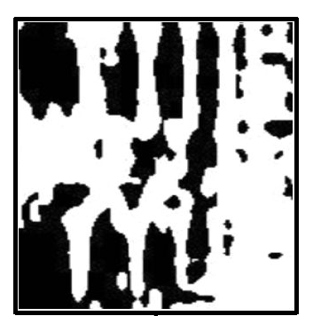
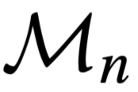
Problem formulation
Unlabeled video and , with audios and
Mixed signal: , spectrogram
Objects: detected in and
Goal: separate for objects
Soft masking using spectrogram mask :
[Gao & Grauman, arXiv 2019]

Slide 14
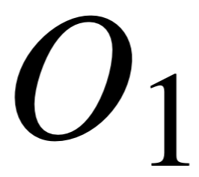
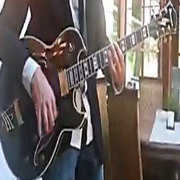
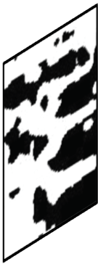
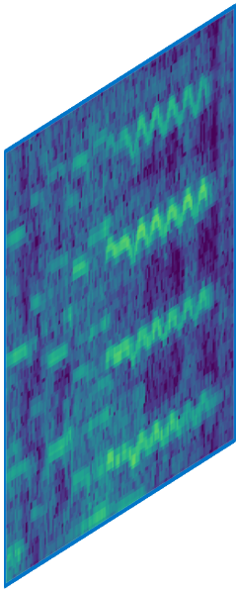
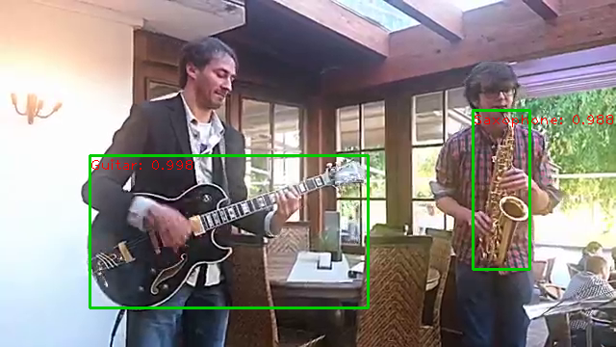
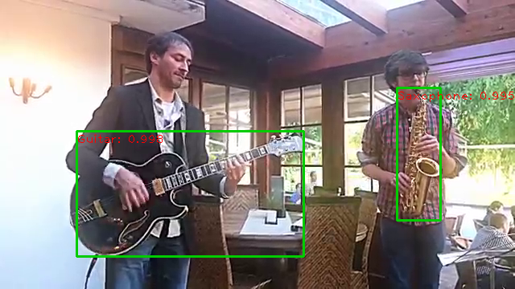
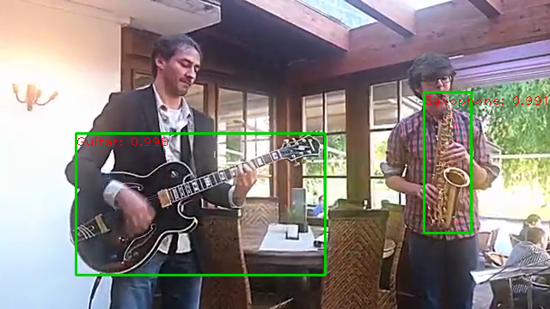
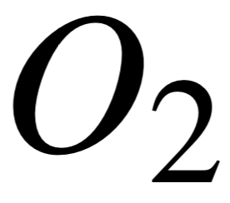
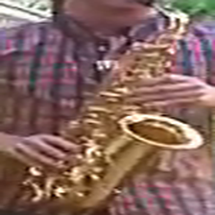
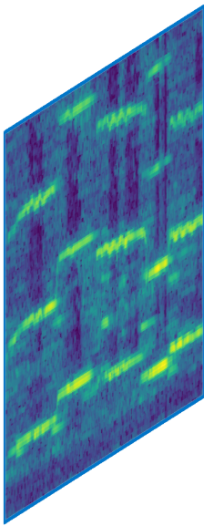
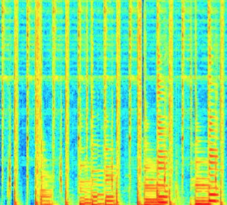
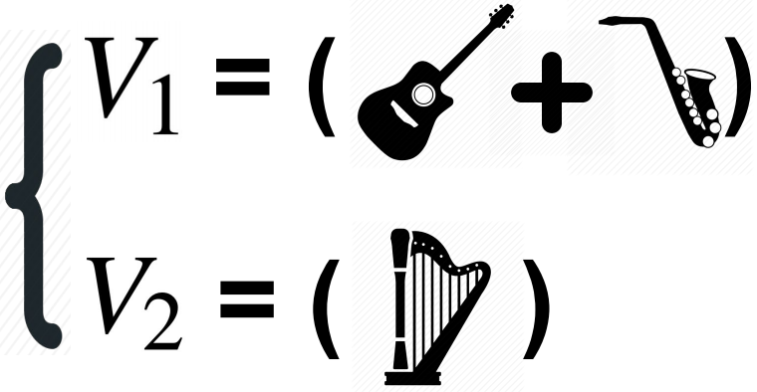
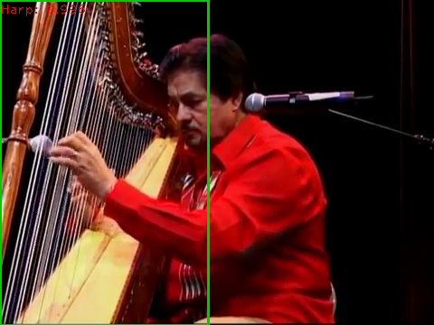
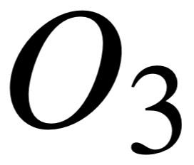
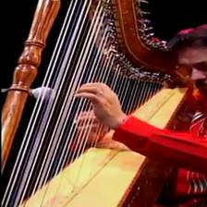
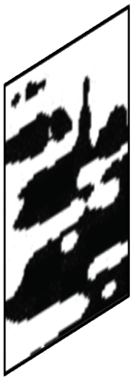
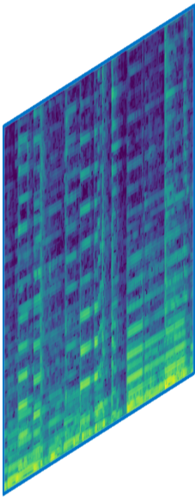
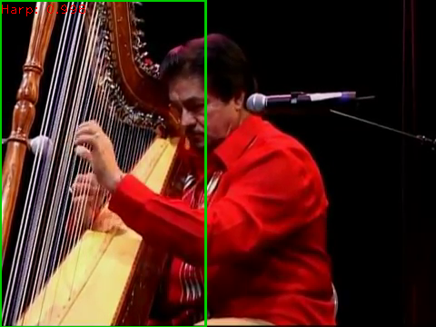
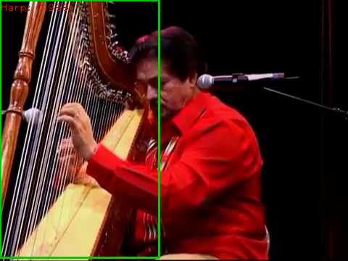
Co-Separation training paradigm
audio-visual separator
consistency loss
audio-visual separator
consistency loss
mixed audio
STFT
co-separation loss
audio-visual separator
consistency loss
[Gao & Grauman, arXiv 2019]

Slide 15
Datasets
AudioSet-Unlabeled
> 100,000 10s video clips of 15 musical instruments
[Gemmeke et al. 2017]
MIT MUSIC
[Zhao et al. 2018]
536 solo and 149 duet videos of 11 instrument categories
[Gao & Grauman, arXiv 2019]

Slide 16
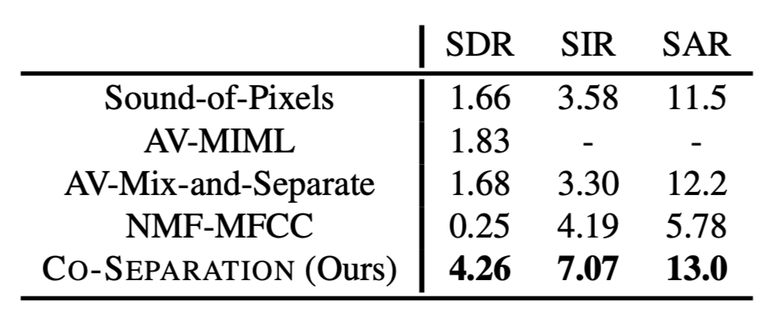
Results: Separating object sounds
MIT MUSIC Dataset
(SDR: Signal-to-Distortion Ratio, SIR: Signal-to-Interference Ratio, SAR: Signal-to-Artifacts Ratio)
AudioSet-Unlabeled
NMF-MFCC: [Spiertz et al. 2009]; AV-MIML: [Gao et al. 2018]; Sound-of-Pixels: [Zhao et al. 2018]
Our method achieves large gains, and it also has the capability to match the separated source to meaningful acoustic objects in the video.
Our method achieves large gains, and it also has the capability to match the separated source to meaningful acoustic objects in the video.

Slide 17
Results
Baseline: NMF-MFCC [Spiertz et al. 2009]
Baseline: Sound-of-Pixels [Zhao et al. 2018]
Dataset: MUSIC [Zhao et al. 2018]
[Gao & Grauman, arXiv 2019]

Slide 18
Results
[Gao & Grauman, arXiv 2019]

Slide 19
Failure case
[Gao & Grauman, arXiv 2019]

Slide 20
This talk
Learning to see and hear with unlabeled video
1. Separating object sounds from unlabeled video
co-separation
2. Audio spatialization by watching unlabeled video
Video frames
Monaural
Binaural
“Lift”

Slide 21
Video Credit: https://binauralenthusiast.com/examples/

Slide 22
Video Credit: https://binauralenthusiast.com/examples/

Slide 23
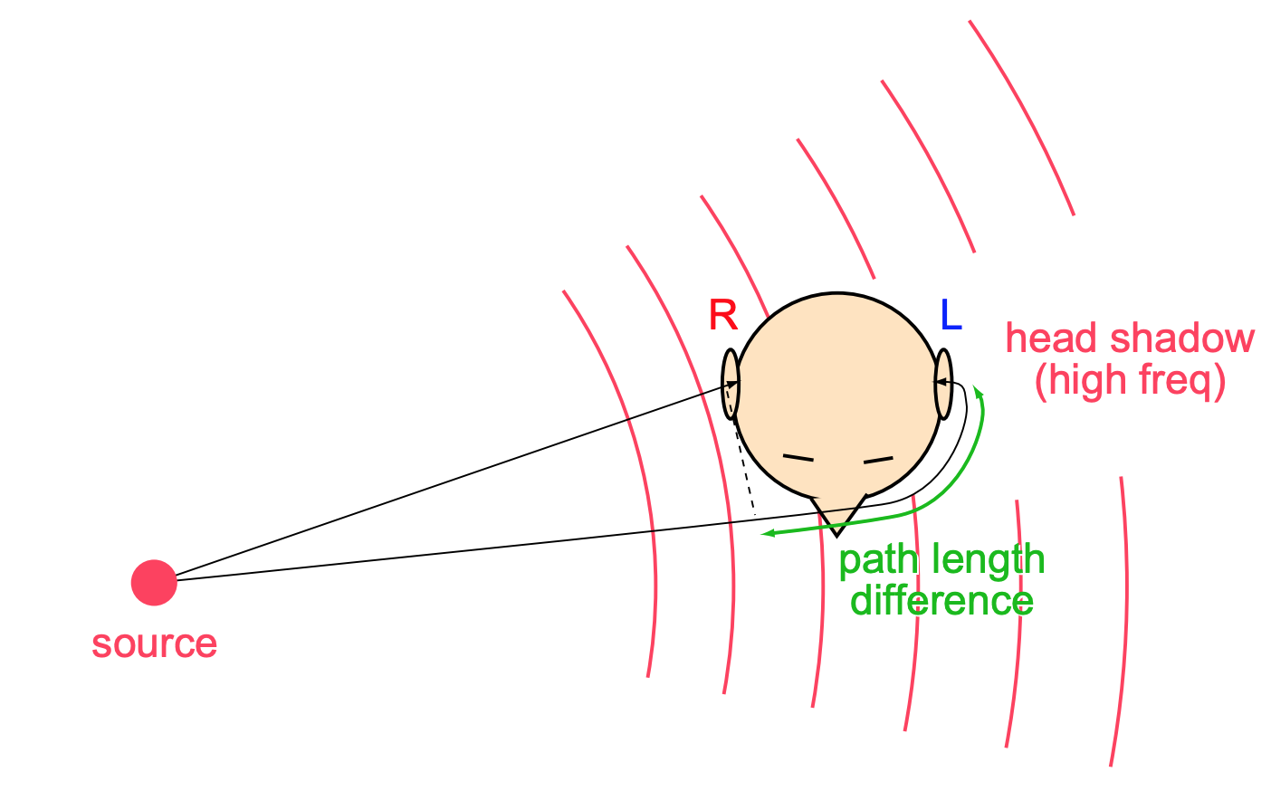
Spatial effects in audio
Spatial effects absent in monaural audio
Cues for spatial hearing:
Interaural time difference (ITD)
Interaural level difference (ILD)
Spectral detail (from pinna reflections)
Image Credit: Michael Mandel

Slide 24
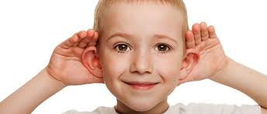
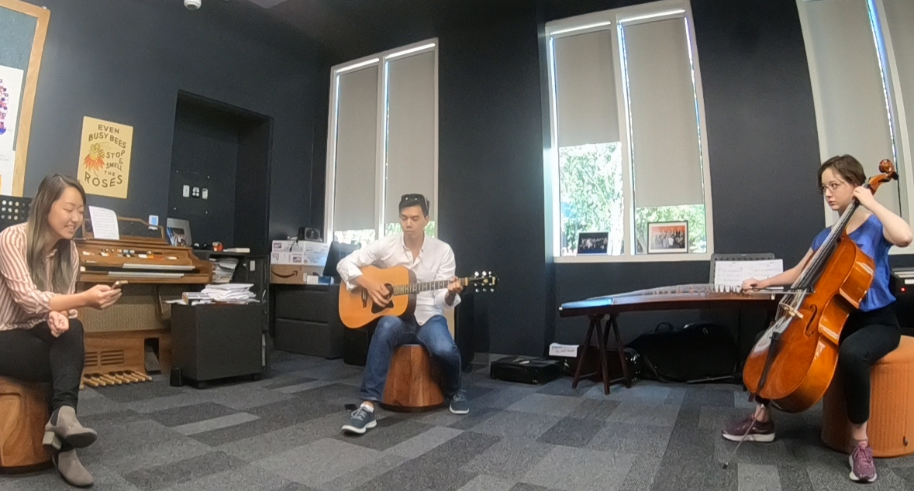
Our idea: 2.5D visual sound
“Lift” mono audio to spatial audio via visual cues
Monaural
Binaural
“Lift”
+
[Gao & Grauman, CVPR 2019]

Slide 25
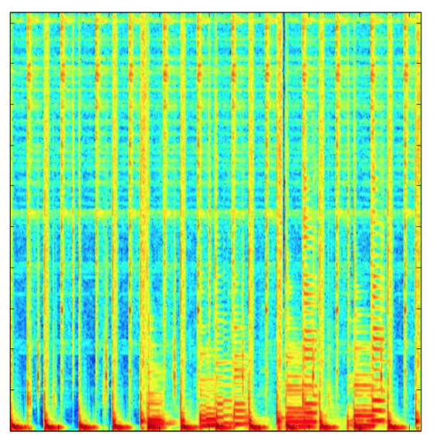
Our idea: 2.5D visual sound
“Lift” mono audio to spatial audio via visual cues
left channel
spectrogram
mono audio
predicted left channel
right channel
visual frame = spatial cues
Mono2Binaural
predicted right channel

Slide 26
Why infer binaural sound?
Upgrade audio
Improve separation
Monaural Audio
Predicted Binaural Audio
[Gao & Grauman, CVPR 2019]

Slide 27
New: FAIR-Play dataset
https://github.com/facebookresearch/FAIR-Play
Data collection rig
Binaural microphone rig linked to camera and monaural mic
Capture ~5 hours video and binaural sound in a music room
[Gao & Grauman, CVPR 2019]

Slide 28
Results: 2.5D visual sound
Mono
Listen with headphones!
[Gao & Grauman, CVPR 2019]

Slide 29
Results: 2.5D visual sound
Input video
Left channel
Right channel
Mono
Our method
Ground-truth
vision.cs.utexas.edu/projects/2.5D_visual_sound/

Slide 30
Datasets
FAIR-Play
10 musical instruments, e.g., cello, guitar, harp, trumpet, etc.
~5 hours of performances
Ambisonics Datasets
[Morgado et al. NeurlPS 2018]
Streets, random YouTube
~1000 360° video clips
Converted to binaural audio using decoder
[Gao & Grauman, CVPR 2019]

Slide 31
Results: 2.5D visual sound
Input video
Left channel
Right channel
Our method
Mono
Ground-truth
vision.cs.utexas.edu/projects/2.5D_visual_sound/

Slide 32
Results: Binaural audio prediction
Best binaural prediction results on all four datasets
Ambisonics: Morgado et al. NeurIPS 2018

Slide 33
Results: User study
Our inferred binaural audio offers more realistic 3D sensation
[Gao & Grauman, CVPR 2019]

Slide 34
Results: Source separation
mixed predicted binaural audio
drum
trumpet
2.5D visual sound leads to cleaner separation
[Gao & Grauman, CVPR 2019]

Slide 35
Summary
Learning to see and hear with unlabeled video
End-to-end co-separation training paradigm
Learn well from multi-source videos
First to upgrade monaural to binaural audio via video
2.5D visual sound enhances source separation
Kristen Grauman

